Slide 1
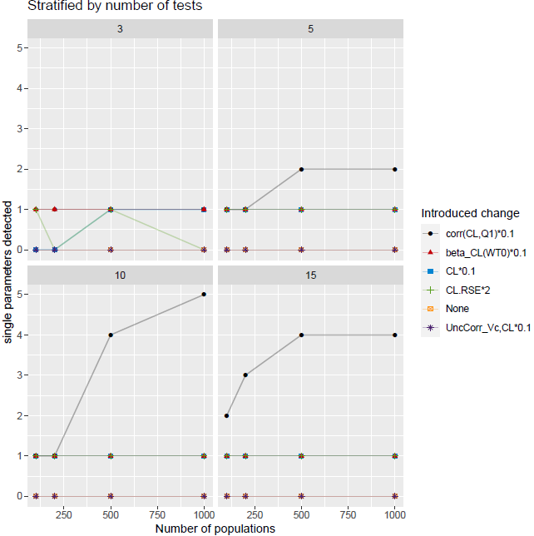
Use Cases for detectSampleDiscrepancy()
Single parameters varied to a large extend:
Reduced IIV correlation corr(CL,Q1)
corr(CL,Q1)*0.1
Reduced covariate effect beta_CL(WT0)
beta_CL(WT0) *0.1
Reduced CL parameter
CL*0.1
Increase RSE of CL
CL_RSE*2
Reduction in uncertainty correlation between CL and kabs (no effect, not shown)
Low parameter value, no effect on outcome and not shown
Reduction in uncertainty correlation between Vc and CL
UncCorr_Vc,CL*0.1
Higher parameter value, not effect on outcome

Slide 2
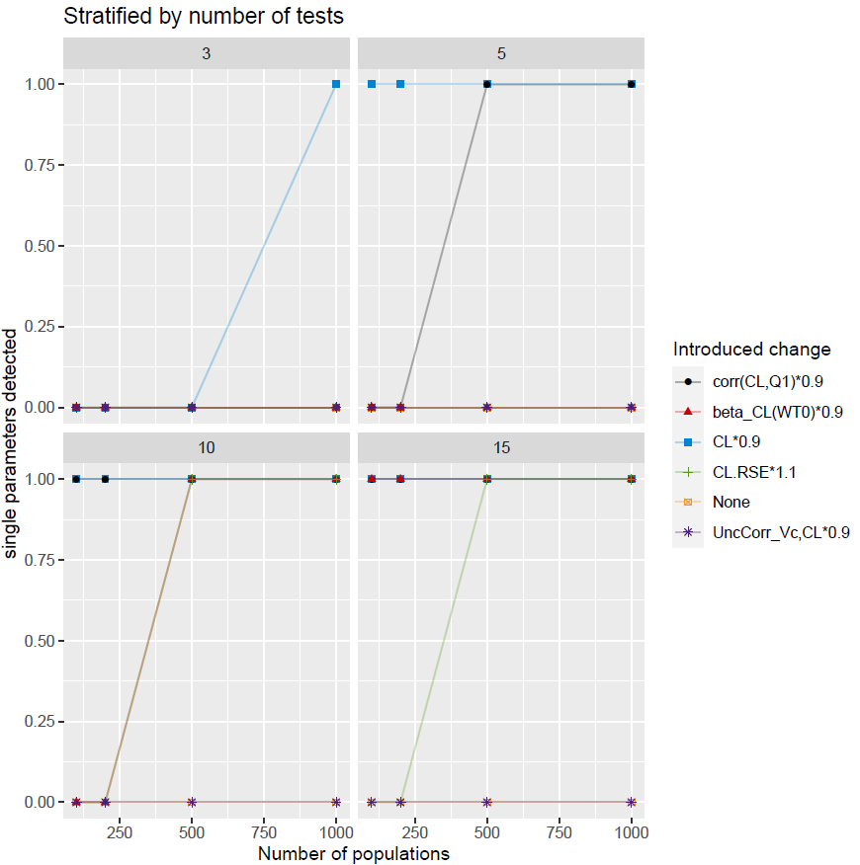
Use Cases for detectSampleDiscrepancy()
Single parameters varied to a small extend:
Reduced IIV correlation corr(CL,Q1)
corr(CL,Q1)*0.9
Reduced covariate effect beta_CL(WT0)
beta_CL(WT0) *0.9
Reduced CL parameter
CL*0.9
Increase RSE of CL
CL_RSE*1.1
Reduction in uncertainty correlation between CL and kabs (no effect, not shown)
Low parameter value, no effect on outcome and not shown
Reduction in uncertainty correlation between Vc and CL
UncCorr_Vc,CL*0.9
Higher parameter value, not effect on outcome

Slide 3
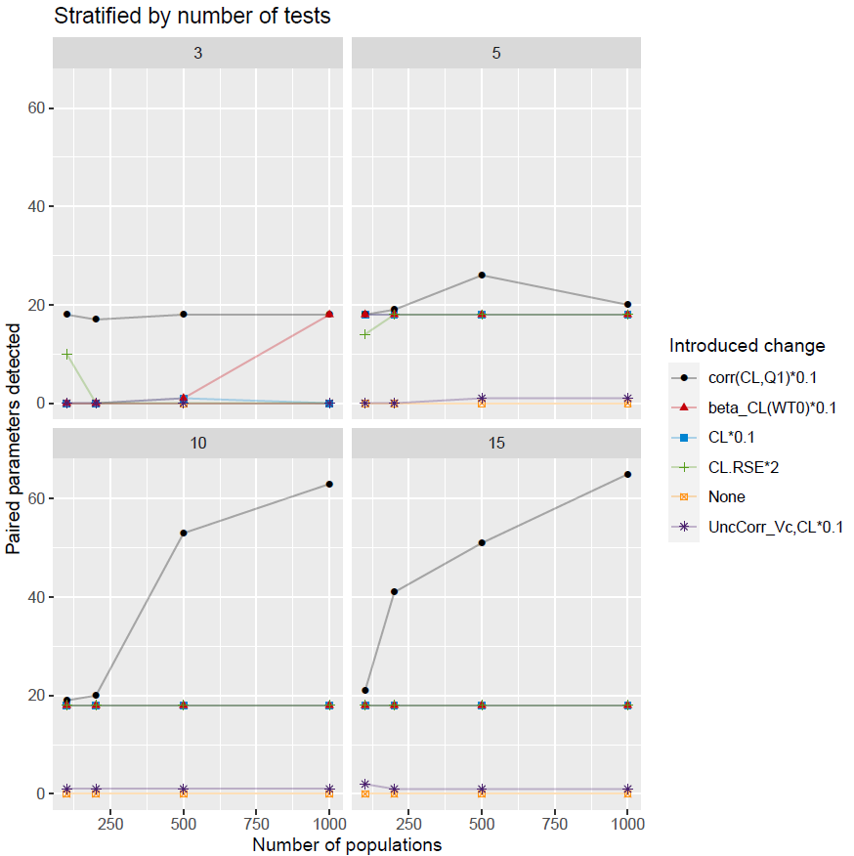
Use Cases for detectSampleDiscrepancy()
Detected paired parameters for a large change of a parameter :
Reduced IIV correlation corr(CL,Q1)
corr(CL,Q1)*0.1
Reduced covariate effect beta_CL(WT0)
beta_CL(WT0) *0.1
Reduced CL parameter
CL*0.1
Increase RSE of CL
CL_RSE*2
Reduction in uncertainty correlation between Vc and CL
UncCorr_Vc,CL*0.1
Only single paired parameters detected

Slide 4
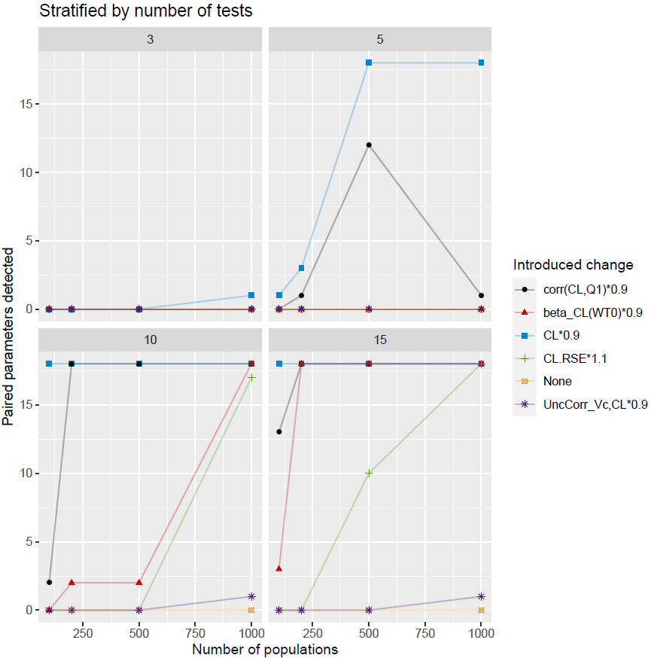
Use Cases for detectSampleDiscrepancy()
Detected paired parameters for a small change of a parameter :
Reduced IIV correlation corr(CL,Q1)
corr(CL,Q1)*0.9
Reduced covariate effect beta_CL(WT0)
beta_CL(WT0) *0.9
Reduced CL parameter
CL*0.9
Increase RSE of CL
CL_RSE*1.1
Reduction in uncertainty correlation between Vc and CL
UncCorr_Vc,CL*0.9
Only single paired parameters detected

Slide 5
Use Cases for detectSampleDiscrepancy()
Different direction of IIV correlation
-corr(CL,Vc)
Large number of nSingleDetected
- corr(Vc,Q1) -> ERROR
Sampling positive definite IIV covariance matrix from uncertainty failed.
- corr(CL,Q1) -> ERROR
Sampling positive definite IIV covariance matrix from uncertainty failed.
Different direction of uncertainty correlation for CL and kabs -> ERROR
Sampling positive definite IIV covariance matrix from uncertainty failed.
 | Change | nSingleDetected | singleDetected | nPairsDetected | Npop | Ntests
1 | CLVc_corr_inverted | 1 | corr(CL,Q1) | 9 | 100 | 3
2 | CLVc_corr_inverted | 2 | corr(CL,Q1),corr(CL,Vc) | 1 | 200 | 3
3 | CLVc_corr_inverted | 2 | corr(CL,Q1),corr(CL,Vc) | 0 | 500 | 3
4 | CLVc_corr_inverted | 3 | corr(CL,Q1),corr(CL,Vc),corr(Vc,Q1) | 33 | 1000 | 3
5 | CLVc_corr_inverted | 3 | corr(CL,Q1),corr(CL,Vc),corr(Vc,Q1) | 45 | 100 | 5
6 | CLVc_corr_inverted | 3 | corr(CL,Q1),corr(CL,Vc),corr(Vc,Q1) | 51 | 200 | 5
7 | CLVc_corr_inverted | 4 | omega(Q1),corr(CL,Q1),corr(CL,Vc),corr(Vc,Q1) | 53 | 500 | 5
8 | CLVc_corr_inverted | 5 | omega(Vc),omega(Q1),corr(CL,Q1),corr(CL,Vc),corr(Vc,Q1) | 52 | 1000 | 5
9 | CLVc_corr_inverted | 5 | omega(Vc),omega(Q1),corr(CL,Q1),corr(CL,Vc),corr(Vc,Q1) | 60 | 100 | 10
10 | CLVc_corr_inverted | 5 | omega(Vc),omega(Q1),corr(CL,Q1),corr(CL,Vc),corr(Vc,Q1) | 72 | 200 | 10
11 | CLVc_corr_inverted | 5 | omega(Vc),omega(Q1),corr(CL,Q1),corr(CL,Vc),corr(Vc,Q1) | 80 | 500 | 10
12 | CLVc_corr_inverted | 5 | omega(Vc),omega(Q1),corr(CL,Q1),corr(CL,Vc),corr(Vc,Q1) | 80 | 1000 | 10
13 | CLVc_corr_inverted | 5 | omega(Vc),omega(Q1),corr(CL,Q1),corr(CL,Vc),corr(Vc,Q1) | 67 | 100 | 15
14 | CLVc_corr_inverted | 5 | omega(Vc),omega(Q1),corr(CL,Q1),corr(CL,Vc),corr(Vc,Q1) | 80 | 200 | 15
15 | CLVc_corr_inverted | 5 | omega(Vc),omega(Q1),corr(CL,Q1),corr(CL,Vc),corr(Vc,Q1) | 80 | 500 | 15
16 | CLVc_corr_inverted | 5 | omega(Vc),omega(Q1),corr(CL,Q1),corr(CL,Vc),corr(Vc,Q1) | 80 | 1000 | 15

