Slide 1
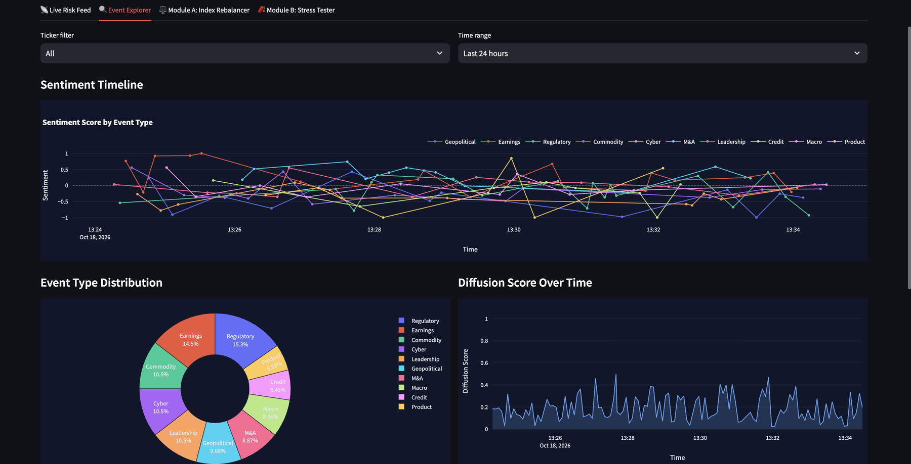
S&P GLOBAL & CRISIL | CODE TO CONNECT HACKATHON 2026
FinRisk
Explainable Event-Driven Market Risk Intelligence
“From unstructured market events to explainable index rebalancing and stress-testing decisions.”
Explainable
Auditable
Bounded
Mrinal Mohit
VIT Vellore
Notes:
Introduce FinRisk in one breath: unstructured events in, explainable portfolio decisions out. Emphasise explainability and bounded response.

Slide 2
From event noise to portfolio decisions
Analysts face hundreds of headlines across news, filings and social feeds. They need fast, auditable signals, not just sentiment scores.
1
2
3
Event sources
RiskSignal
Portfolio decision
News (GDELT), SEC EDGAR filings, StockTwits and tweet replay: unstructured text, around the clock.
Sentiment, event type, impact, confidence, provenance and explanation in one frozen schema.
Module A tilts index weights within bounds. Module B stress-tests the book with Monte Carlo.
4
10
2
330+
data sources
event types classified
downstream risk modules
automated tests
Notes:
Problem in our own words: latency between a breaking event and a quantified exposure is itself a risk. FinRisk turns events into structured signals, then into portfolio decisions.

Slide 3
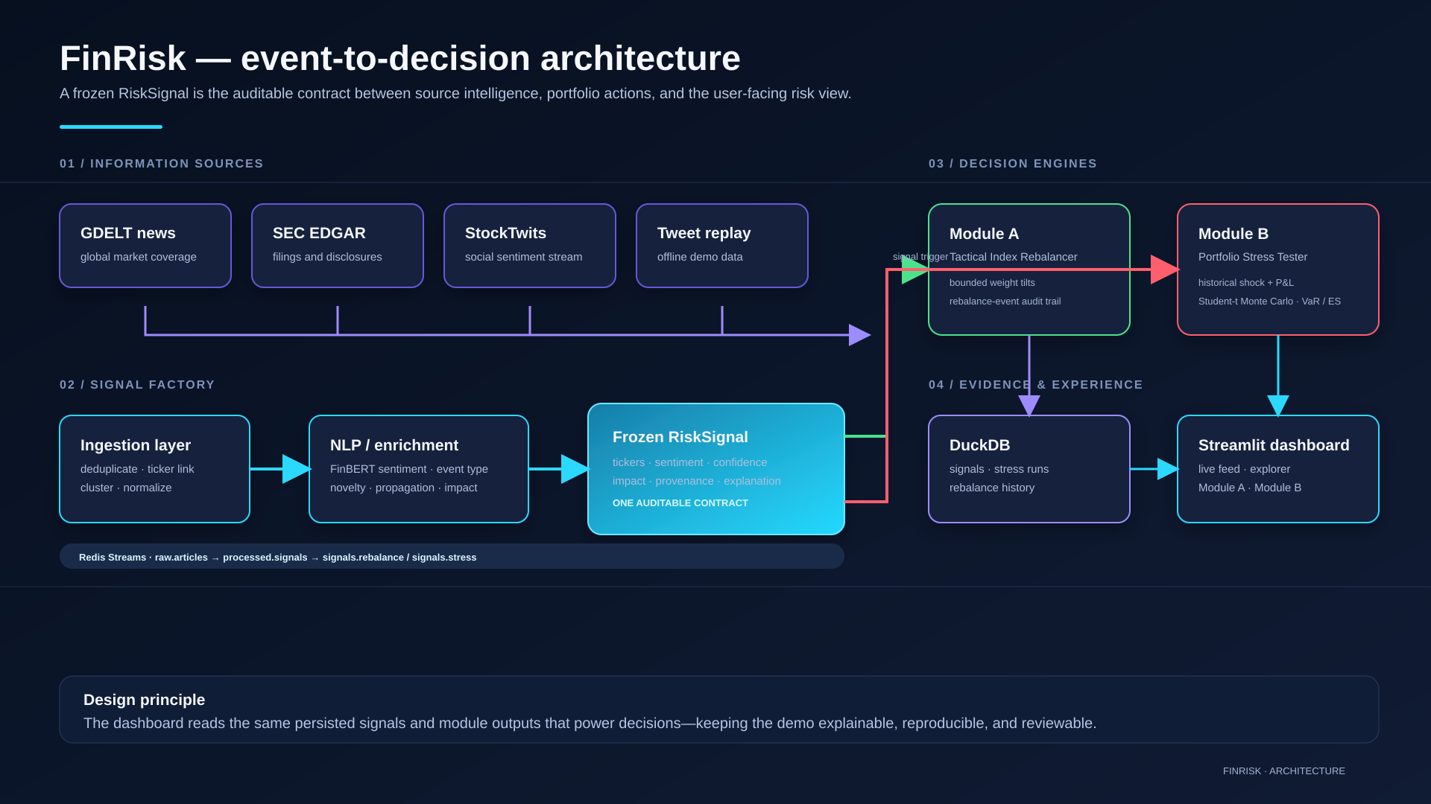
One signal contract, two risk engines
INGEST
SHA-256 dedup, ticker linking and event clustering across four sources.
UNDERSTAND
FinBERT sentiment, event classifier, XGBoost impact model with rule-based fallback.
CONTRACT
A frozen RiskSignal schema is the single interface for every consumer.
DECIDE AND SERVE
Rebalancer and stress tester; Redis Streams, DuckDB, FastAPI, Streamlit.
Diffusion / propagation score: estimates whether an event is spreading across sources and becoming more material (a Hawkes-lite decay feature, not a generative model).
Notes:
Walk left to right: sources, ingestion, NLP worker, RiskSignal, then two decision engines. Stress that propagation is a signal feature, not a diffusion model.

Slide 4
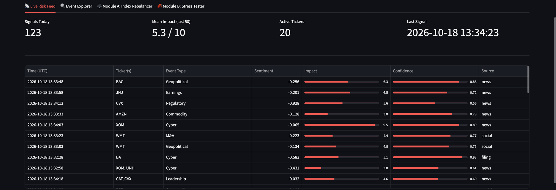
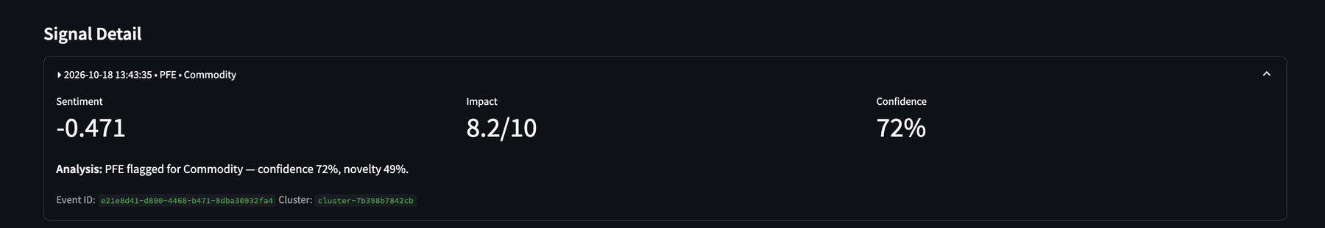
Every signal explained and auditable
+0.318
Spearman ρ of the impact model, trained on abnormal returns (stock minus SPY). Rule-based baseline: −0.067.
FinBERT gives financial-domain sentiment
10 event types: earnings, M&A, regulatory, geopolitical, credit and more
Novelty and propagation prioritise emerging, multi-source events
Immutable RiskSignal keeps source, cluster ID and explanation
Notes:
Show the Live Risk Feed, then expand one signal: sentiment, impact, confidence, novelty, event ID and cluster ID. No claims of predicting the market.

Slide 5
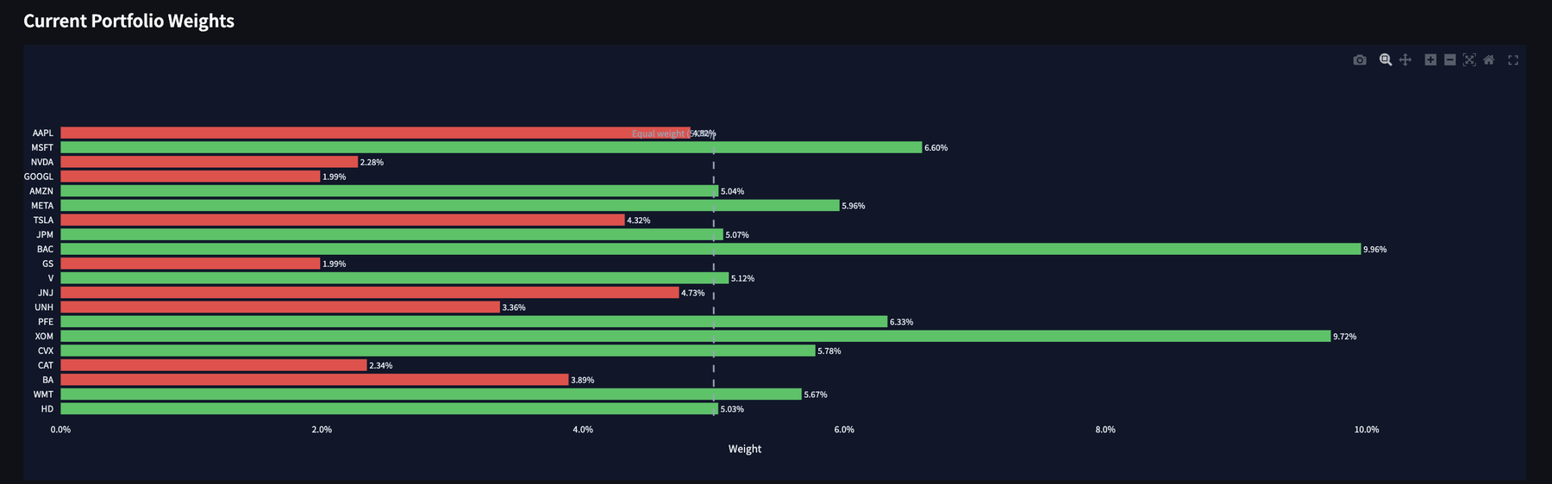
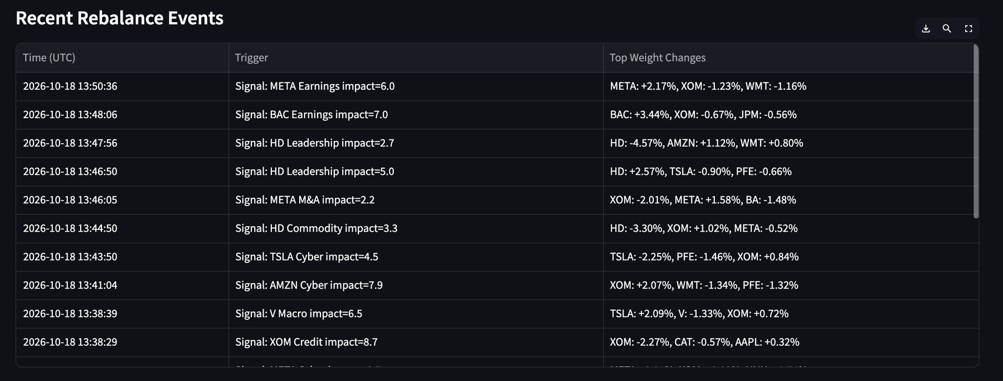
Module A: controlled index rebalancing
Signal to weight tilt
High-materiality signals become bounded weight adjustments, never a full reallocation.
Reviewable log
Every rebalance records its trigger signal and its top weight changes.
Controlled by design
An equal-weight base stays as the reference. A demo of controlled reaction, not autonomous trading.
Synthetic 20-stock index. Not investment advice.
Notes:
Green bars are above the 5% equal-weight line, red below. Each row in the table is an auditable event-to-weight link.

Slide 6
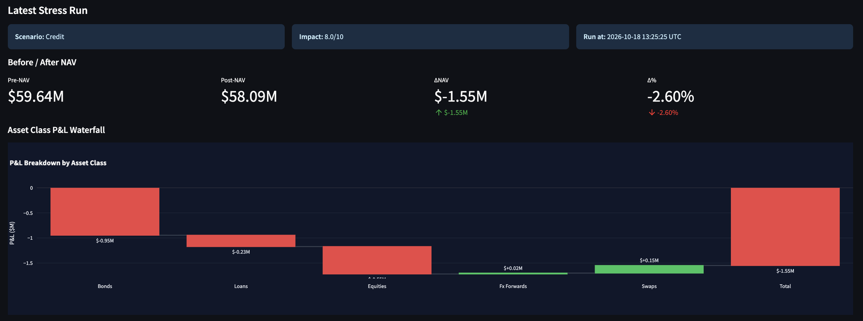
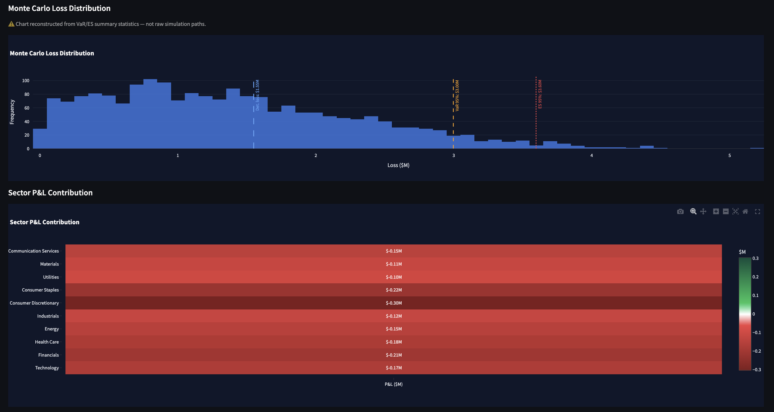
Module B: stress testing with tail risk
−$1.55M
$3.00M
$3.60M
10,000
Deterministic ΔNAV (−2.60%), Credit event, impact 8.0
Monte Carlo VaR 95%
Expected Shortfall 95%
Student-t (df=5) paths, Cholesky-correlated
Bonds use duration-convexity, loans use PD x LGD x EAD, swaps use DV01.
A reverse stress test finds the minimum impact that breaches a loss limit.
Histogram is reconstructed from VaR/ES summary statistics, not raw paths.
Notes:
Deterministic shock gives the scenario-specific hit; Monte Carlo with fat tails gives the broader downside. VaR and ES are on a synthetic 300-position book.

Slide 7
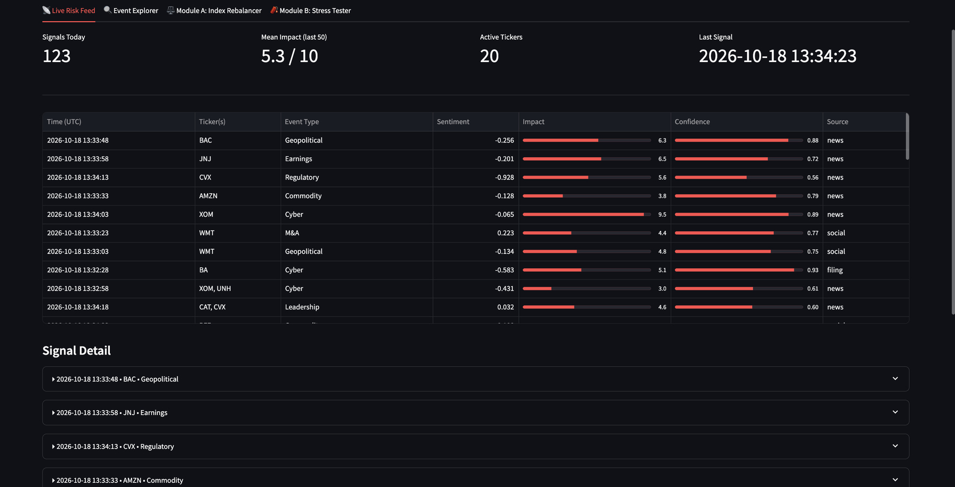
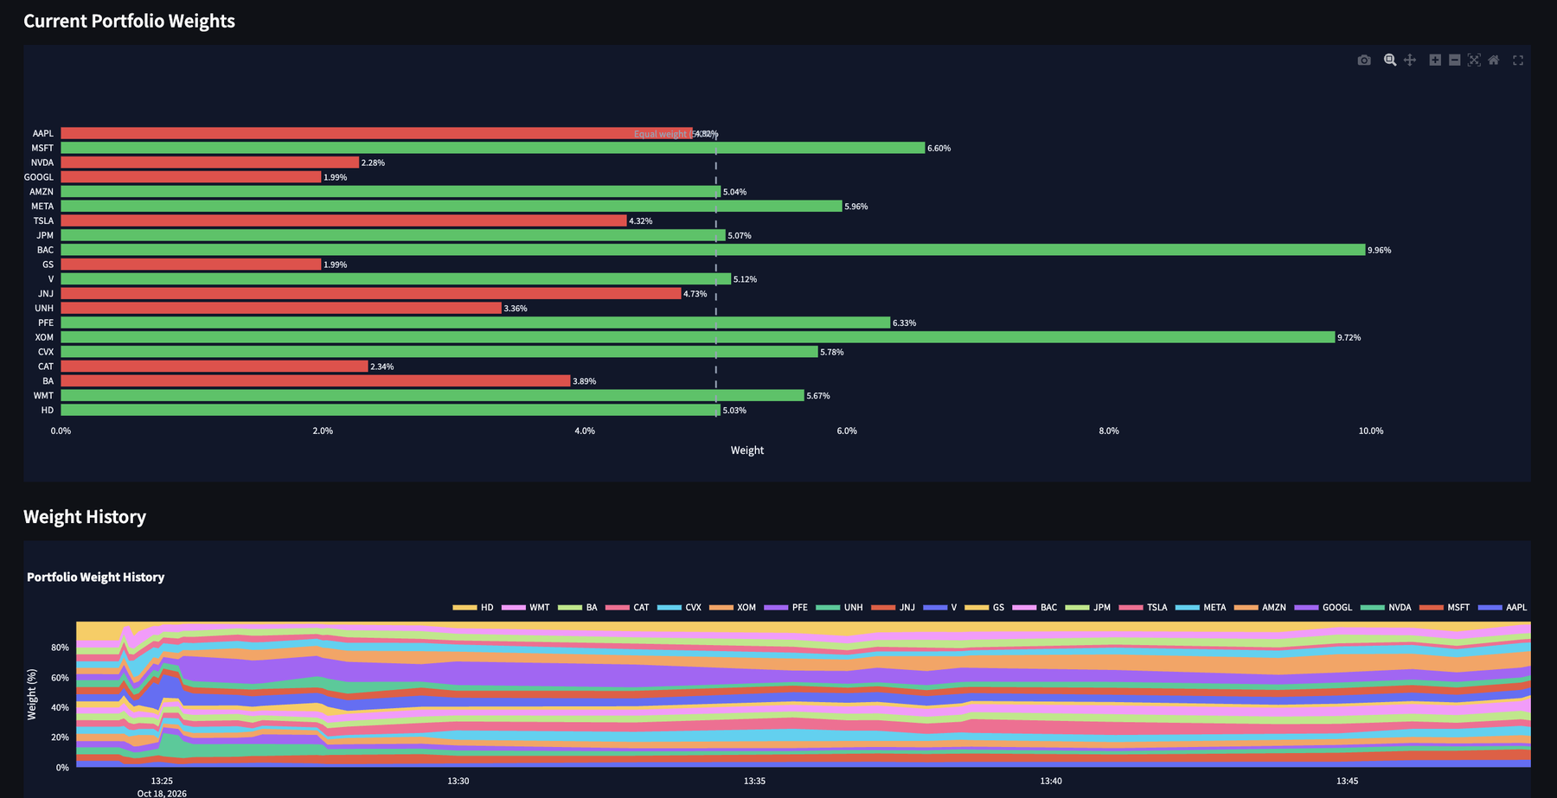
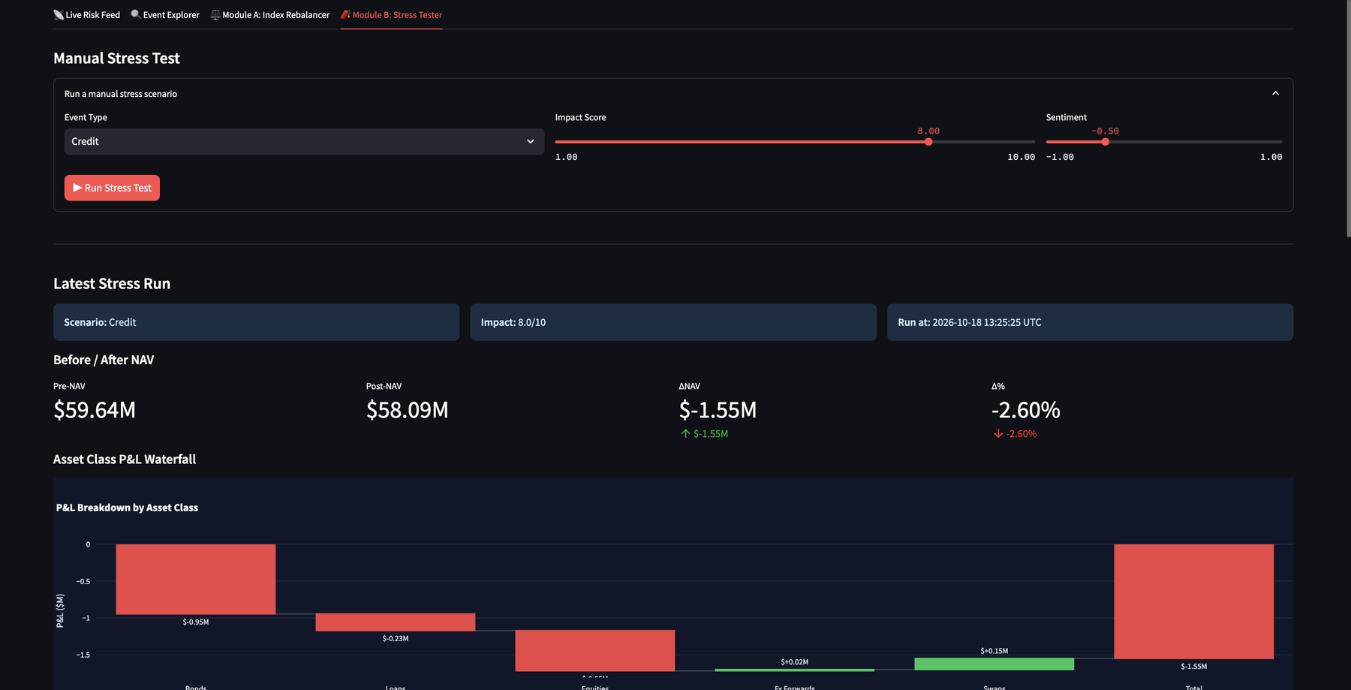
Impact, limits and next steps
Impact
Limitations
Next steps
Event noise becomes explainable, reviewable action
Every portfolio response traces back to its originating signal
Runs offline in replay mode with a one-command Docker demo
Synthetic portfolio and signals; not investment advice
Impact model trained on synthetic prices
Loss histogram reconstructed from VaR/ES
Real-data evaluation and better calibration
Stronger monitoring and drift checks
Broader scenario coverage
Live Risk Feed
Module A: Index Rebalancer
Module B: Stress Tester
GitHub: github.com/MMWARRIOR03/VIT_Vellore-Mrinal_Mohit-hackathon Demo video: [add unlisted YouTube link]
Notes:
Close on traceability and honesty about limits. Point judges to the repo and the demo video.

