Slide 1
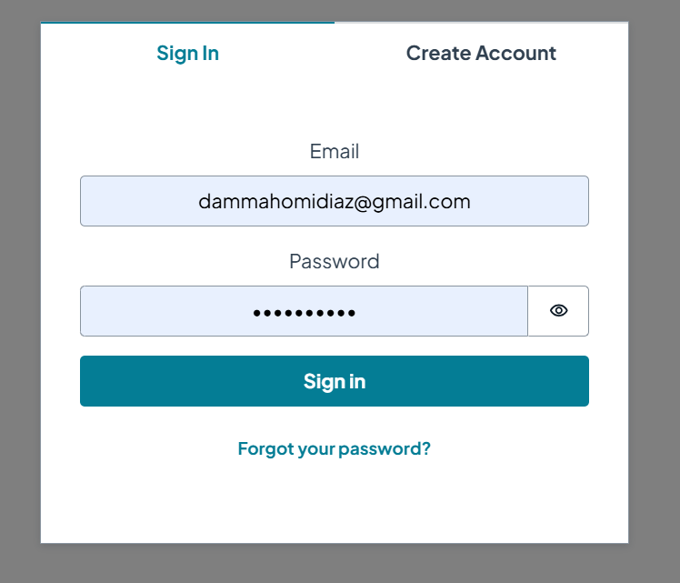
Sign IN/ User Auth using Cognito / AWS-Amplify

Slide 2
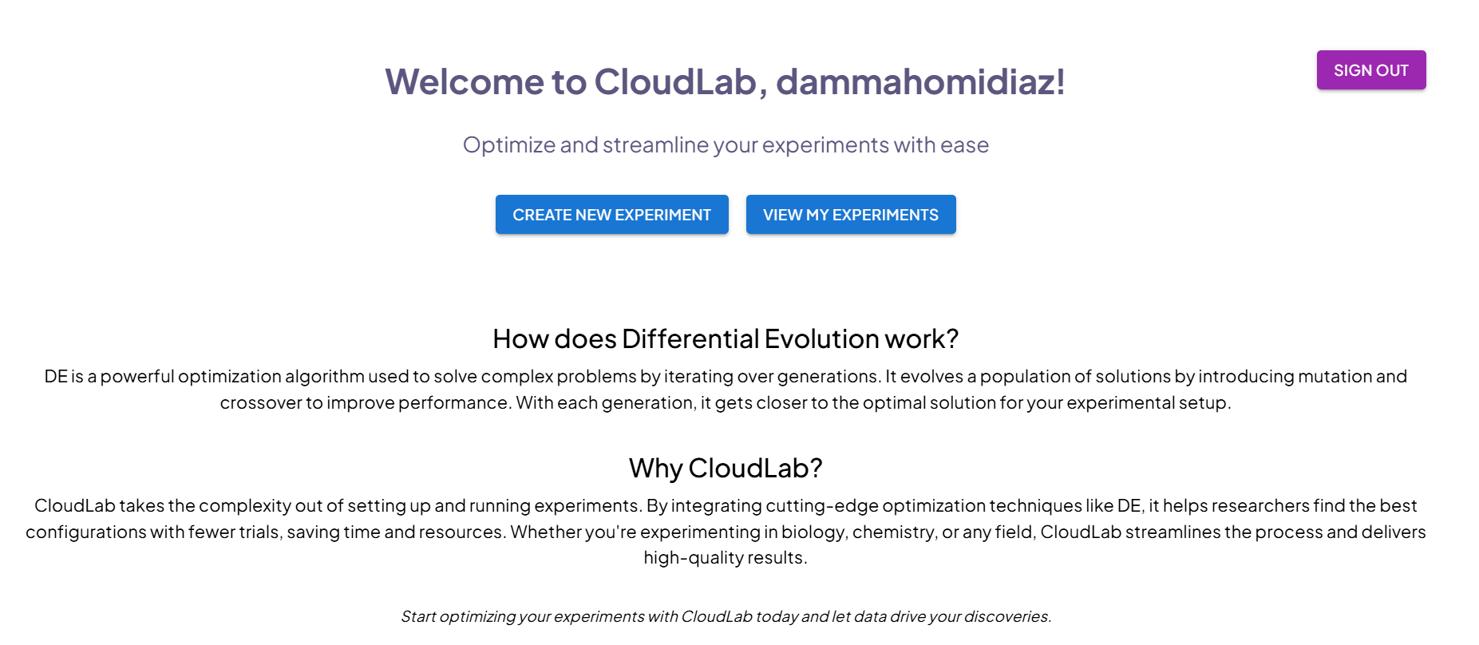
React Typescript Front end
Landing page with basic introduction, sign out, create new experiment, view all experiments

Slide 3
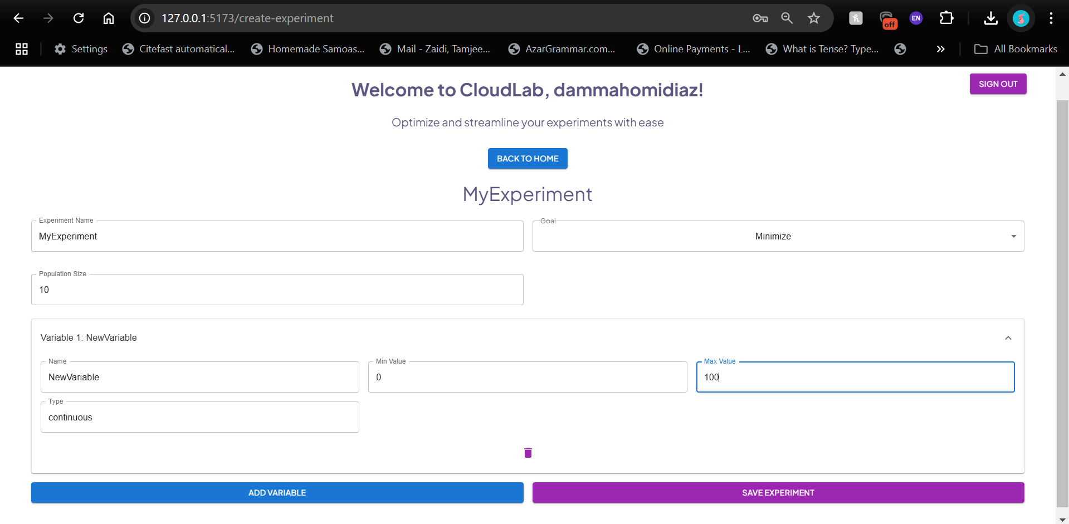
Interactive experiment design page, saves experiments to DynamoDB using AWS API Gateway to trigger python lambda function for saving experiments

Slide 4
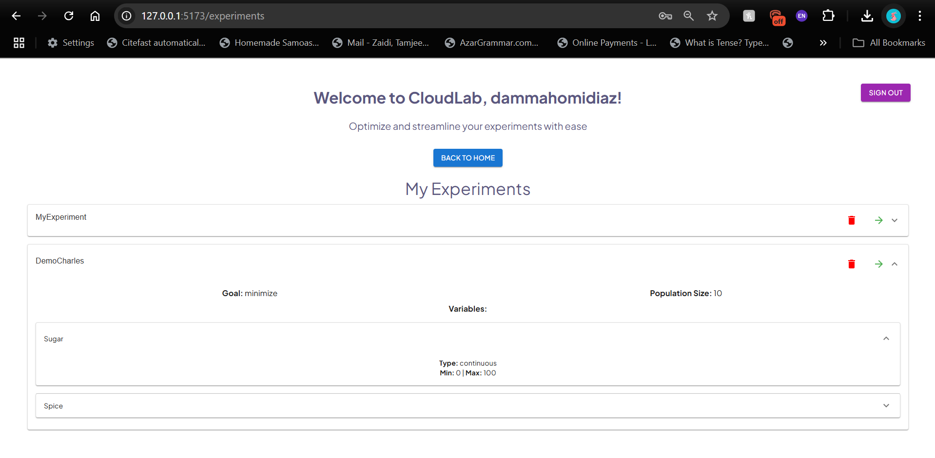
Interactive “View my Experiments” page that fetches all users’ experiments from the DynamoDB, displays their info, allows for deletion with the 🗑️ icon and continue experiment with → icon

Slide 5
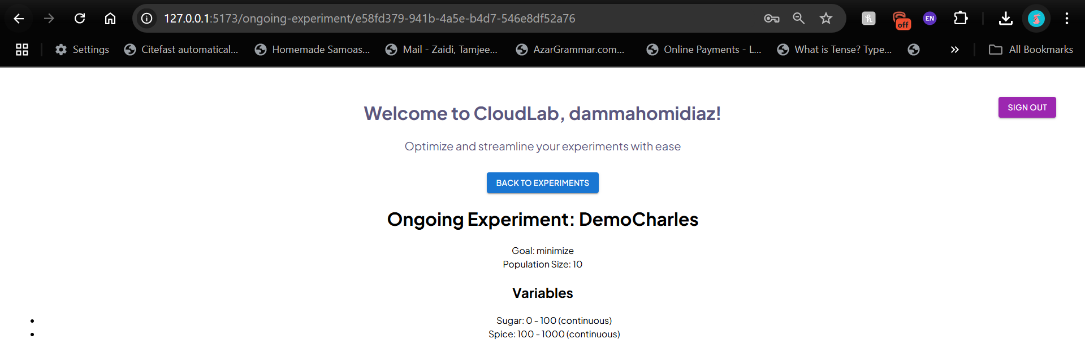
Final piece of the puzzle in progress. Ongoing experiment page where researchers are presented with the variable configurations to test as generated by the DE algorithm on the backend and allows users to input results and generate next population to test. DE algorithm was implemented at start of semester and is currently being used as a console app by the researchers, need to develop the UI and tie into our backend. Goal of completion during Thanksgiving Break.

