Slide 1
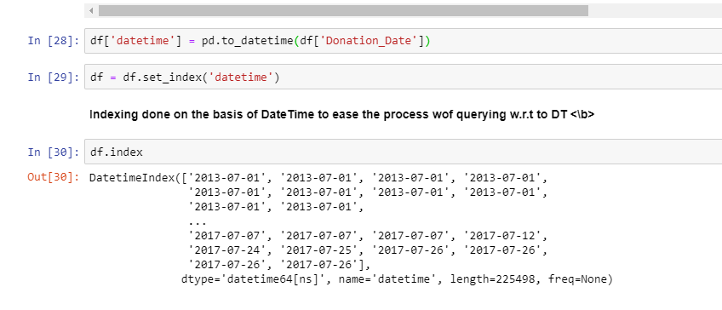
A Time Series Analysis of the Number of Donors who Failed the Blood Tests

Slide 2

Much of the explanations have been done in the notebook itself. This ppt contains the snapshots of the notebook.

Slide 3
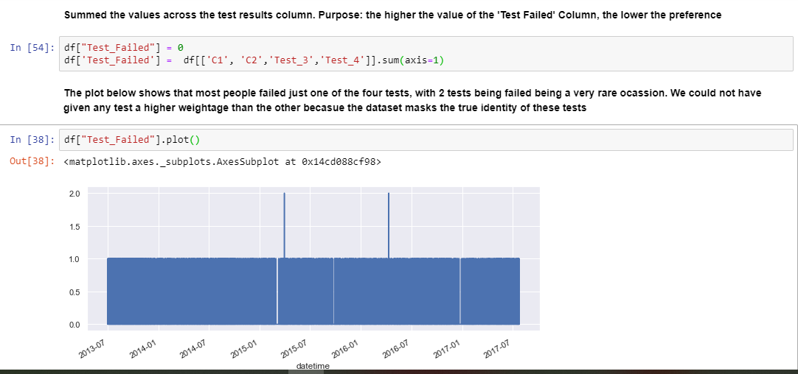

Slide 4

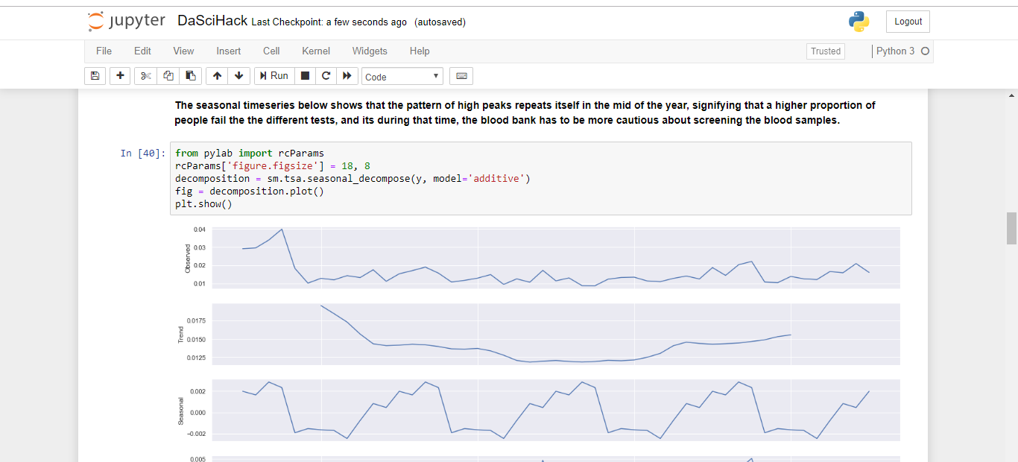
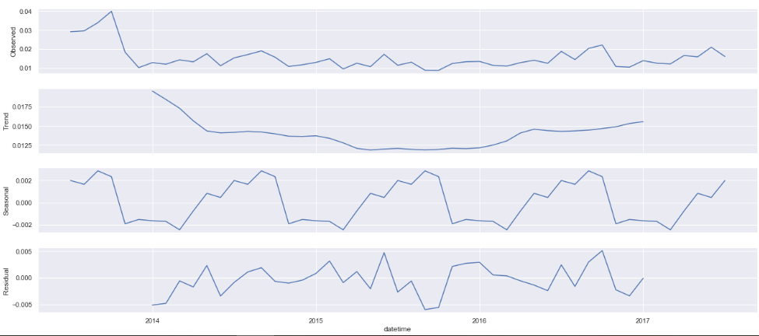

Slide 5
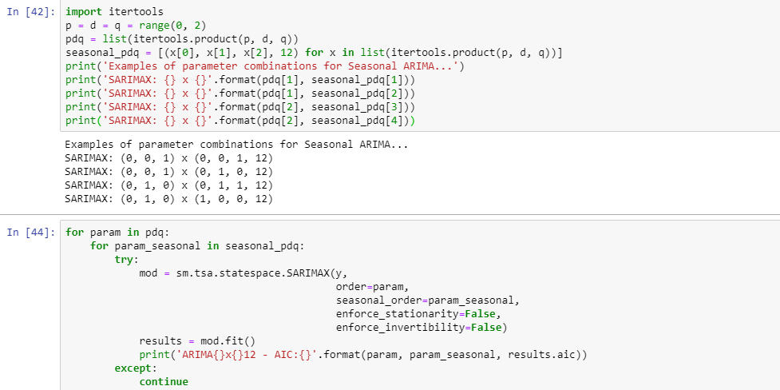

Slide 6

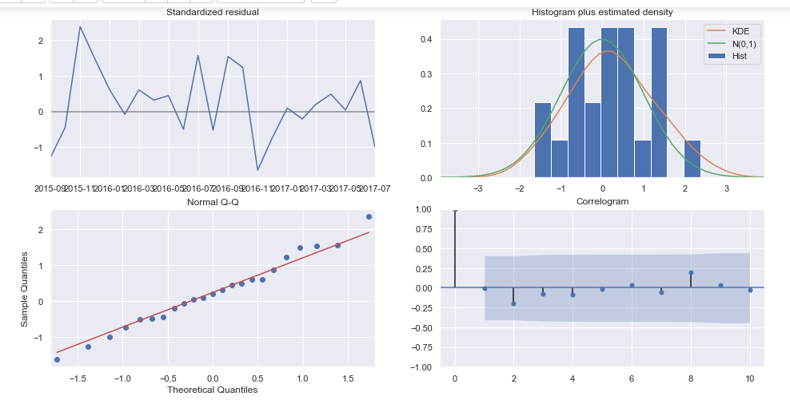

Slide 7

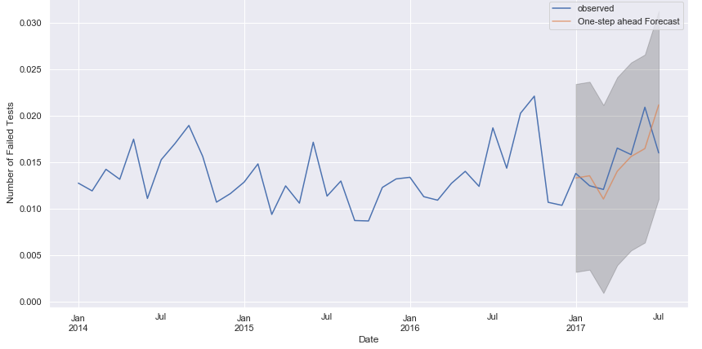

Slide 8
