Slide 1
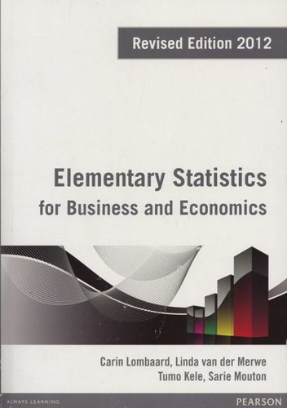
QTS105D
SLIDES . BY
.
.
.
.
.
.
.
.
.
.
.
Matsilele Mabaso
Tshwane University of Technology

Slide 2
QTS105D
Course Materials
Lecture Notes
  https://github.com/MMabaso/Quantitative-Techniques-Lecture

Slide 3
Descriptive Statistics
Chapter 2

Slide 4
§ 2.1
Frequency Distributions and Their Graphs

Slide 5
Objectives
After this lecture, you should be able to:
1.
Organize data using a frequency distribution.
2.
Represents data in frequency distribution graphically
>
Histograms
>
Frequency polygon, and
>
Ogives
3.
Draw and interpret stem and leaf plot.

Slide 6
Frequency Distributions
Raw data: When the data is in its original form.
Common frequency distribution: categorical and grouped frequency distribution.
Frequency distribution
Categorical frequency distribution
Grouped frequency distribution
Used for data placed in a specific category.
Used when the range of data is large.

Slide 7
Frequency Distributions
A frequency distribution is a table that shows classes or intervals of data with a count of the number in each class. The frequency f of a class is the number of data points in the class.
Class | Frequency, f
1 – 4 | 4
5 – 8 | 5
9 – 12 | 3
13 – 16 | 4
17 – 20 | 2
Upper Class Limits
Lower Class Limits
Frequencies

Slide 8
Frequency Distributions
The class width is the distance between lower (or upper) limits of consecutive classes.
Class | Frequency, f
1 – 4 | 4
5 – 8 | 5
9 – 12 | 3
13 – 16 | 4
17 – 20 | 2
5 – 1 = 4
9 – 5 = 4
13 – 9 = 4
17 – 13 = 4
The class width is 4.
The range is the difference between the maximum and minimum data entries.

Slide 9
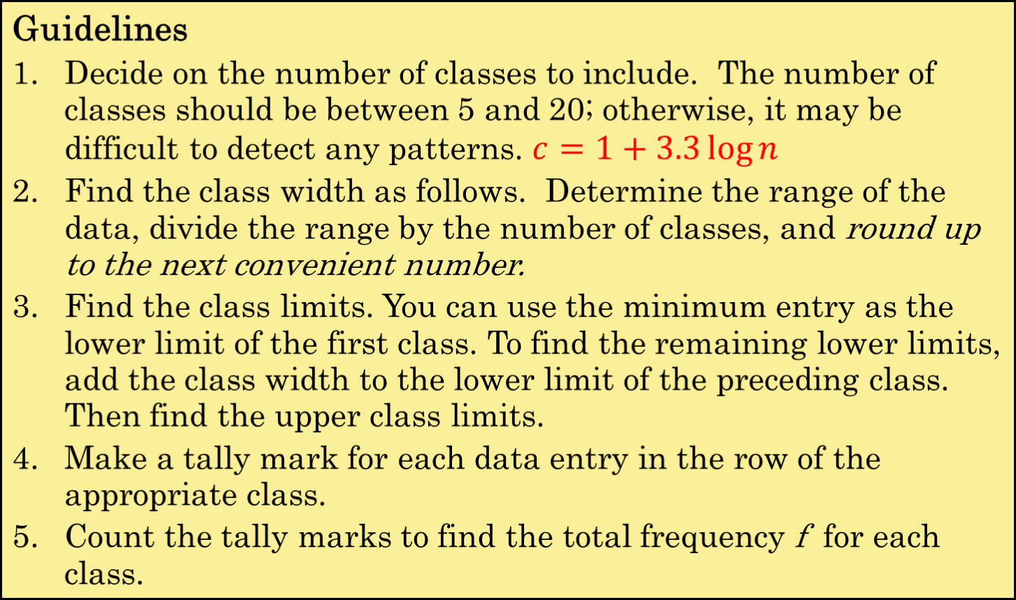
Constructing a Frequency Distribution

Slide 10
Constructing a Frequency Distribution
Example:
The following data represents the ages of 30 students in a statistics class. Construct a frequency distribution that has five classes.
Ages of Students
18 | 20 | 21 | 27 | 29 | 20
19 | 30 | 32 | 19 | 34 | 19
24 | 29 | 18 | 37 | 38 | 22
30 | 39 | 32 | 44 | 33 | 46
54 | 49 | 18 | 51 | 21 | 21
Continued.

Slide 11
Constructing a Frequency Distribution
Example continued:
The number of classes (5) is stated in the problem.
2. The minimum data entry is 18 and maximum entry is 54, so the range is 36. Divide the range by the number of classes to find the class width.
36
Class width =
= 7.2
Round up to 8.
5
Continued.

Slide 12
Constructing a Frequency Distribution
Example continued:
3. The minimum data entry of 18 may be used for the lower limit of the first class. To find the lower class limits of the remaining classes, add the width (8) to each lower limit.
The lower class limits are 18, 26, 34, 42, and 50.
The upper class limits are 25, 33, 41, 49, and 57.
4. Make a tally mark for each data entry in the appropriate class.
5. The number of tally marks for a class is the frequency for that class.
Continued.

Slide 13

Constructing a Frequency Distribution
Example continued:
Number of students
Ages
Ages of Students
Class
Tally
Frequency, f
18 – 25
13
26 – 33
8
34 – 41
4
42 – 49
3
Check that the sum equals the number in the sample.
50 – 57
2

Slide 14
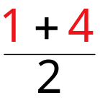


Midpoint
The midpoint of a class is the sum of the lower and upper limits of the class divided by two. The midpoint is sometimes called the class mark.
(Lower class limit) + (Upper class limit)
Midpoint =
2
Class
Frequency, f
Midpoint
1 – 4
4
2.5
Midpoint =

Slide 15
Midpoint
Example:
Find the midpoints for the “Ages of Students” frequency distribution.
Ages of Students
Class
Frequency, f
Midpoint
18 + 25 = 43
18 – 25
13
21.5
43 ÷ 2 = 21.5
26 – 33
8
29.5
34 – 41
4
37.5
42 – 49
3
45.5
50 – 57
2
53.5

Slide 16
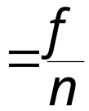

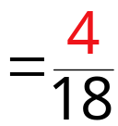

Relative Frequency
The relative frequency of a class is the portion or percentage of the data that falls in that class. To find the relative frequency of a class, divide the frequency f by the sample size n.
Class frequency
Relative frequency =
Sample size
Class | Frequency, f | Relative Frequency
1 – 4 | 4
0.222
Relative frequency

Slide 17

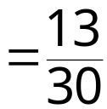

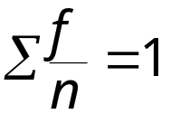
Relative Frequency
Example:
Find the relative frequencies for the “Ages of Students” frequency distribution.
Class
Frequency, f
Relative Frequency
Portion of students
18 – 25
13
0.433
26 – 33
8
0.267
34 – 41
4
0.133
42 – 49
3
0.1
50 – 57
2
0.067

Slide 18
Cumulative Frequency
The cumulative frequency of a class is the sum of the frequency for that class and all the previous classes.
Ages of Students
Class
Frequency, f
Cumulative Frequency
18 – 25
13
13
26 – 33
8
21
+
34 – 41
4
25
+
42 – 49
+
3
28
Total number of students
+
50 – 57
2
30

Slide 19
Frequency Plots
Three most commonly used graphs in research
The histogram.
The frequency polygon.
The cumulative frequency graph, or give (pronounced o-jive).

Slide 20
Frequency Histogram
A frequency histogram is a bar graph that represents the frequency distribution of a data set.
The horizontal scale is quantitative and measures the data values.
The vertical scale measures the frequencies of the classes.
Consecutive bars must touch.
Class boundaries are the numbers that separate the classes without forming gaps between them.
The horizontal scale of a histogram can be marked with either the class boundaries or the midpoints.

Slide 21
Class Boundaries
Example:
Find the class boundaries for the “Ages of Students” frequency distribution.
Ages of Students
Class
Frequency, f
Class Boundaries
The distance from the upper limit of the first class to the lower limit of the second class is 1.
18 – 25
13
17.5 − 25.5
26 – 33
8
25.5 − 33.5
34 – 41
4
33.5 − 41.5
42 – 49
3
41.5 − 49.5
Half this distance is 0.5.
50 – 57
2
49.5 − 57.5

Slide 22
Frequency Histogram
Example:
Draw a frequency histogram for the “Ages of Students” frequency distribution. Use the class boundaries.
14
13
Ages of Students
12
10
8
8
f
6
4
4
3
2
2
0
Broken axis
17.5
25.5
33.5
41.5
49.5
57.5
Age (in years)

Slide 23
Frequency Polygon
A frequency polygon is a line graph that emphasizes the continuous change in frequencies.
Ages of Students
14
12
10
Line is extended to the x-axis.
8
f
6
4
2
0
Broken axis
13.5
21.5
29.5
37.5
45.5
53.5
61.5
Age (in years)
Midpoints

Slide 24
Relative Frequency Histogram
A relative frequency histogram has the same shape and the same horizontal scale as the corresponding frequency histogram.
0.5
0.433
Ages of Students
0.4
0.3
Relative frequency
(portion of students)
0.267
0.2
0.133
0.1
0.1
0.067
0
17.5
25.5
33.5
41.5
49.5
57.5
Age (in years)

Slide 25
Cumulative Frequency Graph
A cumulative frequency graph or ogive, is a line graph that displays the cumulative frequency of each class at its lower class boundary.
Ages of Students
30
24
The graph ends at the upper boundary of the last class.
18
Cumulative frequency
(portion of students)
12
6
0
17.5
25.5
33.5
41.5
49.5
57.5
Age (in years)

Slide 26
§ 2.2
More Graphs and Displays

Slide 27
Stem-and-Leaf Plot
In a stem-and-leaf plot, each number is separated into a stem (usually the entry’s leftmost digits) and a leaf (usually the rightmost digit). This is an example of exploratory data analysis.
Example:
The following data represents the ages of 30 students in a statistics class. Display the data in a stem-and-leaf plot.
Ages of Students
18 | 20 | 21 | 27 | 29 | 20
19 | 30 | 32 | 19 | 34 | 19
24 | 29 | 18 | 37 | 38 | 22
30 | 39 | 32 | 44 | 33 | 46
54 | 49 | 18 | 51 | 21 | 21
Continued.

Slide 28
Stem-and-Leaf Plot
Ages of Students
Key: 1|8 = 18
1
2
3
4
5
8 8 8 9 9 9
0 0 1 1 1 2 4 7 9 9
Most of the values lie between 20 and 39.
0 0 2 2 3 4 7 8 9
4 6 9
1 4
This graph allows us to see the shape of the data as well as the actual values.

Slide 29
Stem-and-Leaf Plot
Example:
Construct a stem-and-leaf plot that has two lines for each stem.
Ages of Students
Key: 1|8 = 18
1
1
2
2
3
3
4
4
5
5
8 8 8 9 9 9
0 0 1 1 1 2 4
7 9 9
0 0 2 2 3 4
7 8 9
From this graph, we can conclude that more than 50% of the data lie between 20 and 34.
4
6 9
1 4

Slide 30
Dot Plot
In a dot plot, each data entry is plotted, using a point, above a horizontal axis.
Example:
Use a dot plot to display the ages of the 30 students in the statistics class.
Ages of Students
18 | 20 | 21 | 27 | 29 | 20
19 | 30 | 32 | 19 | 34 | 19
24 | 29 | 18 | 37 | 38 | 22
30 | 39 | 32 | 44 | 33 | 46
54 | 49 | 18 | 51 | 21 | 21
Continued.

Slide 31
Dot Plot
Ages of Students
15
18
21
24
27
30
33
36
39
42
45
48
51
54
57
From this graph, we can conclude that most of the values lie between 18 and 32.

Slide 32
Pie Chart
A pie chart is a circle that is divided into sectors that represent categories. The area of each sector is proportional to the frequency of each category.
Accidental Deaths in the USA in 2002
Type | Frequency
Motor Vehicle | 43,500
Falls | 12,200
Poison | 6,400
Drowning | 4,600
Fire | 4,200
Ingestion of Food/Object | 2,900
Firearms | 1,400
(Source: US Dept. of Transportation)
Continued.

Slide 33
Pie Chart
To create a pie chart for the data, find the relative frequency (percent) of each category.
Type | Frequency | Relative Frequency
Motor Vehicle | 43,500 | 0.578
Falls | 12,200 | 0.162
Poison | 6,400 | 0.085
Drowning | 4,600 | 0.061
Fire | 4,200 | 0.056
Ingestion of Food/Object | 2,900 | 0.039
Firearms | 1,400 | 0.019
n = 75,200
Continued.

Slide 34
Pie Chart
Next, find the central angle. To find the central angle, multiply the relative frequency by 360°.
Type | Frequency | Relative Frequency | Angle
Motor Vehicle | 43,500 | 0.578 | 208.2°
Falls | 12,200 | 0.162 | 58.4°
Poison | 6,400 | 0.085 | 30.6°
Drowning | 4,600 | 0.061 | 22.0°
Fire | 4,200 | 0.056 | 20.1°
Ingestion of Food/Object | 2,900 | 0.039 | 13.9°
Firearms | 1,400 | 0.019 | 6.7°
Continued.

Slide 35
Pie Chart
Ingestion
3.9%
Firearms
1.9%
Fire
5.6%
Drowning
6.1%
Poison
8.5%
Motor vehicles
57.8%
Falls
16.2%

Slide 36
Pareto Chart
A Pareto chart is a vertical bar graph is which the height of each bar represents the frequency. The bars are placed in order of decreasing height, with the tallest bar to the left.
Accidental Deaths in the USA in 2002
Type | Frequency
Motor Vehicle | 43,500
Falls | 12,200
Poison | 6,400
Drowning | 4,600
Fire | 4,200
Ingestion of Food/Object | 2,900
Firearms | 1,400
(Source: US Dept. of Transportation)
Continued.

Slide 37
Pareto Chart
Accidental Deaths
45000
40000
35000
30000
25000
20000
15000
10000
5000
Poison
Motor Vehicles
Firearms
Falls
Poison
Drowning
Fire
Ingestion of Food/Object

Slide 38
Scatter Plot
When each entry in one data set corresponds to an entry in another data set, the sets are called paired data sets.
In a scatter plot, the ordered pairs are graphed as points in a coordinate plane. The scatter plot is used to show the relationship between two quantitative variables.
The following scatter plot represents the relationship between the number of absences from a class during the semester and the final grade.
Continued.

Slide 39
Scatter Plot
Absences
Grade
Final
grade
(y)
x
8
2
5
12
15
9
6
y
78
92
90
58
43
74
81
100
90
80
70
60
50
40
0
2
4
6
8
10
12
14
16
Absences (x)
From the scatter plot, you can see that as the number of absences increases, the final grade tends to decrease.

Slide 40
Times Series Chart
A data set that is composed of quantitative data entries taken at regular intervals over a period of time is a time series. A time series chart is used to graph a time series.
Example:
The following table lists the number of minutes Robert used on his cell phone for the last six months.
Month | Minutes
January | 236
February | 242
March | 188
April | 175
May | 199
June | 135
Construct a time series chart for the number of minutes used.
Continued.

Slide 41
Times Series Chart
Robert’s Cell Phone Usage
250
200
150
Minutes
100
50
0
Jan
Feb
Mar
Apr
May
June
Month

Slide 42
§ 2.3
Measures of Central Tendency

Slide 43
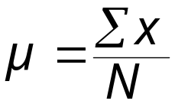
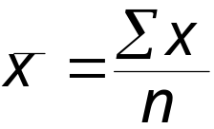
Mean
A measure of central tendency is a value that represents a typical, or central, entry of a data set. The three most commonly used measures of central tendency are the mean, the median, and the mode.
The mean of a data set is the sum of the data entries divided by the number of entries.
Population mean:
Sample mean:
“mu”
“x-bar”

Slide 44
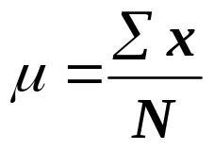
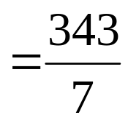

Mean
Example:
The following are the ages of all seven employees of a small company:
53 32 61 57 39 44 57
Calculate the population mean.
Add the ages and divide by 7.
The mean age of the employees is 49 years.

Slide 45
Median
The median of a data set is the value that lies in the middle of the data when the data set is ordered. If the data set has an odd number of entries, the median is the middle data entry. If the data set has an even number of entries, the median is the mean of the two middle data entries.
Example:
Calculate the median age of the seven employees.
53 32 61 57 39 44 57
To find the median, sort the data.
32 39 44 53 57 57 61
The median age of the employees is 53 years.

Slide 46
Mode
The mode of a data set is the data entry that occurs with the greatest frequency. If no entry is repeated, the data set has no mode. If two entries occur with the same greatest frequency, each entry is a mode and the data set is called bimodal.
Example:
Find the mode of the ages of the seven employees.
53 32 61 57 39 44 57
The mode is 57 because it occurs the most times.
An outlier is a data entry that is far removed from the other entries in the data set.

Slide 47
Comparing the Mean, Median and Mode
Example:
A 29-year-old employee joins the company and the ages of the employees are now:
53 32 61 57 39 44 57 29
Recalculate the mean, the median, and the mode. Which measure of central tendency was affected when this new age was added?
Mean = 46.5
The mean takes every value into account, but is affected by the outlier.
Median = 48.5
The median and mode are not influenced by extreme values.
Mode = 57

Slide 48
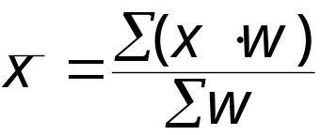
Weighted Mean
A weighted mean is the mean of a data set whose entries have varying weights. A weighted mean is given by
where w is the weight of each entry x.
Example:
Grades in a statistics class are weighted as follows:
Tests are worth 50% of the grade, homework is worth 30% of the grade and the final is worth 20% of the grade. A student receives a total of 80 points on tests, 100 points on homework, and 85 points on his final. What is his current grade?
Continued.

Slide 49
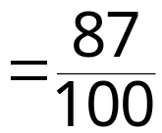

Weighted Mean
Begin by organizing the data in a table.
Source | Score, x | Weight, w | xw
Tests | 80 | 0.50 | 40
Homework | 100 | 0.30 | 30
Final | 85 | 0.20 | 17
The student’s current grade is 87%.

Slide 50
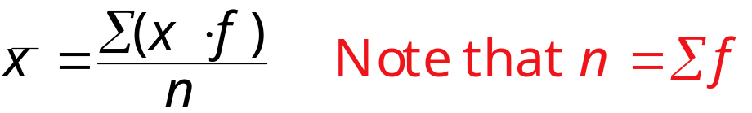
Mean of a Frequency Distribution
The mean of a frequency distribution for a sample is approximated by
where x and f are the midpoints and frequencies of the classes.
Example:
The following frequency distribution represents the ages of 30 students in a statistics class. Find the mean of the frequency distribution.
Continued.

Slide 51
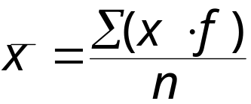
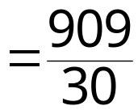

Mean of a Frequency Distribution
Class midpoint
Class | x | f | (x · f )
18 – 25 | 21.5 | 13 | 279.5
26 – 33 | 29.5 | 8 | 236.0
34 – 41 | 37.5 | 4 | 150.0
42 – 49 | 45.5 | 3 | 136.5
50 – 57 | 53.5 | 2 | 107.0
 |  | n = 30 | Σ = 909.0
The mean age of the students is 30.3 years.

Slide 52
Shapes of Distributions
A frequency distribution is symmetric when a vertical line can be drawn through the middle of a graph of the distribution and the resulting halves are approximately the mirror images.
A frequency distribution is uniform (or rectangular) when all entries, or classes, in the distribution have equal frequencies. A uniform distribution is also symmetric.
A frequency distribution is skewed if the “tail” of the graph elongates more to one side than to the other. A distribution is skewed left (negatively skewed) if its tail extends to the left. A distribution is skewed right (positively skewed) if its tail extends to the right.

Slide 53
Symmetric Distribution
10 Annual Incomes
15,000
20,000
22,000
24,000
25,000
25,000
26,000
28,000
30,000
35,000
5
Income
4
f
3
2
1
0
$25000
mean = median = mode
= $25,000

Slide 54
Skewed Left Distribution
10 Annual Incomes
0
20,000
22,000
24,000
25,000
25,000
26,000
28,000
30,000
35,000
5
Income
4
f
3
2
1
0
$25000
mean = $23,500
median = mode = $25,000
Mean < Median

Slide 55
Skewed Right Distribution
10 Annual Incomes
15,000
20,000
22,000
24,000
25,000
25,000
26,000
28,000
30,000
1,000,000
5
Income
4
f
3
2
1
0
$25000
mean = $121,500
median = mode = $25,000
Mean > Median

Slide 56
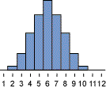
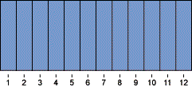
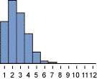
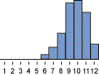
Summary of Shapes of Distributions
Symmetric
Uniform
Mean = Median
Skewed right
Skewed left
Mean > Median
Mean < Median

Slide 57
§ 2.4
Measures of Variation

Slide 58
Range
The range of a data set is the difference between the maximum and minimum date entries in the set.
Range = (Maximum data entry) – (Minimum data entry)
Example:
The following data are the closing prices for a certain stock on ten successive Fridays. Find the range.
Stock | 56 | 56 | 57 | 58 | 61 | 63 | 63 | 67 | 67 | 67
The range is 67 – 56 = 11.

Slide 59
Deviation
The deviation of an entry x in a population data set is the difference between the entry and the mean μ of the data set.
Deviation of x = x – μ
Example:
The following data are the closing prices for a certain stock on five successive Fridays. Find the deviation of each price.
Stock
x
Deviation
x – μ
56
56 – 61 = – 5
58
58 – 61 = – 3
61
61 – 61 = 0
63
63 – 61 = 2
The mean stock price is
μ = 305/5 = 61.
67
67 – 61 = 6
Σx = 305
Σ(x – μ) = 0

Slide 60
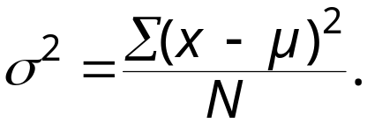
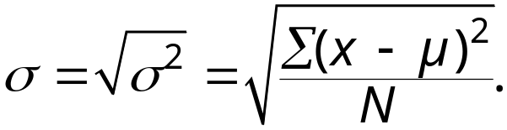
Variance and Standard Deviation
The population variance of a population data set of N entries is
Population variance =
“sigma squared”
The population standard deviation of a population data set of N entries is the square root of the population variance.
Population standard deviation =
“sigma”

Slide 61




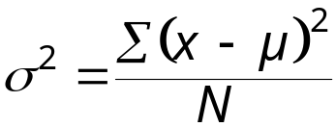
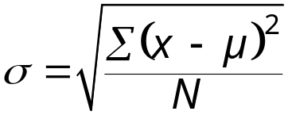
Finding the Population Standard Deviation
Guidelines
In Words In Symbols
Find the mean of the population data set.
Find the deviation of each entry.
Square each deviation.
Add to get the sum of squares.
Divide by N to get the population variance.
Find the square root of the variance to get the population standard deviation.

Slide 62




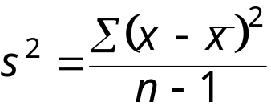
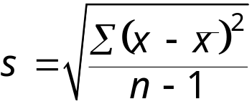
Finding the Sample Standard Deviation
Guidelines
In Words In Symbols
Find the mean of the sample data set.
Find the deviation of each entry.
Square each deviation.
Add to get the sum of squares.
Divide by n – 1 to get the sample variance.
Find the square root of the variance to get the sample standard deviation.

Slide 63
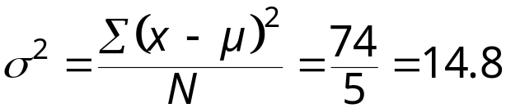
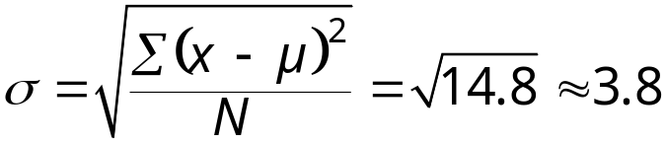
Finding the Population Standard Deviation
Example:
The following data are the closing prices for a certain stock on five successive Fridays. The population mean is 61. Find the population standard deviation.
Always positive!
Stock x | Deviation x – μ | Squared (x – μ)²
56 | – 5 | 25
58 | – 3 | 9
61 | 0 | 0
63 | 2 | 4
67 | 6 | 36
Σx = 305 | Σ(x – μ) = 0 | Σ(x – μ)² = 74
SS₂ = Σ(x – μ)² = 74
3.85
σ ≈ $3.85

Slide 64

Interpreting Standard Deviation
When interpreting standard deviation, remember that is a measure of the typical amount an entry deviates from the mean. The more the entries are spread out, the greater the standard deviation.
14
14
12
= 4
s = 1.18
12
= 4
s = 0
10
10
Frequency
Frequency
8
8
6
6
4
4
2
2
0
0
2
4
6
2
4
6
Data value
Data value

Slide 65
Empirical Rule (68-95-99.7%)
Empirical Rule
For data with a (symmetric) bell-shaped distribution, the standard deviation has the following characteristics.
About 68% of the data lie within one standard deviation of the mean.
About 95% of the data lie within two standard deviations of the mean.
About 99.7% of the data lie within three standard deviation of the mean.

Slide 66
Empirical Rule (68-95-99.7%)
99.7% within 3 standard deviations
95% within 2 standard deviations
68% within 1 standard deviation
34%
34%
2.35%
2.35%
13.5%
13.5%
–4
–3
–2
–1
0
1
2
3
4

Slide 67
Using the Empirical Rule
Example:
The mean value of homes on a street is $125 thousand with a standard deviation of $5 thousand. The data set has a bell shaped distribution. Estimate the percent of homes between $120 and $130 thousand.
68%
105
110
115
120
125
130
135
140
145
μ – σ
μ
μ + σ
68% of the houses have a value between $120 and $130 thousand.

Slide 68
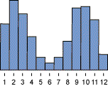
Chebychev’s Theorem
The Empirical Rule is only used for symmetric distributions.
Chebychev’s Theorem can be used for any distribution, regardless of the shape.

Slide 69
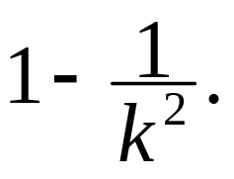
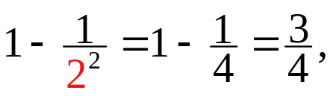
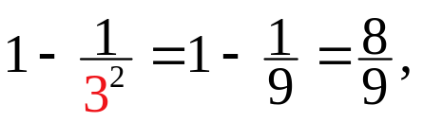
Chebychev’s Theorem
The portion of any data set lying within k standard deviations (k > 1) of the mean is at least
For k = 2: In any data set, at least or 75%, of the data lie within 2 standard deviations of the mean.
For k = 3: In any data set, at least or 88.9%, of the data lie within 3 standard deviations of the mean.

Slide 70
Using Chebychev’s Theorem
Example:
The mean time in a women’s 400-meter dash is 52.4 seconds with a standard deviation of 2.2 sec. At least 75% of the women’s times will fall between what two values?
2 standard deviations
μ
45.8
48
50.2
52.4
54.6
56.8
59
At least 75% of the women’s 400-meter dash times will fall between 48 and 56.8 seconds.

Slide 71
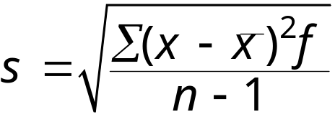
Standard Deviation for Grouped Data
Sample standard deviation =
where n = Σf is the number of entries in the data set, and x is the data value or the midpoint of an interval.
Example:
The following frequency distribution represents the ages of 30 students in a statistics class. The mean age of the students is 30.3 years. Find the standard deviation of the frequency distribution.
Continued.

Slide 72


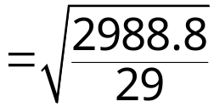


Standard Deviation for Grouped Data
The mean age of the students is 30.3 years.
Class | x | f | x – | (x – )² | (x – )²f
18 – 25 | 21.5 | 13 | – 8.8 | 77.44 | 1006.72
26 – 33 | 29.5 | 8 | – 0.8 | 0.64 | 5.12
34 – 41 | 37.5 | 4 | 7.2 | 51.84 | 207.36
42 – 49 | 45.5 | 3 | 15.2 | 231.04 | 693.12
50 – 57 | 53.5 | 2 | 23.2 | 538.24 | 1076.48
 |  | n = 30
The standard deviation of the ages is 10.2 years.

Slide 73
§ 2.5
Measures of Position

Slide 74
Quartiles
The three quartiles, Q₁, Q₂, and Q₃, approximately divide an ordered data set into four equal parts.
Median
Q₁
Q₂
Q₃
0
25
50
75
100
Q₁ is the median of the data below Q₂.
Q₃ is the median of the data above Q₂.

Slide 75
Finding Quartiles
Example:
The quiz scores for 15 students is listed below. Find the first, second and third quartiles of the scores.
28 43 48 51 43 30 55 44 48 33 45 37 37 42 38
Order the data.
Lower half
Upper half
28 30 33 37 37 38 42 43 43 44 45 48 48 51 55
Q₁
Q₂
Q₃
About one fourth of the students scores 37 or less; about one half score 43 or less; and about three fourths score 48 or less.

Slide 76
Interquartile Range
The interquartile range (IQR) of a data set is the difference between the third and first quartiles.
Interquartile range (IQR) = Q₃ – Q₁.
Example:
The quartiles for 15 quiz scores are listed below. Find the interquartile range.
Q₁ = 37
Q₂ = 43
Q₃ = 48
(IQR) = Q₃ – Q₁
The quiz scores in the middle portion of the data set vary by at most 11 points.
= 48 – 37
= 11

Slide 77
Box and Whisker Plot
A box-and-whisker plot is an exploratory data analysis tool that highlights the important features of a data set.
The five-number summary is used to draw the graph.
The minimum entry
Q₁
Q₂ (median)
Q₃
The maximum entry
Example:
Use the data from the 15 quiz scores to draw a box-and-whisker plot.
28 30 33 37 37 38 42 43 43 44 45 48 48 51 55
Continued.

Slide 78
Box and Whisker Plot
Five-number summary
The minimum entry
Q₁
Q₂ (median)
Q₃
The maximum entry
28
37
43
48
55
Quiz Scores
28
37
43
48
55
28
32
36
40
44
48
52
56

Slide 79
Percentiles and Deciles
Fractiles are numbers that partition, or divide, an ordered data set.
Percentiles divide an ordered data set into 100 parts. There are 99 percentiles: P₁, P₂, P₃…P₉₉.
Deciles divide an ordered data set into 10 parts. There are 9 deciles: D₁, D₂, D₃…D₉.
A test score at the 80th percentile (P₈₀), indicates that the test score is greater than 80% of all other test scores and less than or equal to 20% of the scores.

Slide 80
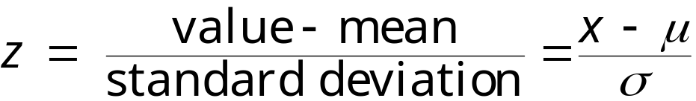
Standard Scores
The standard score or z-score, represents the number of standard deviations that a data value, x, falls from the mean, μ.
Example:
The test scores for all statistics finals at Union College have a mean of 78 and standard deviation of 7. Find the z-score for
a.) a test score of 85,
b.) a test score of 70,
c.) a test score of 78.
Continued.

Slide 81
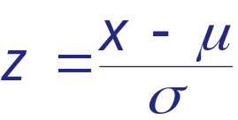
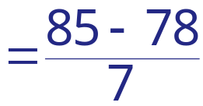

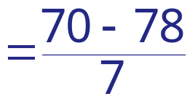

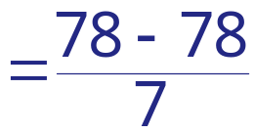

Standard Scores
Example continued:
a.) μ = 78, σ = 7, x = 85
This score is 1 standard deviation higher than the mean.
b.) μ = 78, σ = 7, x = 70
This score is 1.14 standard deviations lower than the mean.
c.) μ = 78, σ = 7, x = 78
This score is the same as the mean.

Slide 82
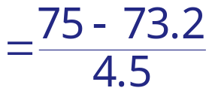
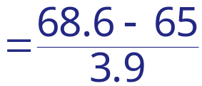


Relative Z-Scores
Example:
John received a 75 on a test whose class mean was 73.2 with a standard deviation of 4.5. Samantha received a 68.6 on a test whose class mean was 65 with a standard deviation of 3.9. Which student had the better test score?
John’s z-score
Samantha’s z-score
John’s score was 0.4 standard deviations higher than the mean, while Samantha’s score was 0.92 standard deviations higher than the mean. Samantha’s test score was better than John’s.

