Slide 1


QTS105D
SLIDES . BY
.
.
.
.
.
.
.
.
.
.
.
Matsilele Mabaso
Tshwane University of Technology

Slide 2
QTS105D
Course Materials
Lecture Notes
https://github.com/MMabaso/Quantitative-Techniques-Lecture

Slide 3
§ 1.1
An Overview of Statistics

Slide 4
Application in Business and Economics
Accounting - public accounting firms use statistical sampling procedures when conducting audits for their clients.
Economics - economists use statistical information in making forecasts about the future of the economy or some aspect of it.
Finance – financial advisors use price-earnings ratios and dividend yields to guide their investments.

Slide 5
Data and Statistics
Definitions:
Data consists of information coming from observations, counts, measurements, or responses.
A variable is a characteristic or attribute that can assume different values.
Statistics is the science of collecting, organizing, analyzing, and interpreting data in order to make decisions.
A population is the collection of all outcomes, responses, measurement, or counts that are of interest.
A sample is a subset of a population.

Slide 6
Populations & Samples
Example:
In a recent survey, 250 college students at TUT were asked if they smoked cigarettes regularly. 35 of the students said yes. Identify the population and the sample.
Responses of all students at TUT (population)
Responses of students in survey (sample)

Slide 7
Populations & Samples
Population
Sample

Slide 8
Parameters & Statistics
A parameter is a numerical description of a population characteristic.
A statistic is a numerical description of a sample characteristic.
Parameter
Population
Statistic
Sample

Slide 9
Parameters & Statistics
Example:
Decide whether the numerical value describes a population parameter or a sample statistic.
a.) A recent survey of a sample of 450 college students reported that the average weekly income for students is $325.
Because the average of $325 is based on a sample, this is a sample statistic.
b.) The average weekly income for all students is $405.
Because the average of $405 is based on a population, this is a population parameter.

Slide 10
Branches of Statistics
The study of statistics has two major branches: descriptive statistics and inferential statistics.
Statistics
Descriptive statistics
Inferential statistics
Involves the organization, summarization, and display of data.
Involves using a sample to draw conclusions about a population.

Slide 11
Descriptive and Inferential Statistics
Example:
In a recent study, volunteers who had less than 6 hours of sleep were four times more likely to answer incorrectly on a science test than were participants who had at least 8 hours of sleep. Decide which part is the descriptive statistic and what conclusion might be drawn using inferential statistics.
The statement “four times more likely to answer incorrectly” is a descriptive statistic. An inference drawn from the sample is that all individuals sleeping less than 6 hours are more likely to answer science question incorrectly than individuals who sleep at least 8 hours.

Slide 12
§ 1.2
Data Classification

Slide 13
Types of Data
Data sets can consist of two types of data: qualitative data and quantitative data.
Data
Qualitative Data
Quantitative Data
Consists of attributes, labels, or nonnumerical entries.
Consists of numerical measurements or counts.

Slide 14
Qualitative and Quantitative Data
Example:
The grade point averages of five students are listed in the table. Which data are qualitative data and which are quantitative data?
Student | GPA
Sally | 3.22
Bob | 3.98
Cindy | 2.75
Mark | 2.24
Kathy | 3.84
Qualitative data
Quantitative data

Slide 15
Quantitative Data
Quantitative data can be further into two categories: discrete and continuous.
Quantitative Data
Discrete Data
Continuous Data
Data which take only integers (whole number)
Data which take inifinitely many possible
e.g.
0, 1, 2, 3, …
e.g.
3.265452

Slide 16
Levels of Measurement
The level of measurement determines which statistical calculations are meaningful. The four levels of measurement are: nominal, ordinal, interval, and ratio.
Nominal
Lowest to highest
Levels of Measurement
Ordinal
Interval
Ratio

Slide 17
Nominal Level of Measurement
Data at the nominal level of measurement are qualitative only.
Nominal
Levels of Measurement
Calculated using names, labels, or qualities. No mathematical computations can be made at this level.
Blood types: O, A, B, AB
Names of students in your class
Genders: Male & Female

Slide 18
Ordinal Level of Measurement
Data at the ordinal level of measurement are qualitative or quantitative.
Levels of Measurement
Ordinal
Arranged in order, but differences between data entries are not meaningful.
Class standings: freshman, junior, senior
Taste of food: bad, so-so, good, delicious
Top 50 songs played on the radio

Slide 19
Interval Level of Measurement
Data at the interval level of measurement are quantitative. A zero entry simply represents a position on a scale.
Levels of Measurement
Interval
Arranged in order, the differences between data entries can be calculated.
Temperatures
Average Stating Salary: Economics/Finance: R40084, History: R32108, Psychology: R27454
Econ/Fin majors earn R7976 more than History majors and R12630 more than Psychology majors.

Slide 20
Ratio Level of Measurement
Data at the ratio level of measurement are similar to the interval level, but a zero entry is meaningful.
A ratio of two data values can be formed so one data value can be expressed as a ratio.
Levels of Measurement
Ratio
Econ/Fin majors salaries are 1.24 times History major salaries and are 1.46 times Psychology major salaries.
Ages
Weights

Slide 21
Summary of Levels of Measurement
Level of measurement
Put data in categories
Arrange data in order
Subtract data values
Determine if one data value is a multiple of another
Nominal
Yes
No
No
No
Ordinal
Yes
Yes
No
No
Interval
Yes
Yes
Yes
No
Ratio
Yes
Yes
Yes
Yes

Slide 22
§ 1.3
Experimental Design

Slide 23
Designing a Statistical Study
GUIDELINES
Identify the variable(s) of interest (the focus) and the population of the study.
Develop a detailed plan for collecting data. If you use a sample, make sure the sample is representative of the population.
Collect the data.
Describe the data.
Interpret the data and make decisions about the population using inferential statistics.
Identify any possible errors.

Slide 24
Methods of Data Collection
In an observational study, a researcher observes and measures characteristics of interest of part of a population.
In an experiment, a treatment is applied to part of a population, and responses are observed.
A simulation is the use of a mathematical or physical model to reproduce the conditions of a situation or process.
A survey is an investigation of one or more characteristics of a population.
A census is a measurement of an entire population.
A sampling is a measurement of part of a population.

Slide 25
Types of Sampling Methods
Sampling
Probabilistic
Non-probabilistic
All elements have equal chance of being selected.
Elements selected based on their availability
E.g. - Simple random sampling
- Systematic rand sampling
- Stratified rand sampling
- Cluster sampling
E.g. - Convenience sample
- Purpose sample
- Quota

Slide 26
Simple Random Sampling
A simple random sample is a subset of the population selected in such a manner that every sample of size n from the population has an equal chance of being selected. members from each segment of a population.
Example 1.2 (page 11)

Slide 27
Simple Random Sampling
Procedure:
How to draw a random sample:
Number all members of the population sequentially.
Use a table, calculator, or computer to select random numbers from the numbers assigned to the population members.
Create the sample by using population members with numbers corresponding to those randomly selected.

Slide 28
Stratified Sampling
A stratified sample has members from each segment of a population. This ensures that each segment from the population is represented.
Freshmen
Sophomores
Juniors
Seniors

Slide 29
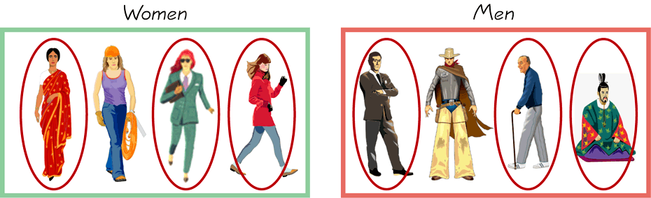
Stratified Sampling
A stratified sample has members from each segment of a population. This ensures that each segment from the population is represented.
Draw a sample from each stratum

Slide 30
Cluster Samples
A cluster sample has all members from randomly selected segments of a population. This is used when the population falls into naturally occurring subgroups.
All members in each selected group are used.
The city of Clarksville divided into city blocks.

Slide 31
Systematic Samples
A systematic sample is a sample in which each member of the population is assigned a number. A starting number is randomly selected and sample members are selected at regular intervals.
Every fourth (k) member is chosen.

Slide 32
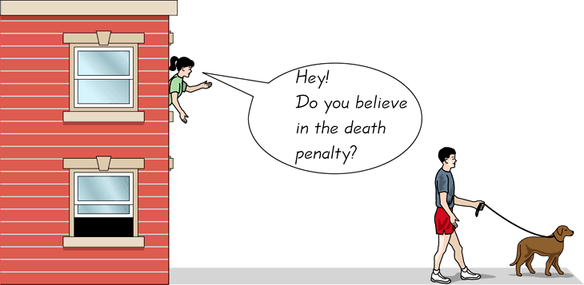
Convenience Samples
A convenience sample consists only of available members of the population.
Use results that are easy to get

Slide 33
Convenience Samples
A convenience sample consists only of available members of the population.
Example:
You are doing a study to determine the number of years of education each teacher at your college has. Identify the sampling technique used if you select the samples listed.
1.) You randomly select two different departments and survey each teacher in those departments.
2.) You select only the teachers you currently have this semester.
3.) You divide the teachers up according to their department and then choose and survey some teachers in each department.
Continued.

Slide 34
Identifying the Sampling Technique
Example continued:
You are doing a study to determine the number of years of education each teacher at your college has. Identify the sampling technique used if you select the samples listed.
1.) This is a cluster sample because each department is a naturally occurring subdivision.
2.) This is a convenience sample because you are using the teachers that are readily available to you.
3.) This is a stratified sample because the teachers are divided by department and some from each department are randomly selected.

Slide 35
EXERCISEs
Self review exercise – page 29 to page 34 (All exercises)

