Slide 1
Object Detection for Self-Driving Cars
By: Mahmoud, Viraj, Shloak, Jonathan

Slide 2
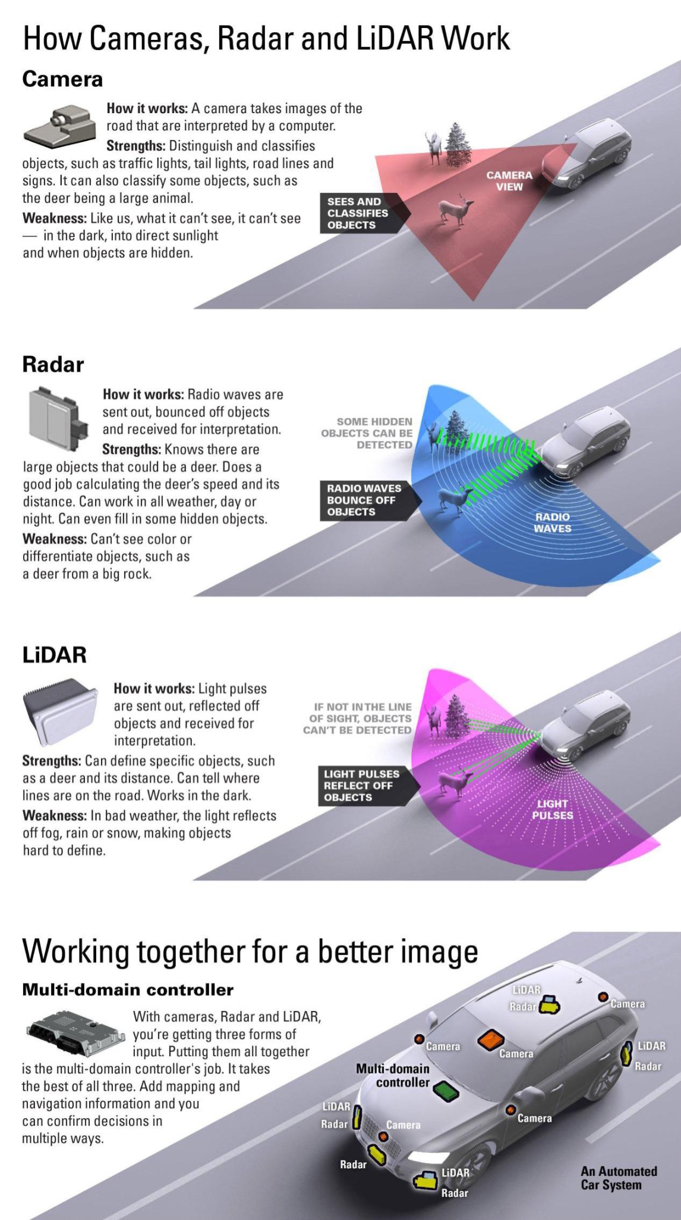
What Are Self-Driving Cars and How Do They See?
Autonomous vehicles use a mix of LiDAR, radar, and camera-based vision systems to sense the objects either moving away from them, or staying still.
This is where AI-based image classification helps the car recognize what's on the road, and provide input to our image classification

Slide 3
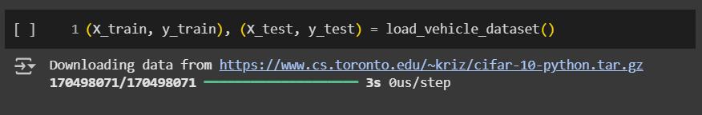
Understanding The Data
We used a few select pieces of a dataset called CIFAR-10, a dataset that specializes in image classification.
Specifically we used the vehicle dataset: car, track, and background
This gives us a manageable way to train an image classifier that forms the foundation of a self-driving car’s vision system.

Slide 4
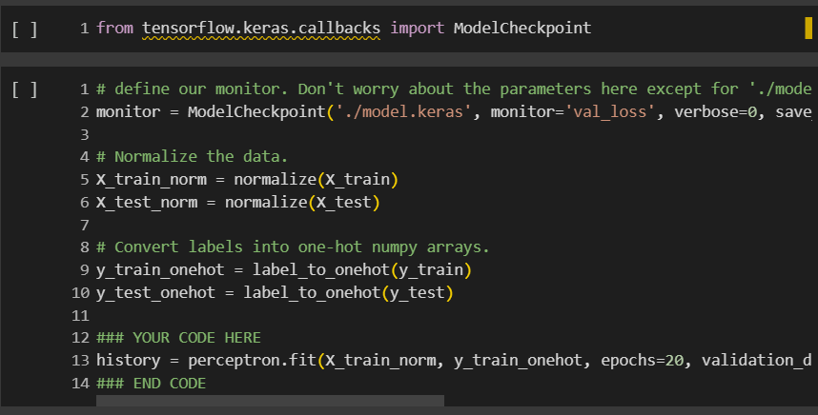
Preprocessing and Model Design
Normalize images (0-1 range)
One-hot encode labels
Neural network - 128 hidden units
Optimizer: Adam + 20 epochs

Slide 5
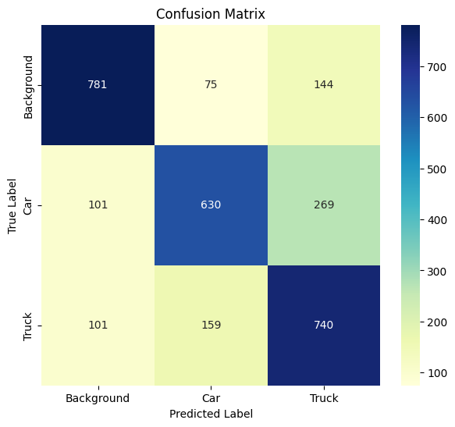
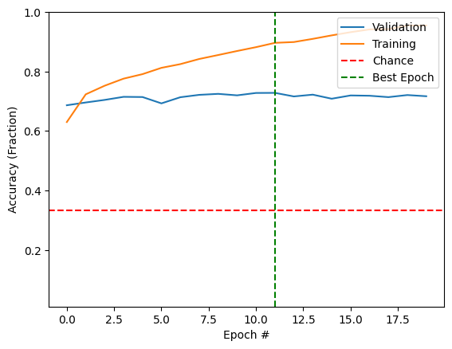
Results - Accuracy and Confusion
70 percent classification accuracy
Confusion: cars vs trucks
Background class was the easiest
Foundation for vision systems

Slide 6
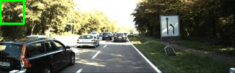
What is a sliding window?
It’s a technique to scan different parts of an image.
Helps find where an object is located.
We break the image into small overlapping windows.
Notes:
Since an image of every object in view is not fed to the model individually, an algorithm analyse the full image must be made. Imagine you’re looking at a big image through a small square, you then slide that square across the entire image, left to right, top to bottom, checking a small section every second. That’s essentially the sliding window, It allows our model to analyse every object in view of the frame that was fed as an input.

Slide 7

Sliding Window Algorithm: Code Breakdown
for y in range(0, new_image.shape[0], step_h):
for x in range(0, new_image.shape[1], step_w):
if y + window_h <= new_image.shape[0] and x + window_w <= new_image.shape[1]:
image_window = new_image[y:y+window_h, x:x+window_w]
windows.append(image_window)
We scan the image in small overlapping windows.
Each window is 32×32 pixels.
Windows are saved to be sent into the model.
Notes:
The following code moves a small 32x32 window across the image, one step at a time using a nested for loop in which the outer loop moves 16 pixels vertically (step_h) and at each iteration, the inner loop repeatedly moves 16 pixels horizontally (step_w). This is done to make sure that every section in the frame is checked. For each position, if the window fits, we extract that patch by indexing the image and storing it in the array: ‘windows’. These patches are what we’ll later use to check for objects.

Slide 8
Results: Perceptron VS CNN
Prediction Results
Perceptron
CNN
Simple neural network
Uses convolutional layers
Layers: Flatten → Dense(128) → Dense(3)
Conv2D → ReLU → Pooling → Dense(128) → Dense(3)
Accuracy on sliding windows: ~73%
Accuracy on sliding windows: ~82%
Notes:
After we generated image windows using the sliding window, we needed a model to classify what’s inside each window, for example: background, car, or other objects.
We started with a simple model called a perceptron, it just flattens the image and passes it through dense layers. This is like trying to understand the image without really “seeing” the structure inside it. The accuracy was around 73%, not bad, but not great.
Then we used a Convolutional Neural Network (CNN). CNNs are designed to understand visual patterns, like edges, textures, and shapes. They do this using convolutional layers, which act like mini filters scanning the image.
Because CNNs learn these patterns and preserve the spatial layout of the image, they performed much better, achieving about 82% accuracy on the same task. That’s a 9% improvement, just by switching to a better model.

Slide 9
The Next Step: Transfer Learning
Our Models
Expert Models
Inexperienced
Limited Training
Roughly knows:
  Cars
  Trucks
  Non Cars/Trucks
Experienced
Extensive Training
Knows:
  Cars
  Trucks
  Thousands of other categories
Notes:
The models we have made so far are very inexperienced. So far, they only know roughly what cars and trucks look like and what aren’t cars and trucks (the background). What if we could use a very experienced model that knew thousands of different categories and was trained on millions of images? Surely with its knowledge, it could help us with our task. In deep learning, the idea of using a model trained on another task as a starting point for your model is known as transfer learning. The model we will use as a starting point is VGG 16.

Slide 10
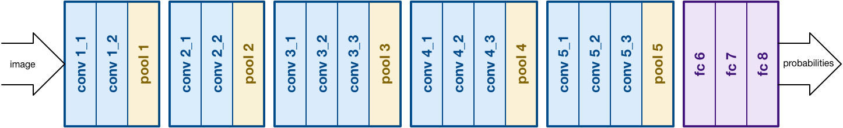
The Expert Model
VGG 16
Categories
Training
Accuracy
20,000+ to distinguish between
14 million images, studied 74 times
95% accurate in distinguishing between our three categories
Notes:
VGG 16 is a model that was built for the famous 'ImageNet' classification problem. The problem included distinguishing between 20,000+ categories using 14 million images for training. VGG 16 studied the images 74 times and was then able to guess something close to the real label better than a human can.
After having it train on our data, it was 95% accurate in distinguish between cars, trucks, and background

Slide 11
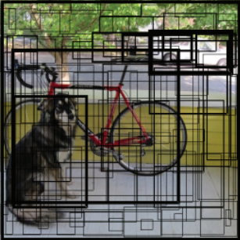
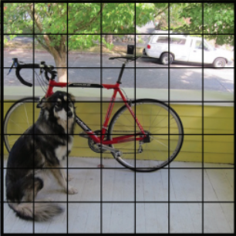
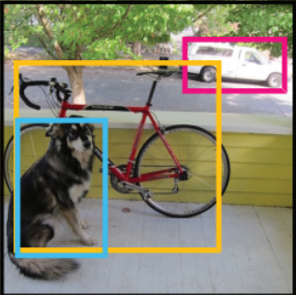
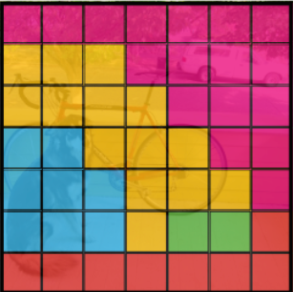
The YOLO Model
STEP 1
STEP 2
STEP 3
N x N grid on input
Bounding Boxes + Confidence
Class Probability Map
Final Detections
Like the sliding window model
Notes:
The “You Only Look Once,” or YOLO, family of models are a series of end-to-end deep learning models designed for fast object detection. The approach involves a single deep convolutional neural network (DarkNet, based on the VGG models) that splits the input into a grid of cells, with each cell directly predicting a bounding box and object classification. The result is a large number of candidate bounding boxes that are consolidated into a final prediction by a post-processing step.

Slide 12
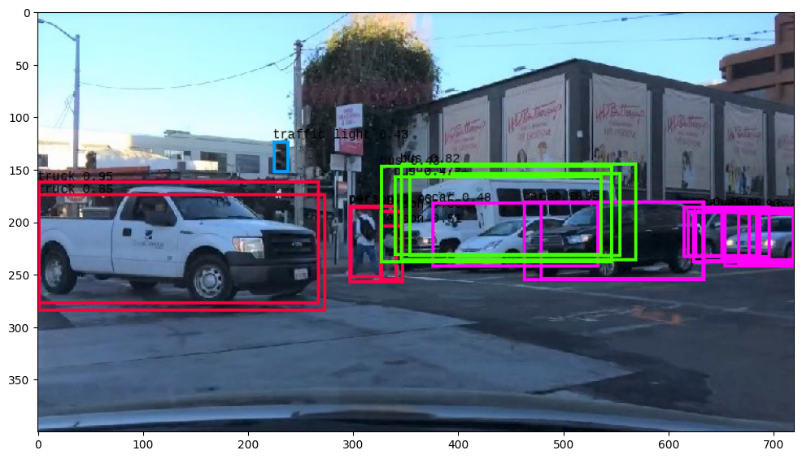
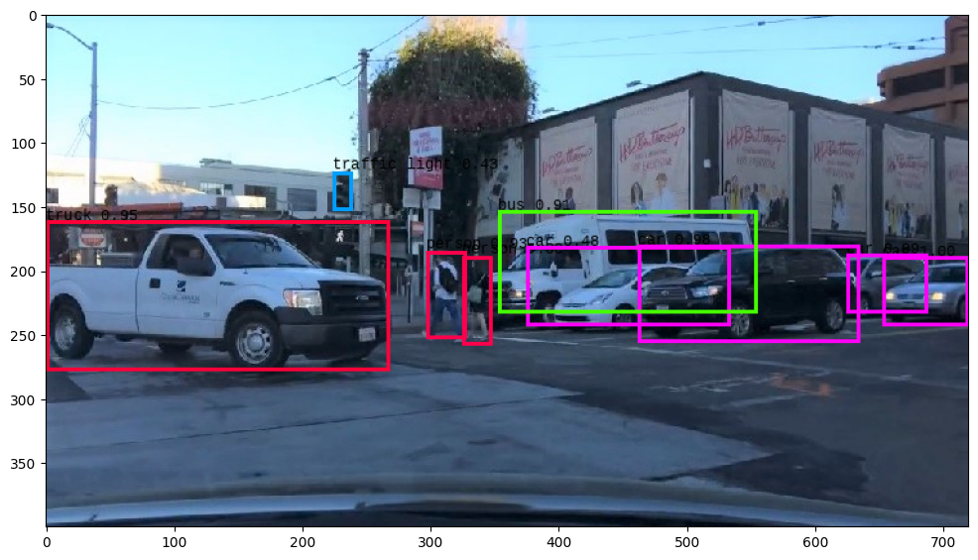
Non-Maximal Suppression
do_nms(boxes, nms_thresh, obj_thresh)
Before After
Step 1
Step 2
Step 3
Threshold added
Overlap threshold
Outcome
This creates limits on how sure a box is for it to actually register as an object (obj_thresh)
If a box overlaps a lot (more than nms_thresh) with another box which is more sure of an object
Both of these help ensure that only real objects are detected, and the same object isn’t detected many times
Notes:
So, using the the sliding window from earlier, we process each of the sections and figure out if it’s an object. We essentially use these three

Slide 13

Now we turn it into a video!
Take the code from before
Run it on each of the frames of a short video
String the frames into a video

Slide 14
Conclusion
Less Successful sections | Successes
Perceptron on CIFAR data - ~70% accuracy. Not ideal. CNN - 83%, better but still high amount of inaccuracy | VGG-16 provided 95% accuracy on data Bounding Box w YOLO was mostly successful Rendered video at the end produced good results
- | -

Slide 15
The End
Thank You For Listening!

