Slide 1
Adapter Pattern
By
Muhammad Abdul-Fattah Nasr

Slide 2

What’s Adapter Design Pattern
Adapter design pattern is one of the structural design pattern and its used so that two unrelated interfaces can work together. The object that joins these unrelated interface is called an Adapter.
One of the great real life example of Adapter design pattern is mobile charger. Mobile battery needs 3 volts to charge but the normal socket produces either 120V (US) or 240V (India). So the mobile charger works as an adapter between mobile charging socket and the wall socket.

Slide 3
Two Way Adapter Pattern
While implementing Adapter pattern, there are two approaches – class adapter and object adapter – however both these approaches produce same result.
Class Adapter – This form uses java inheritance and extends the source interface, in our case Socket class.
Object Adapter – This form uses Java Composition and adapter contains the source object.

Slide 4
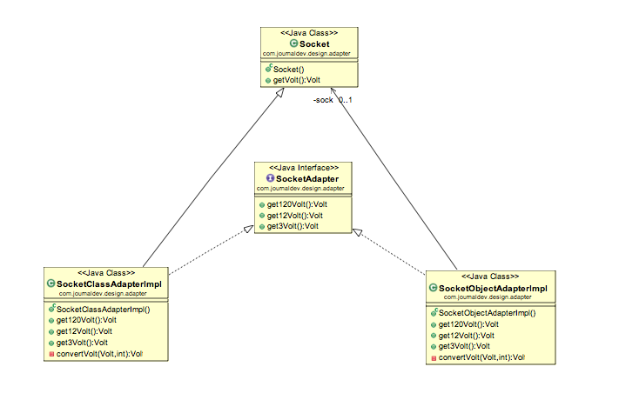
Pattern Example

Slide 5
Drawbacks
All requests are forwarded, so there is a slight increase in the overhead.
Sometimes many adaptations are required along an adapter chain to reach the type which is required.

