Slide 1
Lazy Loading: Proxy Design Pattern
By
Muhammad Abdul-Fattah Nasr

Slide 2

What’s Proxy DP
The Proxy design pattern is one of the twenty-three well-known GoF design patterns that describe how to solve recurring design problems to design flexible and reusable object-oriented software, that is, objects that are easier to implement, change, test, and reuse.

Slide 3
What problems can the Proxy design pattern solve?
The access to an object should be controlled .
Additional functionality should be provided when accessing an object.
When accessing sensitive objects, for example, it should be possible to check that clients have the needed access rights.

Slide 4
What solution does the Proxy design pattern describe?
Define a separate Proxy object that
can be used as substitute for another object (Subject) and
implements additional functionality to control the access to this subject.
This enables to work through a Proxy object to perform additional functionality when accessing a subject. For example, to check the access rights of clients accessing a sensitive object.
To act as substitute for a subject, a proxy must implement the Subject interface. Clients can't tell whether they work with a subject or its proxy.

Slide 5
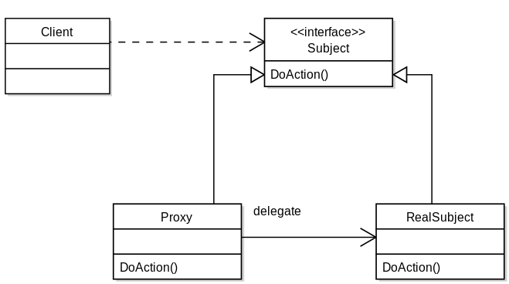
Proxy in UML

Slide 6
Possible Usage Scenarios
Remote Proxy
In distributed object communication, a local object represents a remote object (one that belongs to a different address space). The local object is a proxy for the remote object, and method invocation on the local object results in remote method invocation on the remote object. An example would be an ATM implementation, where the ATM might hold proxy objects for bank information that exists in the remote server.
Virtual Proxy
In place of a complex or heavy object, a skeleton representation may be advantageous in some cases. When an underlying image is huge in size, it may be represented using a virtual proxy object, loading the real object on demand.
Protection Proxy
A protection proxy might be used to control access to a resource based on access rights.

