Slide 1
Observer Design Pattern
By
Muhammad Abdul-Fattah Nasr

Slide 2

What’s Observer Pattern
Observer Pattern is one of the behavioral design pattern. Observer design pattern is useful when you are interested in the state of an object and want to get notified whenever there is any change. In observer pattern, the object that watch on the state of another object are called Observer and the object that is being watched is called Subject.

Slide 3
What’s Observer Pattern
According to GoF, observer design pattern intent is;
“Define a one-to-many dependency between objects so that when one object changes state, all its dependents are notified and updated automatically”
Subject contains a list of observers to notify of any change in it’s state, so it should provide methods using which observers can register and unregister themselves. Subject also contain a method to notify all the observers of any change and either it can send the update while notifying the observer or it can provide another method to get the update.
Observer should have a method to set the object to watch and another method that will be used by Subject to notify them of any updates.

Slide 4
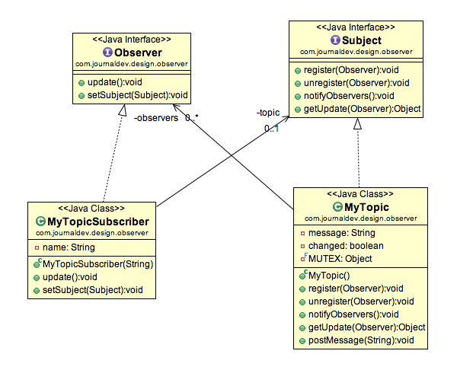
Observer Pattern Example

Slide 5
Drawbacks
It does not prevent clients from accessing the underlying classes
Note that Facade does not add any functionality, it just simplifies interfaces

