Slide 1
EchoCAL: A mobile wireless calibration system for echo sounders.
Presented By:
Joseph M. Godlewski and Michael Ryan
NOAA,NMFS, NEFSC
Ecosystems Survey Branch
Advanced Sampling Technologies

Slide 2
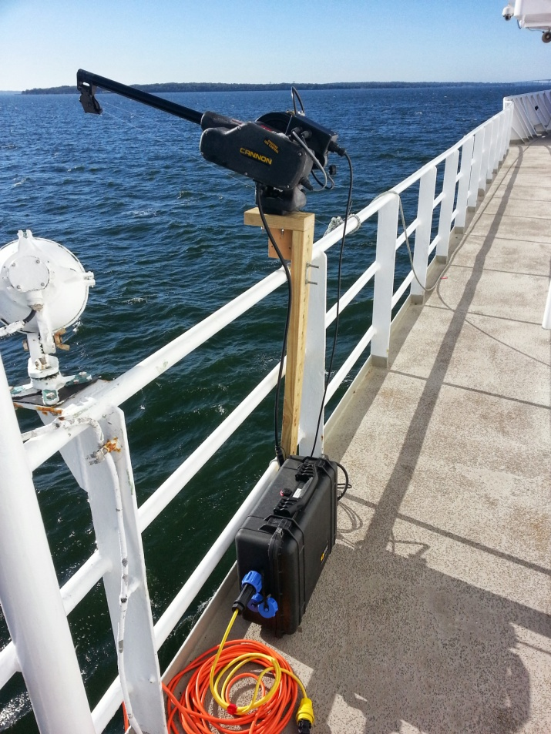
EchoCAL: A mobile wireless calibration system for echo sounders
EchoCAL Hardware:
System Diagram;
Control Box Assembly;
Microcontroller Firmware;
Zigbee Wireless Protocol;
Wireless Base Station.
Wireless Routers.
EchoCAL Software GUI.
Results.

Slide 3
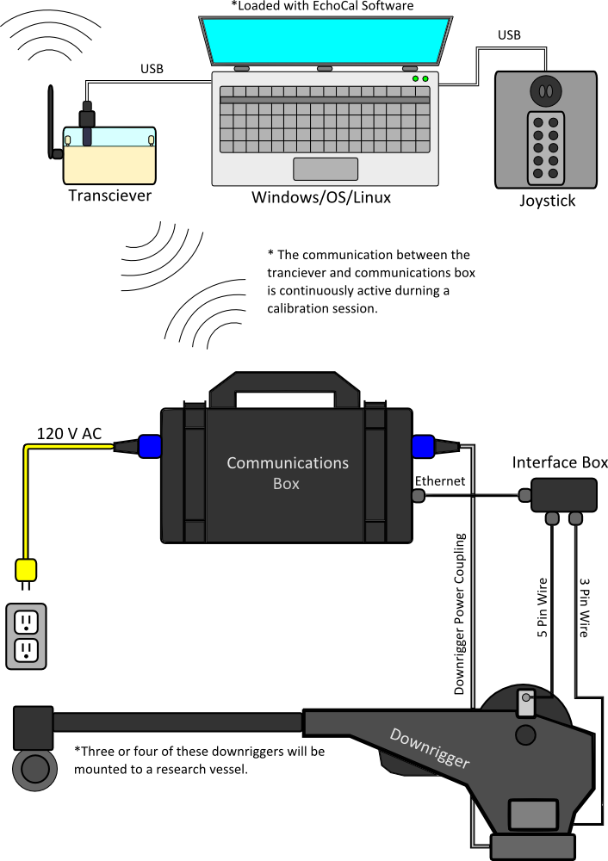
EchoCAL System Diagram:
Notes:
Modifications to Cannon Downrigger:
Added connector to downrigger case to wire control box relays in parallel with switch in downrigger.
Mounted 3PS Inc. Quadrature Encoder to outside of downrigger case.
Two magnets installed on downrigger wheel, each mounted at 180 degrees apart.
(This gives us approximately 6 inches of line movement with every “COUNT” of the encoder.)

Slide 4
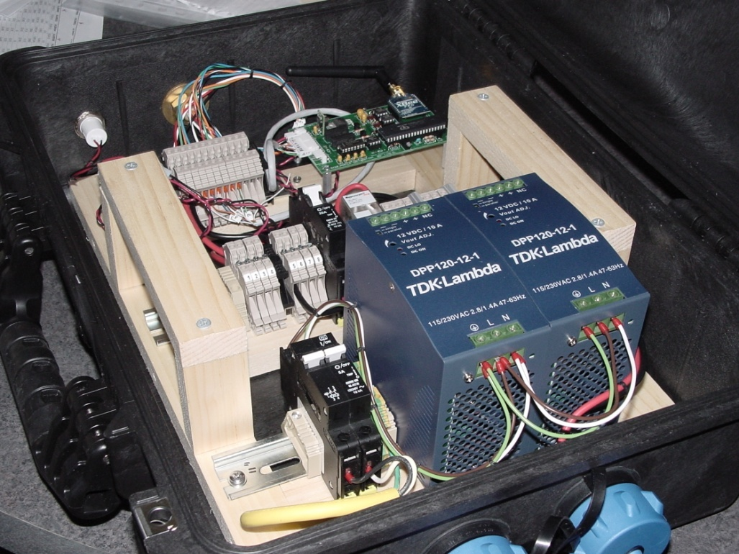
EchoCAL Control Box Assembly:
Control Box consists of the following components:
Two TDK Lambda 12VDC, 10 Amp Power supplies;
One TDK Lambda 12VDC, 830 mA Power supply;
Custom circuit board with Parallax microcontroller and Digi International XBee Pro Wireless Transceiver;
Two power relays for switching between battery and AC power modes.

Slide 5
Parallax Microcontroller Firmware:
Parallax Microcontroller programmed using two languages designed specifically for it:
“Spin” language = High-level object-based,
“Propeller Assembly” = Low-level, highly optimized.
Microcontroller has eight processing cores (Cogs) which act as a hardware threading mechanism. Allows functions to run in parallel. EchoCAL firmware uses three processing Cogs:
One Cog for Main program.
Second Cog for handling data and command I/O with XBee Pro transceiver.
Third Cog for monitoring the Encoder output and determining direction and line length (ie. Counts) that the downrigger has accomplished.

Slide 6
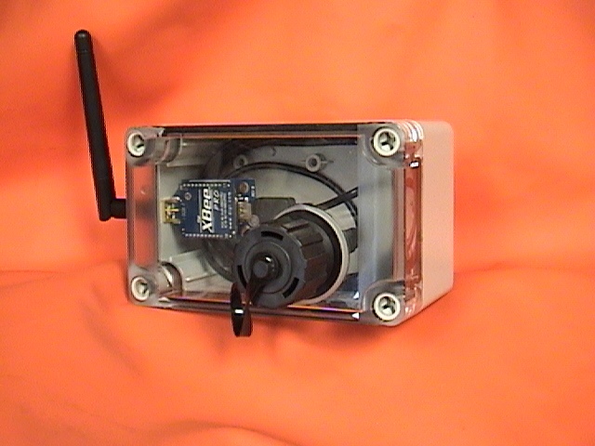
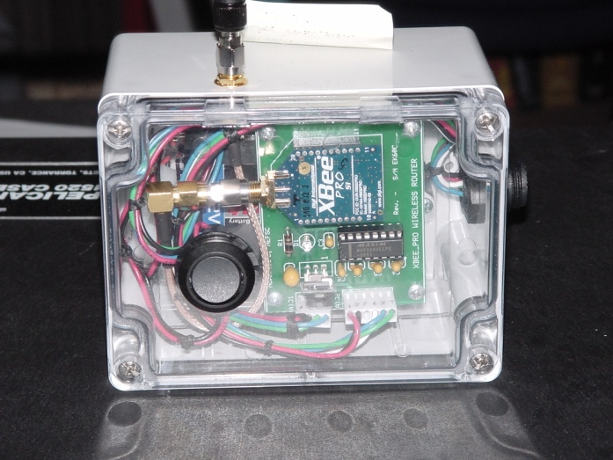
XBee Pro Base Station and Router:
The XBee Pro Base Station consists of the following:
Parallax XBee USB Adapter board;
One Digi Inc. XBee Pro Wireless Transceiver;
Power provided by USB bus in the PC.
The XBee Pro Router hardware:
Powered by a 12 VDC, 2000 mAh battery pack.
Custom PCB which converts 12 VDC to 3.6 VDC for XBee Pro transceiver operation.
Notes:
XBee Pro Base Station:
- Parallax XBee USB adapter board eliminates the need to build a custom circuit board.
- Simply mount XBee Pro transceiver to adapter board and you are in business.
- Power provided through the USB bus.
XBee Pro Router:
- Powered by a 12 VDC 2000 mAh battery pack.
- Custom circuit board that converts 12 VDC to 3.6 VDC for use with the XBee Pro transceiver.
- Board also contains an Analog Devices ADM3202 RS232 transceiver chip to provide RS232 support for upgrading the XBee Pro transceiver.
- We can do away with the custom PCB if we use the same Parallax XBee USB adapter board that was used in the Base Station.

Slide 7
XBee Pro Digimesh Network:
The XBee Pro network is known as a Low Rate Wireless Personal Area Network (LR-WPAN), commonly referred to as a Wireless Sensor Network:
Incorporates an Ad Hoc On-Demand Distance Vector mesh routing;
Self-healing and discovery capable for network stability;
Operates in the 2.4 GHz wireless frequency band;

Slide 8

EchoCAL Software Interface:
EchoCAL Software:
Developed using JAVA NetBeans IDE platform;
Joystick enabled;
Location indicators;
Programmatic sensors,
Hardware safety functions,
Automatic navigation function,
Navigate function (Sphere locator function).

Slide 9
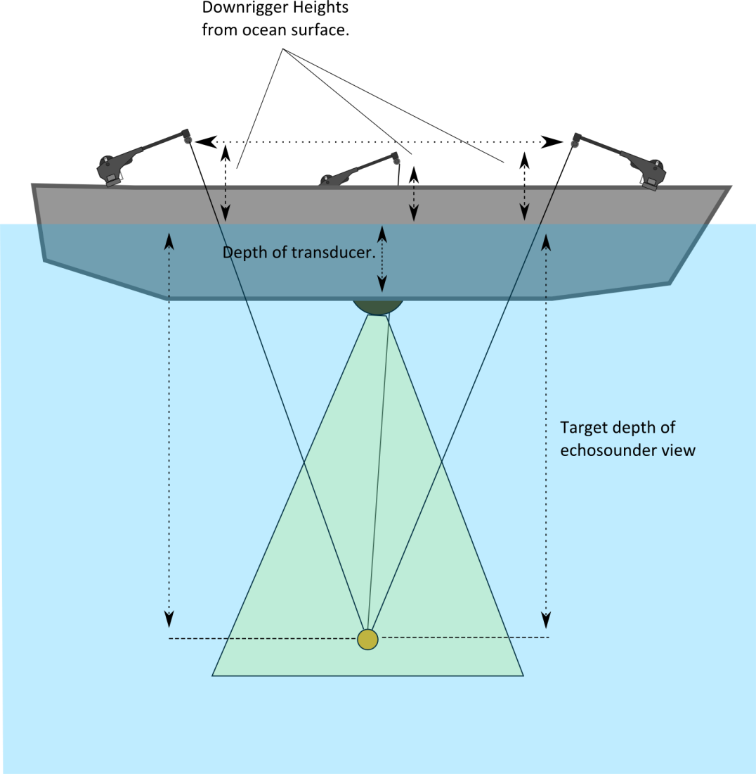
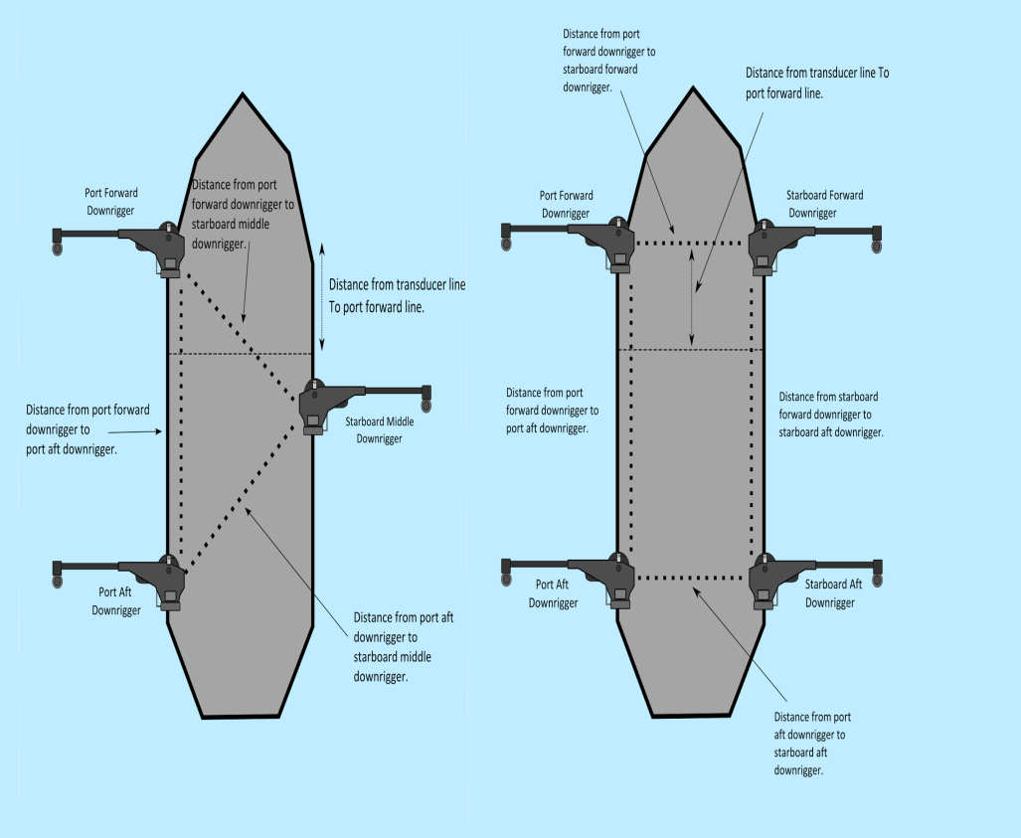
EchoCAL Geometry Manager Inputs:
(Visual Reference)
Measurements are used to build a geometrical reference map which allows the EchoCAL system to perform accurate automated calibration sessions.
Notes:
Vessel Config file is used to provide a general location of the mounted downriggers on the vessel.
Vessel specific measurements are made to determine the location of the downriggers with respect to the onboard echosounder transducers.

Slide 10
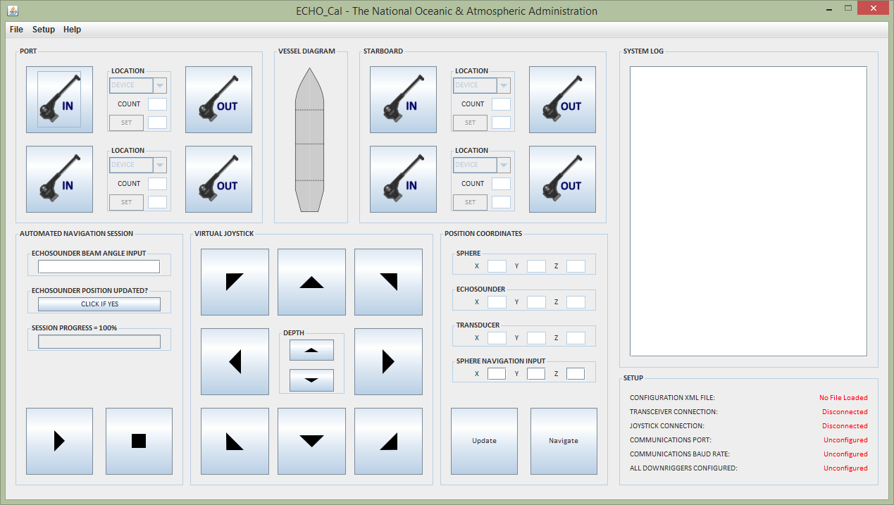
EchoCAL Graphical User Interface:

Slide 11
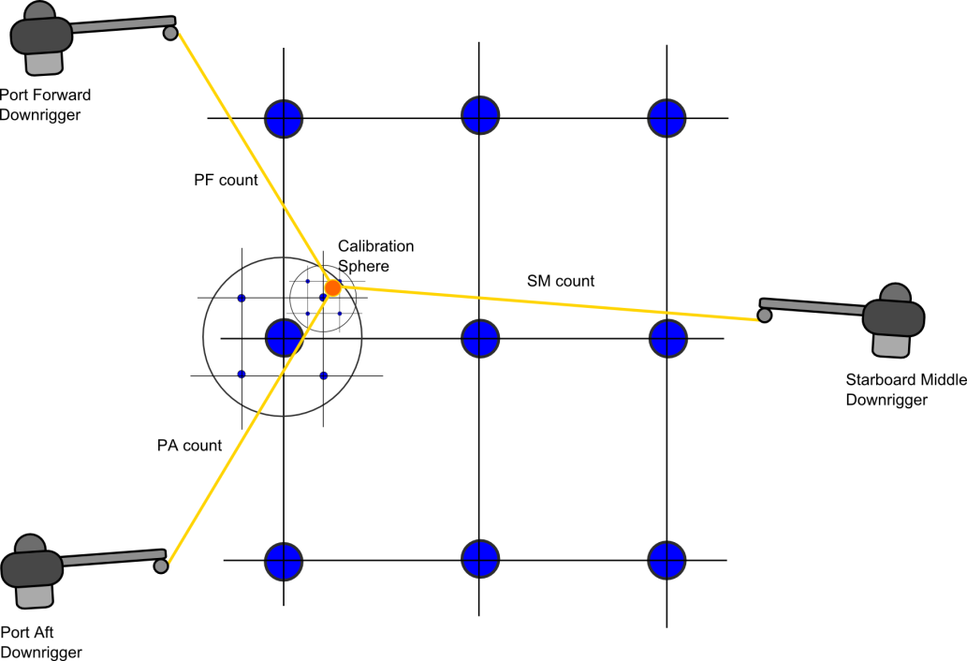
EchoCAL’s True Power:
Coordinate Transformation Algorithms
EchoCAL Software Coordinate Solutions:
Uses a process of coordinate filtering to find the Euclidian position of the calibration sphere.
Runs on a separate thread so that the geometrical information is updated in real time.
Uses the XML configuration file for a geometrical basis.
All inputs and outputs are Euclidian, but all calculations are done in downrigger coordinates.
Notes:
Graphic represents a two dimensional view of a three dimensional space.
Each circle represents a set of coordinates. The software checks which downrigger coord transformation is closest to the systems current downrigger counts, and builds another set of points around it. This method builds an array of coordinates

Slide 12
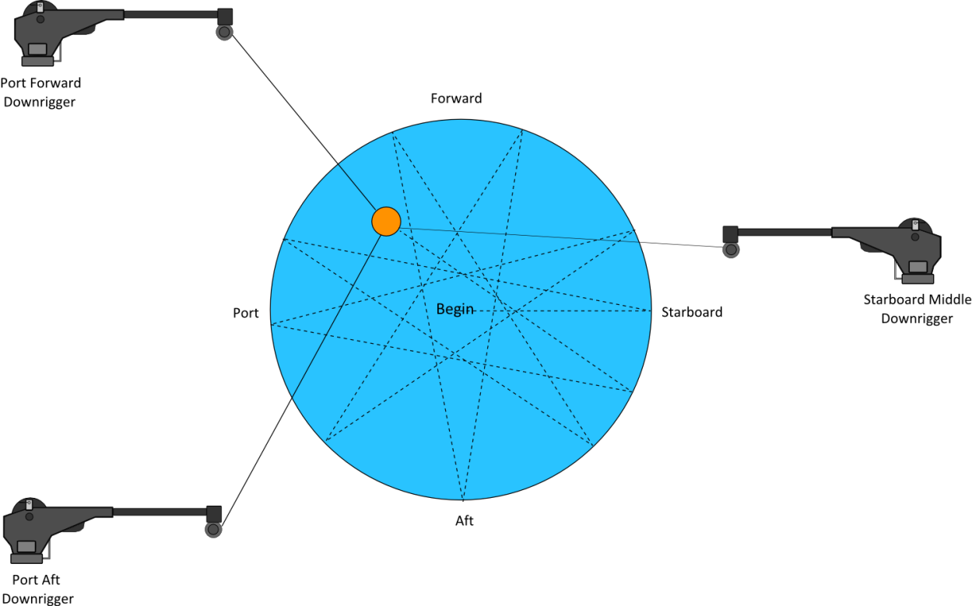
EchoCAL Automated Calibration Session:
EchoCALs Automated Navigation Function:
Automatically moves the sphere through echosounder beam in a “Star” shaped pattern.
Area covered is slightly larger than the beam angle that was input in the GUI.
Reasonable coverage is obtained in the echosounder beam.
An automated session takes approximately 10 minutes to perform, depending on beam angle size.
Notes:
EchoCALs Automated Navigation Function:
Automatically moves the sphere through the echosounder beam in a “Star-shaped” pattern.
- Other patterns are being researched.
The area covered is slightly larger than the beam angle that was input in the GUI.
Reasonable coverage is obtained in the echosounder beam.
An automated session takes approximately 10 minutes to perform, depending on the beam angle size.

Slide 13
EchoCAL Automated Calibration Session:
EchoCALs Time Saving Abilities:
Initially locating the sphere in the echosounder beam can be a difficult task. (Especially when surface winds, or ocean currents are high.) Use of both the “Navigation” and “Auto-navigation” functions allow the operator to easily position the sphere in the echosounder’s beam.
Echosounder position updates; (Allows higher order corrections to geometry if system generated values are wrong).
Automated calibration sessions: Enjoy a coffee rather than standing out in the rain!
Notes:
Time Saving Abilities:
- Initially finding the sphere in the echosounder beam can be a difficult task. (Especially when surface winds, or ocean currents are high.)
The “Navigation” and “Auto-navigation” functions of the EchoCAL software allow the operator to easily position the sphere in the echosounder’s
beam. The Navigation function will get the sphere to the proper depth, and in the vicinity of the echosounder’s beam. If the sphere is not seen
at this point, the operator can perform an initial “Auto-navigation” session with a larger than normal beam angle, and once the sphere appears
in the beam, the operator can stop the “Auto-navigation” session, and position the sphere using the joystick controls.
- Software allows the operator to update the position of the sphere in the center of a beam. This allows operator to reposition the sphere automatically in
the beam should the sphere somehow get lost during calibrations.

Slide 14

Hardware Safety Functions:
EchoCAL Hardware Safety Functions:
Built-in tension sensor function to keep lines from breaking.
Built-in communication loss warning message.
Automatic system halting functions. (Pauses system when mechanical or communication failures occur).
Built-In real-time System Log for general information and system status.

Slide 15
EchoCAL System Results:
The EchoCAL echosounder calibration system has been used successfully on three NOAA vessels to date:
NOAA Ship Okeanos Explorer (April 2013),
NOAA Ship Gordon Gunter (April 2014),
NOAA Ship Henry Bigelow (September 2013, April 2014).
Extending the wireless signal outside the vessels proved to be easier than expected. (Only three routers required for the above vessels.)

Slide 16
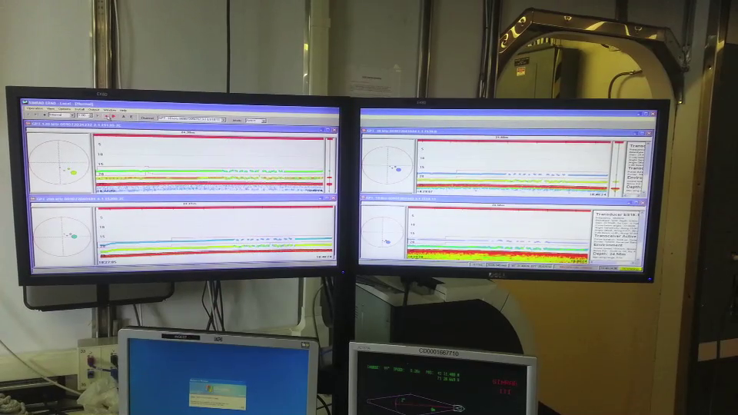
EchoCAL System Results:

Slide 17
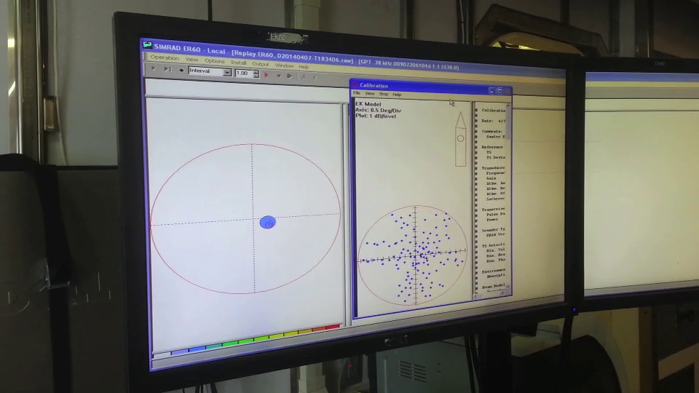
EchoCAL System Results:

Slide 18
Questions?

