Slide 1
Collection Framework ArrayList Class
momedaram

Slide 2
ArrayList is like an array, which can grow in memory dynamically.
The underlying data structure is growable array.
Allows duplicate objects
Elements will be stored according to the insertion order
Allows Heterogeneous objects
Null insertion is possible

Slide 3
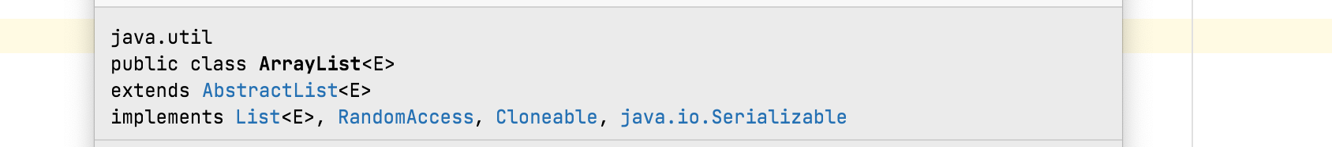
we use collection to store and transfer objects from one tier to another tier. To support this every Collection class internally implements Serializable and Cloneable interfaces.
ArrayList implements RandomAccess interface so that any random element we can access with the same speed.
[ java.util.RandomAccess is a marker interface]

Slide 4
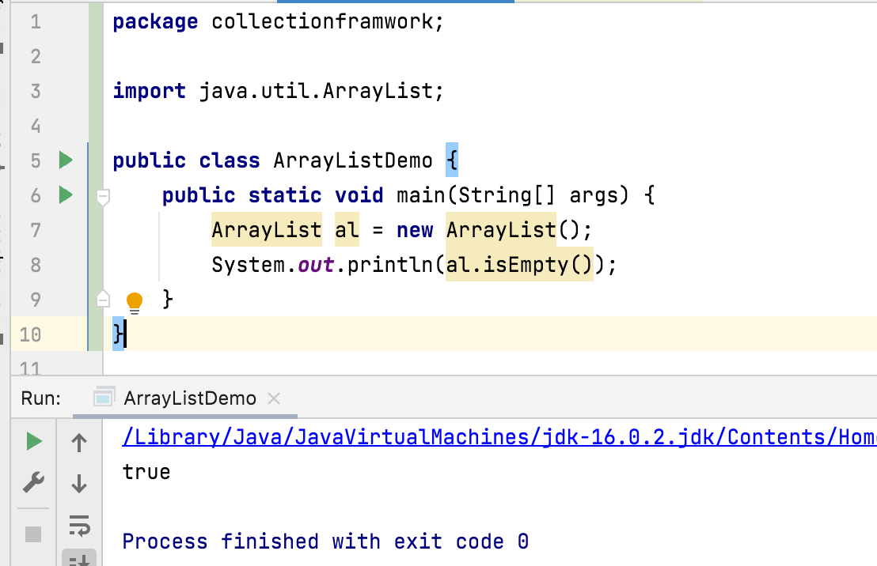
ArrayList Constructor Detail
Constructors of ArrayList, provides many ways to create the ArrayList objects.
1. ArrayList al = new ArrayList();
Constructs an empty list with an initial capacity of ten.

Slide 5





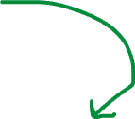











Once the ArrayList object reaches it max capacity , a new ArrayList Object will be created with new capacity of (Current Capacity * 3/2) +1 and objects will be shifted to newly created ArrayList object and so on.
A B C D E F G H I J
al
A
B
C
D
E
F
G
H
I
J
K

Slide 6
2. ArrayList al = new ArrayList(initialCapacity: 100);
Constructs an empty list with the specified initial capacity.
3. ArrayList al = new ArrayList(Collection<? extends E> c)
Constructs a list containing the elements of the specified collection

Slide 7
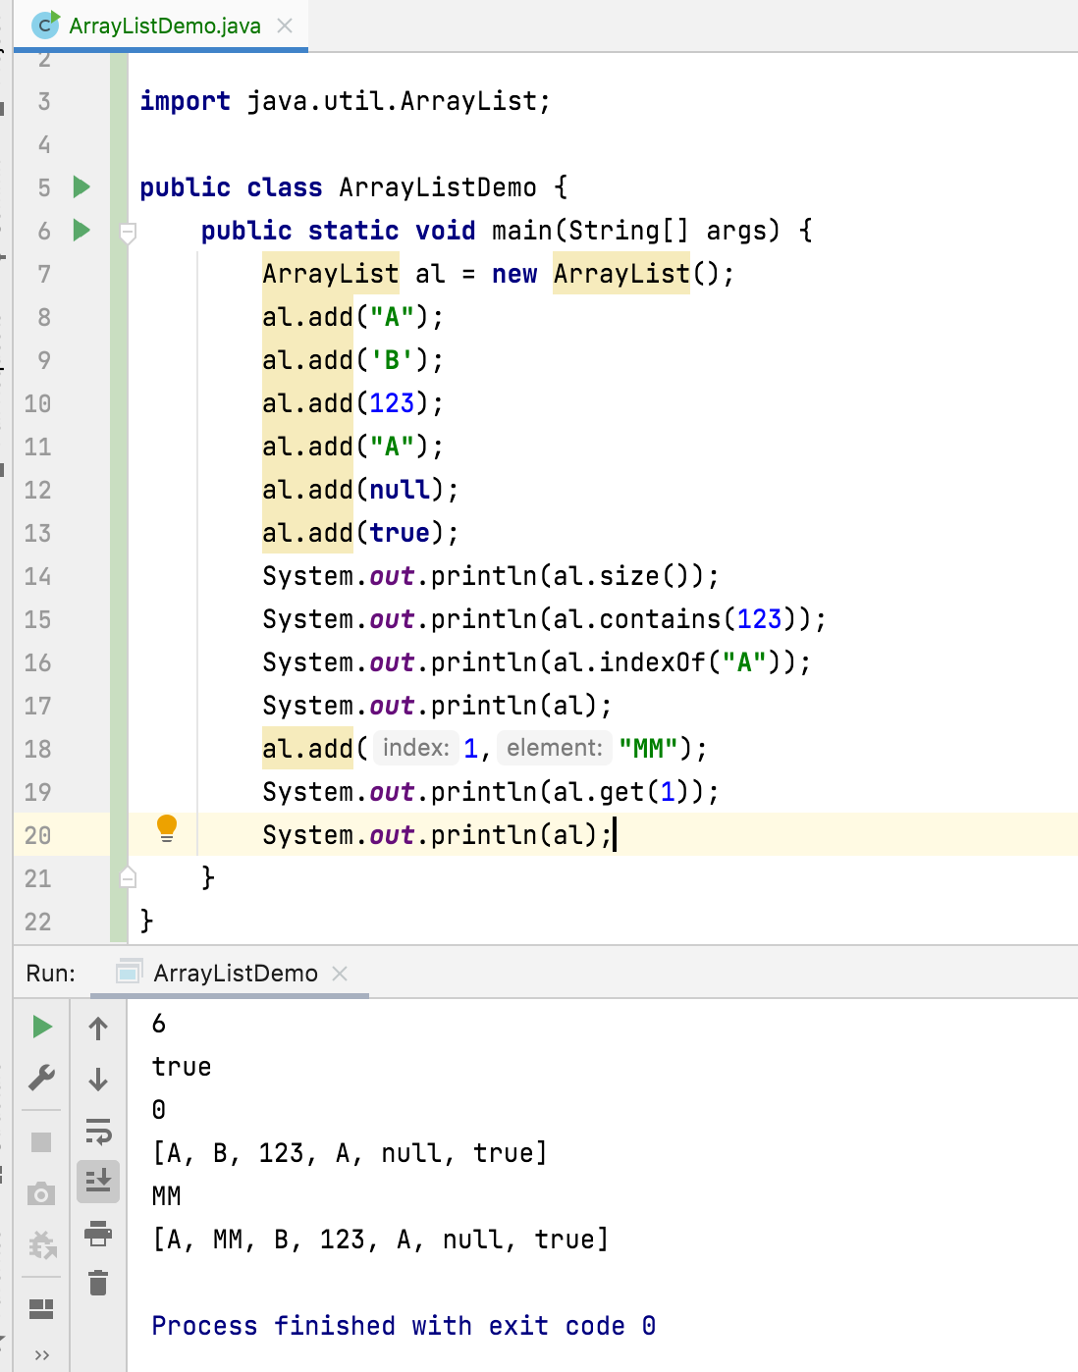
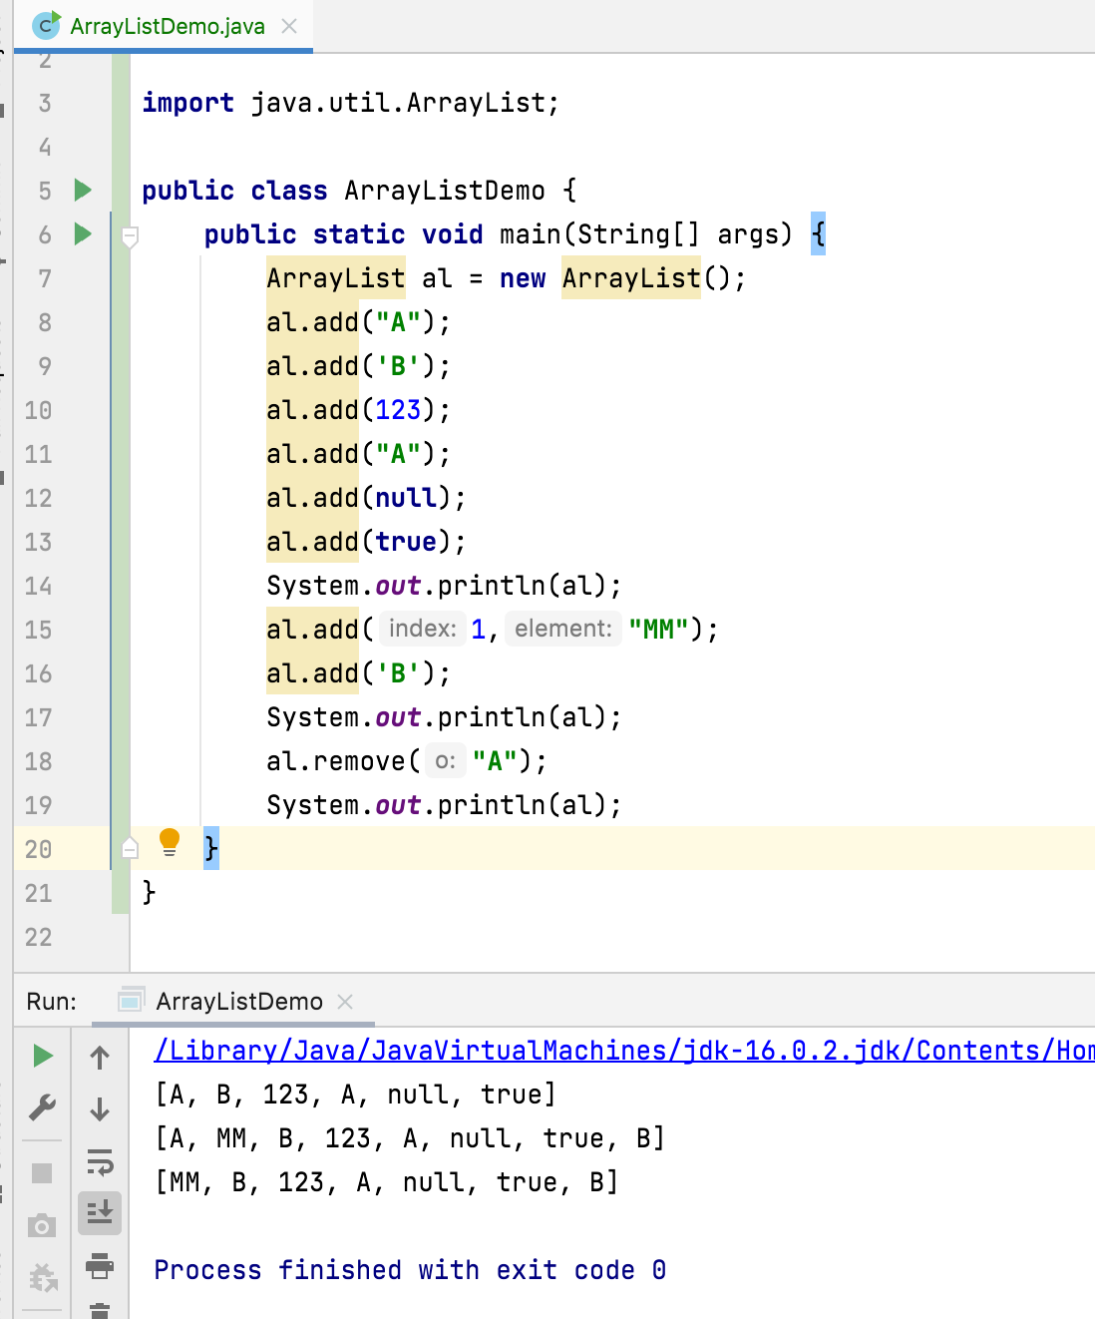

Slide 8
add() – takes O(1) time;
worst-case scenario, when a new array has to be created and all the elements copied to it, it's O(n)
add(index, element) – on average O(n) time
remove() – O(n) time.
We have to iterate the entire array to find the element qualifying for removal and elements need to shift to left hand side.
indexOf() – O(n) time.
It iterates through the internal array and checks each element one by one, so the time complexity for this operation always requires O(n) time.
contains() – implementation is based on indexOf(), so it'll also run in O(n) time.
get() – O(1) time

Slide 9
Thank You !
momedaram

