Slide 1
Collection Framework HashMap
momedaram

Slide 2
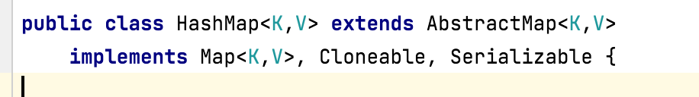

HashMap:
Is a popular implementation of Map interface which holds the data as key-value pairs.
HashMap Is Hashtable based implementation of the Map interface.
Doesn’t allow duplicate keys. But it can have duplicate values.
Can have multiple null values and only one null key.
Heterogeneous objects are allowed for both key and value.
Maintains no order. Elements will be ordered according to hash code of keys.
Map (I)
HashMap ( C )

Slide 3
HashMap Constructor Detail
Constructors of HashMap, provides many ways to create the HashMap objects.
1. HashMap h = new HashMap();
Constructs an empty HashMap with the default initial capacity (16) and the default load factor (0.75).
2. HashMap h = new HashMap (int initialCapacity);
Constructs an empty HashMap with the specified initial capacity and the default load factor (0.75).
3. HashMap h = HashMap (int initialCapacity, float loadFactor) ;
Constructs an empty HashMap with the specified initial capacity and load factor.
4. HashMap h = new HashMap (Map m);
Constructs a new HashMap with the same mappings as the specified Map. The HashMap is created with default load factor (0.75) and an initial capacity sufficient to hold the mappings in the specified Map.

Slide 4
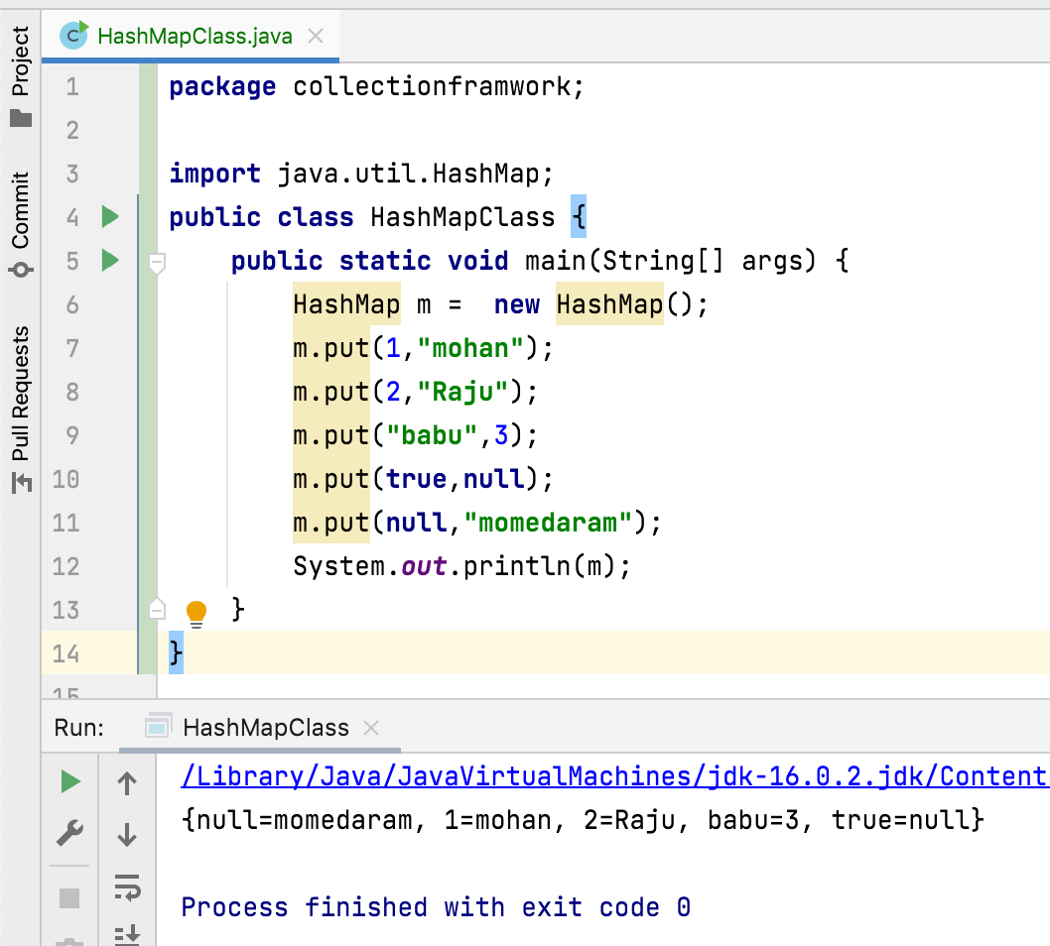

Slide 5
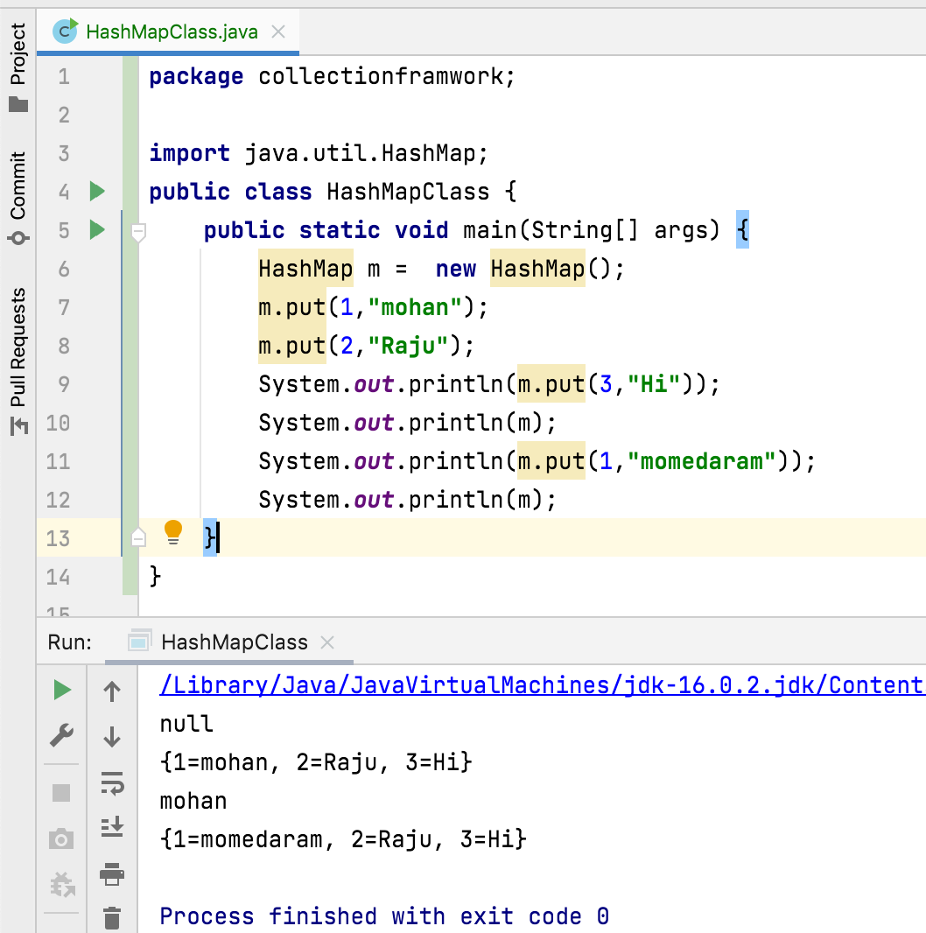
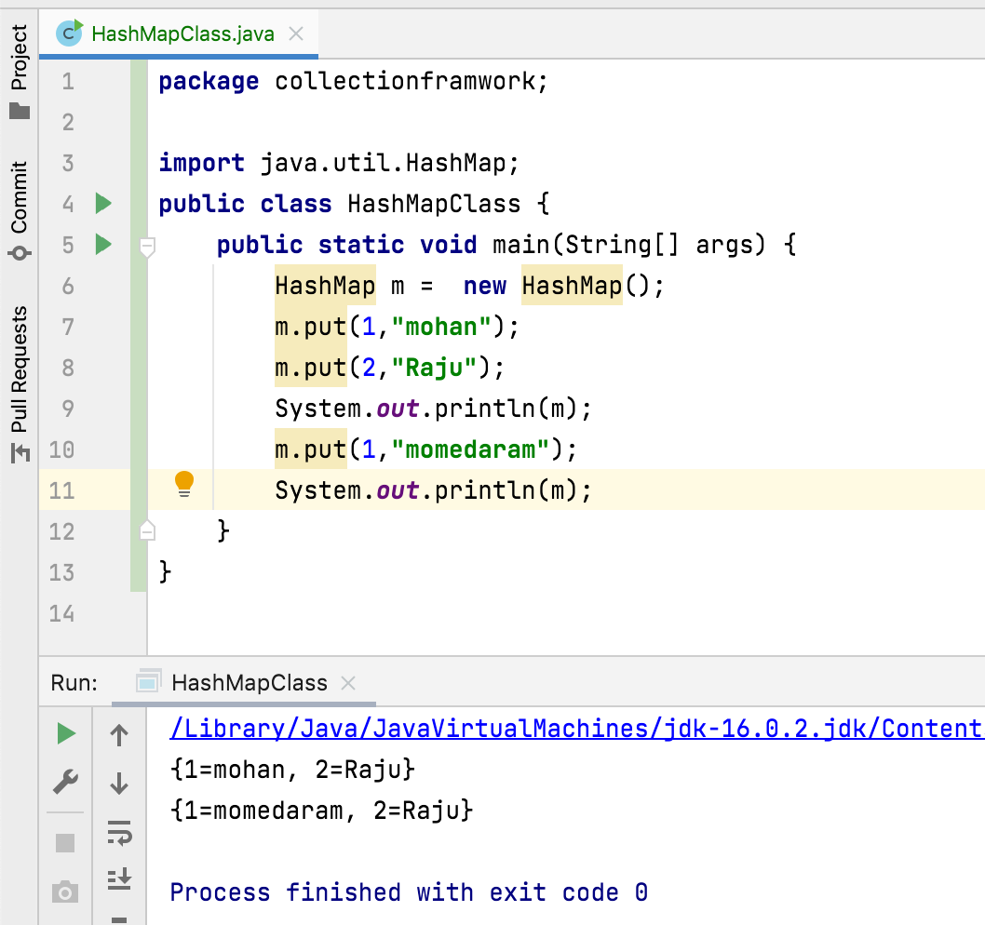

Slide 6
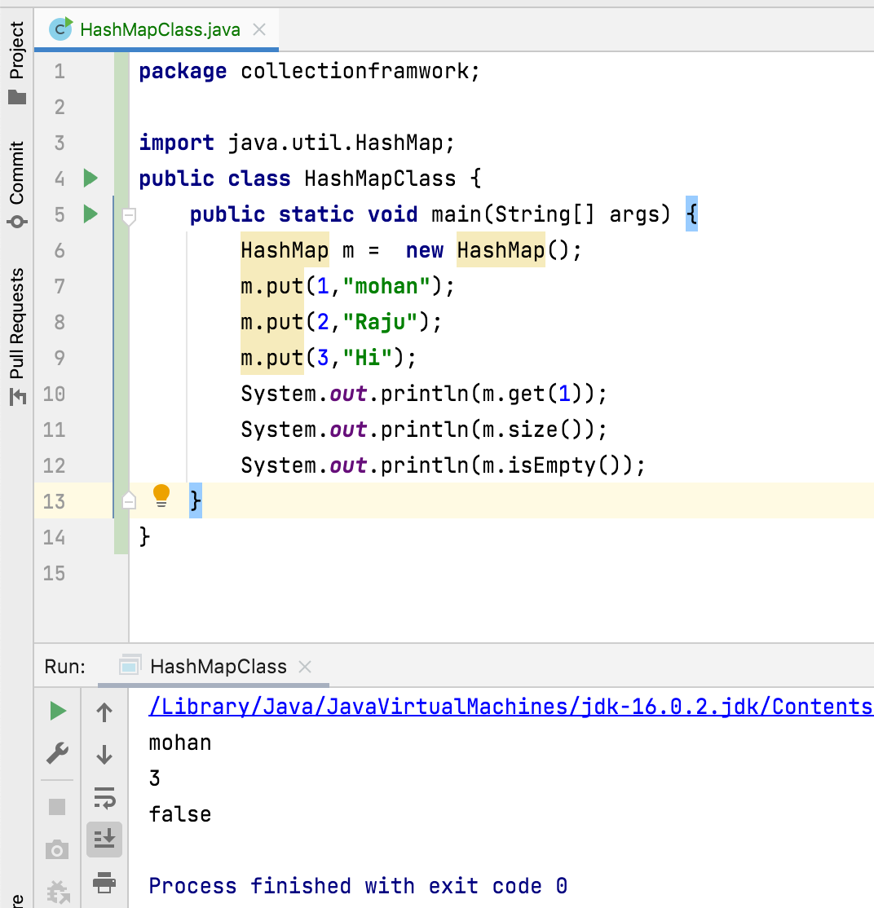
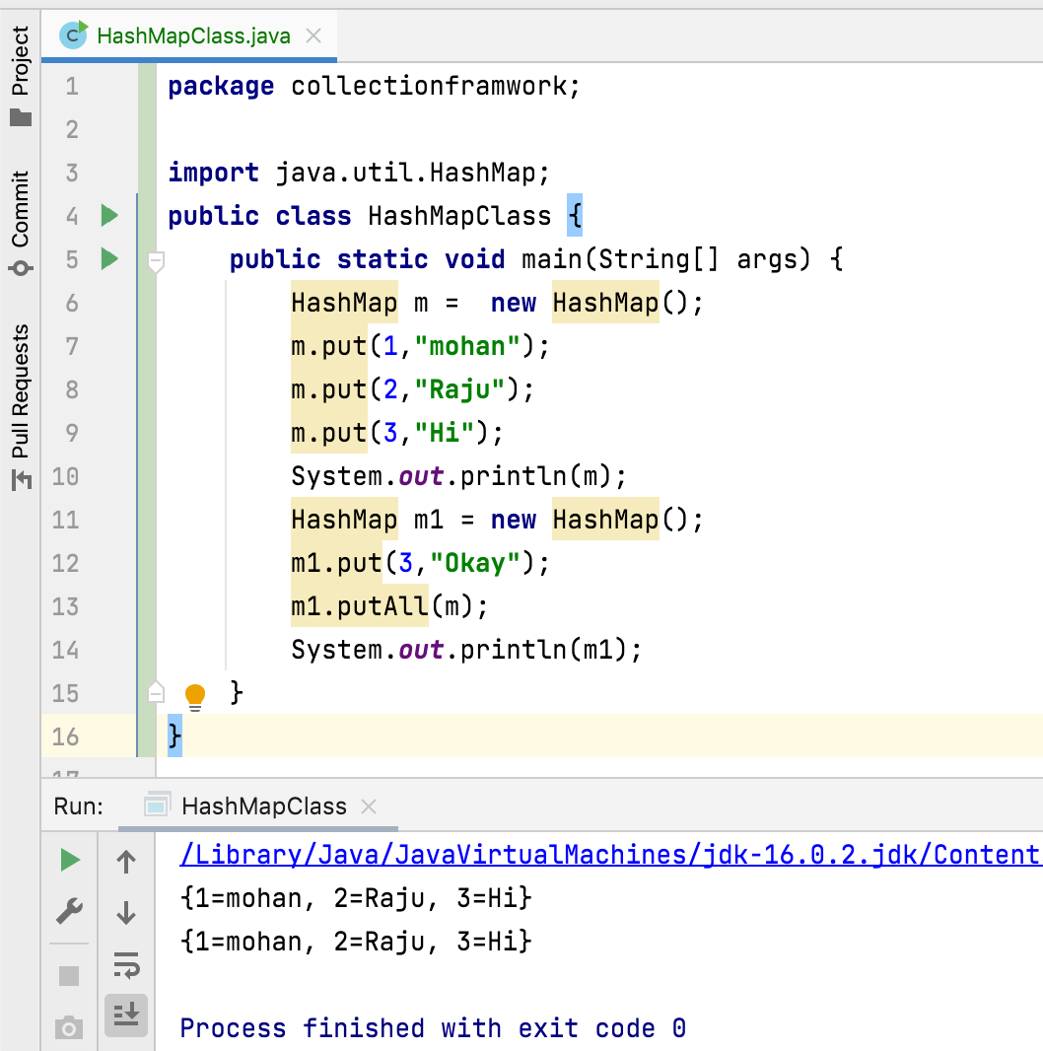

Slide 7
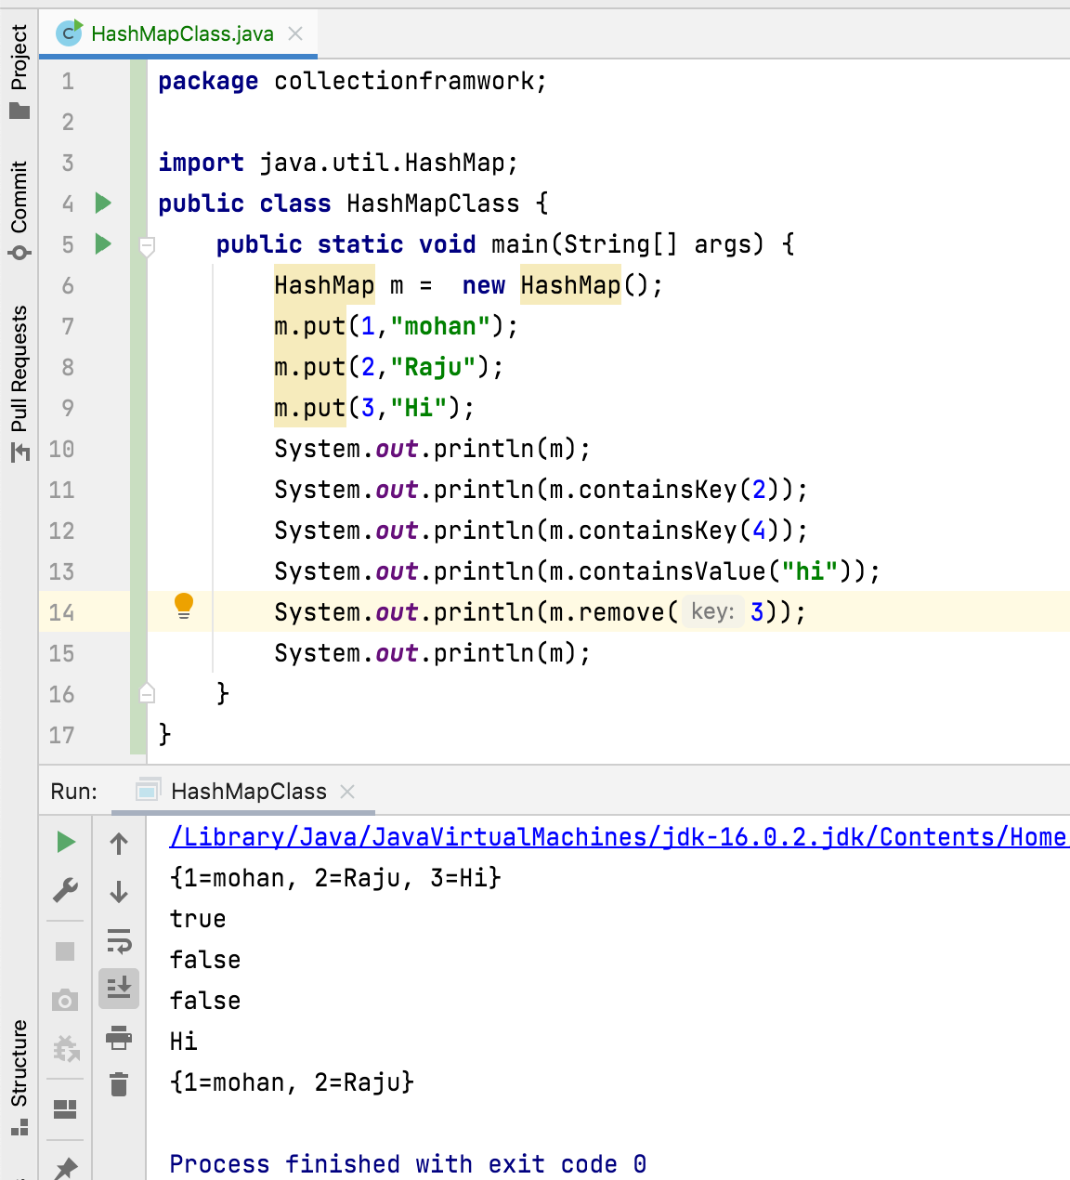

Slide 8
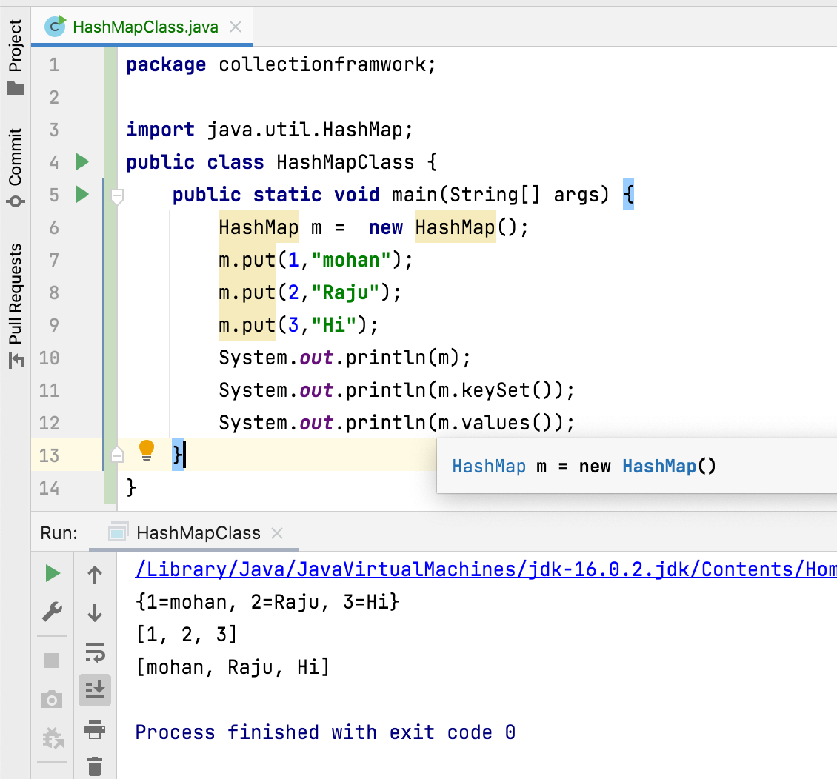

Slide 9
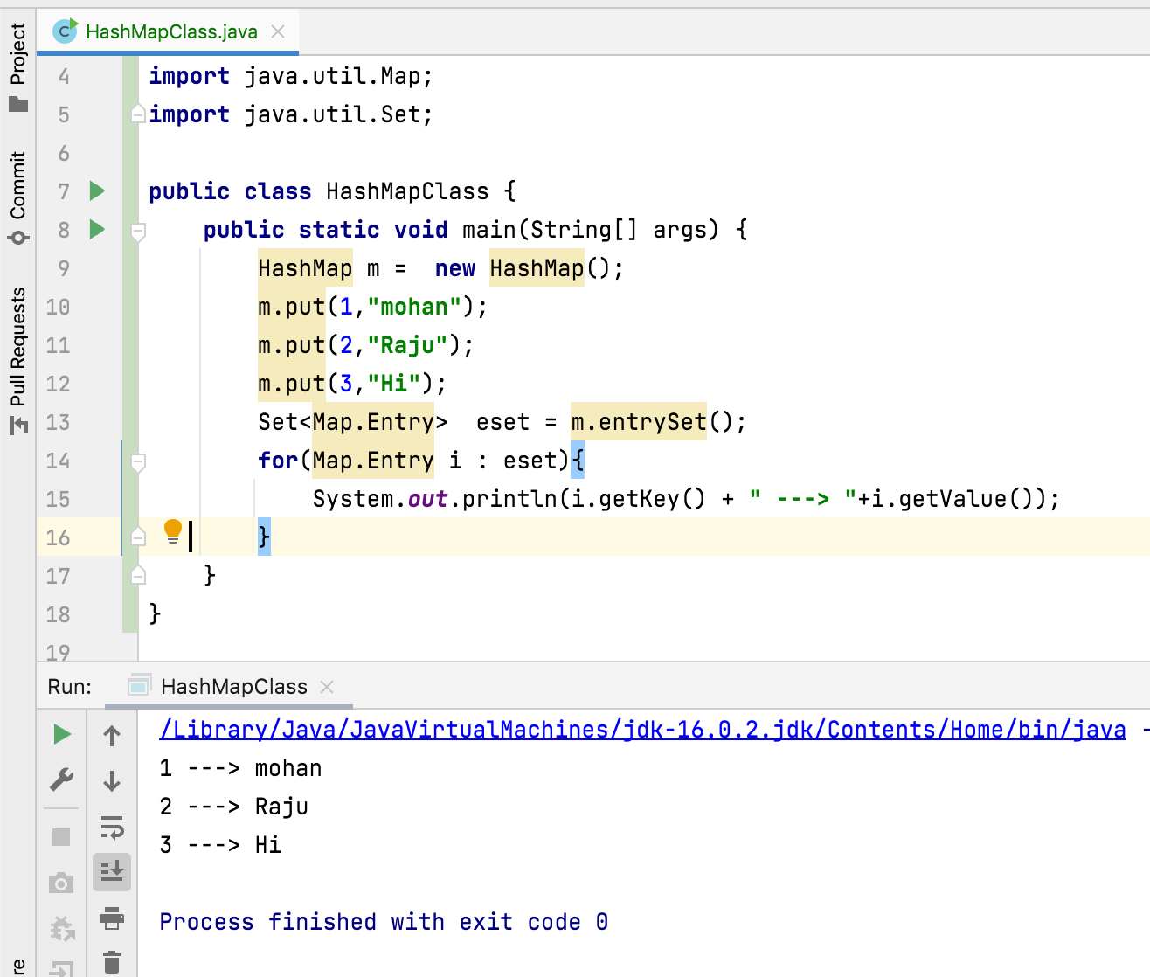

Slide 10
Thank You !
momedaram

