Slide 1
Collection Framework HashSet
momedaram

Slide 2
HashSet represents a set of elements (objects).
The Implemented data structure for HashSet is HashTable.
Duplicate elements are not allowed , if you try to add , the add() will return false.
Elements will be inserted according to the hash code of the elements.
Allows Heterogeneous objects
‘null’ insertion is possible(Allows only One ‘null’)

Slide 3
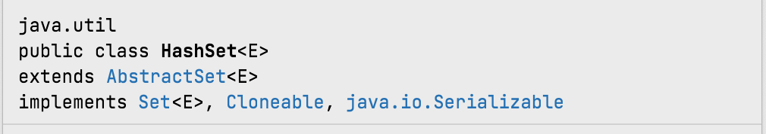
HashSet class internally implements Serializable and Cloneable interfaces.

Slide 4
HashSet Constructor Detail
Constructors of HashSet, provides many ways to create the HashSet objects.
1. HashSet h = new HashSet();
Creates an empty HashSet object with default initial capacity (16) and default load factor (0.75).
2. HashSet h = new HashSet(int initialCapacity);
Creates an empty HashSet object with specified initial capacity and default load factor (0.75).

Slide 5

















Once the ArrayList object reaches it max capacity , a new ArrayList Object will be created with new capacity of (Current Capacity * 3/2) +1 and objects will be shifted to newly created ArrayList object and so on.
A B C D E F G H I J
al
A
B
C
D
E
F
G
H
I
J
K

Slide 6
HashSet Constructor Detail
HashSet h = HashSet(int initialCapacity, float loadFactor) ;
Creates an empty HashSet object with specified initial capacity and specified load factor.
4. HashSet h = new HashSet(Collection c);
Creates a new set containing the elements in the specified collection with default load factor (0.75) and an initial capacity sufficient to contain the elements in the specified collection.

Slide 7
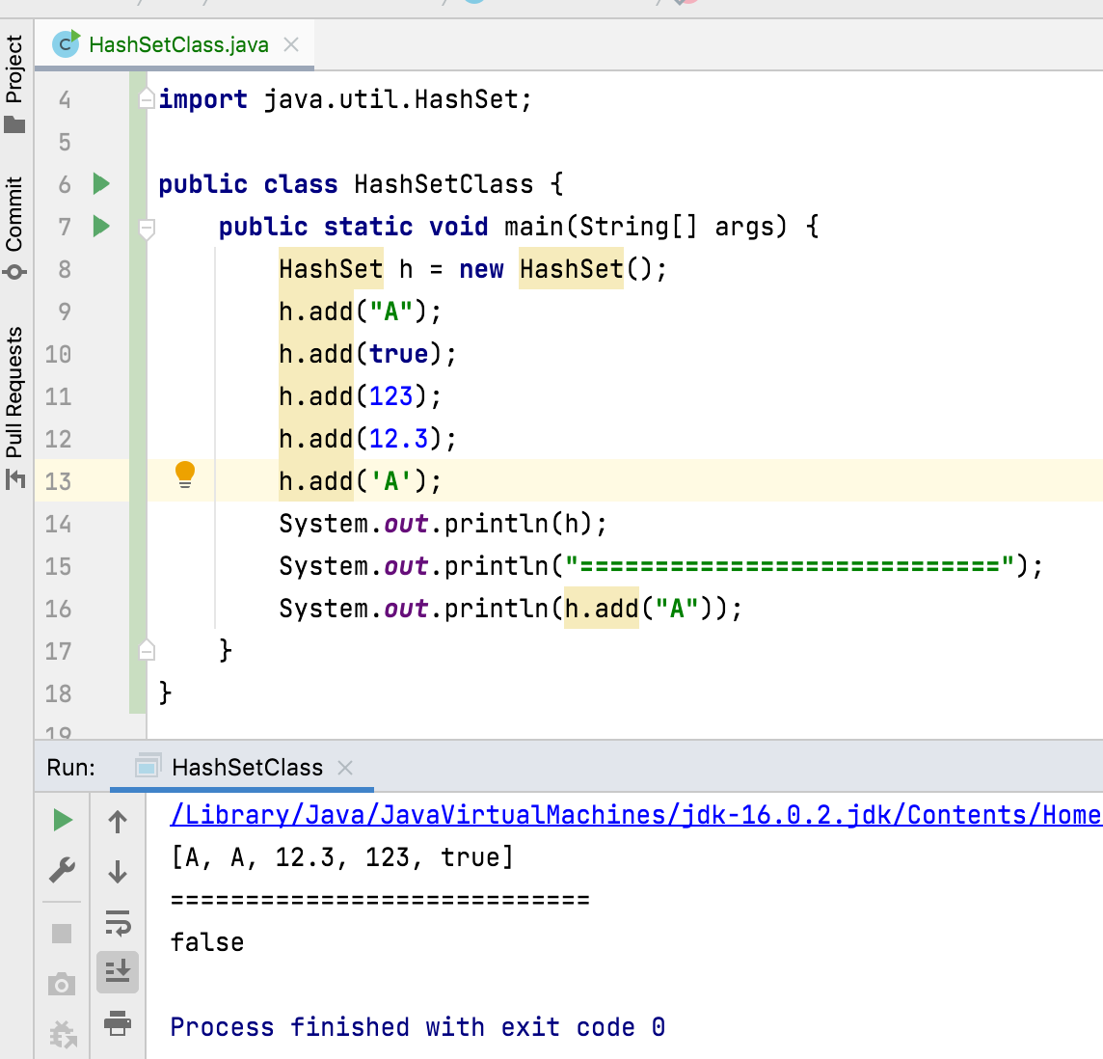
Time complexity of add(), remove() and contains() operations cost constant O(1) time.

Slide 8
Thank You !
momedaram

