Slide 1
Collection Framework LinkedHashSet
momedaram

Slide 2
The LinkedHashSet is an ordered version of HashSet.
LinkedHashSet is child class of HashSet.
The Implemented data structure for LinkedHashSet is HashTable + Doubly Linked List.
LinkedHashSet introduced in 1.4V
Duplicate elements are not allowed , if you try to add , the add() will return false.
Elements will be ordered according to insertion Order.
Allows Heterogeneous objects
‘null’ insertion is possible(Allows only One ‘null’)

Slide 3
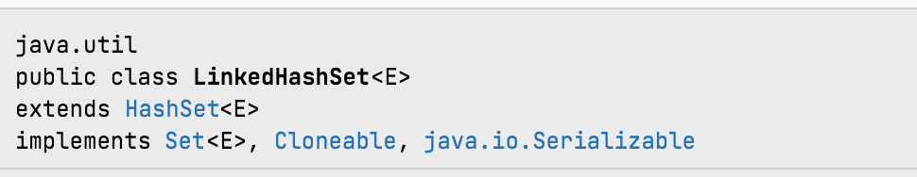
LinkedHashSet class internally implements Serializable and Cloneable interfaces.

Slide 4
LinkedHashSet Constructor Detail
Constructors of LinkedHashSet, provides many ways to create the LinkedHashSet objects.
1. LinkedHashSet h = new LinkedHashSet ();
Creates an empty LinkedHashSet object with default initial capacity (16) and default load factor (0.75).
2. LinkedHashSet h = new LinkedHashSet(int initialCapacity);
Creates an empty LinkedHashSet object with specified initial capacity and default load factor (0.75).

Slide 5
LinkedHashSet Constructor Detail
LinkedHashSet h = new LinkedHashSet(int initialCapacity, float loadFactor) ;
Creates an empty LinkedHashSet object with specified initial capacity and specified load factor.
4. LinkedHashSet h = new LinkedHashSet(Collection c);
Creates a new set containing the elements in the specified collection with default load factor (0.75) and an initial capacity sufficient to contain the elements in the specified collection.

Slide 6
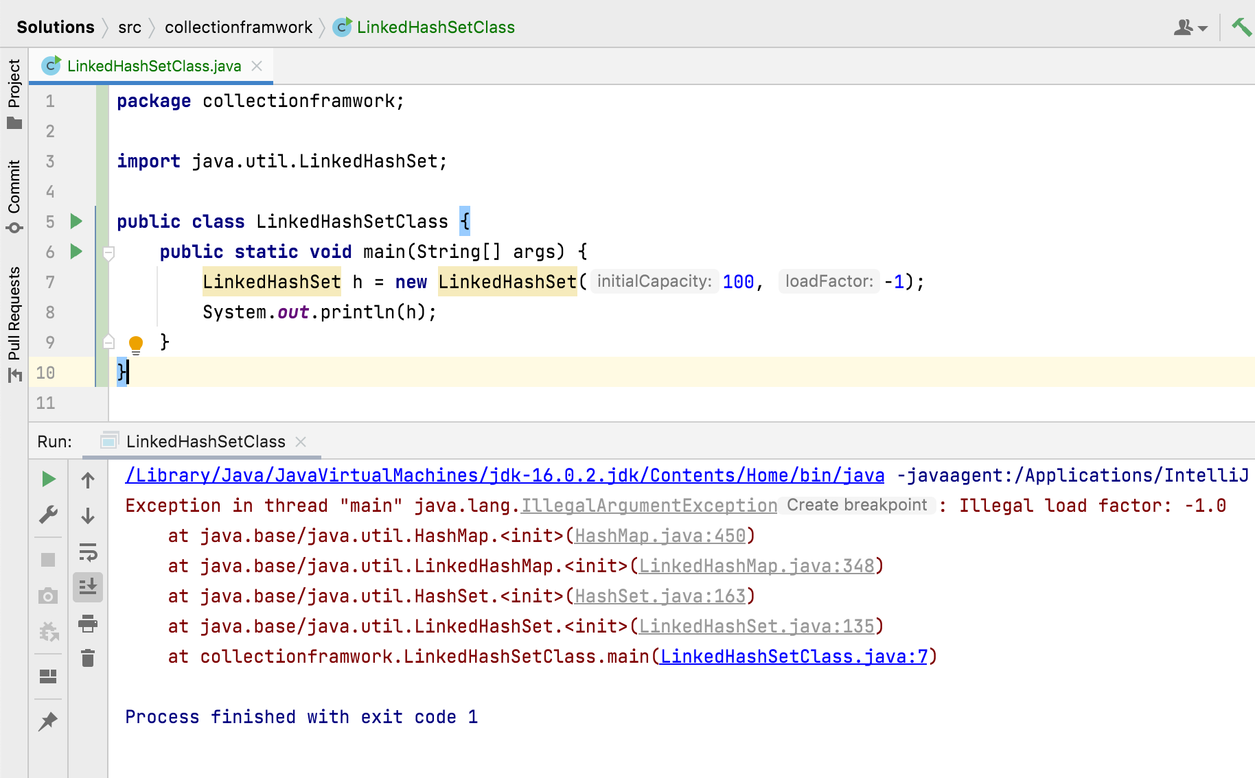

Slide 7
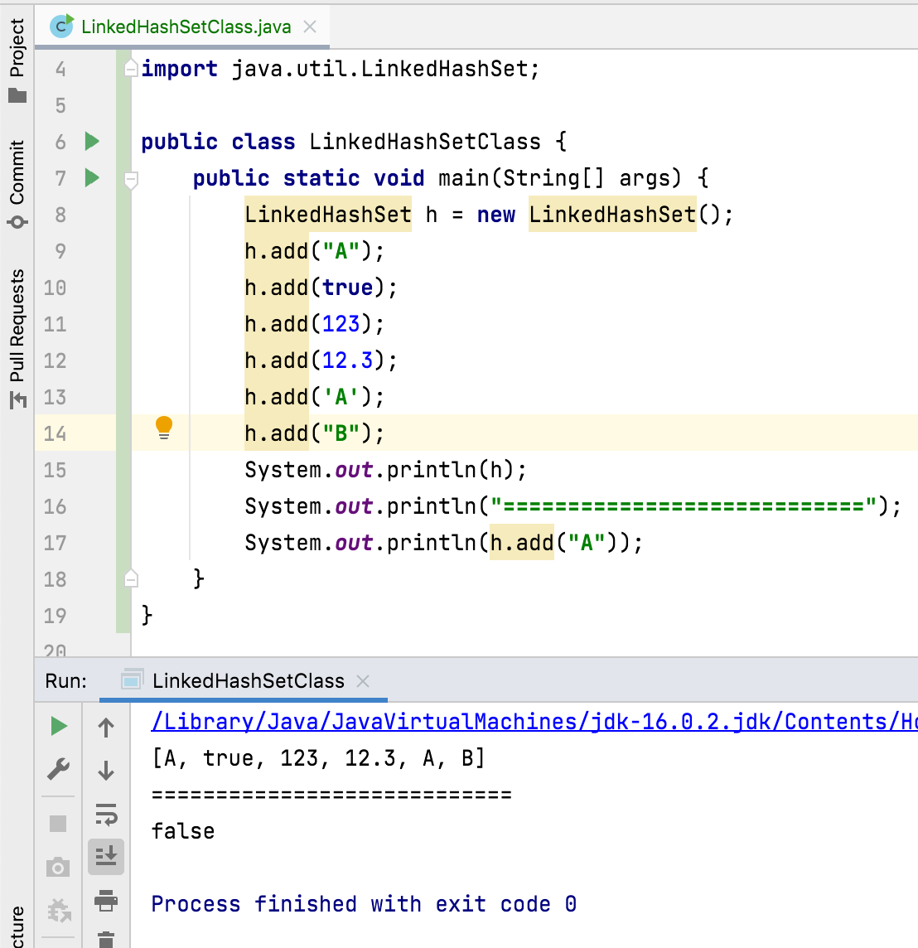
Time complexity of add(), remove() and contains() operations cost constant O(1) time.
Cache Based Applications

Slide 8
Thank You !
momedaram

