Slide 1
Collection Framework LinkedList Class
momedaram

Slide 2

LinkedList class is implementation class for List interface.
Iterable
Collection
List
LinkedList
Vector
ArrayList

Slide 3






The LinkedList class in Java is an implementation of doubly linked list.
In general terms, LinkedList is a data structure where each element consist of three things.
First one is the reference to previous element, second one is the actual value of the element last one is the reference to next element.
A LinkedList class contains a group of elements in the form of nodes.
data
data
data

Slide 4
Allows duplicate objects
insertion order is preserved
Allows Heterogeneous objects
Null insertion is possible

Slide 5
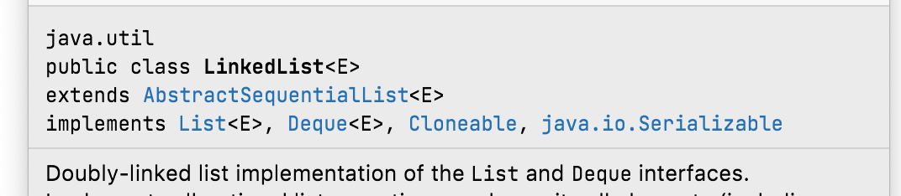
LinkedList class implements Serializable and Cloneable interfaces but not RandomAccess interface.

Slide 6
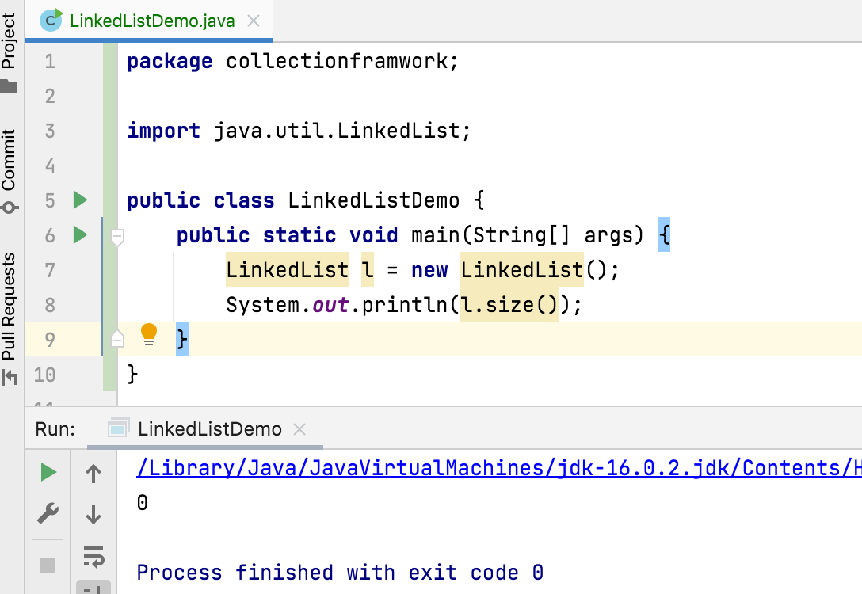
LinkedList Constructor Detail
Constructors of LinkedList class, provides many ways to create the LinkedList objects.
1. LinkedList l = new LinkedList();
Constructs an empty list.

Slide 7
2. LinkedList l = new LinkedList(Collection<? extends E> c) Constructs a list containing the elements of the specified collection.
This constructor may throw NullPointerException - if the specified collection is null

Slide 8
Generally, we use LinkedList to implement Stacks and Queues.
To provide support for this , LinkedList class defines the following 6 specific methods. We can apply these methods only on LinkedList object.
void addFirst(Object o);
void addLast(Object o);
Object getFirst();
Object getLast();
Object removeFirst();
Object removeLast();

Slide 9
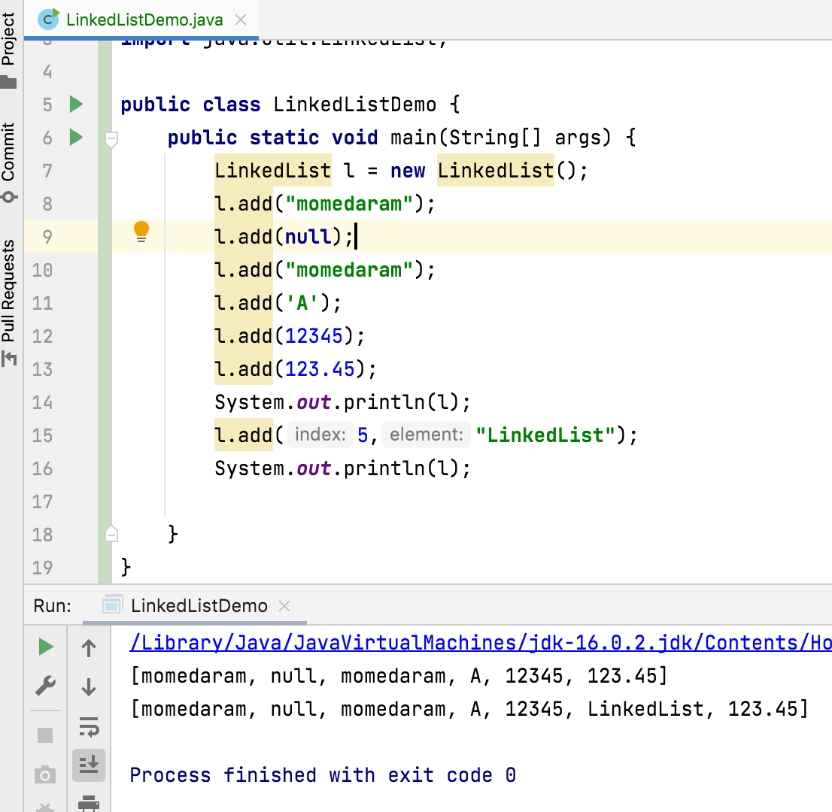

Slide 10
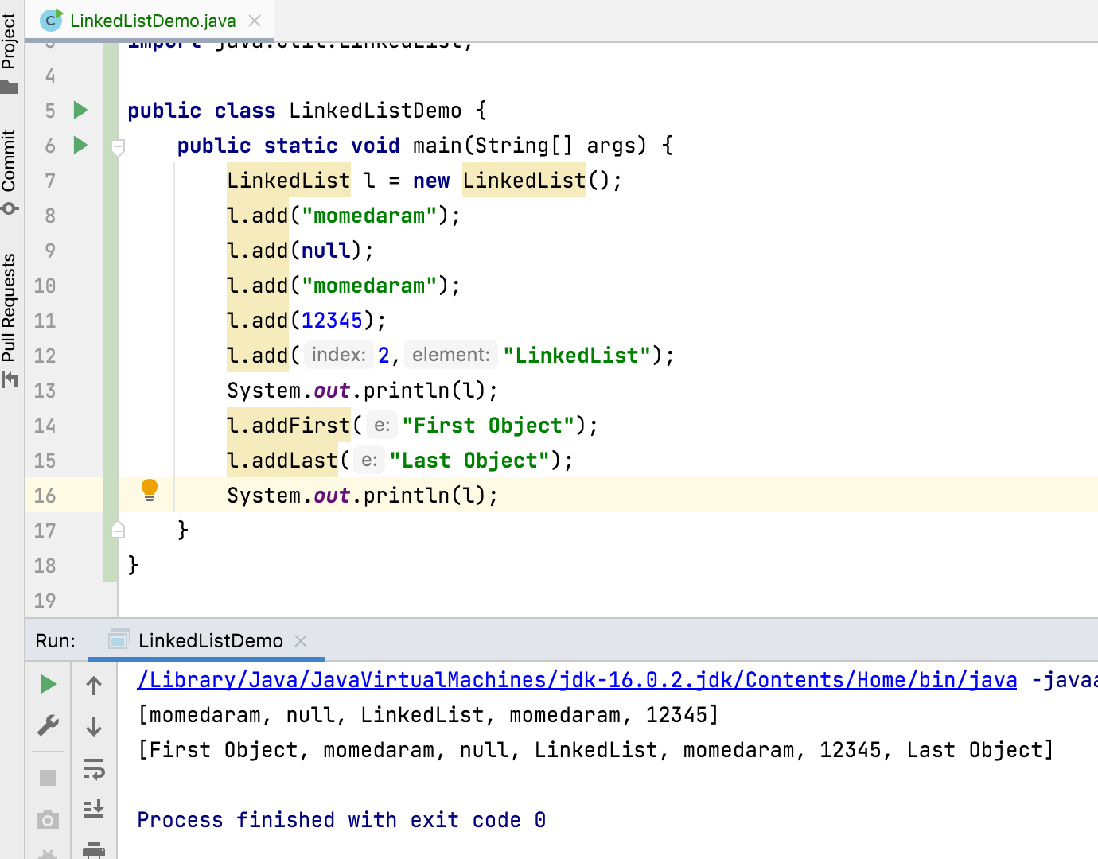
public void addFirst(E e) - Inserts the specified element at the beginning of this list. public void addLast(E e) - Appends the specified element to the end of this list. This method is equivalent to add(E).
Notes:
LinkedList class implements both Deque and Queue interface. It inherits add(E) method from Queue, and addLast(E) method from Deque. Both the methods have same functionality.
Return type add – Boolean , addLast void

Slide 11
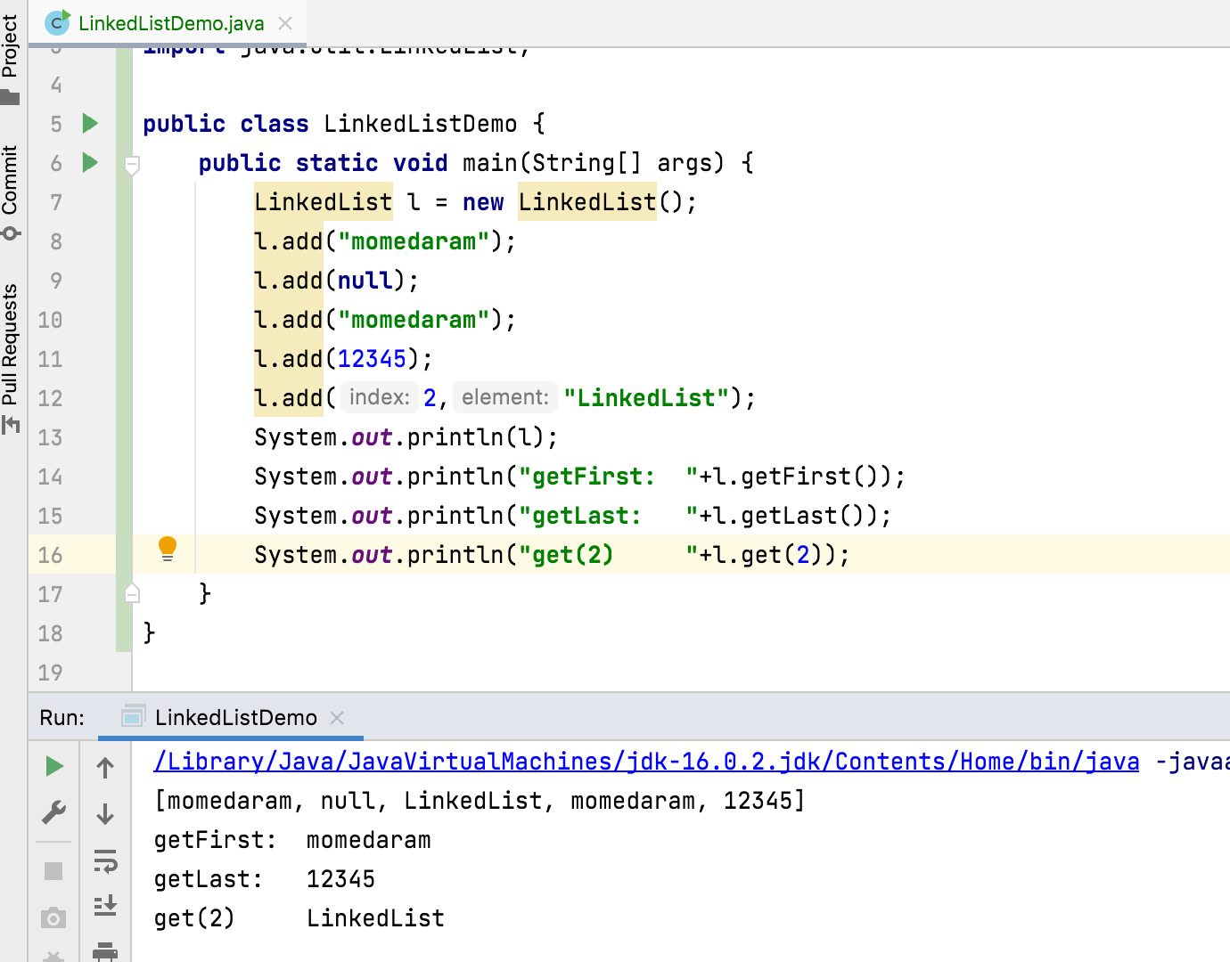
public E getFirst() - Returns the first element in this list.
public E getLast() - Returns the last element in this list.
Throws: NoSuchElementException - if this list is empty

Slide 12
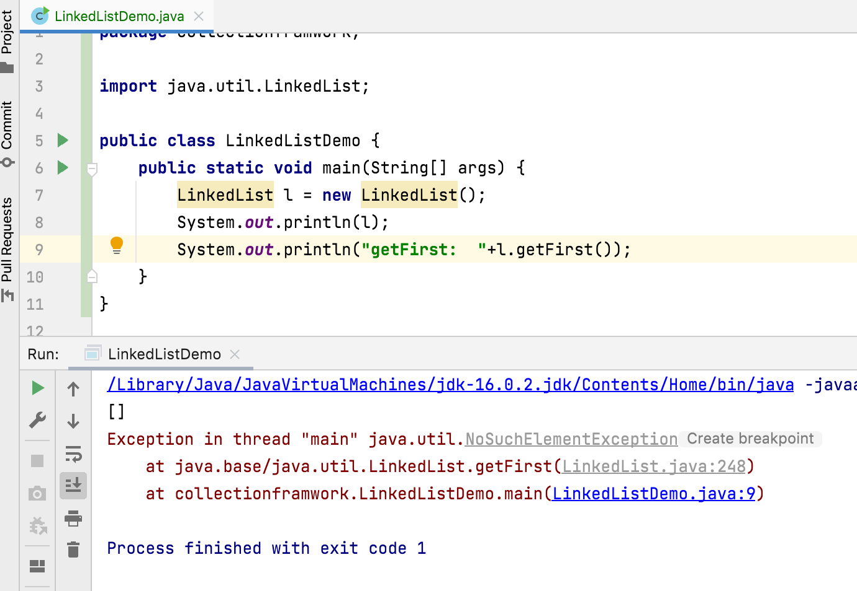

Slide 13
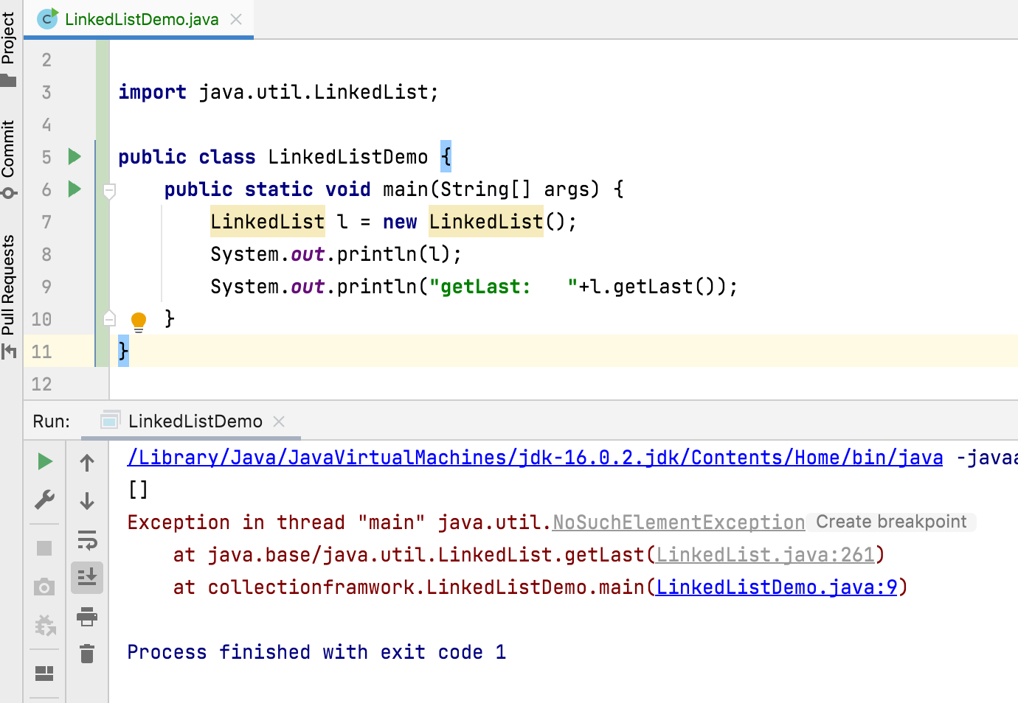

Slide 14
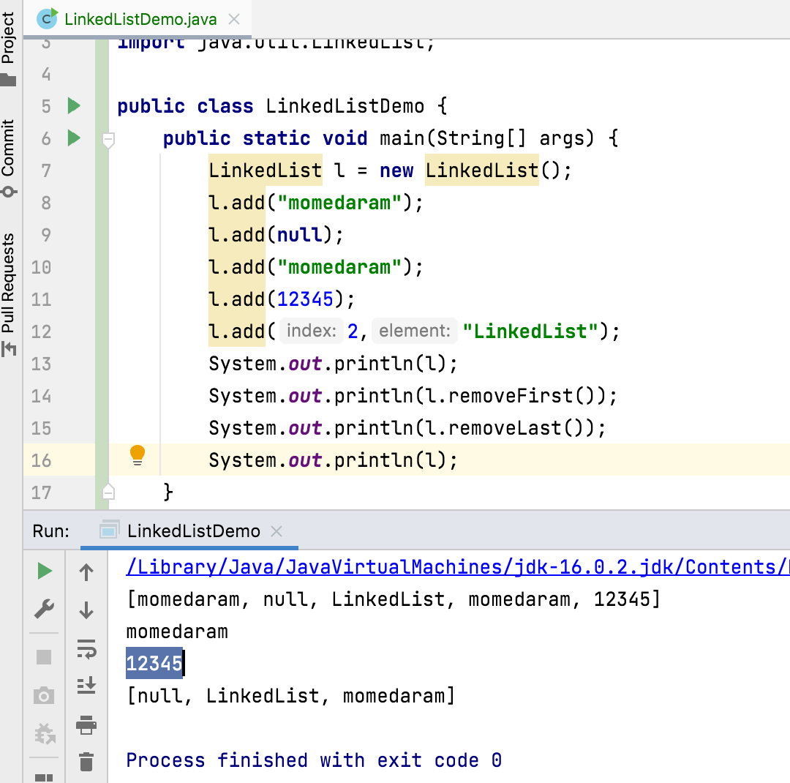
public E removeFirst() - Removes and returns the first element from this list.
public E removeLast() - Removes and returns the last element from this list.
Throws : NoSuchElementException - if this list is empty

Slide 15
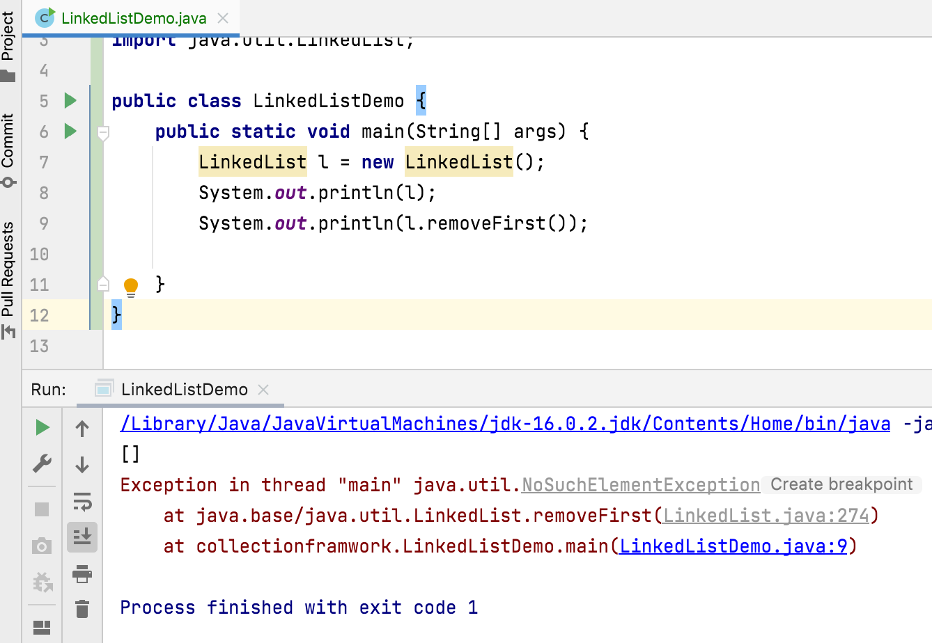
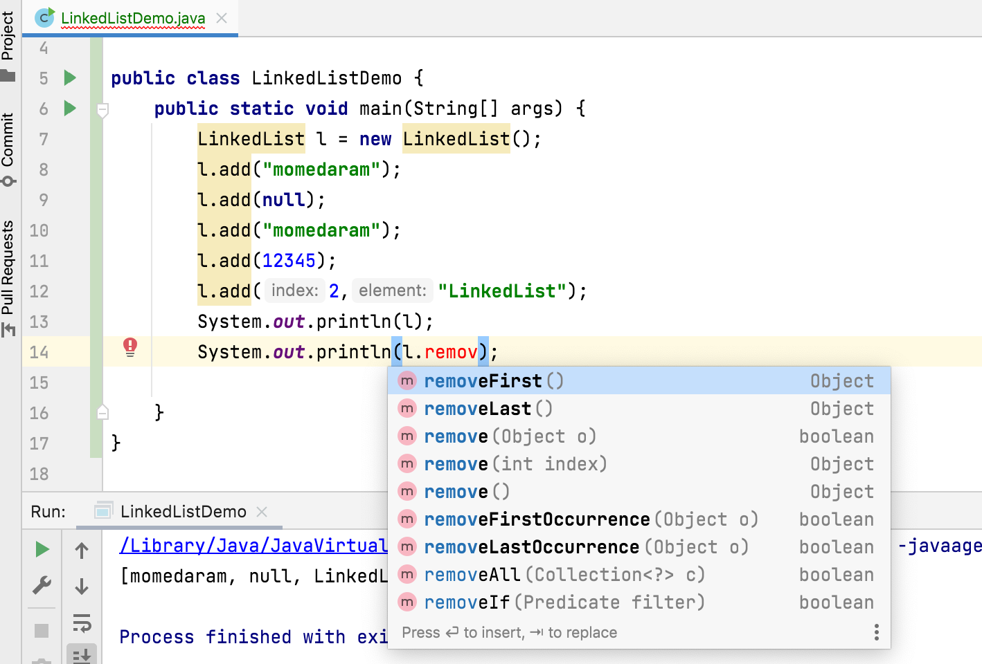

Slide 16







LinkedList l = new LinkedList(); l.add("momedaram"); l.add(null); l.add("momedaram"); l.add(12345);
null
momedaram
momedaram
12345
ABC

Slide 17
If our frequent operation is insertion (or) deletion then LinkedList is the best choice.
If our frequent operation is retrieval operation then LinkedList is not recommended.

Slide 18
Thank You !
momedaram

