Slide 1
Collection Framework SortedSet
momedaram

Slide 2








Iterable (I)
SortedSet is a child interface of Set Interface
Collection (I)
Set (I)
SortedSet (I)
HashSet (C)
NavigatableSet (I)
LinkedHashSet (C)
TreeSet (C)

Slide 3
1. SortedSet is a set in which elements are placed according to supplied comparator.
This Comparator is supplied while creating a SortedSet.
If we don’t supply comparator, elements will be placed according to DNS.
Default Natural Sorting:
A,B,C,….. (Alphabetical order)
….-1,0,1,2,3,4,5,..(Ascending Order)
2. Duplicate elements are not allowed.
3. SortedSet can not have null elements. If you try to insert null element, it gives NullPointerException at run time.
[Allows ’null’ element if it is only the element in SortedSet]
4. Inserted elements must be of Comparable type, other wise throws ClassCastException

Slide 4
Set interface methods:
boolean add​(E e)
boolean addAll​(Collection<? extends E> c)
boolean remove​(Object o)
boolean removeAll​(Collection<?> c)
boolean retainAll​(Collection<?> c)
void clear()
boolean contains​(Object o)
boolean containsAll​(Collection<?> c)
boolean isEmpty()
int size()
Object[] toArray()
T[] toArray(T[] a)
Iterator<E> iterator()
boolean equals(Object o)
int hashCode()

Slide 5
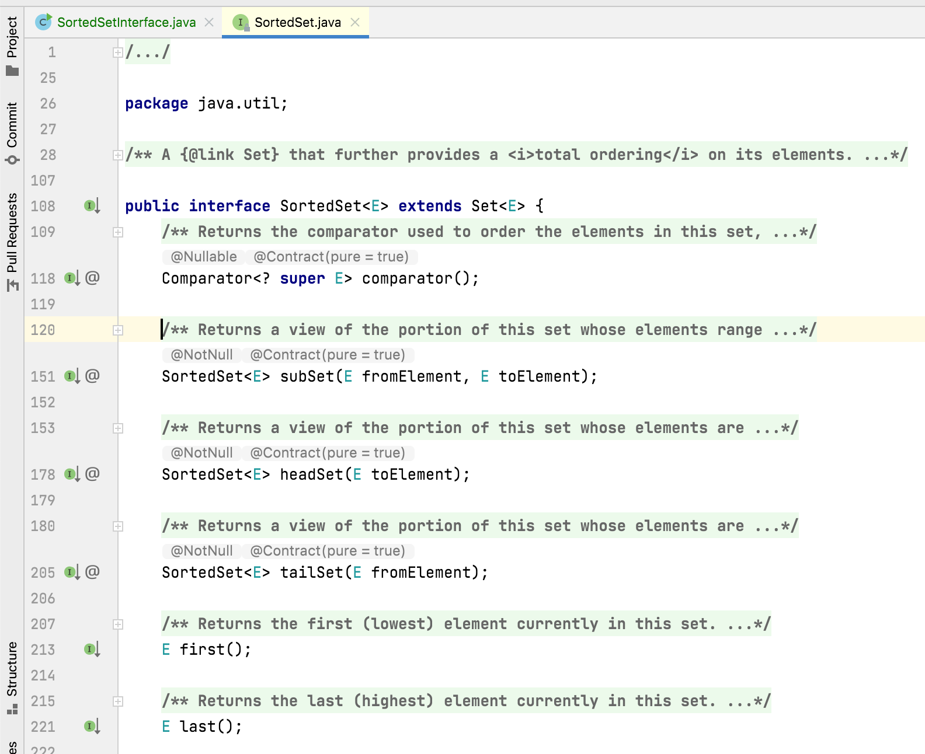
Methods Of SortedSet Interface:
SortedSet interface defines 6 more methods along with the inherited methods from Set interface.
These methods make the processing of SortedSet elements easier.

Slide 6
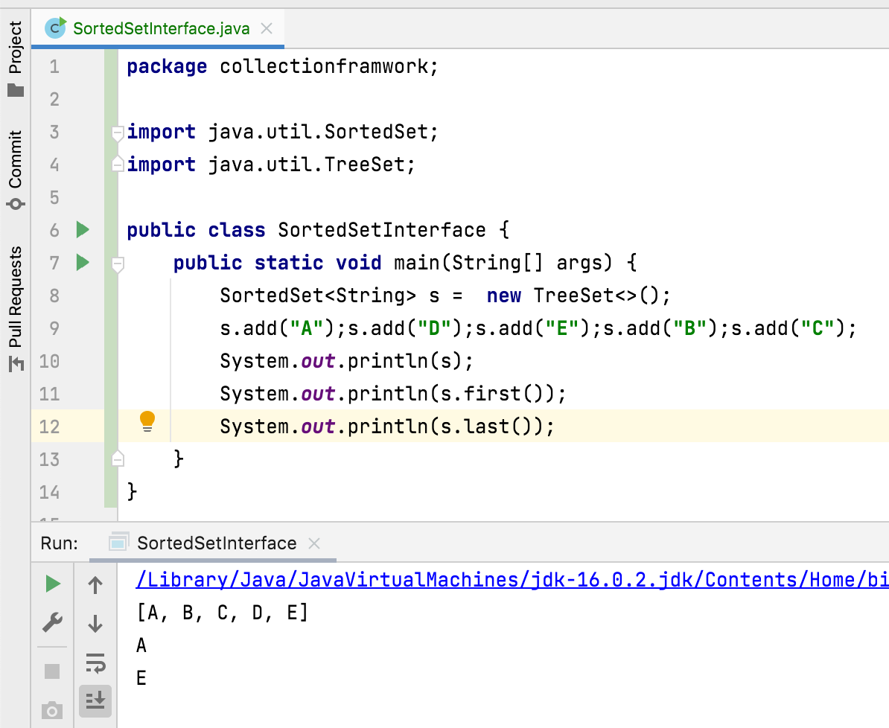
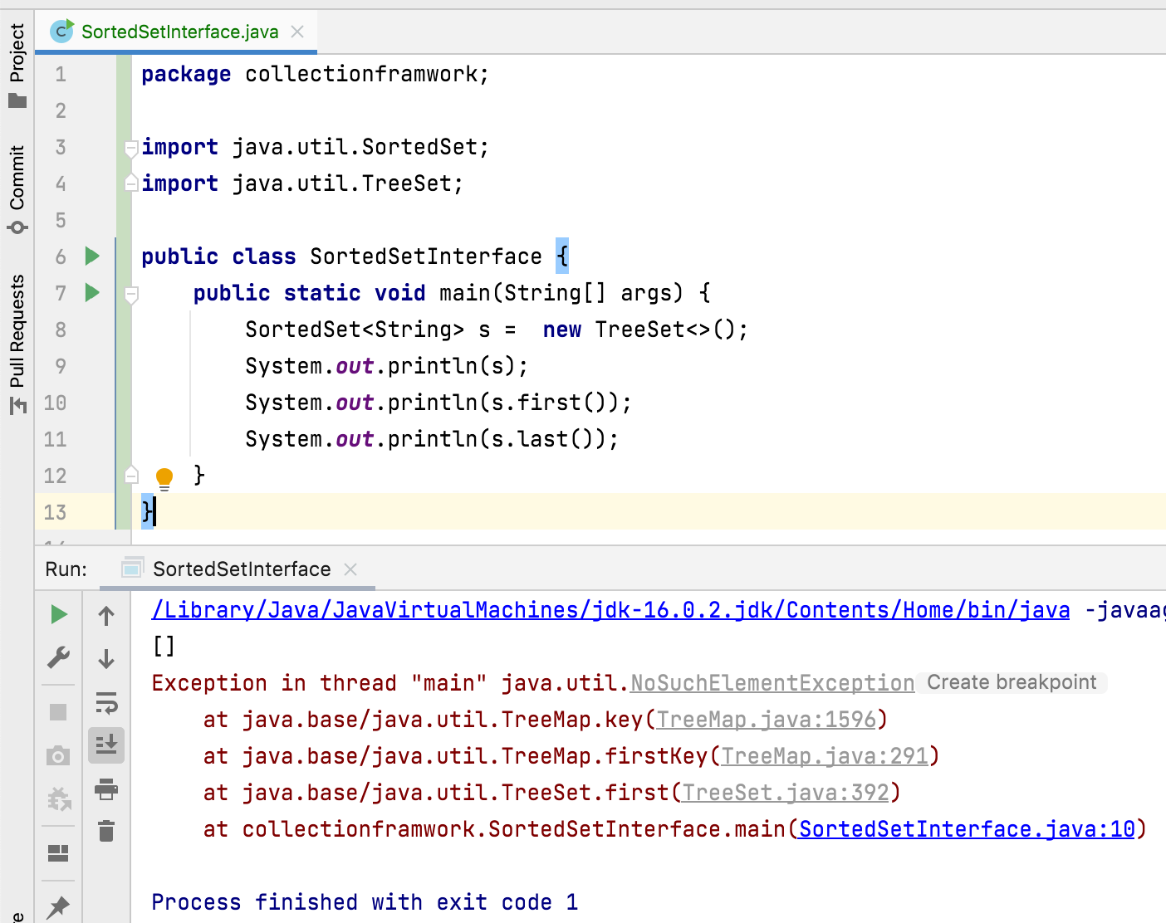
E first() - Returns the first (lowest) element currently in this set.
E last() - Returns the last (highest) element currently in this set.
throws NoSuchElementException if this set is empty

Slide 7
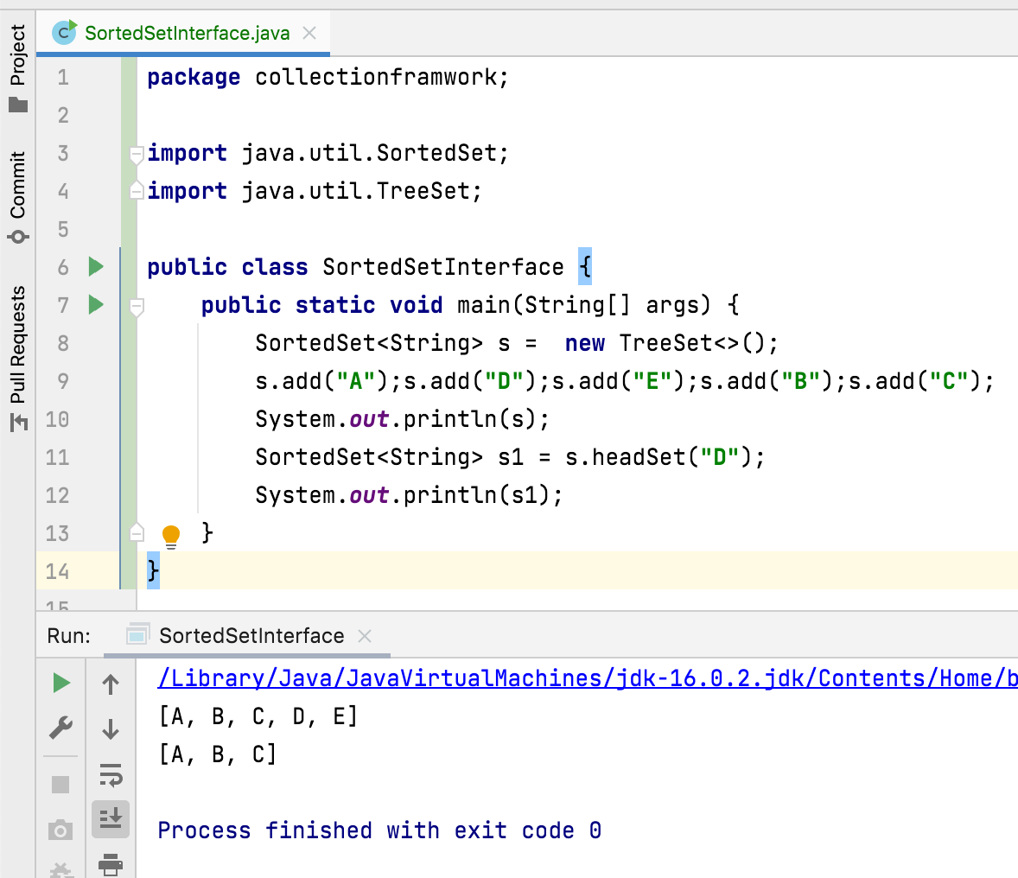
SortedSet<E> headSet(E toElement)
Returns a portion of this set whose elements are strictly less than toElement.
Throws:
ClassCastException – if toElement is not compatible with this set's comparator.
NullPointerException – if toElement is null and this set does not permit null elements

Slide 8
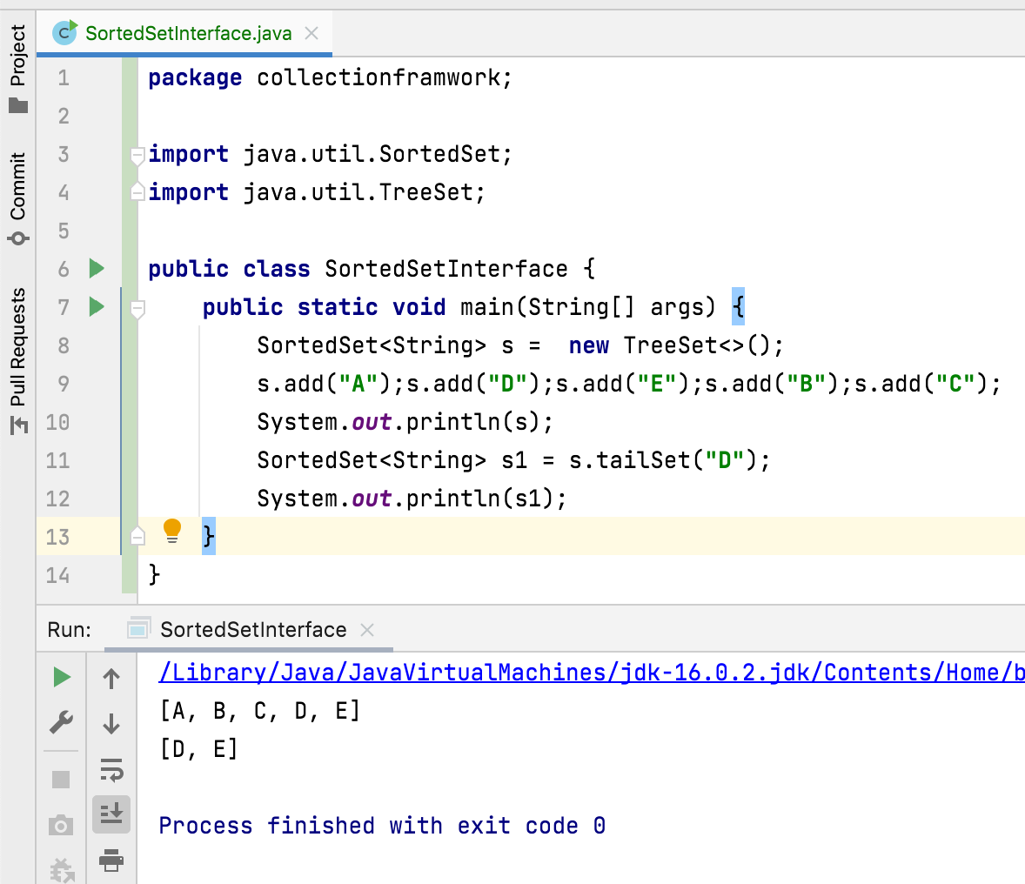
SortedSet<E> tailSet(E fromElement)
Returns a portion of this set whose elements are greater than or equal to fromElement.
Throws:
ClassCastException – if fromElement is not compatible with this set's comparator.
NullPointerException – if fromElement is null and this set does not permit null elements

Slide 9
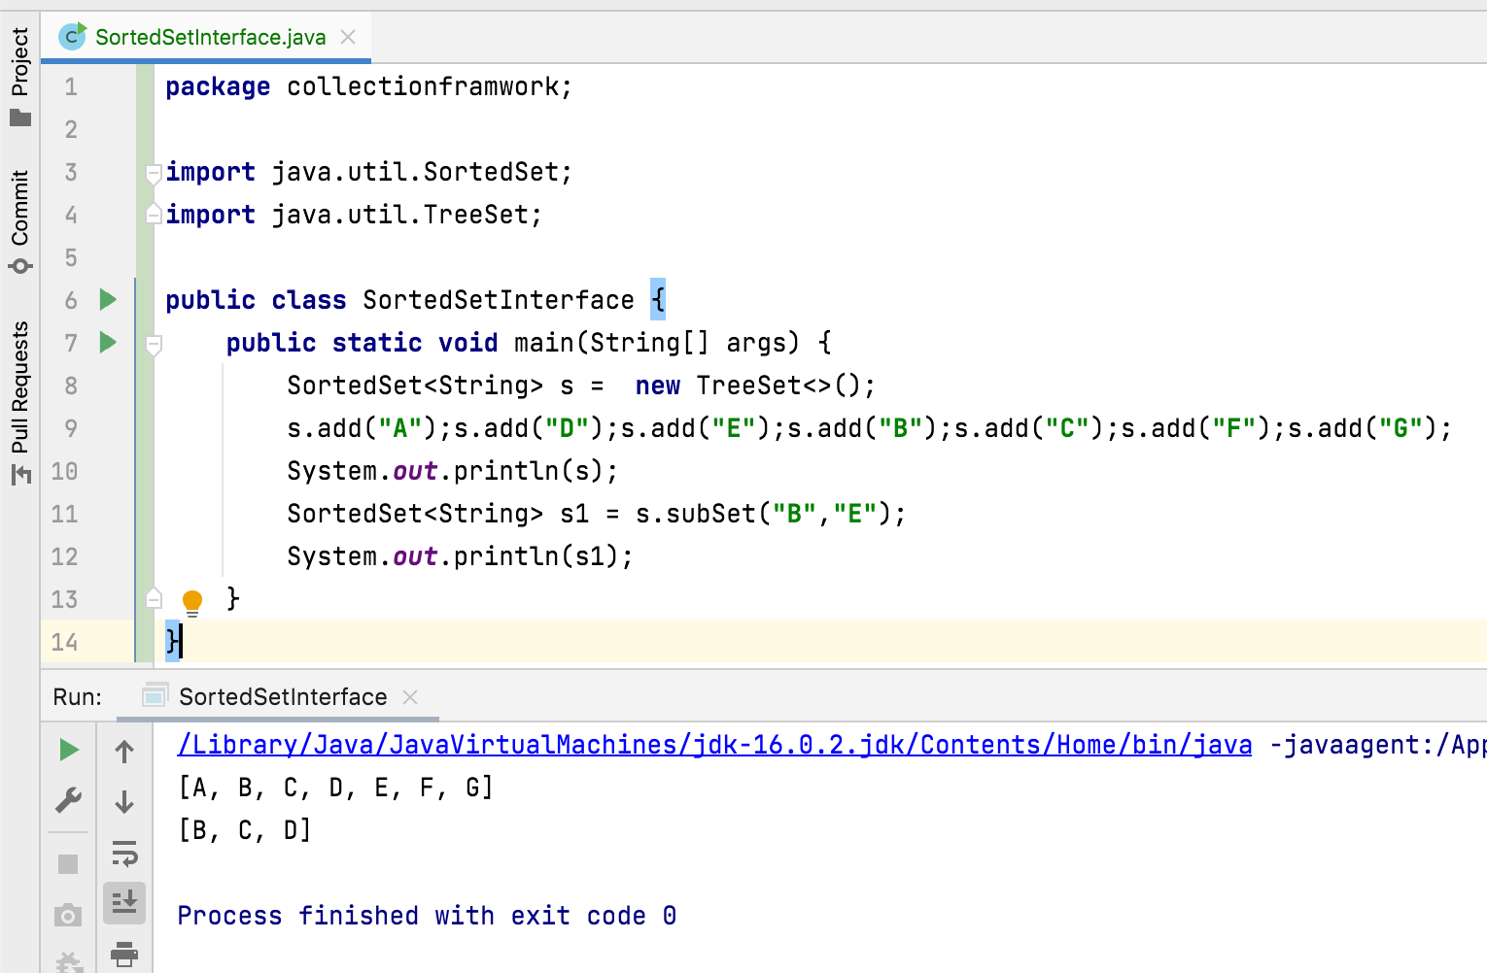
SortedSet<E> subSet(E fromElement, E toElement) Returns a portion of this set whose elements range from fromElement, inclusive, to toElement, exclusive.
Throws:
ClassCastException – if fromElement is not compatible with this set's comparator.
NullPointerException – if fromElement is null and this set does not permit null elements

Slide 10
Thank You !
momedaram

