Slide 1
City of Phoenix Crime Sample
Exploratory Analysis
View online with Tableau Public

Slide 2
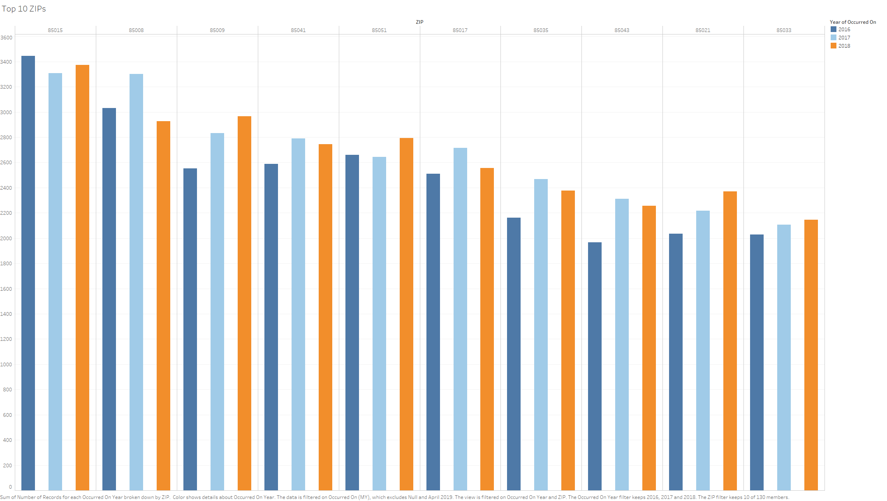

Slide 3
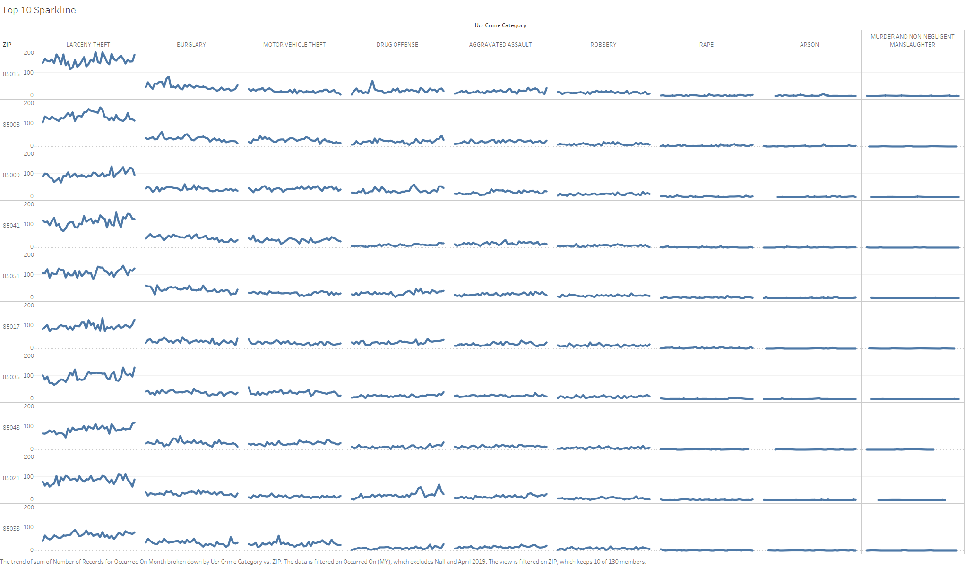

Slide 4


Slide 5
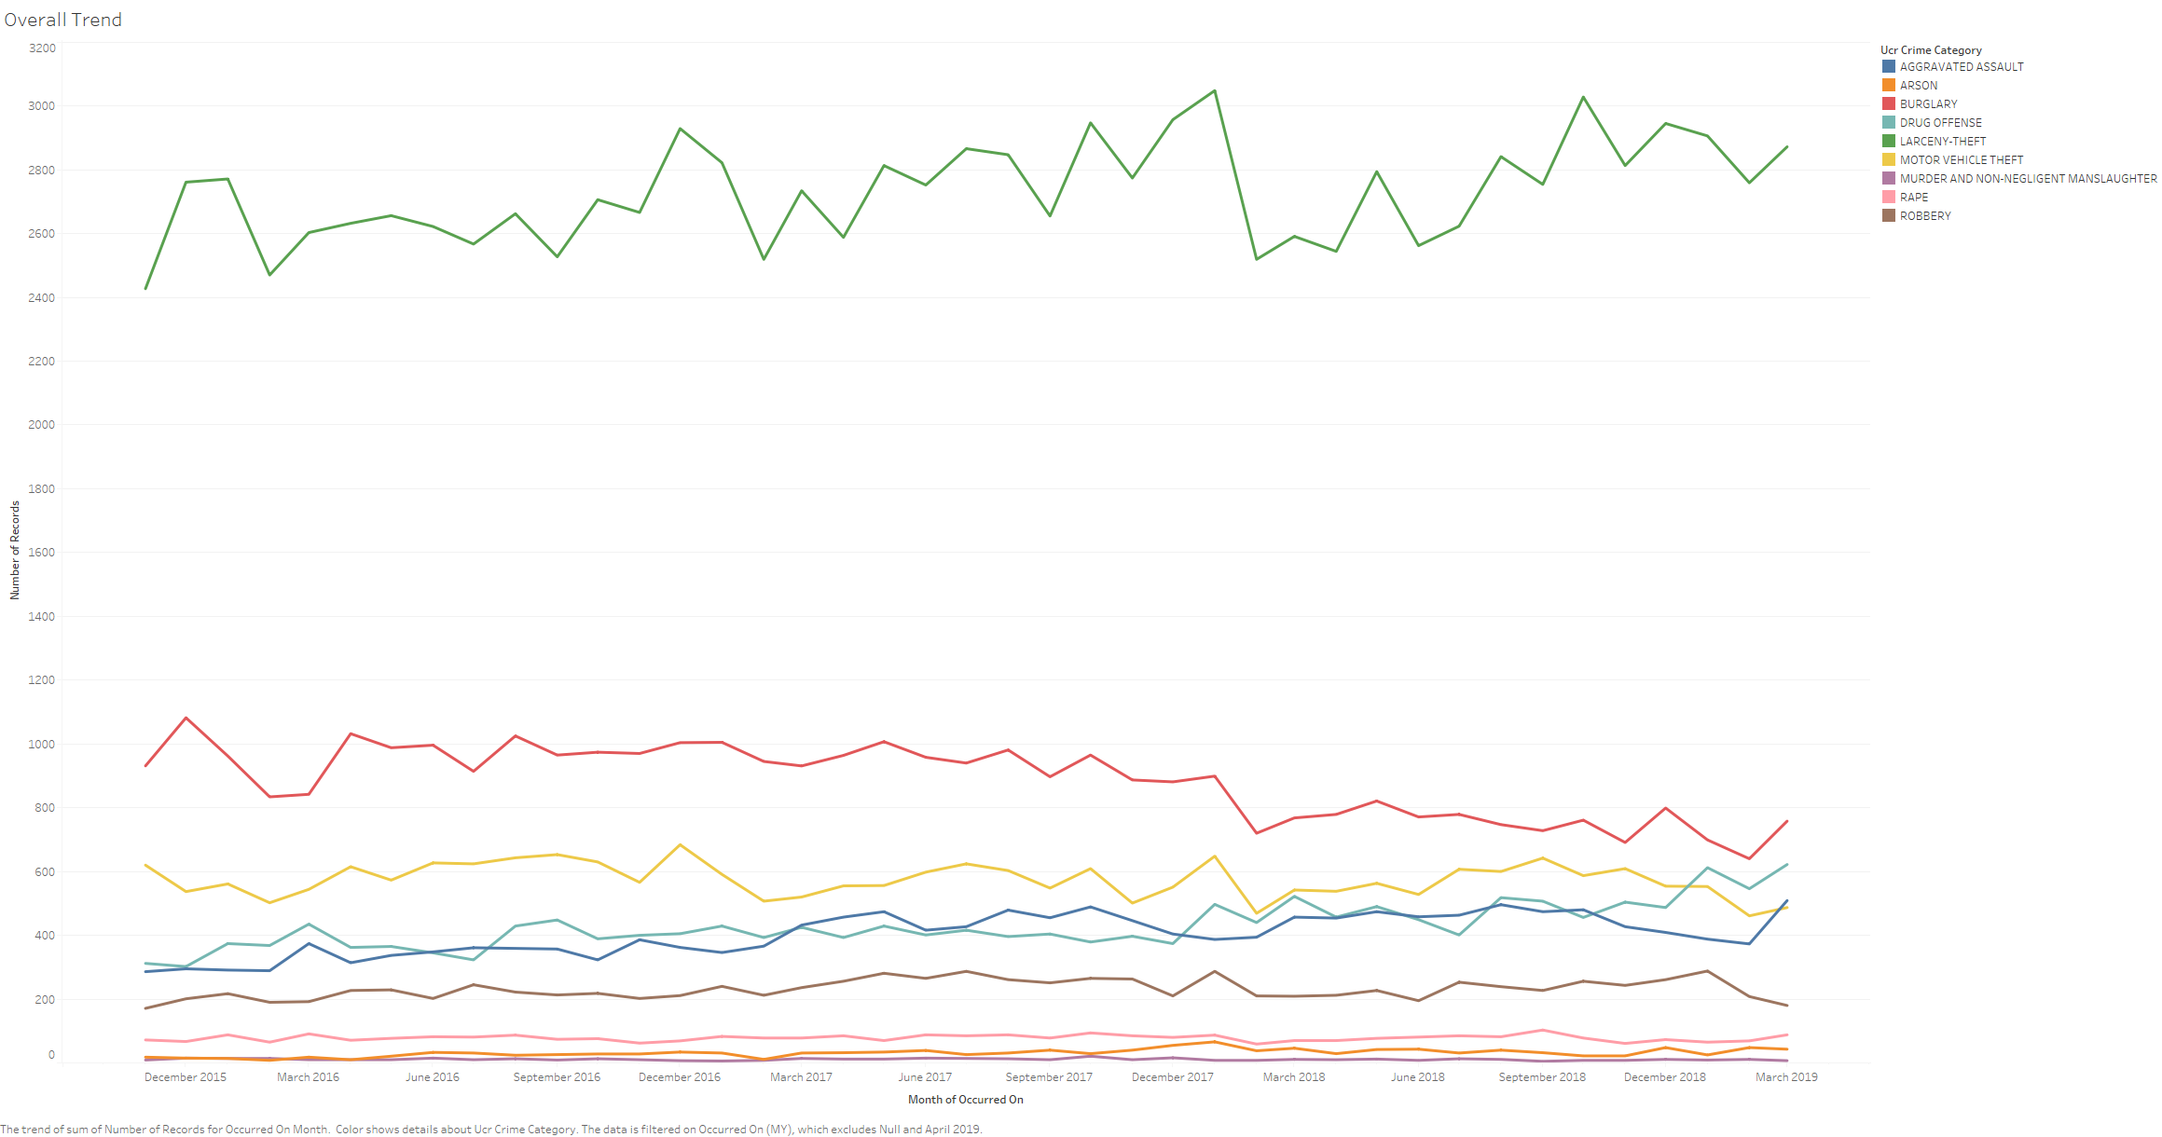

Slide 6
