Slide 1
Efficiently Improving the Reference Genome
Jacob Pritt

Slide 2
Improving the Reference Genome
TATCCATGC
GTTATCCAT
TTATC--ATG
TCCATGCTA
Reference:
AACGTTATCGATGCTAGCTAG
AACGTTATCCATGCTAGCTAG

Slide 3
Improving the Reference Genome
F | L | SA | B
$ | A | 20 | 0
A | G | 0 | 0
A | A | 1 | 1
A | T | 18 | 0
… | ... | … | …
TATCCATGC
GTTATCCAT
TTATC--ATG
TCCATGCTA
Reference:
AACGTTATCGATGCTAGCTAG
?
F | L | SA | B
$ | A | 20 | 0
A | C | 0 | 0
A | A | 1 | 1
A | T | 18 | 0
… | ... | … | …
AACGTTATCCATGCTAGCTAG

Slide 4
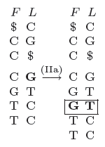
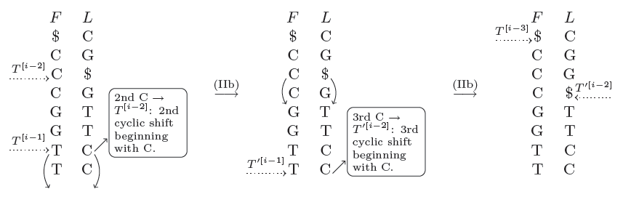
Updating the FM Index
Size | Rebuild | Update
100 | 0.00036 | 0.0000923
1000 | 0.02798 | 0.000395
10000 | 4.15 | 0.06539

Slide 5
Iterative Referencing
Ghanayim and Geiger, 2013
Algorithm:
Match all reads to reference genome
Search among matched reads for common mutations
Update FM index
Repeat until no new reads are matched

Slide 6
Iterative Referencing
Genome length: 5000 nt
5000 reads of length 50
Genome mutation rate: 0.02
Matching up to 1 error per read

Slide 7
Reduce Space?
Linear with number of reads
Linear with error frequency for small values

Slide 8
Space-efficient Alternatives
Store mutations from
every matched read
1% of matched reads
first n mapped reads for every base
first n mapped reads for chunks of the genome
Still O(# reads), but can reduce space significantly

Slide 9
Space-efficient Alternatives
Read Length | Original | Reduced (1%) | Chunk=1, Depth=1 | Chunk=1, Depth=2 | Chunk=50, Depth=2
10 | 0.9916 | 0.9916 | 0.9912 | 0.9916 | 0.9916
20 | 0.972 | 0.9704 | 0.9724 | 0.9748 | 0.9724
30 | 0.924 | 0.9172 | 0.9292 | 0.9248 | 0.9244
40 | 0.8672 | 0.866 | 0.8776 | 0.87 | 0.8728
50 | 0.8388 | 0.8272 | 0.8316 | 0.8356 | 0.8432
60 | 0.7836 | 0.7656 | 0.8012 | 0.7904 | 0.7884
70 | 0.7212 | 0.7092 | 0.7224 | 0.722 | 0.7212
80 | 0.6792 | 0.6368 | 0.6608 | 0.6644 | 0.6604

Slide 10
Further Work
Approximate matching with up to 2 errors
Test on real data
Incorporate PHRED quality score

