Slide 1
Lecture Knowledge-Based Systems Procedural Knowledge
Torsten Zesch
Piush Aggarwal
Andrea Horbach
Language Technology Lab
Universität Duisburg-Essen

Slide 2
Procedural Knowledge
Motto:
Feedback is all you need!

Slide 3
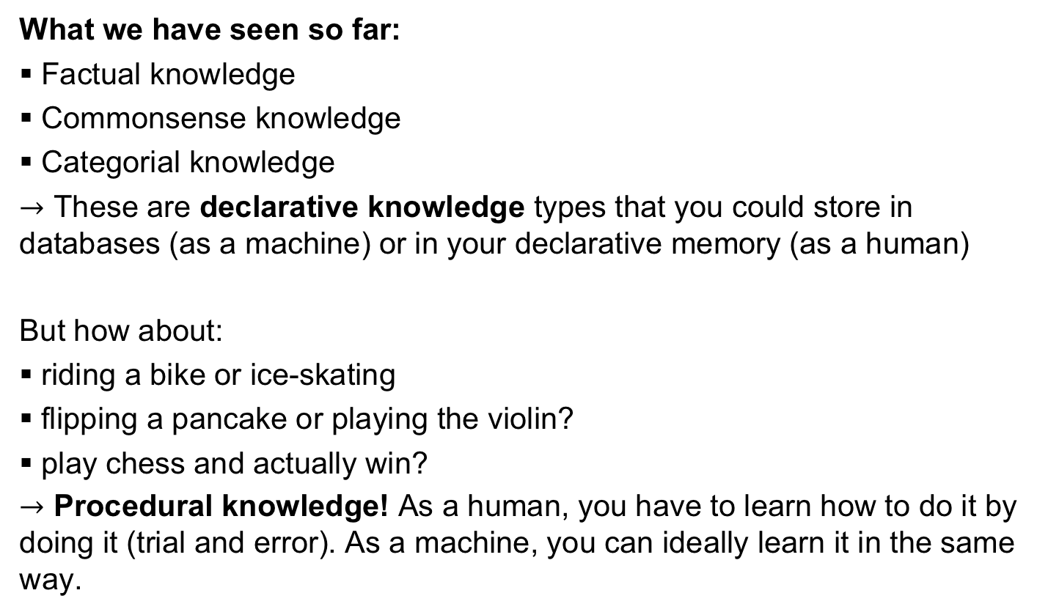
Types of Knowledge
What we have seen so far:
Factual knowledge
Commonsense knowledge
Categorial knowledge
$→$ These are declarative knowledge types that you could store in databases (as a machine) or in your declarative memory (as a human)
But how about:
riding a bike or ice-skating
flipping a pancake or playing the violin?
play chess and actually win?
$→$ Procedural knowledge! As a human, you have to learn how to do it by doing it (trial and error). As a machine, you can ideally learn it in the same way.

Slide 4
Squire‘s Memory Classification (for Humans)
Memory
Declarative
explicit knowledge, you can verbalize ist
Non-Declarative implicit knowledge,
you can do it
Episodic
„Yesterday, Anna called me“
Semantic
„A parrot is a bird.“
Procedural
knowing how to swim
Other
Priming, Classical Conditioning, ...

Slide 5
How to Acquire Procedural Knowledge
For humans:
Acquisition of procedural knowledge is a complex process, involving practice (trial and error). Imagine a child learning to walk, falling down, getting up again, fall again...
Learning procedural knowledge means learning by interacting with your environment. („Oh, I fell down something must have gone wrong!“)
That means we learn by receiving positive or negative feedback („Reinforcement“). Feedback could be for the learning to walk scenario:
falling down and hurting yourself
still be standing and walking and not get hurt
finally reach the table where the chocolate is
but also:
winning or loosing a game of chess
finish Vivaldi‘s violin concerto without your neighbors complaining

Slide 6
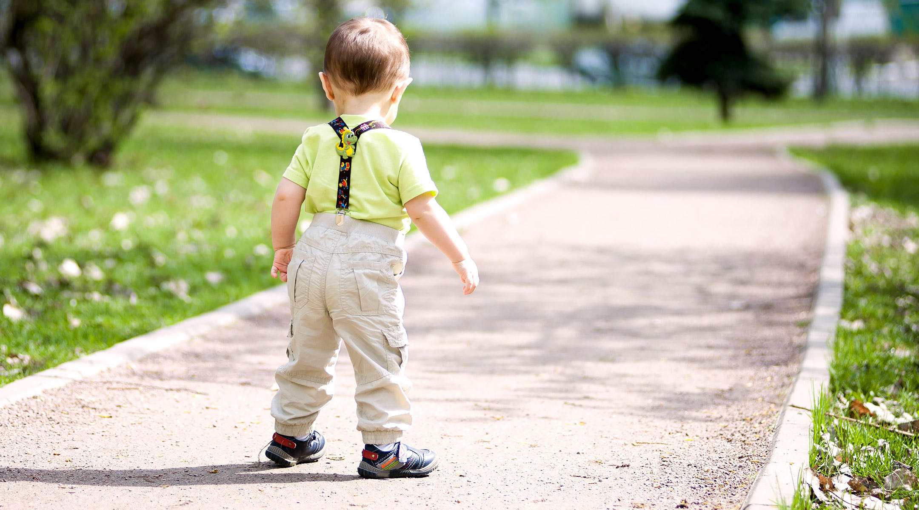
Reinforcement Learning
Learning by interacting with your environment.
https://images.contentful.com/6m9bd13t776q/6ErMnXakpimYOMcUI02YY0/498b44585d4c374aa57c662138f3739f/baby-walking-shoes-desktop.jpg?q=75

Slide 7
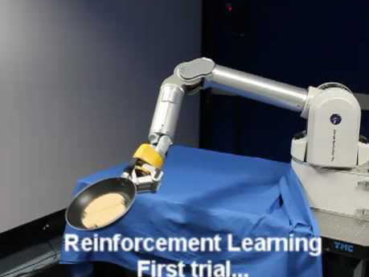
A Machine Learning Procedural Knowledge
The pancake flipping robot

Slide 8
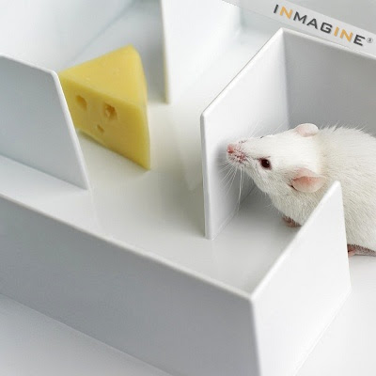
Reinforcement Learning
Learning by interacting with your environment.
Receive a reward or punishment
learn the bet strategy how to reach a certain goal.
http://3.bp.blogspot.com/_1fjMGlWo2xc/TIpubgHQIKI/AAAAAAAAAO8/vXQiCFtbgbk/s400/mouse+maze.jpg

Slide 9
Types of Machine Learning
Machine Learning
Supervised ML
Unsupervised ML
Reinforcement Learning
Notes:
in supervised ML: infeasible to create eg all chess positions as feature vectors an asisgna value to them, better learn from own experience
in unsupervised ML. no feedback whatsoever

Slide 10
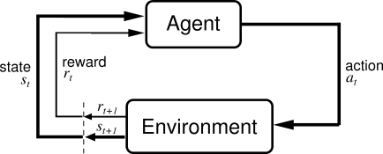
Reinforcement Learning (RL): Interaction with the Environment
Sutton & Barto: Reinforcement Learning
In RL, an agent learns by constantly interacting with its environment. The agent in a certain state performs an action. By performing this action it receives a reward and reaches a new state. Then it performs the next action. Learning in this scenario means to choose your next action so that you maximize your reward.

Slide 11
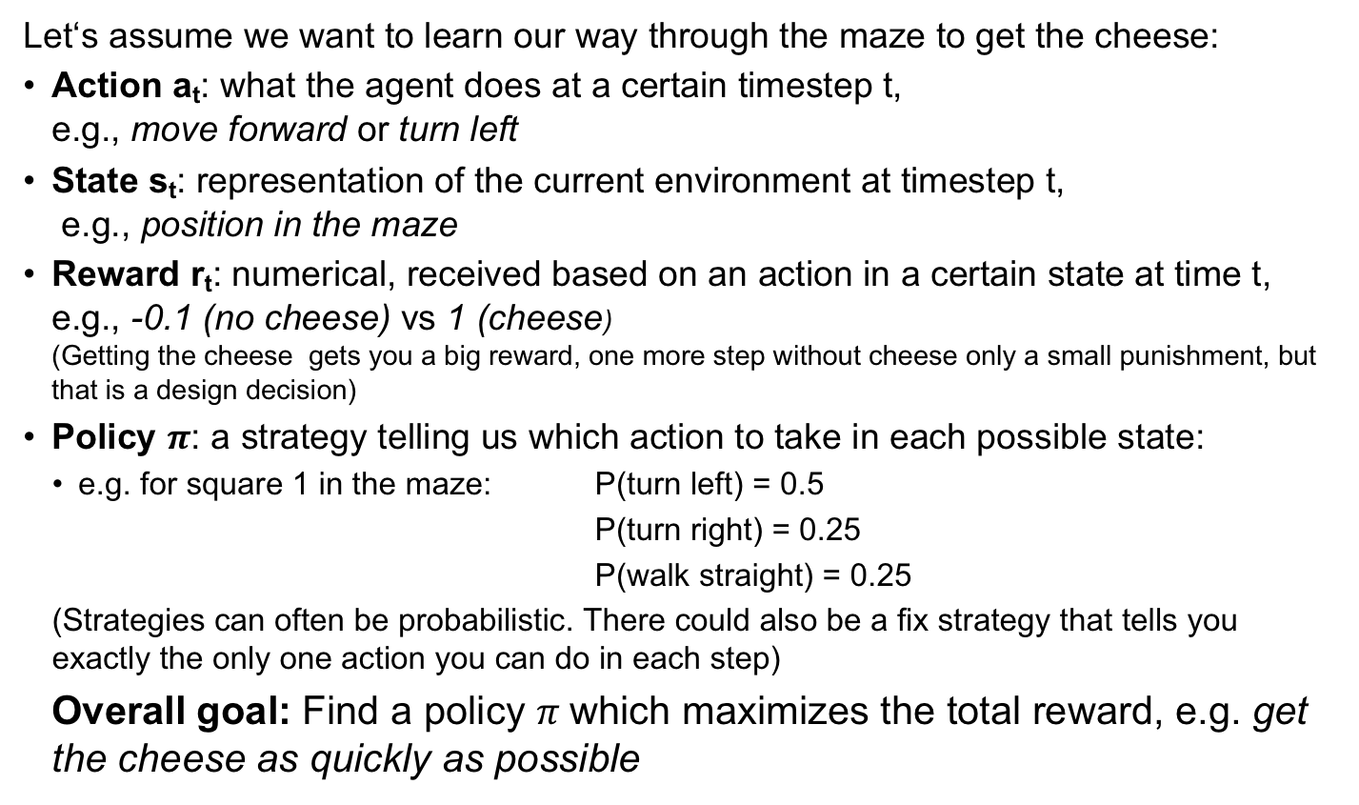
Reinforcement Learning: Core Concepts
Let‘s assume we want to learn our way through the maze to get the cheese:
Action a_{t}: what the agent does at a certain timestep t, e.g., move forward or turn left
State s_{t}: representation of the current environment at timestep t, e.g., position in the maze
Reward r_{t}: numerical, received based on an action in a certain state at time t, e.g., -0.1 (no cheese) vs 1 (cheese) (Getting the cheese gets you a big reward, one more step without cheese only a small punishment, but that is a design decision)
Policy $π$: a strategy telling us which action to take in each possible state:
e.g. for square 1 in the maze: P(turn left) = 0.5
P(turn right) = 0.25
P(walk straight) = 0.25
(Strategies can often be probabilistic. There could also be a fix strategy that tells you exactly the only one action you can do in each step)
Overall goal: Find a policy $π$which maximizes the total reward, e.g. get the cheese as quickly as possible

Slide 12
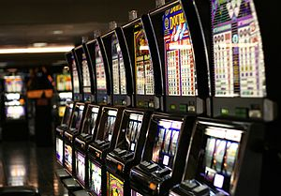
What is a good strategy? Exploration vs. Exploitation
You are standing in front of a number of slot machines („one-armed bandits“). Each machine has a fixed probability to hit the jackpot. You have a lot of time to play. For free. What would you do to maximize the money you get?
You keep track of the average outcome for each machine:
exploitation: select a greedy action – choose the machine that promises the highest reward
exploration: select a non-greedy action, to get a better estimate of the other machines
Notes:
Discussion: what would you do?

Slide 13
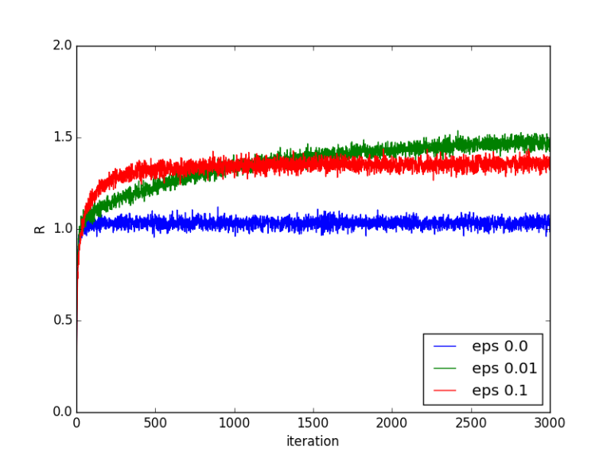
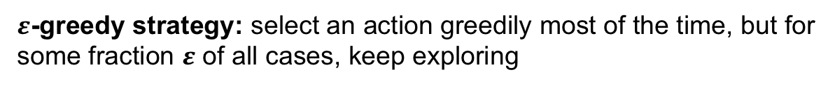
Trade-off between Exploration and Exploitation
$ε$-greedy strategy: select an action greedily most of the time, but for some fraction $ε$ of all cases, keep exploring
In RL, we often plot reward over time, where one iteration is one action. In the graph you can see, that we ge a higher reward earlier if we do more exploration (higher epsilon), but in th long term, selecting the best action greedily is better. A good strategy could be to have a hgher epsilon initially (more exploration) and then use a lower epsilon (more exploitation).

Slide 14
The Gridworld Example
 | A |  | B
 |  |  | B‘
 | A‘
Possible Actions:
right
down
left
up
+5
In state A, all actions lead to A‘
in state B, all actions lead to B‘.
+10
25 states
Rewards:
leave the grid: -1
leave state A: +10
leave state B: +5
otherwise: 0

Slide 15
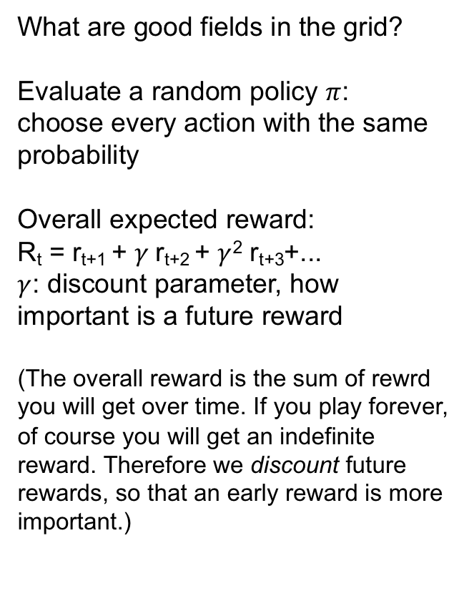
The Gridworld Example
 | A |  | B
 |  |  | B‘
 | A‘
What are good fields in the grid?
Evaluate a random policy $π$: choose every action with the same probability
Overall expected reward:
R_{t} = r_{t+1} + $γ$r_{t+2} + $γ$² r_{t+3}+...
$γ$: discount parameter, how important is a future reward
(The overall reward is the sum of rewrd you will get over time. If you play forever, of course you will get an indefinite reward. Therefore we discount future rewards, so that an early reward is more important.)
+5
+10

Slide 16
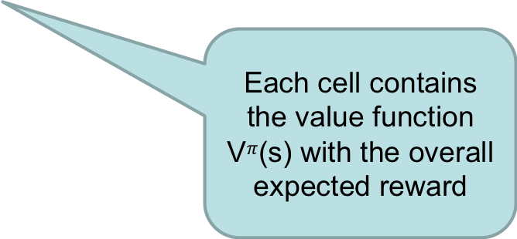
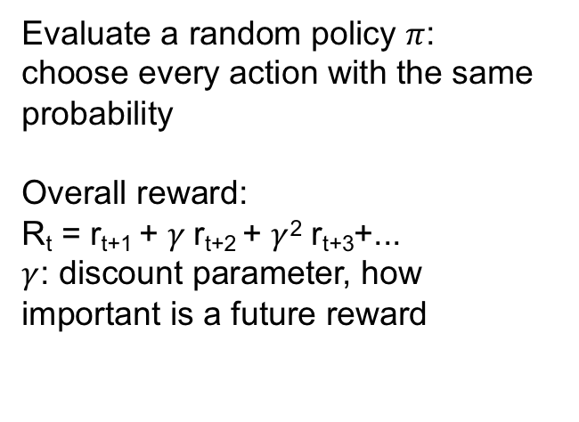
The Gridworld Example
3.3 | 8.8 | 4.4 | 5.3 | 1.5
1.5 | 3.0 | 2.3 | 1.9 | 0.5
0.1 | 0.7 | 0.7 | 0.4 | -0.4
-1.0 | -0.4 | -0.4 | -0.6 | -1.2
-1.9 | -1.3 | -1.2 | -1.4 | -2.0
Evaluate a random policy $π$: choose every action with the same probability
Overall reward:
R_{t} = r_{t+1} + $γ$r_{t+2} + $γ$² r_{t+3}+...
$γ$: discount parameter, how important is a future reward
Each cell contains the value function V$π$(s) with the overall expected reward

Slide 17
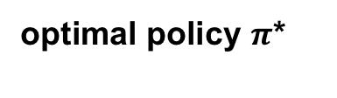
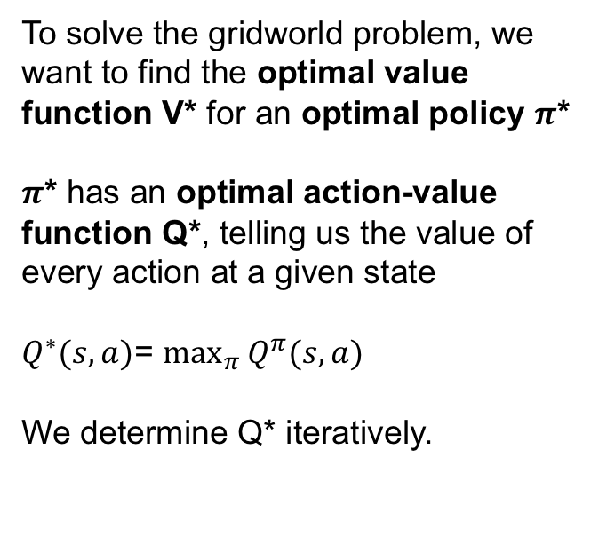
Solving the gridworld problem
To solve the gridworld problem, we want to find the optimal value function V* for an optimal policy $π$*
$π$* has an optimal action-value function Q*, telling us the value of every action at a given state
$Q^{∗}(s,a)$= $\max_{π}{Q^{π}(s,a)}$
We determine Q* iteratively.
optimal policy $π$*

Slide 18
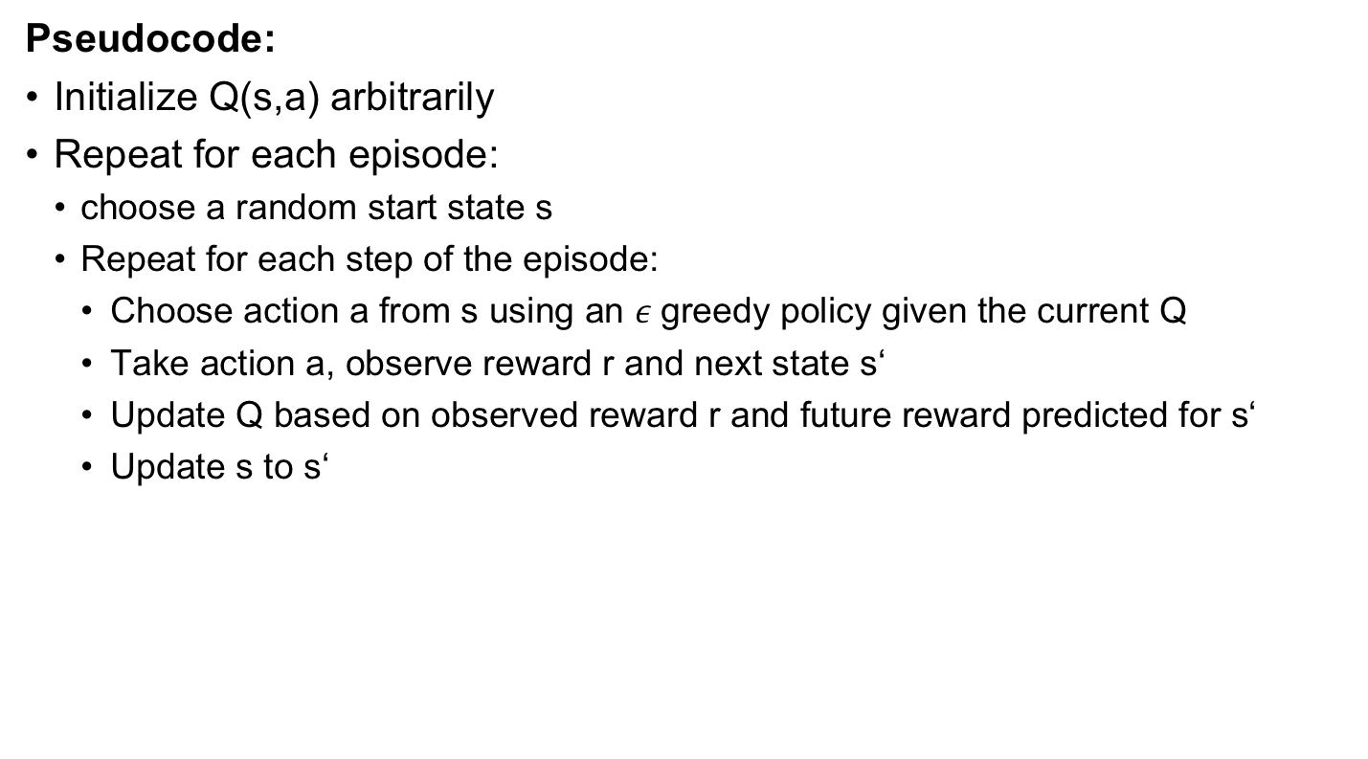
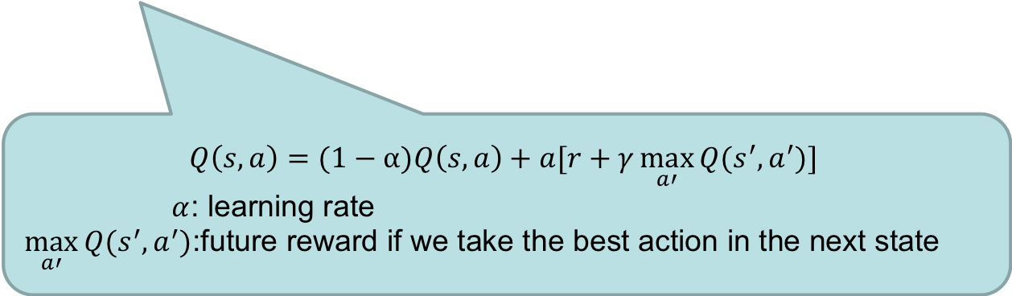
Q-learning: Solving the gridworld problem
Pseudocode:
Initialize Q(s,a) arbitrarily
Repeat for each episode:
choose a random start state s
Repeat for each step of the episode:
Choose action a from s using an $ε$greedy policy given the current Q
Take action a, observe reward r and next state s‘
Update Q based on observed reward r and future reward predicted for s‘
Update s to s‘
$$Q\left(s,a\right)=(1−α)Q\left(s,a\right)+a[r+γ\max_{a′}{Q(s^{′}, a^{′})}]$$
$α$: learning rate
$\max_{a′}{Q(s^{′}, a^{′})}$:future reward if we take the best action in the next state
Notes:
More about that in the exercise

Slide 19
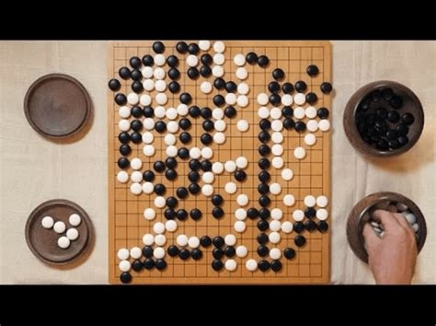
Recent Examples of in Reinforcement Learning
October 2015, AlphaGo defeated the European Go champion Fan Hui.
Large databse with moves + reinforcement lerning by playing against another version of itself.

Slide 20
Recent Examples of Reinforcement Learning
Robotics: robots learn how to walk
Health Care: Find optimal treatment policies for patients with chronic diseases:
Dialogue systems: Find a good dialogue policy for a chatbot.
Intelligent Tutoring systems: adapt teaching strategy to optimize learning gain
Job shop scheduling: assign tasks to machines

Slide 21
Summary Reinforcement Learning
RL mimicks the way how humans acquire procedural knowledge through trial and error
As a variant in machine learning, it is suitable for problems where it is hard to provide training instances with labels. Instead we use the reward, that sometimes comes with a dely. (When playing chess we might not know how good an individual move is, but we know in the end whether we won the game.)
The knowledge of a trained RL system is the strategy that tells us what the agent should do in a certain state.
When modeling a task as RL problem as a developer, we have to carefully decide how to model the environment
what are allowed action?
what states can the agent be in?
what reward do we receive for which action in which state?

