Slide 1
Lecture Knowledge-based Systems Part 7 – RTE/NLI
Torsten Zesch
Piush Aggarwal
Andrea Horbach
Language Technology Lab
Universität Duisburg-Essen

Slide 2
Motto
“If it rains, the street is wet”

Slide 3

Any other open questions?

Slide 4
RTE – Recognizing Textual Entailment
Definition (Dagan et al, 2013): “Textual entailment is defined as a directional relationship between pairs of text expressions, denoted by T (the entailing “Text”) and H (the entailed “Hypothesis”). We say that T entails H if humans reading T would typically infer that H is most likely true.”
An example: Text: The drugs that slow down or halt Alzheimer’s disease work best the earlier you administer them. Hypothesis: Alzheimer’s disease is treated using drugs. Entailment? Yes!

Slide 5
Textual Entailment vs Logical Entailment
T: It rains.
H: The street is wet.
“But it could be, that the street is covered, so it probably does not necessarily follow that the street is wet.” → no logical entailment
“But most people would find it plausible that the street is wet” → textual entailment
The notion of textual entailment is somewhat softer.
Textual entailment is often not a strict logical entailment.

Slide 6
Beyond Entailment
Text: The purchase of Houston-based LexCorp by BMI for $2Bn prompted widespread sell-offs by traders as they sought to minimize exposure. LexCorp had been an employee-owned concern since 2008.
Hyp 1: BMI acquired an American company. Entailment Hyp 2: BMI bought employee-owned LexCorp for $3:4Bn. Contradiction Hyp 3: BMI is an employee-owned concern. Unknown
Dagan et al. | entailment | non-entailment
Giampiccolo et al | entailment | contradiction | unknown

Slide 7
Applications – Short Answer Scoring
A teacher asks a student a questions. The computer judges if the learner answer is correct or incorrect, often by comparing it to a target answer.
A learner answer is considered correct if it entails the target answer. (i.e. a learner answer should be at least as specific as the target answer.)

Slide 8
Applications – Short Answer Scoring
Question: You used several methods to separate and identify the substances in mock rocks. How did you separate the salt from the water?
Target Answer: The water was evaporated, leaving the salt. Learner Answer 1: Let the water evaporate and the salt is left behind. Correct Learner Answer 2: I saw a pinkish grayish color that was blocking the water. Irrelevant Learner Answer 3: Evaporate Partially-correct/Incomplete Learner Answer 4: I do not know. Non-domain Learner Answer 5: The salt evaporated. Contradiction

Slide 9
Entailment Labels in Short-Answer Scoring
Dagan et al. | entailment | non-entailment |  |  | -
Giampiccolo et al | entailment | contra- diction | unknown |  | -
Dzikowska et al | correct | contra-diction | partially correct /incomplete | irrelevant | non-domain

Slide 10
NLI – Natural Language Inference
A very similar task, often considered equivalent to RTE.
Sometimes, also inference “in the other direction” is of interest:
Dagan et al. | entailment |  | non-entailment |  |  | -
Giampiccolo et al. | entailment |  | contra- diction | unknown |  | -
Dzikowska et al. | correct |  | contra-diction | partially correct/incomplete | irrelevant | non-domain
MacCartney et al. | equi-valence | Forward entailment | negation | alternation – cover - independence |  | -

Slide 11
Applications – Question Answering
User asks a question, computer answers. An answer candidate is considered correct, if the hypothesized answer statement is entailed by the candidate passage from which the answer was retrieved. Question: Who painted “The Scream”? Retrieved Text Passage: Norway’s most famous painting, ‘The Scream’ by Edvard Munch,…” Answer Candidate: Edvard Munch painted “The Sceam”
Entailment?

Slide 12
Datasets
RTE-1 to 7
600-1000 text-hypothesis pairs, labeled as entailed/non-entailed or entailed/contradiction/irrelevant
SemEval 2013, Student Response Analysis (SRA)
250 questions, target answers and 13,000 learner answers to science questions, annotated according to the 2-, 3- and 5-way labels
Stanford Natural Language Inference (SNLI) Corpus
570k sentence pairs labeled as entailment, contradiction and neutral

Slide 13
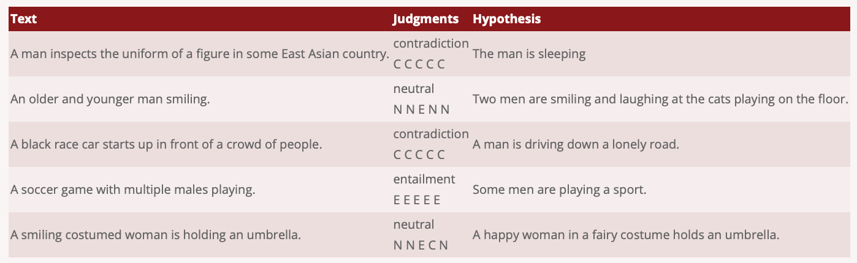
Stanford Natural Language Inference (SNLI)

Slide 14
*NLI
https://nlp.stanford.edu/projects/snli/
MultiGenre NLI (MultiNLI or MNLI) Corpus
Multiple genres or domains
MedNLI
Clinical domain data
XNLI
Cross-lingual
e-SNLI
Explanation annotations

Slide 15
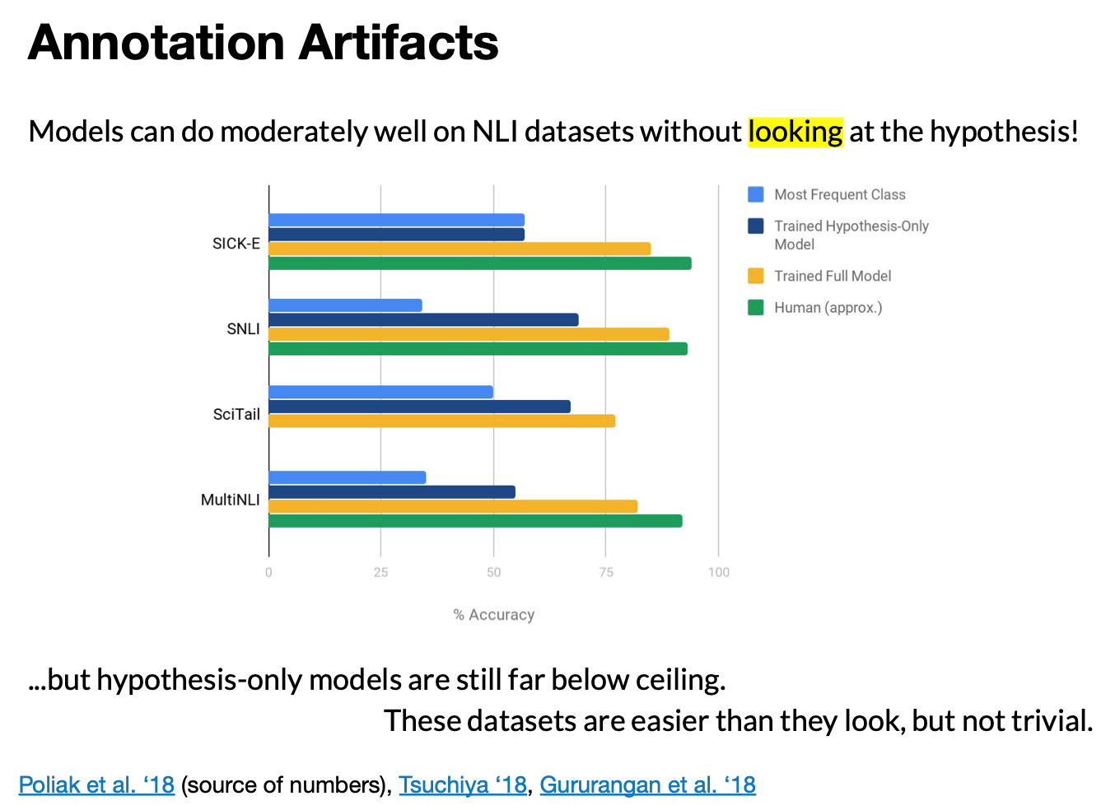
Everything you wanted to know about NLI
https://nlitutorial.github.io/nli_tutorial.pdf

Slide 16
Everything you wanted to know about NLI

Slide 17
How easy is the task for humans?
Human performance is often an upper bound for performance of computers.
If humans cannot agree if there is entailment, how can we know if the computer is right?
95% as an upper bound for human performance.
Some entailment decisions are context-dependent:
T: The witness saw John level a handgun toward the victim moments before gunshots were fired
H: The victim was shot by John
reading comprehension test for students → entailment
judge in court → in dubio pro reo (no entailment)

Slide 18
Challenges
Active vs passive
A bought B from C
B was bought from C
Semantic roles
A bought B from C
C sold B to A
Modality
A might buy B from C
A bought B from C

Slide 19
Challenges II
Temporal reference
Company A was founded in 2017
A existed in 2015
Comparatives
ITEL won twice as many orders than APCOM. APCOM won ten orders.
ITEL won twenty orders.

Slide 20
Challenges III
Ellipsis
John wrote a report, and Bill said Peter did too.
Bill said Peter wrote a report.
Anaphora
John said Peter hurt him.
Someone hurt John.
Quantifiers
No delegate finished the report.
Some delegate finished the report on time.

Slide 21
Challenges IV – World Knowledge
T: A man inspects the uniform of a figure in some East Asian country. H: The man is sleeping. CONTRADICTION You cannot inspect something while sleeping.
T: A soccer game with multiple males playing. H: Some men are playing a sport. ENTAILMENT Soccer is a sport.

Slide 22
Recognizing Textual Entailment
In an ideal world:
translate text and hypothesis into some meaning representation
check whether the meaning of the hypothesis is contained in the meaning of the text
John Smith drove to Seattle and bought a Honda Civic
Drive(E1, John Smith, Seattle) Buy(E2, John Smith, a Honda Civic)
John Smith drove to Seattle
Drive(E1, John Smith, Seattle)
Entailment

Slide 23
Recognizing Textual Entailment
In an ideal world:
translate text and hypothesis into some meaning representation
check whether the meaning of the hypothesis is contained in the meaning of the text
John Smith drove to Seattle and bought a Honda Civic
Drive(E1, John Smith, Seattle) Buy(E2, John Smith, a Honda Civic)
A Honda Civic drove to Seattle
Drive(E1, a Honda Civic, Seattle)
Non-Entailment

Slide 24
Levels of Representation in RTE systems
Originally: Entailment was thought of as a relation between texts, but other levels are possible:
single terms
pet → animal
predicates
X marry Y → Y is X’s spouse
propositions
cure(aspirin, headache) → eliminate(painkiller, headache)

Slide 25
Levels of Representation in RTE systems - Lexical RTE
Bag-of-words approach: Check whether the hypothesis contains all the material of the text.
T: John Smith drove to Seattle and bought a Honda Civic
H: John Smith drove to Seattle
but also
T: John Smith drove to Seattle and bought a Honda Civic
H: A Honda Civic drove to Seattle
Syntax is important!

Slide 26
Levels of Representation in RTE systems - Semantic Roles
Semantic Roles: Who did what to whom and when and why?
John Smith drove to Seattle and bought a Honda Civic
John Smith drove to Seattle
drove
and
bought
Agent
Direction
Agent
Patient
John
Smith
to
Seattle
John
Smith
a
Honda
Civic
drove
Agent
Direction
Now, we can detect, whether semantic roles correspond to each other!
John
Smith
to
Seattle

Slide 27
Approaches to RTE- Similarity Based Approaches
Basically, any sentence similarity method (see last week) can be used to compare text and hypothesis.
Lexical overlap (using word similarities, WordNet etc)
Edit distance
Syntactic tree similarity
But: similarity is not entailment, entailment is directional

Slide 28
Approaches to RTE – Proof-Theoretic Approaches
Text: John bought a Jeep.
Hypothesis: John owns a car.
Idea: We transform the text into the hypothesis.
World knowledge:
Rule 1: A Jeep is a car
Rule 2: If X buys Y, then X owns Y.
Proof:
Initial state: John bought a Jeep
Apply rule 1: John bought a car.
Apply rule 2: John owns a car

Slide 29
Entailment graphs

Slide 30
Entailment graphs
Tool for text exploration
represent entailment data in a compact format, e.g. analyzing customer interactions/user complaints from a certain website.
Sentences in one node are consideres equivalent, i.e. paraphrases.
Numbers on nodes represent frequency of a statement
Numbers on edges represent confidence of the entailment judgement
Challenge
Automatic construction of such graphs from pairwise entailment decisions

Slide 31
Knowledge Sources for RTE
Relations between words
WordNet: synonymy, hypo-/hypernymy
Word embeddings: similarity
Syntactic relations
Active-passive transformations
Anaphora resolution
Ellipses
Relations between verbs and their roles
FrameNet (We will see that in the following)

Slide 32
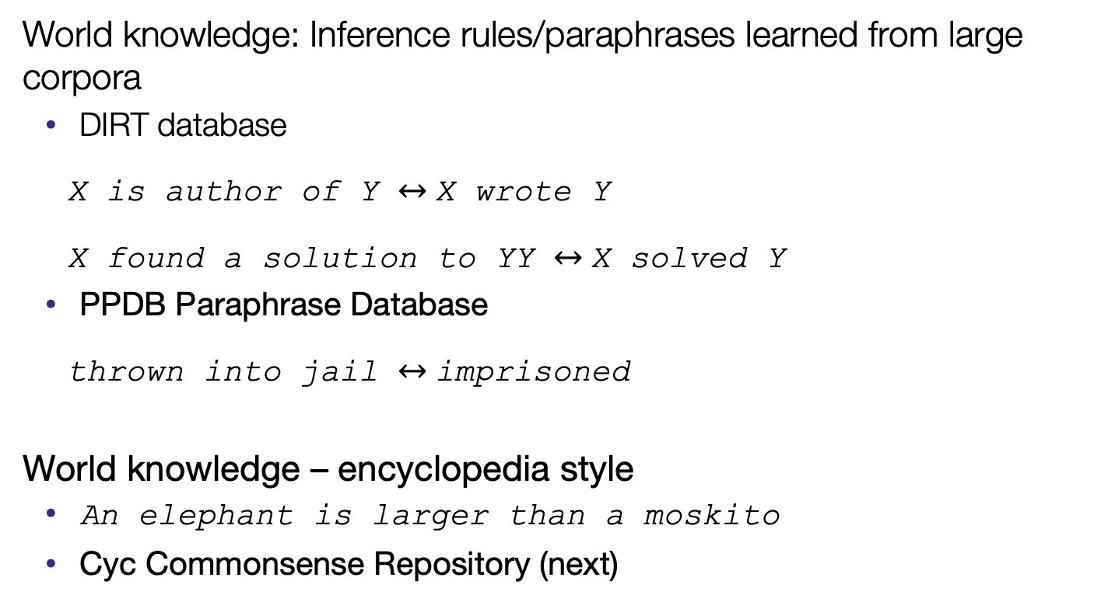
Knowledge Sources for RTE
World knowledge: Inference rules/paraphrases learned from large corpora
DIRT database
X is author of Y X wrote Y
X found a solution to YY X solved Y
PPDB Paraphrase Database
thrown into jail imprisoned
World knowledge – encyclopedia style
An elephant is larger than a moskito
Cyc Commonsense Repository (next)

Slide 33
Frame Semantics (I)
Frame Semantics (Fillmore 1976, Fillmore et al. 2003)
A frame represents a conceptual structure, or a prototypical situation, with a (frame-specific) set of roles that identify the participants or props involved in the situation
Frames are organised in a hierarchy, with various frame-to-frame relations
Inheritance, subframe (defining scenarios)
FrameNet database (http://framenet.icsi.berkeley.edu/)
FrameNet 1.5 : 1,019 frames, 9,423 lemmas, 11,942 lexical units
Commerce-goods-transfer
Seller | BMW bought Rover from British Aerospace.
Buyer | Rover was bought by BMW, which financed [...] the new Range Rover.
Goods | BMW, which acquired Rover in 1994, is now dismantling the company.
Money | BMW‘s purchase of Rover for $1.2 billion was a good move.
Slides adapted from Anette Frank and Aljoscha Burchardt
Notes:
Rollen, die die Teilnehmer und Requisiten der Situation beschreiben

Slide 34
Frame Semantics (II)
Frame: a conceptual structure or prototypical situation
Frame elements (roles)
Identify participants of the situation and the props involved in the situation
Are local to their frame
E.g. VERDICT frame:
[The jury]_{Judge} convicted [him]_{Defentant} [on the counts of theft]_{Charges}
On Thursday [a jury]_{Judge} found [the youth]_{Defendant} [guilty of wounding Mr Lay]_{Finding}
Frame evoking elements
verbs introduce frames, they are the prototypical frame-evoking elements
predicate-like nouns and adjectives introduce frames
e.g. nouns denoting events (development), relations (brother), states (height)
Notes:
Verdict - Urteil

Slide 35
Why Frame Semantics?
Disregarding aspects of „deep“ semantics
Negation, modality, quantification, ...
Normalisation: syntactic alternations
[Fred_{Agent}] hit_{Cause_Impact} [the ball_{Impactee}].
[The ball_{Impactee}] was hit_{Cause_Impact}
[John_{Donor}] gave_{Giving} [Mary_{Recipient}] [a book_{Theme}].
[John_{Donor}] gave_{Giving} [a book_{Theme}] [to Mary_{Recipient}].
Normalisation: lexical alternations (within and across part-of-speech)
[Marylin_{Speaker}] spoke_{Statement} about [her past_{Topic}].
[Marylin_{Speaker}]‘s statement_{Statement} about [her past_{Topic}].
[Marylin_{Speaker}] talked_{Statement} about [her past_{Topic}].

Slide 36
Frame-to-Frame Relations
Inheritance relation
a frame inherits all roles of one or more “super” frame(s)
Intentionally_act
Agent
Patient
Arrest
Authorities
Suspect
Offense
Charges

Slide 37
Frame-to-Frame Relations
Subframe relation
Super frame represents complex event
Subframes represent sub-events
Subframes usually inherit some roles of the super frame
Defense
Judge
Defendant
Jury
Court
Criminal
process
Offense
Charge
Prosecution
Defendant
Charge
...
...
...
...
Arraignment
Arrest
Sentencing
Trial

Slide 38
Coverage issues in FrameNet
Senses encountered in corpus may have no corresponding LU in FrameNet
behandeln1 (treat an illness) → Frame CURE
behandeln2 (treat with kindness) → No frame available
Low lexical coverage compared to WordNet
9,423 lemmas in FrameNet 1.5
156,584 lemmas in WordNet 3.0
The focus of FrameNet is on predicate-like lexemes
Many nouns and adjectives evoke uninteresting frames, hence few of them have been included [Baker and Fellbaum 2009]
E.g., nouns denoting artifacts and natural kinds; adjectives denoting colors

Slide 39
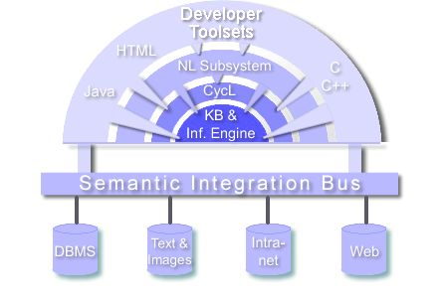
Cyc

Slide 40
What is CYC?
Repository of “Common Sense” knowledge
“CYC” is derived from encyclopedia
CYC = knowledge base + inference engine
Knowledge base
an ontology, containing terms and assertions about terms
Assertions are entered by humans, e.g. You have to be awake to eat.
Started in 1984 (by Douglas Lenat)
1994, Cycorp was founded to commercialize the Cyc technology
http://www.opencyc.org – OpenCyc: only the core Cyc ontology
http://researchcyc.cyc.com/ - ResearchCyc: substantially larger subset of the Cyc Knowledge Base
Notes:
was founded in 1984 by Dr. Douglas Lenat as a lead project in the Microelectronics and Computer Technology Corporation (MCC).
Break the "software brittleness bottleneck"
CycL Ontologiesprache, baut auf Prädikatenlogik auf

Slide 41
ResearchCyc – Numbers
500,000 concepts, forming an ontology in the domain of human consensus reality
5,000,000 assertions (facts and rules)
Assertions - examples
Surgeons are doctors. / Masons are builders.
You have to be awake to eat.
You can see people’s noses, but not their hearts.
How about a surgeon?
You cannot remember events that have not happened yet.
When people die, they stop buying things
Kerosene flows downhill
When a bowl is overturned, its contents fall out.

Slide 42
The Knowledge Base
Upper Ontology: Abstract Concepts
EVENT ⊆ TEMPORAL-THING ⊆ INDIVIDUAL ⊆ THING
Core Theories: Space, Time, Causality, …
Knowledge
Base
Layers
For all events a and b, a causes b implies a precedes b
Upper
Ontology
Core Theories
Domain-Specific Theories
For any mammal m and any anthrax bacteria a, m’s being exposed to a causes m to be infected by a.
Domain-Specific Theories
Facts
(Database)
Facts: Instances
John is a person infected by anthrax.

Slide 43
What’s in Cyc?
A Knowledge Base (KB) consisting of terms
Dog, DogFood, Doghouse, SnoopDoggyDogg
Assertions that relate these terms.
Ground Assertions:
(isa MyDogSharkey BelgianSheepdog)
(genls BelgianSheepdog Dog)
Rules, which derive assertions from Ground Assertions:
(isa THING COL ) +
(genls COL SUPERCOL) --->
(isa THING SUPERCOL)

Slide 44
A Dog is a …..
Agent Agent-Generic AirBreathingVertabrate Animal Agent Agent-Generic AirBreathingVertabrate Animal AnimalBLOBilateralObject BiologicalLivingObect CanineAnimal CarnivoreCarnivoreOrder ChordataPhylum Coelmates Container-Underspecified Dog EukaryoticOrganism Eutheria FrontAndBackSidedObject Heterotroph HexelateralObjectHomeotherm HumanScaleObject Individual IndividualAgentLeftAndRightSidedObject Location-Underspecified MammalNaturalTangibleStuff NonPersonAnimal OrganicStuff Organism-Whole PartiallyTangible PerceptualAgent Region-UnderspecifiedSentientAnimal SolidTangibleThing SomethingExistingSpatialThing SpatialThing-Localized System-GenericTemporalThing TerrestrialOrganism ThingTopAndBottomSidedObject Trajector-Underspecified VertebrateAnimalBLOBilateralObject BiologicalLivingObect CanineAnimal CarnivoreCarnivoreOrder ChordataPhylum Coelmates Container-Underspecified Dog EukaryoticOrganism EutheriaFrontAndBackSidedObject Heterotroph HexelateralObjectHomeotherm HumanScaleObject Individual IndividualAgentLeftAndRightSidedObject Location-Underspecified MammalNaturalTangibleStuff NonPersonAnimal OrganicStuff Organism-Whole PartiallyTangible PerceptualAgent Region-UnderspecifiedSentientAnimal SolidTangibleThing SomethingExistingSpatialThing SpatialThing-Localized System-GenericTemporalThing TerrestrialOrganism ThingTopAndBottomSidedObject Trajector-Underspecified Vertebrate

Slide 45
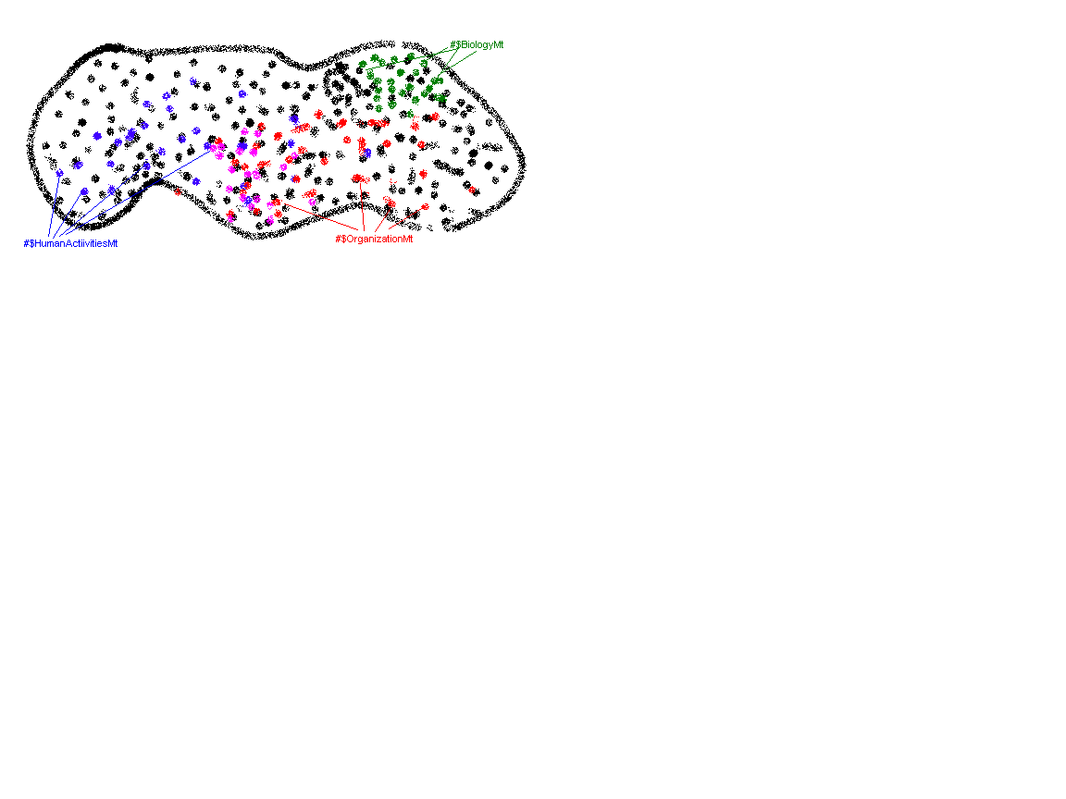
Microtheories
A way of grouping assertions and rules which share a set of assumptions; about a domain, level of detail, period in time, source, topic, etc.
Each KB assertion occurs within some microtheory
These allow for a KB that copes with global inconsistency and that can focus inference according to necessary detail

Slide 46
Microtheories
Though no monotonic contradictions are allowed inside a microtheory, assertions in different microtheories may be inconsistent
Time
MT1: Mandela is an elder statesman
MT2: Mandela is the President of South Africa
MT3: Mandela is a political prisoner
Granularity/domain
MT1: Tables are solid
MT2: Tables are mostly space
Microtheories are arranged in an inheritance hierarchy

Slide 47
Microtheory Inheritance: genlMt
#$BaseKB
genlMt
genlMt
#$NaiveSpatialMt
#$MovementMt
genlMt
genlMt
genlMt
#$NaturalGeographyMt
#$NaivePhysicsMt
genlMt
#$TransportationMt

Slide 48
Predicates and Denotational Functions
Predicates are truth-functional relations which can be evaluated according to facts in the KB and used to make sentences that are true or false
Usually Lowercase
(objectHasColor BrownDog Brown)
(memberStatusOfOrganization Norway NATO FoundingMember)
Functions take arguments to denote Non-Atomic Terms (NATs), expressions that represent things
Usually Uppercase
(FruitFn AppleTree) denotes an apple
(BorderBetweenFn Sweden Norway) denotes the border between Sweden and Norway.

Slide 49
Arity and Argument Types
Every predicate or function is defined with particular arity and argument types
Arity: Number of Arguments
(arity mother 2) (arity MotherFn 1)
Argument Types: use isa and genl relations
(arg1Isa mother Animal)
(arg2Isa mother FemaleAnimal)
(arg1Isa TransportViaFn ExistingObjectType)
(arg1Genl treatmentTypeAppliedToConditionType
MedicalTreatmentEvent)

Slide 50
Predicates and Rules
Can be built to form meaningful, well-formed logical sentences
You can add your own, using ASSERT
Mt: AgentGMt
Rule: (implies
(and
(isa ?HELP HelpingAnAgent)
(performedBy ?HELP ?HELPER)
(beneficiary ?HELP ?HELPED)
(positiveVestedInterest ?HELPER ?HELPED)

Slide 51
CycL – Assertions
“Animals sleep at home.”
(ForAll ?x (ForAll ?S (ForAll ?PLACE (implies (and (isa ?x Animal) (isa ?S SleepingEvent) (performer ?S ?x) (location ?S ?PLACE)) (home ?x ?PLACE)))))
if x is an animal and the performer of a sleeping event
then the place where that event takes place is the home of x.

Slide 52
CycL – More examples
"Bill Clinton belongs to the collection of U.S. presidents“
(#$isa #$BillClinton #$UnitedStatesPresident)
"All trees are plants".
(#$genls #$Tree-ThePlant #$Plant)
"Paris is the capital of France."
(#$capitalCity #$France #$Paris)
"a fact about sets"
(#$implies
(#$and
(#$isa ?OBJ ?SUBSET)
(#$genls ?SUBSET ?SUPERSET))
(#$isa ?OBJ ?SUPERSET))

Slide 53
Specialized Content
Cyc has several specialized and useful areas of KB content
Times and Dates
temporallyIntersects,startsAfterStartingOf,YearsDuration
Spacial Properties and Relations
constituent, ingredient, ~60 in predicates, ~60 Shape Attributes
Event Types, with Roles and Actors
MovementEvent, MedicalTreatmentEvent, GivingSomething

Slide 54
The Cyc Lexicon
Cyc also knows a lot about English
There are entries for Lexical items as well
Treat-TheWord Use-TheWord
Several predicates express relationships which translate English expressions into CycL (and vice versa)
(verbSemTrans Use-TheWord 0 TransitiveNPFrame
(and
(isa :ACTION UsingAnObject)
(performedBy :ACTION :SUBJECT)
(instrument-Generic :ACTION :OBJECT)))

Slide 55
Important Lexical Predicates
denotation
Relates a LexicalWord and SpeechPart to some denoted Thing (e.g. some Individual or Collection).
multiWordString
Relates a list of strings (e.g. ("hot")), a LexicalWord (e.g. Dog-TheWord), and a SpeechPart to some denoted Thing (e.g. HotDog); c.f. MultiWord -PhrasePrediciate.
verbSemTrans
Relates a LexicalWord, sense number, and SubcategorizationFrame to a NLTemplateExpression; c.f. SemTransPredicate.
nameString
Relates a Thing to a string which (conventionally) refers to it

Slide 56
References
Dagan, I., Roth, D., Sammons, M., & Zanzotto, F. M. (2013). Recognizing textual entailment: Models and applications. Synthesis Lectures on Human Language Technologies, 6(4), 1-220.
Josef Ruppenhofer, Michael Ellsworth, Miriam R. L Petruck, Christopher R. Johnson, Collin F. Baker, Jan Scheffczyk: FrameNet II: Extended Theory and Practice (Revised November 1, 2016.)
Kotlerman, L., Dagan, I., Magnini, B., & Bentivogli, L. (2015). Textual entailment graphs. Natural Language Engineering, 21(5), 699-724.
Lin, D., & Pantel, P. (2001, August). Dirt@ sbt@ discovery of inference rules from text. In Proceedings of the seventh ACM SIGKDD international conference on Knowledge discovery and data mining (pp. 323-328).
Stern, A., & Dagan, I. (2012, July). Biutee: A modular open-source system for recognizing textual entailment. In Proceedings of the ACL 2012 System Demonstrations (pp. 73-78). Association for Computational Linguistics.
Dzikovska, M. O., Nielsen, R. D., Brew, C., Leacock, C., Giampiccolo, D., Bentivogli, L., ... & Dang, H. T. (2013). Semeval-2013 task 7: The joint student response analysis and 8th recognizing textual entailment challenge. NORTH TEXAS STATE UNIV DENTON.

