Slide 1
Structuring the Literature Review

Slide 2
Introduction
Purpose of a Literature Review
Sections in literature review
Writing style
Assessment on the literature found
Effective literature review
Literature Map

Slide 3
Purpose of a Literature Review
To identify and justify the needs for the proposed study
To provide support for your study in comparison with other similar studies
To avoid ineffective approaches
To understand existing methods used
To identify key variables
To understand what has been researched and what needs to be researched
To understand good methodology techniques used
To help you make sense of your findings during data analysis
To conduct conclusions in comparison with other studies

Slide 4
Sections in Literature Review
1) Introduction
Describing what the literature review will cover and the scope of the literature included. Introduce the reader about the sections included in it.
2) Main Body
Section where the literature chosen is discussed, analysed and compared.
Discuss literature regarding:
Independent variable(s) – consider subsections or focus on the single most important variable
Dependent variable(s) - consider subsections or focus on the single most important variable
Studies that relate the independent variable(s) to the dependent variable(s). Studies should be similar to the proposed study.
3) Conclusions
Summarizing the main themes and their significance for your study. Highlight the most important studies.

Slide 5
Writing style – Researcher’s Voice
The literature review is not a list of articles and books. It has to be written in a way that includes the researcher’s VOICE.
The researcher’s VOICE is important because it helps the reader understand the literature in relation to the proposed research framework.
It is important that the researcher’s VOICE is supported by data and findings from previous studies.

Slide 6

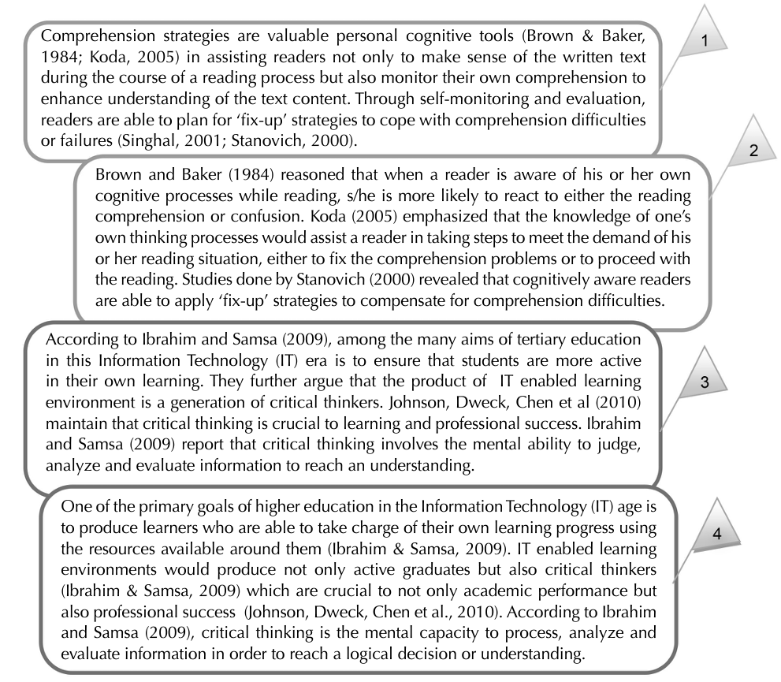
Writing style - Researcher’s Voice
Can you identify which of the below paragraphs contain the researcher’s VOICE?

Slide 7
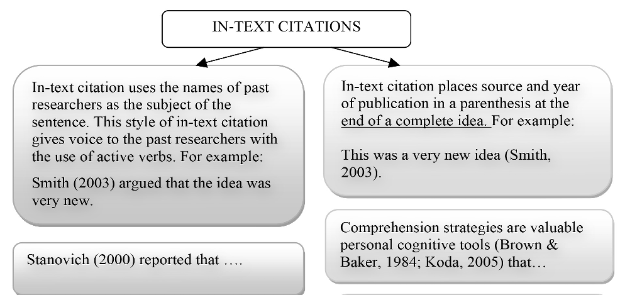
Writing style - Researcher’s Voice
Answer: (1) and (4) contain the researcher’s VOICE
Each sentence in the (2) and (3) begins with ‘someone’ saying something about the topic. Example: Brown & Baker (1984) reasoned that….
There are two types on in-text citations
(a) – putting the names of researchers as the subjects of the sentence
(b) – having the source and year of publication in parentheses at the end of a sentence

Slide 8
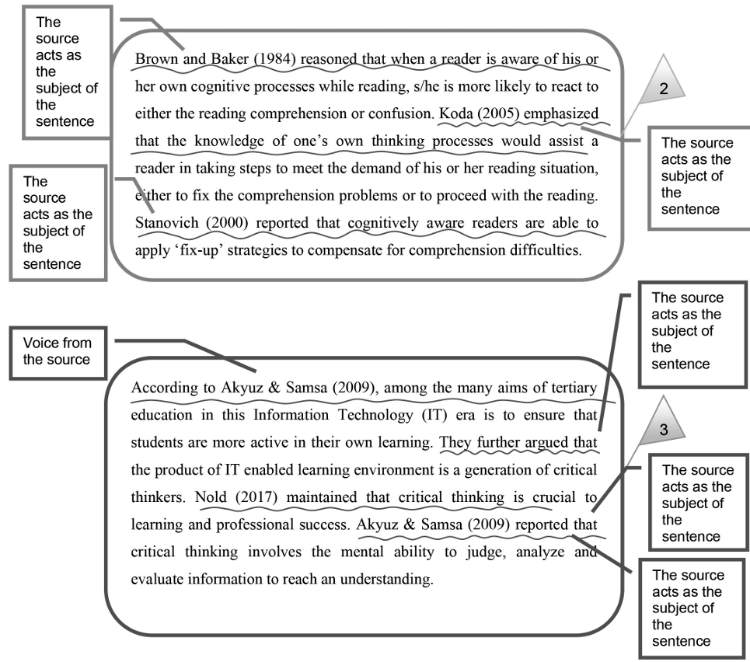
Writing style - Researcher’s Voice
Paragraphs that make use a lot of in-text citations that start at the beginning of a sentence might reduce the author’s voice. Readers might get distracted with all the names of past researchers and what ‘they said’. The researcher’s VOICE might get lost and overwhelmed by other ‘voices’.

Slide 9
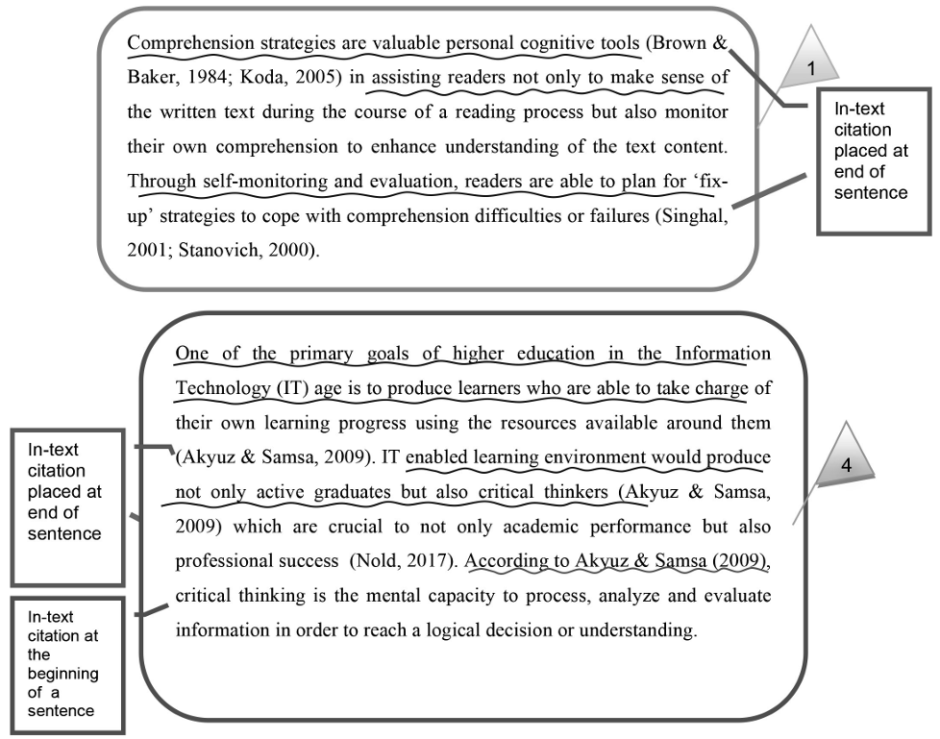
Writing style - Researcher’s Voice
Sentences that do not begin with ‘someone’ says or reports something would naturally sound like the researcher’s voice. But it also suggested to make use of both approaches where appropriate to change the writing style and the tone of the paragraph.

Slide 10
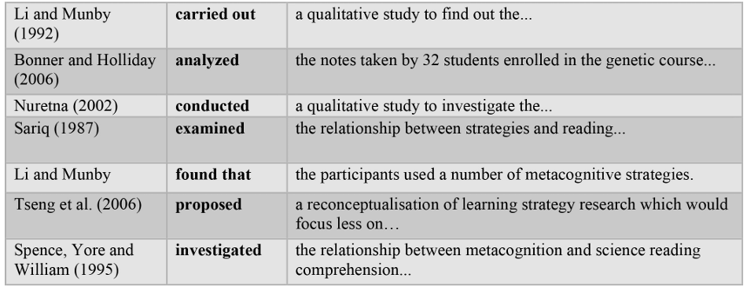
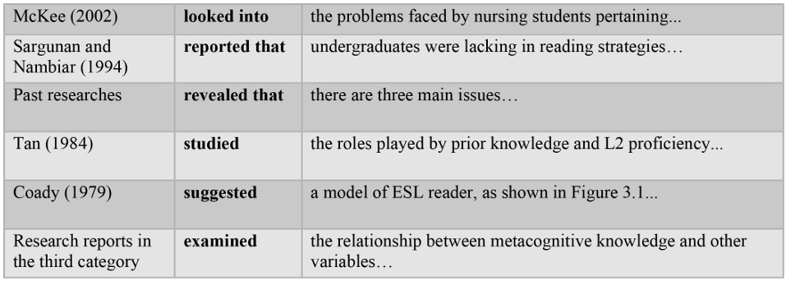
Writing style – English Phrases
Phrases that can be used to cite previous researchers:
Past Tense
Usually used when reporting about past findings

Slide 11
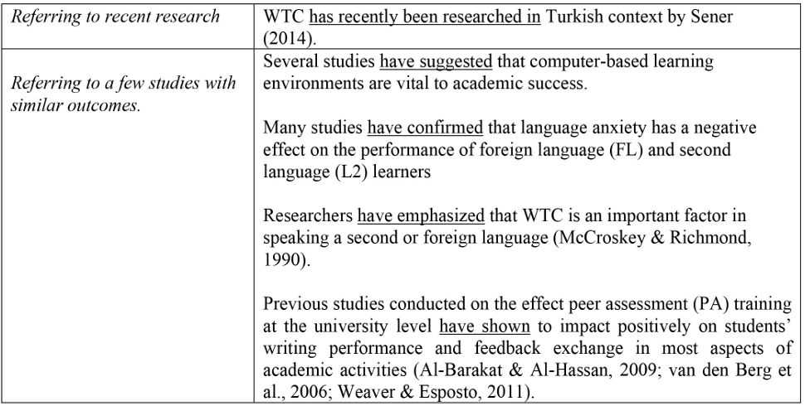
Writing style – English Phrases
Phrases that can be used to cite previous researchers:
Present perfect tense:
Usually used when referring to recent study and also to make generalization about past research in the area

Slide 12
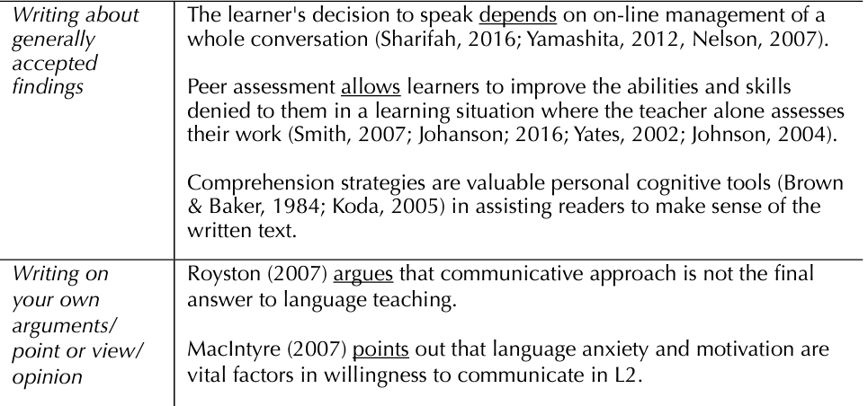
Writing style – English Phrases
Phrases that can be used to cite previous researchers:
Present tense:
Usually used to write on generally accepted findings or when you as the author write about your arguments from your point of view

Slide 13
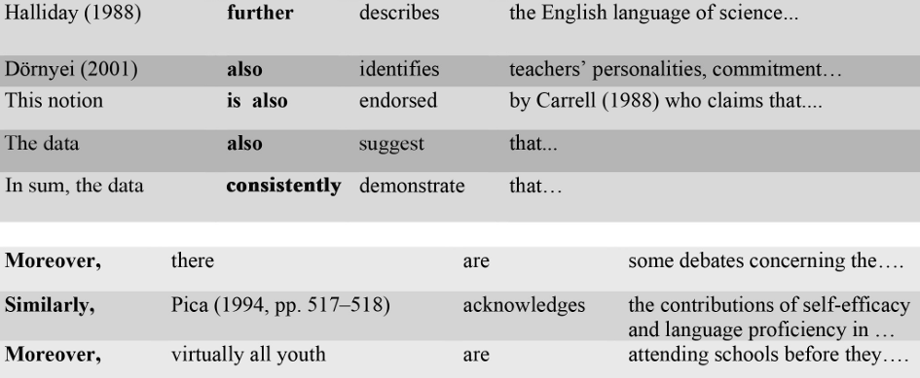
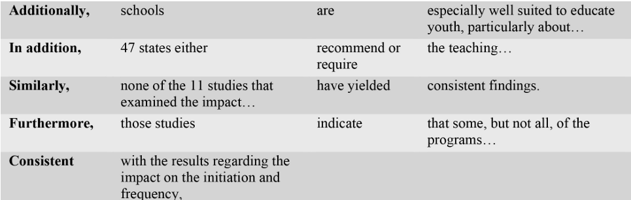
Writing style – English Phrases
Phrases that can be used to show evidence of similarities and differences in the found studies.
Similarity

Slide 14
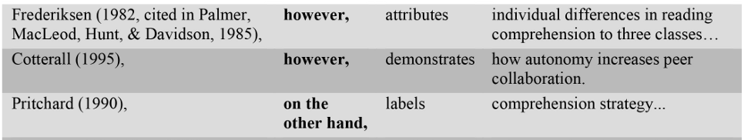
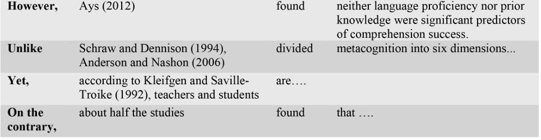
Writing style – English Phrases
Phrases that can be used to show evidence of similarities and differences in the found studies.
Contrast

Slide 15
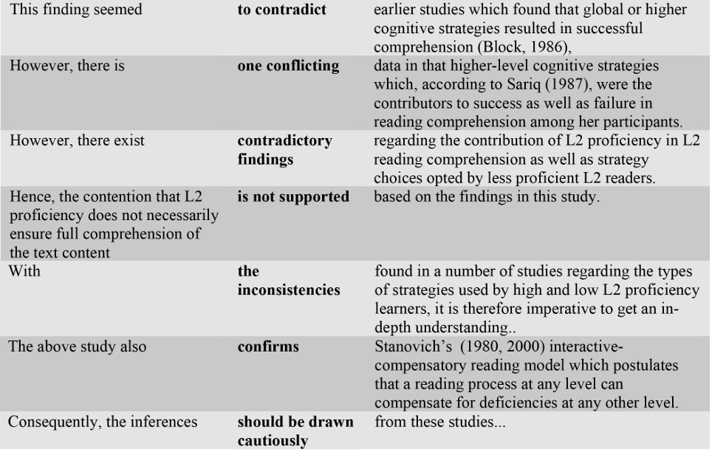
Writing style – English Phrases
Phrases that can be used to show evidence of similarities and differences in the found studies.
Contrast

Slide 16
How to Cite IEEE
IEEE citation format in-text citations do not require mentioning of the author’s name, pages used, or publication date. Instead, the style requires that you refer to the source with a number in a square bracket, corresponding to its full citation in your reference list.
Place the bracketed citation after the text, before any punctuation. Ensure that there is a space before the first bracket.
Number your sources in the order of which they appear in your paper. Once you refer to a source and give it a number, continue using that number whenever you cite them again in the paper.
Use the reference numbers either as a noun or a footnote. When used as a footnote, you can directly write “in [1]” within the sentence, instead of saying “in reference [1].”
When citing multiple sources at once, list each number separately with their brackets. You can use either a comma or a hyphen between the numbers.

Slide 17
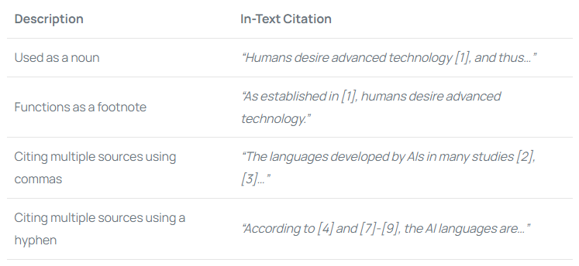
How to Cite IEEE

Slide 18
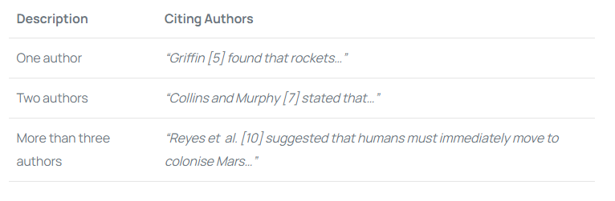
How to Cite IEEE
When citing authors within your paper (only when it is essential), write the author’s last name followed by the bracketed citation. Here are a couple of examples to see how IEEE style applies to citing different authors:

Slide 19
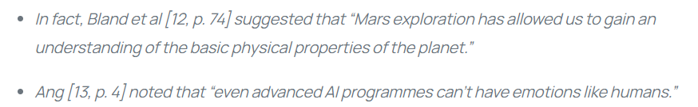
How to Cite IEEE
A short direct quote contains no more than four lines of the quoted material. Here are two examples of a short direct quote in the IEEE citation style:

Slide 20

How to Cite IEEE
Here is an example of a long direct quote:

Slide 21
Assessment on the Literature found
You might find a lot of sources related to your area of study. It is suggested that you assess (filter) the literature found based on these criteria:
Literature is relevant to your area of study
Author found is knowledgeable. Example: published other research on related topic
Study found is methodologically robust and therefore respectable and trustworthy
Source of information is reputable. Example: well known publishers

Slide 22
Concept Map
A Literature map is a visual representation of the themes within the relevant existing research.
The objective when creating a literature map, is to organize the literature found using categories.
Overtime the map might evolve with new sources or categories.
It makes it easier for you to analyse and identify which sources you’re going to discuss under each category and what issues you need to address.
It can contain multiple subtopics under a particular main topic with building/opposing views.
The map should be build while you’re reading the literature.
It helps you to write a better structured literature review.

Slide 23
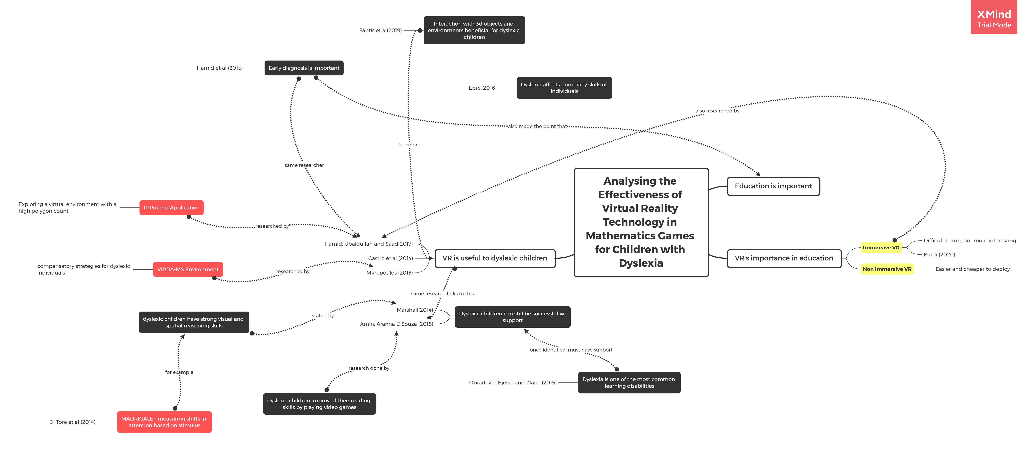
Concept Map – Example (1)

Slide 24
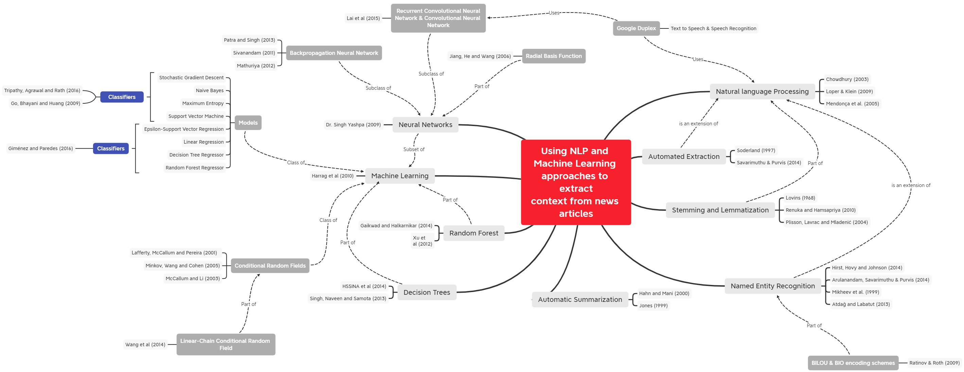
Concept Map – Example (2)

Slide 25
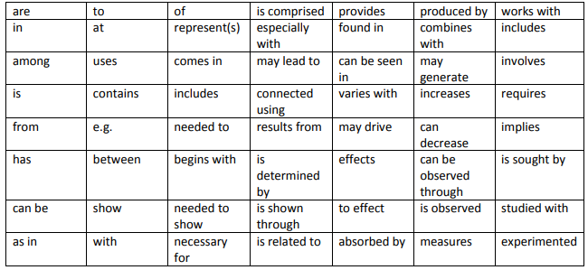
Concept Map – Cross Links – Cheat Sheet
Other phrases that can be used: https://files.eric.ed.gov/fulltext/EJ1244695.pdf

Slide 26
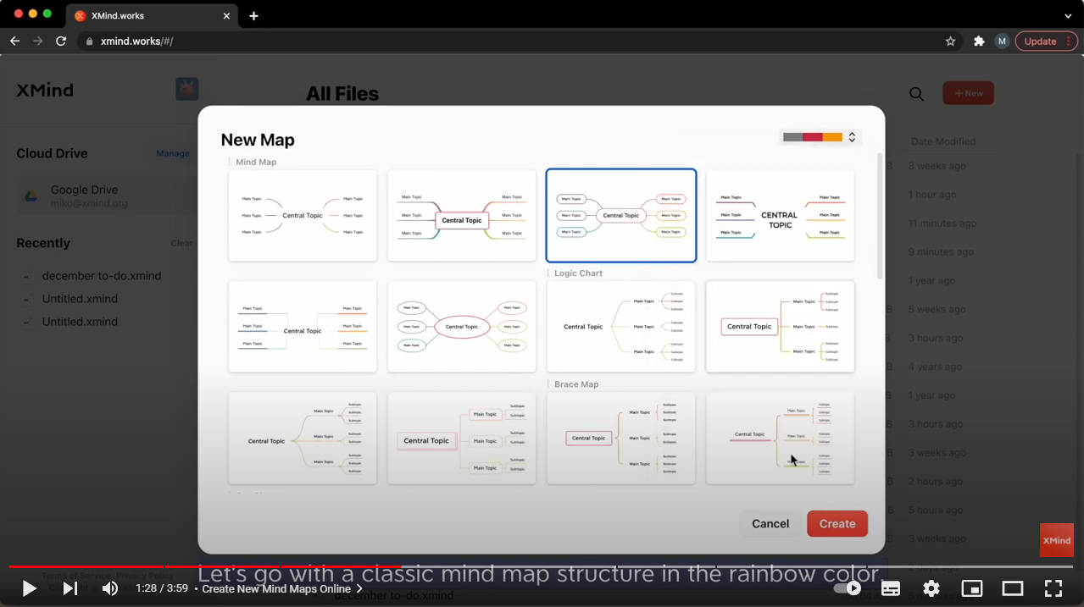
Concept Map
Software to create concept maps: https://xmind.works/

