Slide 1
Project 1

Slide 2

Library

Slide 3
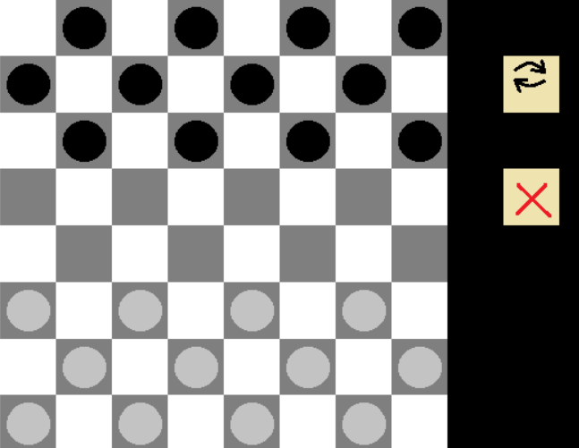
Checkers

Slide 4

Move

Slide 5
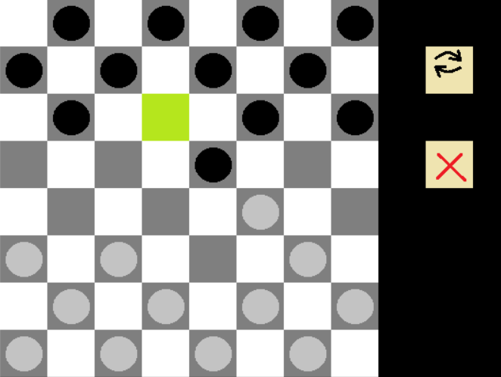
Capture

Slide 6
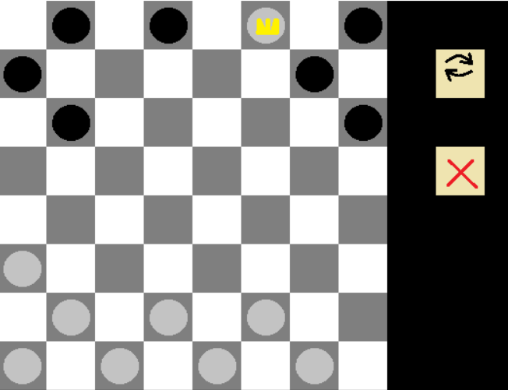
Promotion

Slide 7
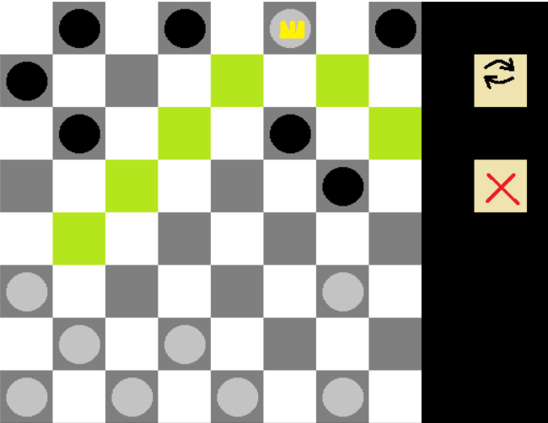
King’s moveset

Slide 8
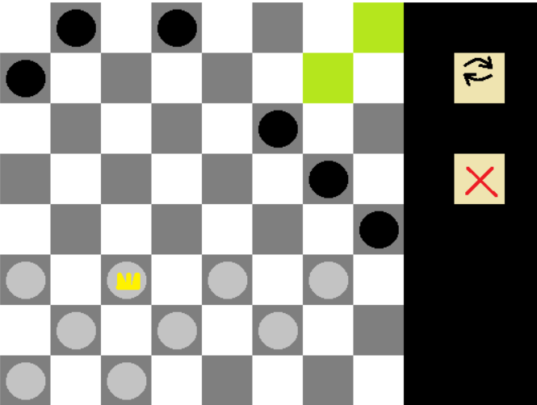
King’s moveset

Slide 9

Winner

Slide 10
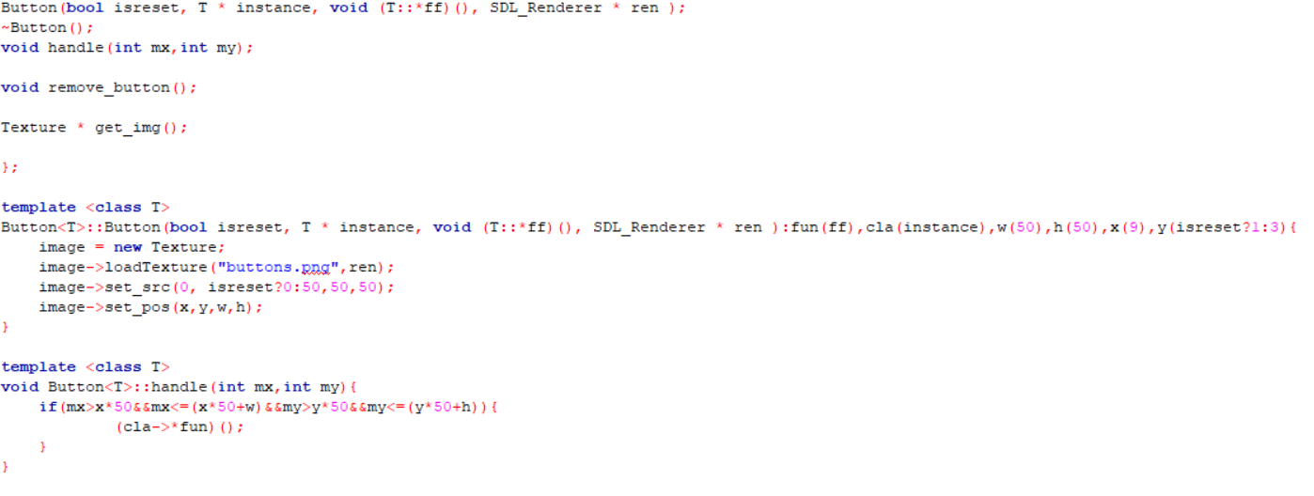
Button class

