Slide 1
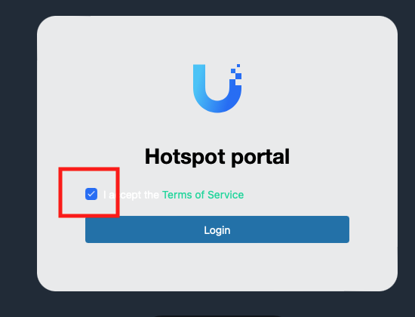
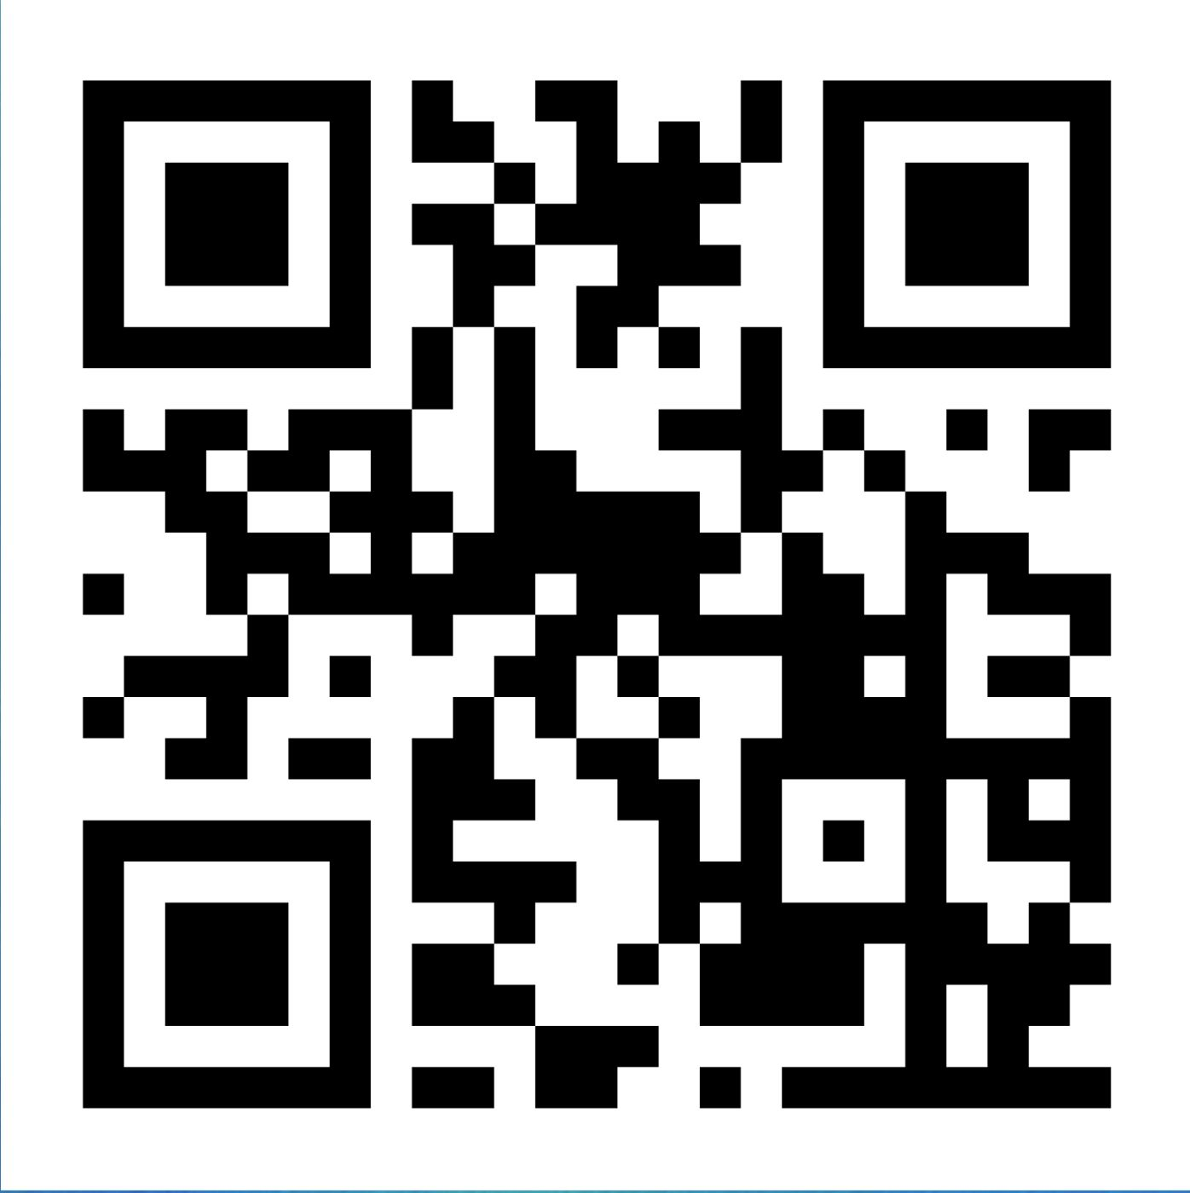
1. ORDER DINNER
2. WIFI: Hudson Grille
3. SUBSCRIBE Luma.com/AICATL

Slide 2
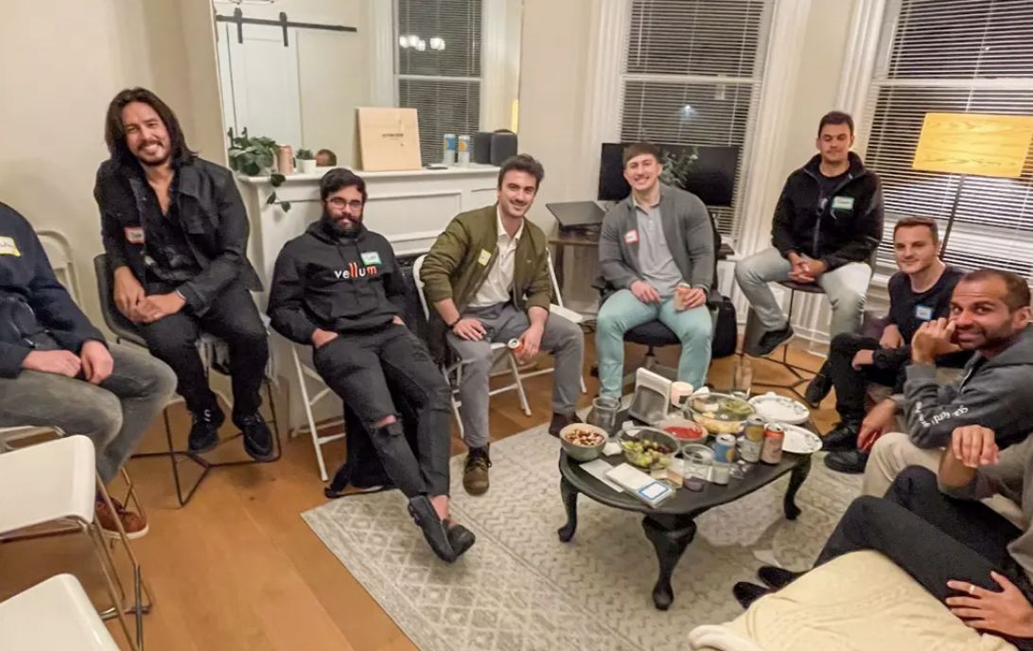

Welcome Everyone!
The AI Collective is a grassroots community created in San Francisco, Feb. 2023 by ten AI engineers at leading AI companies who knew what AI was capable of doing.
  These young engineers questioned what would happen with humans in a world dominated by AI and what could they do about it. They kept meeting and talking about AI asking what will our purpose be?
  They decided to find a way to help humans by arranging in-person meetings like this at scale to talk about and learn all aspects of AI

Slide 3
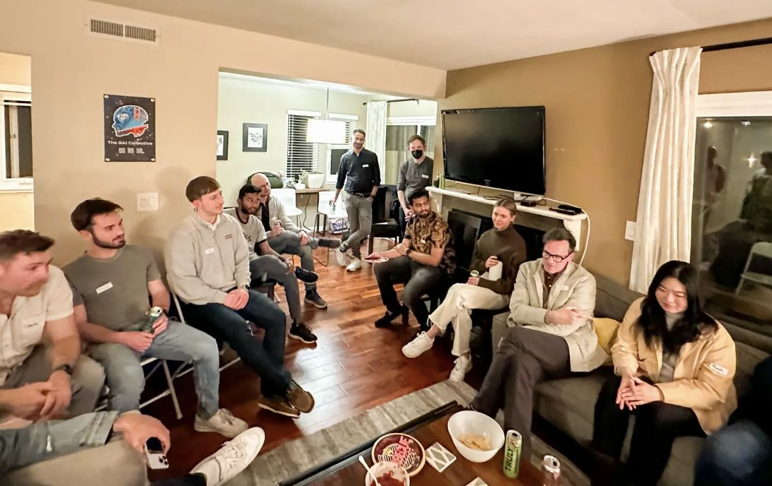
Our Mission
Their “why” became our mission to represent humans in AI, protect human flourishing, and actively educate and upskill communities around the world
Our goal is to become a voice for advocacy with governments and AI companies
Together we share what we know and learn how to control AI rather than allowing AI to control humans
We believe AI is for everyone and nobody should be left behind when it comes to AI education
We meet AI professionals where they are at every level

Slide 4

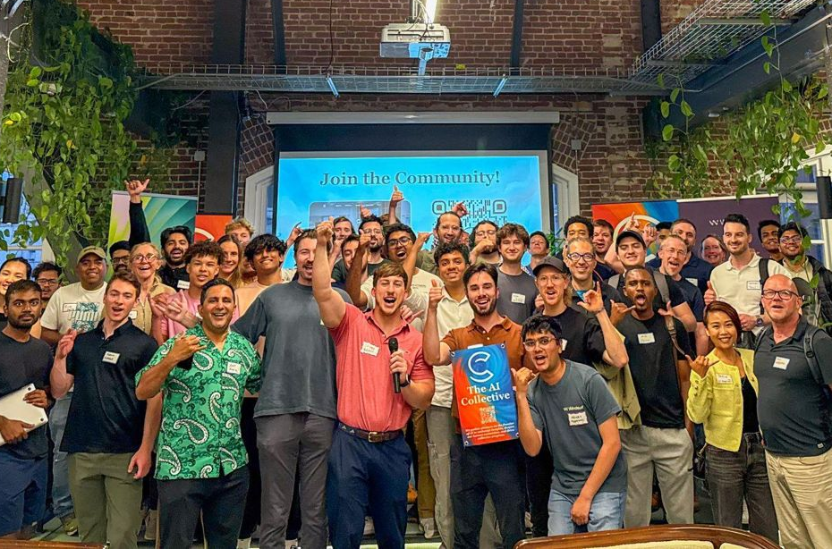
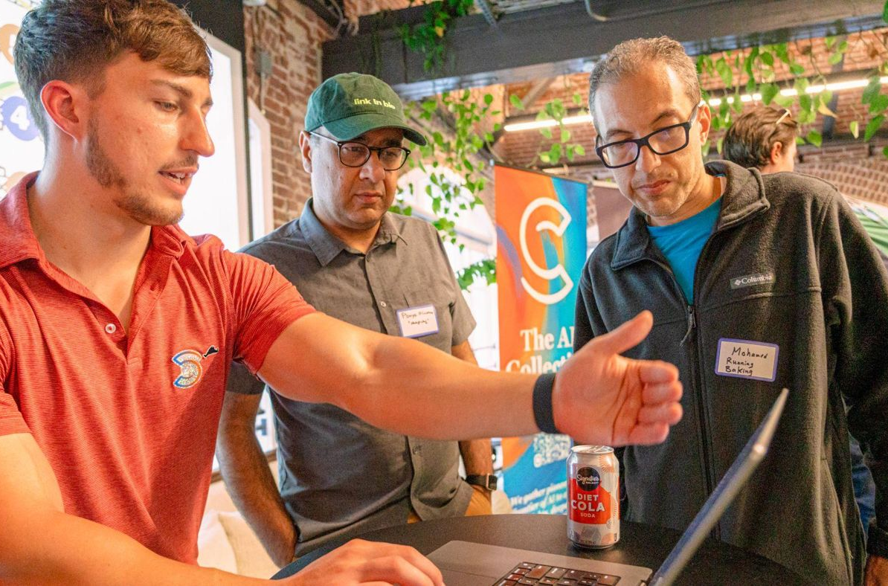
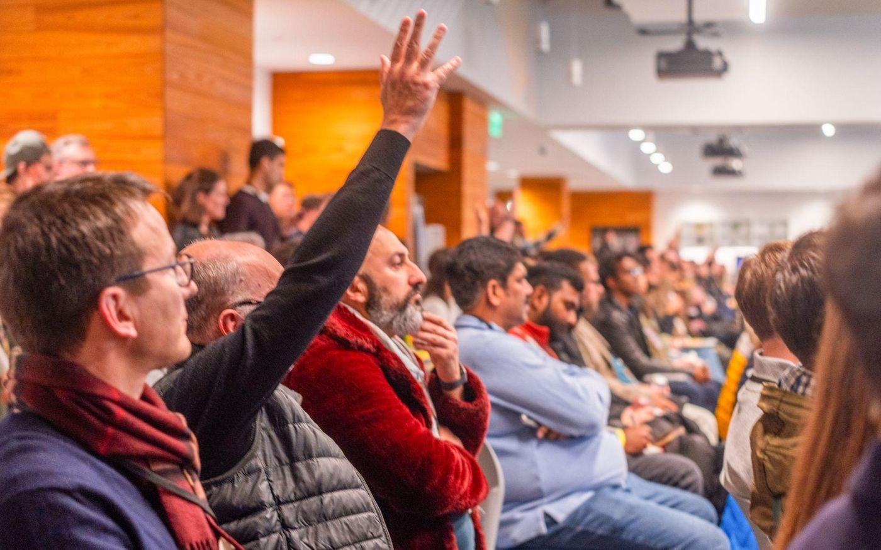
OUR COMMUNITY VALUES
Connection: The Collective’s strength is 1+1 connections
Positive Sum: If we all think win-win, we all win
Curiosity: Everyone has something to teach you
Belonging: Create the community you’ve been searching for

Slide 5

Local Impact Global Scale
The AI Collective is the world’s largest grassroots AI community.
The AI Collective Global = 511,000+ members, 300+ chapters in 75 countries
We added 50,000+ members in the last 30 days.
When you signed up to join tonight’s event, you became a member.
Our Region = South Central: 17 chapters, 7,800+ members. Carolinas: 6 chapters, 560 members.
The AI Collective Atlanta = 4,800+ members, 115+ events since July 2025
We meet 2 to 3 times a week all over the Atlanta area.
24 organizers in Atlanta, and we’re adding more to cover the metro area and lead committees and special interest groups.

Slide 6

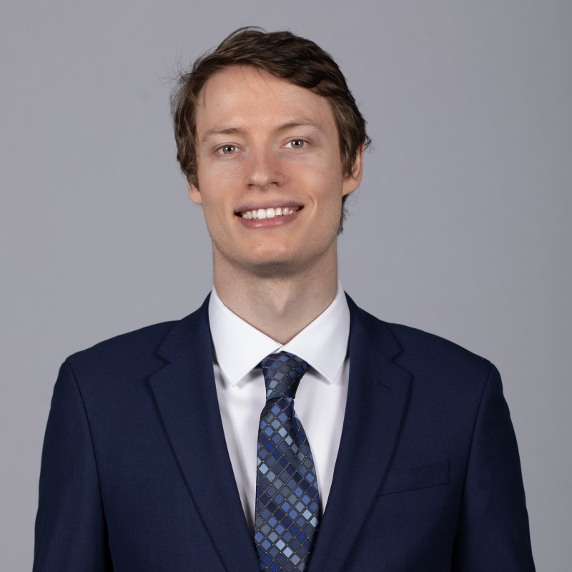



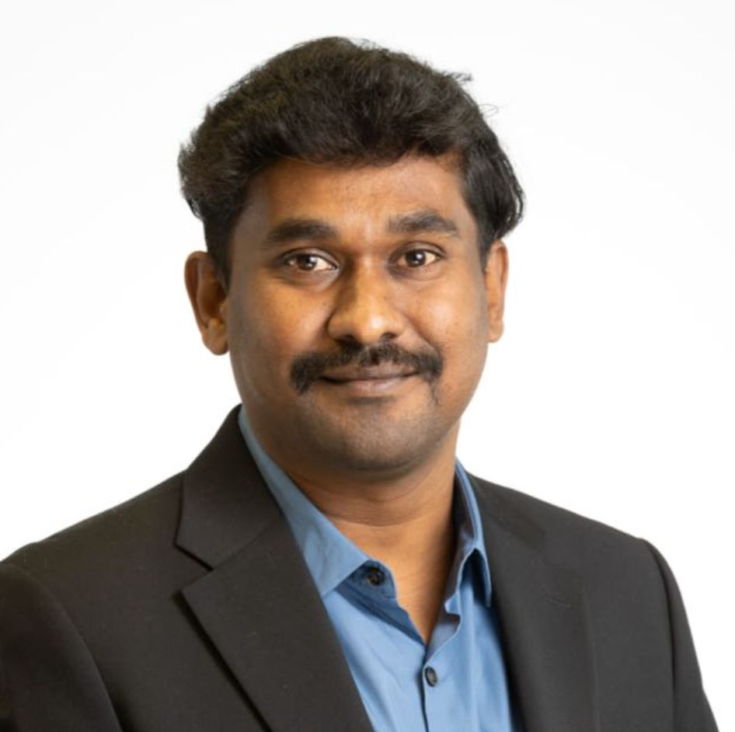
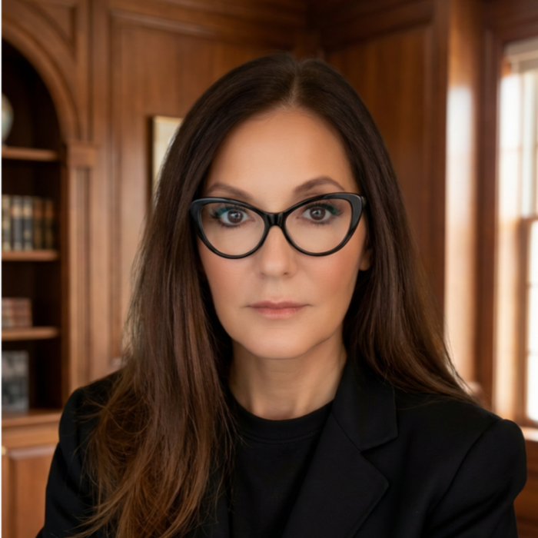
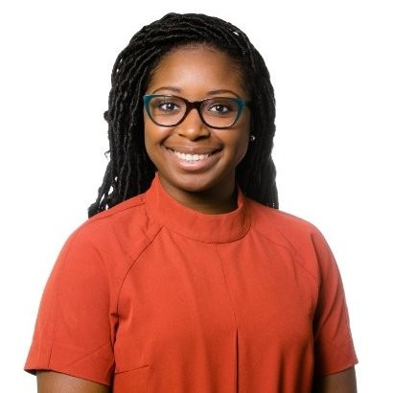
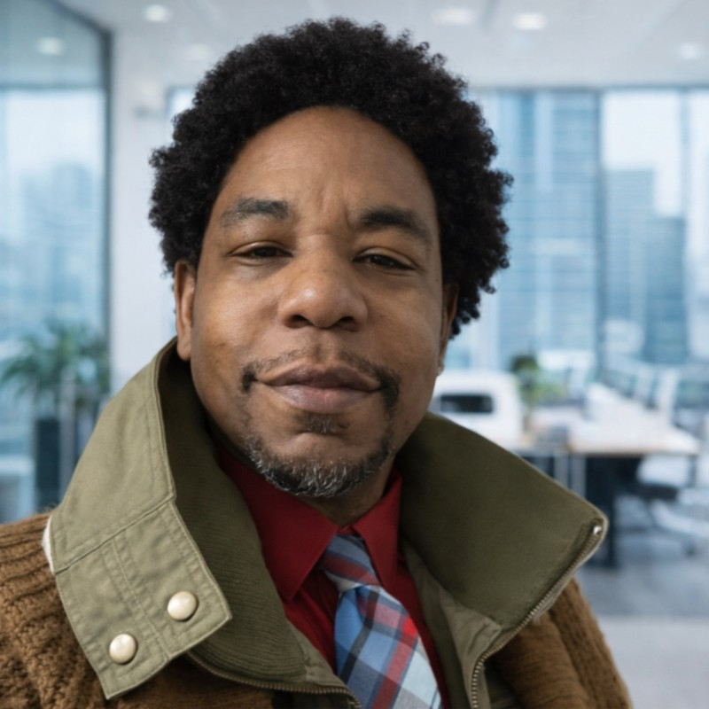
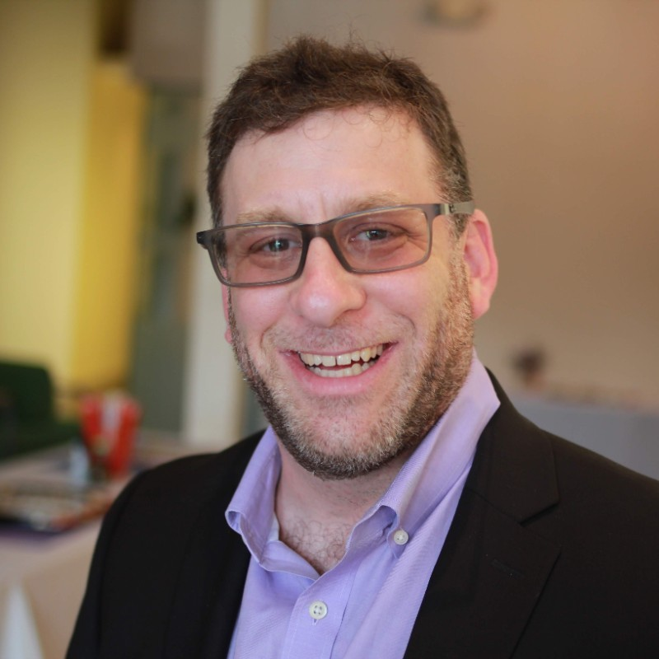
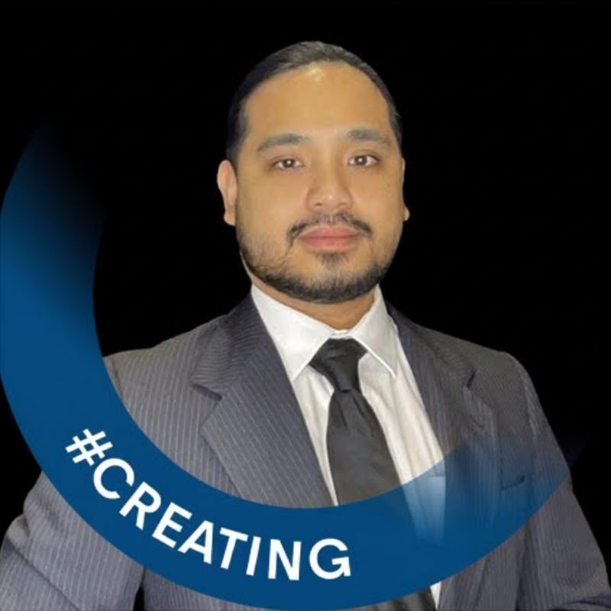
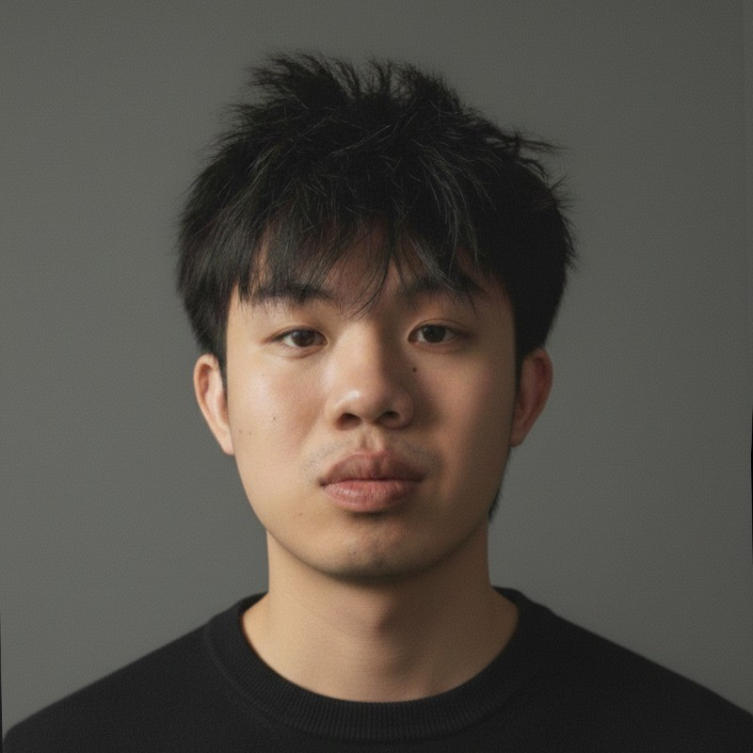

The AI Collective - Atlanta - Team
Mark Michelson
Kenneth Eaton
Tyler Sztuka
Krishen Kota
Sonal Shah Chandler
Sooryakumar Thoppan
Suzel Wyvill-Jones
Anika Fisher
Anthony Webb
Drew Schillinger
Jordan Elizaga
Ruitao Chen
Dr. Tope Mitchell

Slide 7
Types of Events
Socials
Walk & Talk AI
Vibe Nights
Coffee/Breakfasts
‘Appy Hour Meetups
Lunch & Learn
Ice Cream Socials
Taco’bout AI Tuesdays
Meditation, Tai Chi, Yoga
Education
Demo Nights
Roundtables
Panel Discussions
Workshops
Hackathons
Pitch Nights

Slide 8
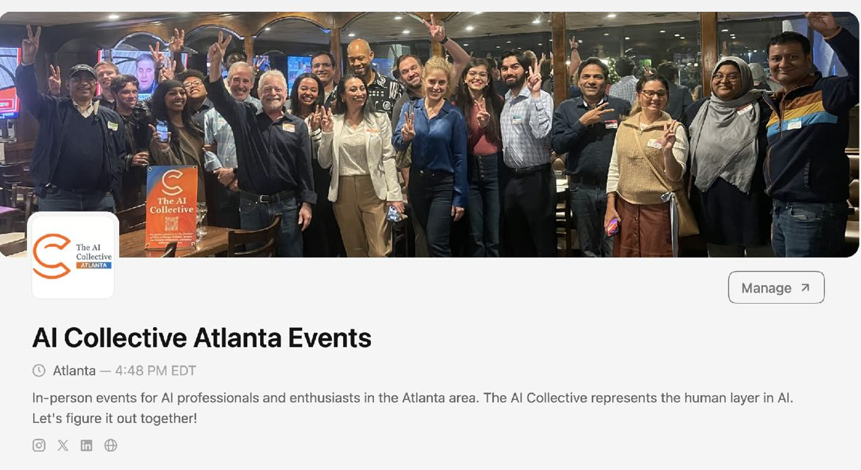
Subscribe to: Luma.com/AICATL

Slide 9

BEFORE WE BEGIN
Tonight's Rules
🍔 Order Something
💻 Laptop Open
2-item minimum per person. Eat, drink, and code.
Everything runs in your browser. Free accounts are fine.
🚫 No Judgment
⚡ Context Is Everything
Beginners welcome. Experts welcome. The only rule is you try.
Tell the AI what you want, why you want it, and what good looks like.

Slide 10
QUICK POLL
Who's in the Room?
Show of hands — which one are you tonight?
1
2
3
4
Never heard of it
Heard of it
Tried it once or twice
I vibe code regularly
Vibe coding? What's that?
Haven't tried it yet
Dipped a toe in
Already building stuff

Slide 11
THE CORE IDEA
What Is Vibe Coding?
"You're the architect. The AI is the builder. You never write a line of code."
01
02
03
Describe it
Review the output
Direct corrections
Say what you want in plain language. Be specific about what it should do and look like.
The AI does the hard part and shows you the result. You look at what it made, not the code.
“Make it darker.” “Add a date.” “That button doesn’t work. Fix it.”

Slide 12
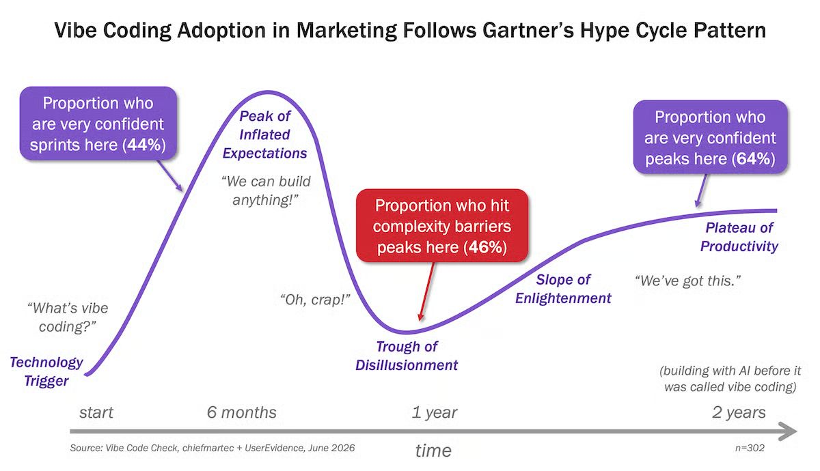
← You are here tonight!

Slide 13
AN AGENT IS REALLY AN ASSISTANT
Assistant vs. App
🤖 Assistant (agent)
🛠️ App
• Does stuff for you, on your behalf
• A tool that does one thing well
• Searches, compares, and fills things in
• Works the same way every time
• Figures out HOW to get it done
• Has buttons, forms, and screens
Example: Plan my trip to Chicago. Flights, hotel, food, and fun.
Example: A tracker that shows my week at a glance.
Tonight you build both. First an assistant, then an app.

Slide 14
WHAT'S POSSIBLE TODAY
Free Assistants to Try Tonight
Assistant
Where to find it
What it does for you
Muse
muse.ai or the Muse app
Meta's new assistant. Plans, fills in forms, and books.
Comet
Free browser from Perplexity
Reads the page you're on and clicks through tasks.
Gemini
gemini.google.com
Researches and builds your plan. Deep Research is free.
Manus
manus.im
Works through a bigger job, step by step.
No subscription needed. Free plans limit how much they do, so start small.

Slide 15
EXERCISE 1 · 6:30 – 7:00 PM
Build Your Weekend Concierge
Open your favorite AI. Tell your assistant about the trip you want.
🚘 Drive
🏨 Airbnb
🧘‍♀️ Getaways
🍽️ Restaurants
🎭 Shows
📍 Things To Do

Slide 16
THE ASSISTANT RECIPE: WHAT · CONTEXT · TARGET
Tell Your Assistant What You Want
1. What do you want it to do? Plan a 4-day trip for two, from Atlanta to Chicago, November 12 to 15.
2. Context: We've never been there. We love museums, art, and natural history. Suggest what to see, where to eat, and the best area to stay.
3. Target: Keep flights, hotel, and getting around under $1,200 for two, or as close as you can. Show me a day-by-day plan with prices.
4. Questions: Ask me any questions that would help refine this before you start.
Say it the way you'd say it to a friend.
💡 No need to say “act like a travel agent.” Just say what you want done.

Slide 17
EXERCISE 1 · 6:30–7:00 PM
It’s Vibe Time!
What will your assistant do for you?

Slide 18
PICK ONE YOU LIKE
Four Tools to Vibe Code Tonight
Tool
Where to find it
Best for
Claude
claude.ai
A great writer and builder. Best for bigger apps and detailed instructions.
ChatGPT
chatgpt.com
Fast and familiar. A good all-around helper.
Gemini
gemini.google.com
Works with your Google account. Good for quick builds.
Perplexity
perplexity.ai
Searches the web and shows its sources. Great for research.
All free in your browser. Pick one you know, or try them all.

Slide 19
EXERCISE 2 · 7:00 – 7:45 PM
Build an App
Context is the most important part. Give the AI the whole picture.
What and why: What are you building, and what problem does it solve?
Who uses it: Just you? Your team? Your kids?
How it looks: iPhone, web, or both? Simple or detailed? Any colors you love?
What good looks like: When it works, what do you see? Describe the finished app.
Questions: Ask me questions along the way if you're unsure. Don't guess.
Have an idea? Use it. No idea? The next slide has three ready-made ones.

Slide 20
NO IDEA? START HERE
App Starter Ideas
🏃 Health Tracker
I want a simple iPhone app to log my workouts so I stay consistent. Just for me. Big buttons, calm blue colors. Good looks like: one tap to log, and I see my weekly streak.
📞 Sales Activity Tracker
I want a web app to log my sales calls and follow-ups so nothing slips. For me and my team. Clean and simple, works on phone and laptop. Good looks like: my week on one screen.
🎮 Mini Game
I want a word guessing game my family can play in the browser. Five-letter words, six guesses. Bright colors, easy for kids. Good looks like: we play a round in two minutes.

Slide 21
EXERCISE 2 · 7:00 – 7:45 PM
It’s Vibe Time!
What will your app do for you?

Slide 22
7:45 – 8:30 PM
What Did You Build?
Open mic. Share your screen. Show the room what happened.
What did you build?
What surprised you?
What would you do next?
You just vibe coded. You're almost a builder now.
Same time next month. Watch your inbox.

Slide 23
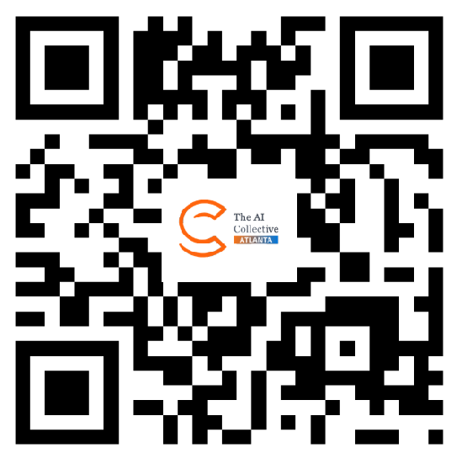
What's Next
📅 Next Vibe Nights
{{NEXT_VN}}
🌐 AIC Atlanta Membership
Free. You joined tonight. Stay connected at aicollective.com/chapters/atlanta
{{EV1_NAME}}{{EV1_SEP}}{{EV1_DETAILS}}
{{EV2_NAME}}{{EV2_SEP}}{{EV2_DETAILS}}
{{EV3_NAME}}{{EV3_SEP}}{{EV3_DETAILS}}
{{EV4_NAME}}{{EV4_SEP}}{{EV4_DETAILS}}
Chapter Page
Thanks for being here tonight.

