Slide 1
Criminal Law
Large Group 10
Consolidation & Assessment

Slide 2
Voluntary assumption of care
Stone & Dobinson; Instan
Relationship
Gibbins & Proctor
Duty to
avert danger created
Miller
Positive duty to act
Statutory duty
Contractual
duty
Pittwood

Slide 3
Identify
Offence
Intent
Actus Reus
Mens Rea
Was the result D’s
aim or purpose?
No
Yes
Was the consequence virtually
certain to happen?
Yes
Did D himself appreciate this?
No
No
Yes
Direct Intent
May be
indirect Intent
Not Guilty

Slide 4
HOMICIDE
ACTUS REUS
Unlawful killing of a human being
MENS REA
With intent to kill or cause GBH (i.e. malice aforethought)
Yes
No
Yes but…
MURDER
VOLUNTARY
MANSLAUGHTER
INVOLUNTARY
MANSLAUGHTER
Diminished responsibility
Abnormality of mental functioning;
Recognised medical condition;
Substantially impairs D’s ability to:
  understand nature of conduct;
  exercise self-control; or
  form a rational judgment;
Provides an explanation for the killing.
Loss of control
D’s actions result from a loss of control;
Qualifying trigger;
A person of D’s sex and age with a normal degree of tolerance might have reacted in the same or similar way.
Unlawful act manslaughter
AR:
  unlawful act;
  dangerous;
  causes death.
MR is of the unlawful act.
Gross negligence manslaughter
Duty of care;
Breach;
Causes death;
Grossly negligent.

Slide 5
SIMPLE CRIMINAL DAMAGE
DESTROY OR DAMAGE
PROPERTY
BELONGING TO ANOTHER
INTENDING OR BEING RECKLESS AS TO THE DESTRUCTION OR DAMAGE
+
KNOWLEDGE OR BELIEF THE PROPERTY BELONGS TO ANOTHER
WITHOUT
LAWFUL EXCUSE
BY FIRE = ARSON
S.5(2)(a)
D honestly believed the owner would have consented had he known of the circumstances (subjective)
S.5(2)(b)
The destruction or damage was necessary in order to protected property (objective): and
D honestly believed:
  the property was in immediate need of protection: and
  the means adopted were reasonable in the circumstances (subjective)

Slide 6
AGGRAVATED CRIMINAL DAMAGE
DESTROY OR DAMAGE
PROPERTY
BELONGING TO SELF OR ANOTHER
INTENDING OR BEING RECKLESS AS TO THE DESTRUCTION OR DAMAGE
+
INTENDING OR BEING RECKLESS AS TO WHETHER LIFE IS ENDANGERED BY THAT DESTRUCTION OR DAMAGE
No life need actually be endangered (Dudley) i.e. this is a mens rea issue
The mens rea re danger to life must come from the damage to the property (Steer)
WITHOUT LAWFUL EXCUSE
Not defined but the s.5 defences do not apply – general defences may apply
BY FIRE = AGGRAVATED ARSON

Slide 7
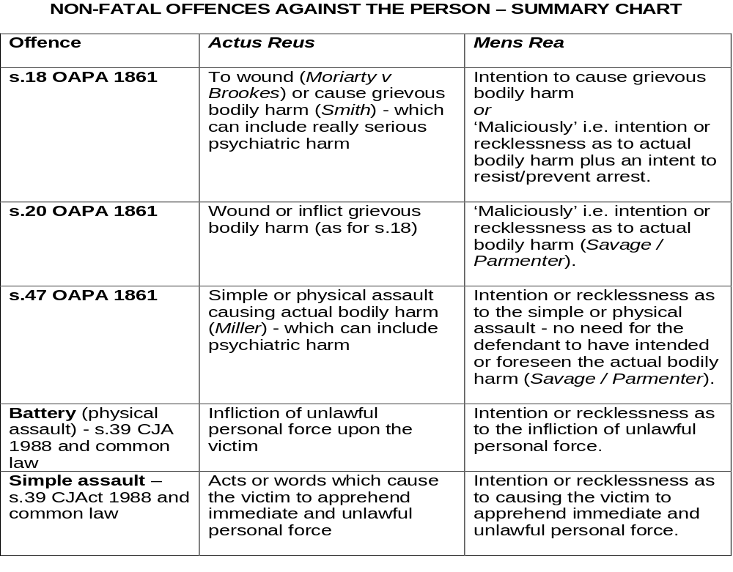

Slide 8
Intoxication
As a defence :
Key Question: Did it cause D to lack MR?
If so, is the intoxication voluntary or involuntary?
If voluntary, is the crime one of specific or basic intent?
2) Impact on other defences:
Jaggard v Dickinson
R v O’Grady

Slide 9
SEXUAL OFFENCES ACT 2003
RAPE: s.1
ASSAULT BY
PENETRATION: s.2
SEXUAL
ASSAULT : s.3
AR:
penetration of vagina, anus or mouth
by the penis
complainant does not consent
AR:
penetration of vagina or anus
with a part of the body or anything else
penetration is sexual
complainant does not consent
AR:
touching of another
touching is sexual
complainant does not consent
MR:
intention to touch
lack of reasonable belief
by D that C consents
MR:
intention to penetrate
lack of reasonable belief by D that C consents
MEANING OF
‘SEXUAL’: s.78
Yes if a reasonable person would consider the act;
‘clearly’ sexual because of its nature; or
may be sexual depending on circumstances and/or purpose of D
MEANING OF
‘CONSENT’: s.74
C consents and has the
freedom and capacity to choose
REBUTTABLE - s.75 (1) and (2):
D did relevant act; and
Any of the following existed:
use/threat of violence against C; or
against another; or
C unlawfully detained; or
C asleep or unconscious; or
C unable to communicate (physical disability); or
Stupefying/overpowering substance given to C; and
3. D knew the circumstance existed
IRREBUTTABLE - s.76(2):
D intentionally deceived C as to
nature or purpose of the act; or
D intentionally induced C to
consent by impersonating a
person known personally to C
PRESUMPTIONS
AS TO CONSENT

Slide 10
OVERVIEW
Theft
Actus reus
Mens rea
appropriation
property
belonging
to another
dishonesty
intn. to
permanently
deprive
With/without the
owner’s consent
owner
clear
by
taking
s.2
exceptions
ordinary
meaning
person with
possession or
control
s.6 extended
meaning
by assuming any
of the rights
of the owner
Ivey v Genting
Casinos test

Slide 11
Theft:
Is D dishonest?
‘Clear’ dishonesty
No
Statute: Does s.2 Theft
Act 1968 apply?
No
Case law: Apply the
test in Ivey v
Genting Casinos
s.2(1)(a) D believes
he had a right in
law to the property
Yes
Subjective
What was D’s knowledge
or belief as to the facts?
Yes
s.2(1)(b) D believes
he would have the
owner’s consent
Yes
Objective
Was D’s conduct
dishonest by the
standards of ordinary
decent people?
s.2(1)(c) D believes the
owner could not be found
by taking reasonable steps
No
Yes
s.2(2) Willingness to pay?
Yes
D was dishonest
D may be dishonest
D was not dishonest
D was dishonest

Slide 12
ROBBERY
STEP 1 – Has D committed THEFT?
AR: Has D
appropriated
property
belonging to another?
+
MR: Did D do so:
dishonestly
with intention to permanently deprive?
G of theft
STEP 2 – Has D committed ROBBERY as well?
Did D use force against a person?
or
Did D threaten to use force against a person?
If yes
Was the force used or the threats made immediately before or at the time of the theft?
If yes
Was the force used or the threats made in order to steal?
G of robbery

Slide 13
ATTEMPTS - S.1 CRIMINAL ATTEMPTS ACT 1981
Actus Reus
Mens Rea
Has D done an act?
(Not an omission)
Did D intend to commit the
substantive offence?
(High MR requirement)
No
Is the offence one of the
exceptions i.e. aggravated
criminal damage / arson?
Yes
Is it more than merely
preparatory? (Q of degree -
Jones [1990]; Gullefer [1987])
Yes
Yes
Recklessness as
to the endangering life
aspect may suffice
Yes
Note: Even if crime is
factually impossible, D
may still be liable - s.1(2)
D is GUILTY
of attempting the
offence
Note: D is judged on facts as
he believed them to be - s.1(3)

Slide 14
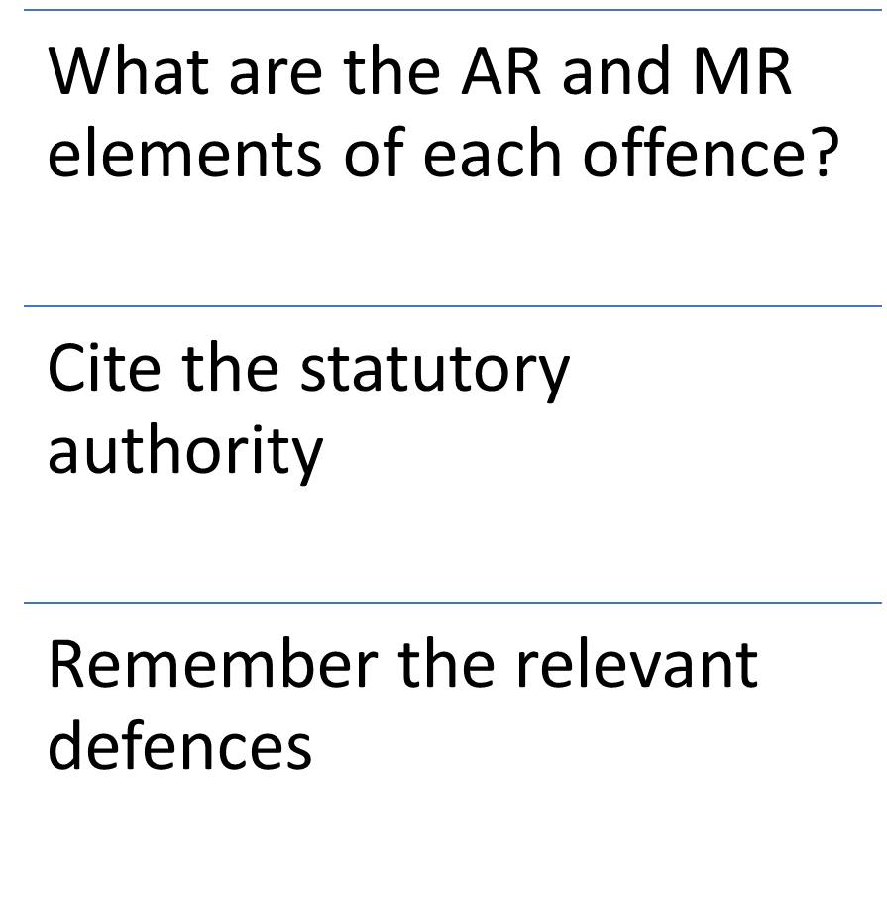
Drug Offences

Slide 15
s.8 Accessories & Abettors Act 1861
Actus Reus
Aid | give assistance
Abet | give encouragement at time
Counsel | give encouragement earlier
Procure | bring about the offence earlier

Slide 16
MENS REA FOR ACCOMPLICE LIABILITY
MR: 1st limb – A must intend to do the act / say the words
MR: 2nd limb – A must have knowledge of any facts necessary for it to be criminal: NCB v Gamble
A must intend PO to act with the MR of the offence i.e. to commit the specific crime
If not A may also be an accomplice if…
1. A knows type of crime
  but not exact details:
  Bainbridge; or
  2. A knows offence will
  be in a limited range:
    Maxwell
Ds start off together
but PO goes beyond
the scope of the plan
PO does the agreed act
but with a different MR
to that intended
by A: Gilmour/Howe
A must intend to assist or encourage
PO in the ‘new’ offence. Foresight
of what PO might do is evidence of such
intent but no more: Jogee/Ruddock
A is guilty as an
accomplice to the
crime which matches
A’s own MR
A is guilty as an
accomplice to the
crime committed
A may be guilty
as an accomplice to
the ‘new’ crime

Slide 17
Module learning outcomes
Demonstrate a sound knowledge and understanding of the Criminal Law in England and Wales and the workings of a wide range of substantive offences, defences and methods of participation.
Describe how the above principles can be applied in a wide variety of personal, social and commercial contexts.
Identify the key facts and relevant issues in a problem scenario by reference to legal principle and accurately apply legal knowledge with supporting reasons in a logical way, using standard techniques for resolving problems.
Explain a range of solutions in light of the legal issues raised and discuss whether the present law is satisfactory.
Conduct independent legal research into familiar and unfamiliar areas, retrieve relevant data using a variety of primary and secondary sources and provide accurate and precise conclusions.
Identify judgments and journal articles to increase the ability to participate in academic debate on some controversial areas of the Criminal Law.
Describe and explain concepts, principles and arguments in a succinct, clear and structured manner.

Slide 18
In your oral presentation you should:
Ensure you have addressed all the relevant content
Think ahead to the questions
Deliver your presentation and answer the questions audibly, at a suitable pace, and within the time limits.
Give reasons for your answers to the questions e.g. authority

