Slide 1
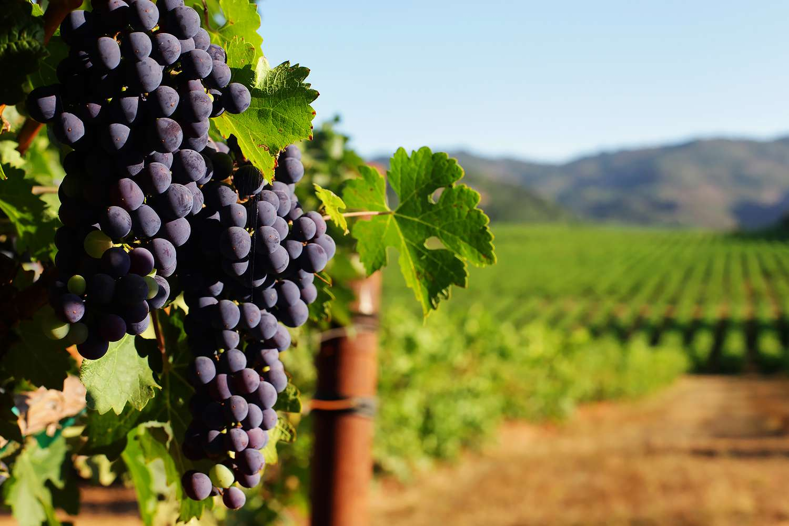
Four WINE-Os
Ryan Jarvis
Melissa Mosquito
Jake Olwig
Anna Hayashi

Slide 2
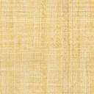
~Presentation Notes/Requirements~
this slide can be used for any notes about the presentation so it’s all grouped in one place
Additional requirements:
All the team members present in equal proportions.
The team demonstrates the interactivity of the dashboard in real time.
The presentation falls within any time limits that the instructor provides.

Slide 3
(Four Wine-Os Dashboard

Slide 4
The selected topic and the reasoning for that selection (6 pts)
this slide can be used for any notes about next slide so it’s all grouped in one place

Slide 5
TOPIC
The group was interested in a entertainment topic.
Discover the relationship between wine properties and quality rating.

Slide 6
A description of the data source (6 pts)
this slide can be used for any notes about the next slide so it’s all grouped in one place

Slide 8
The questions that the team planned to answer with the data (6pts)
this slide can be used for any notes about the next slide so it’s all grouped in one place

Slide 9
QUESTIONS
Is there a correlation between individual chemical variables and the quality of the wine?
Can machine learning be used to predict the quality of a wine based upon an analysis of it’s various chemical properties?

Slide 10
A description of the data exploration phase of the project (6pts)
this slide can be used for any notes about the next slide so it’s all grouped in one place

Slide 12
A description of the analysis phase of the project (6pts)
this slide can be used for any notes about the next slide so it’s all grouped in one place

Slide 14
The technologies, languages, tools, and algorithms that the team used throughout the project (10pts)
this slide can be used for any notes about the next slide so it’s all grouped in one place

Slide 15
TECHNOLOGIES – LANGUAGES – TOOLS - ALGORITHMS
Confusion Matric | Matplotlib | Scatter Plots
Decision Tree Classifier | Microsoft Powerpoint | SKLearn
Entity Relationship Diagram | Numby | Standard Scaler
Github Pages | Pandas | Tableau
Jupyter Notebook | PostgreSQL | Visual Studio Code
Linear Regression | Random Forest Classifier

Slide 16
The results of the analysis (10pts)
this slide can be used for any notes about the next slide so it’s all grouped in one place

Slide 18
Any recommendations for a future analysis (10pts)
this slide can be used for any notes about the next slide so it’s all grouped in one place

Slide 19
FUTURE ANALYSIS RECOMMENDATIONS
More data points
More features

Slide 20
Anything that the team would have done differently if they had more time (10 pts)
this slide can be used for any notes about the next slide so it’s all grouped in one place

