Slide 1
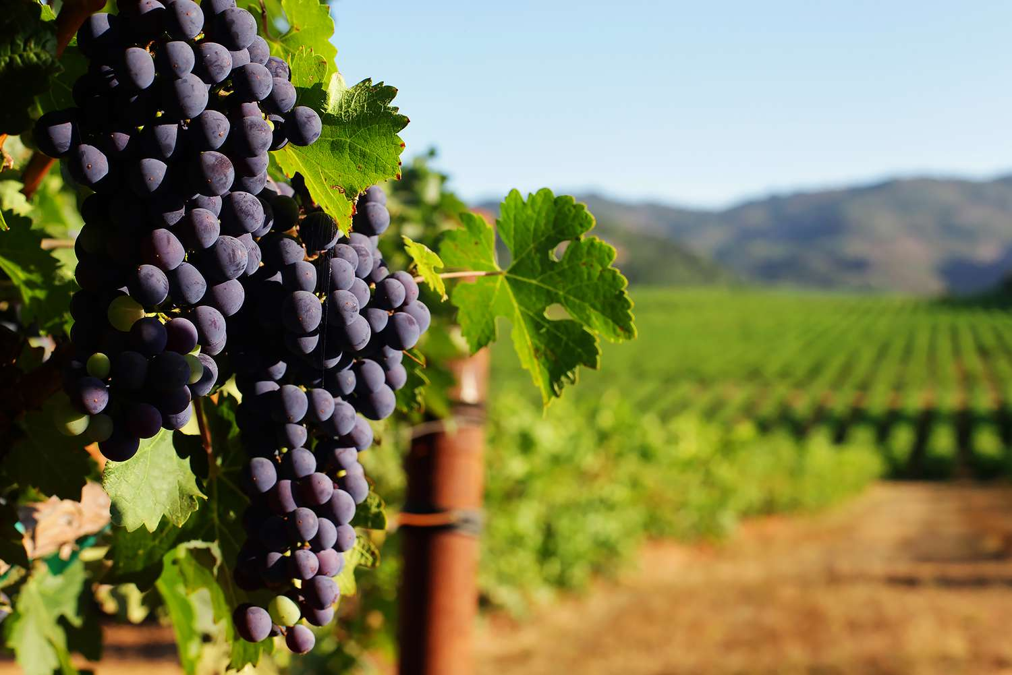
Four WINE-Os
Ryan Jarvis
Melissa Mosquito
Jacob Olwig
Anna Hayashi
Notes:
~Reminder: Tell a story with the data – assumption of the audience not being at the same knowledge level~
Introduction: Melissa (1 min)
Greeting
Who are you & why are you here & what are you presenting
Background
We wanted to work with data that had an entertainment factor, we were looking into movies, songs, but we landed on wine

Slide 2
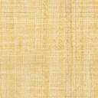
Requirements:
The selected topic and the reasoning for that selection (6 pts)
A description of the data source (6 pts)
The questions that the team planned to answer with the data (6pts)
A description of the data exploration phase of the project (6pts)
A description of the analysis phase of the project (6pts)
The results of the analysis (10pts)
The technologies, languages, tools, and algorithms that the team used throughout the project (10pts)
Any recommendations for a future analysis (10pts)
Anything that the team would have done differently if they had more time (10 pts)
Notes:
*Note: I did highlight them based on what could potentially be touched on together (instead of going point by point, which makes the presentation seem choppy)

Slide 3
ABOUT OUR DATASET
We selected ‘Portugal Wine Data’ from Marilia Prata on kaggle.com
Contains information of approximately 2,000 different wines
11 chemical properties
1 subjective quality rating from a panel of sommeliers
Notes:
Ryan (2.5 min)
Notes:
Our dataset comes from kaggle.com and it is looking at the chemical properties of approximately 2000 different wines based solely in Portugal
The chemical properties of each wine are objective, but each wine was also given a quality score which is a subjective based on sensory data by independent tasters
All chemical data was numerical
Region data was categorical
Dataset that would fit classification models

Slide 4
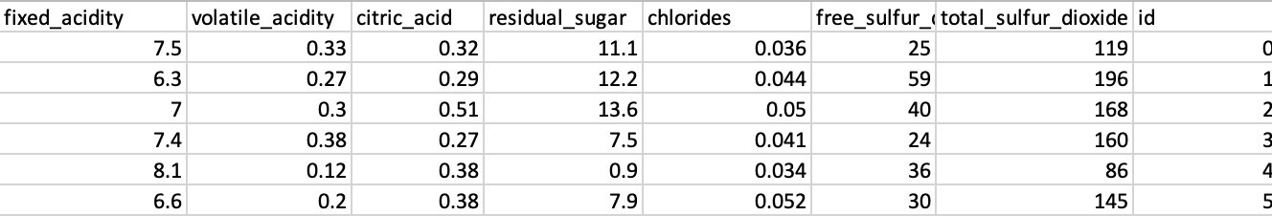
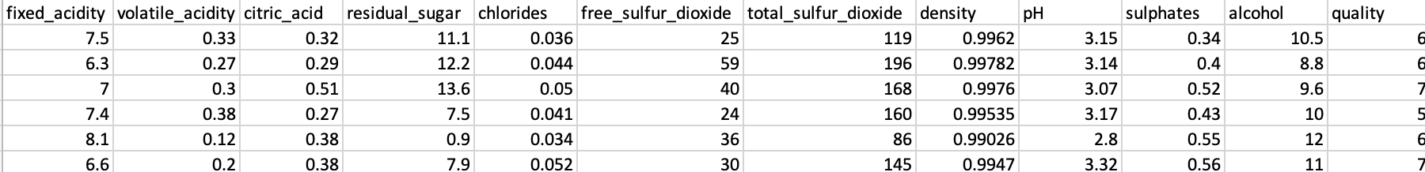
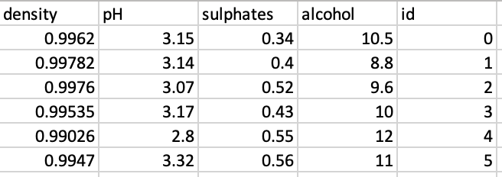
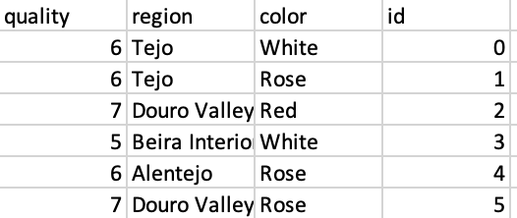
ABOUT OUR DATASET
Finalized combined dataset
Notes:
Ryan
Note: there is transitioning on the pictures
All appear/disappear on a click
Diving into the data, we split the original dataset into three tables:
Explain why
Specifics about the dataset:
The quality ranking falls on a scale of 1 to 10, with 1 being the highest and 10 being the lowest
The chemical data all fall on varying scales, with some chemical values numbering in the thousands, while others are distinguished by hundredths of a decimal.

Slide 5
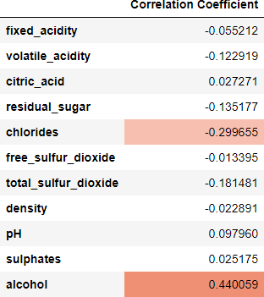
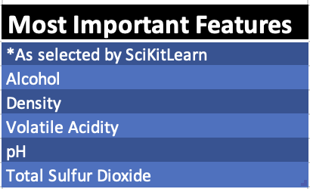
QUESTIONS
Is there a correlation between individual chemical variables and the quality of the wine?
Notes:
Jacob (2-3min)
The questions that we pose are the following:
(read the questions)
So why are these questions important?
Well if there is a correlation between chemical variables and quality, then we can utilize that knowledge for future variations
For example, if pH is high and quality is high, then we can create a heavier focus on high pH wines
And if we can use machine learning to predict the quality based on different chemical properties, we can utilize that data to create a better wine and therefore a superior product within the market
What did we do to our data to start answering our questions?
Explain / Show the linear regression analysis on each property vs quality rating
Explain / Show machine learning model
Reminder of our questions:
Is there a correlation between individual chemical variables and the quality of the wine?
Can machine learning be used to predict the quality of a wine based upon an analysis of it’s various chemical properties?
So what did we find in our exploration in our data?

Slide 6
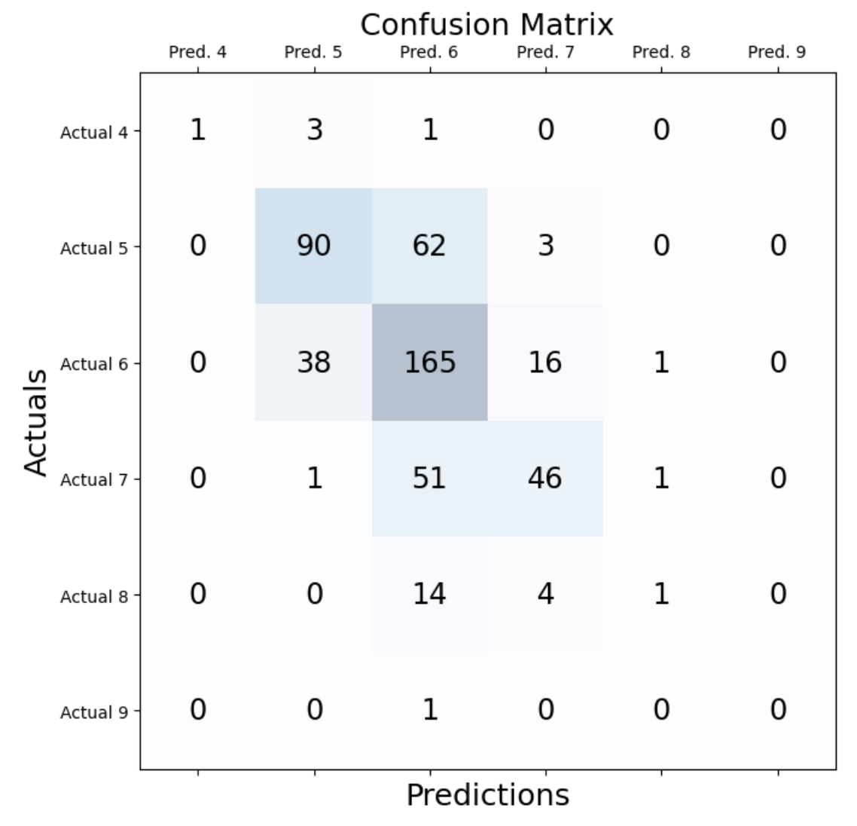
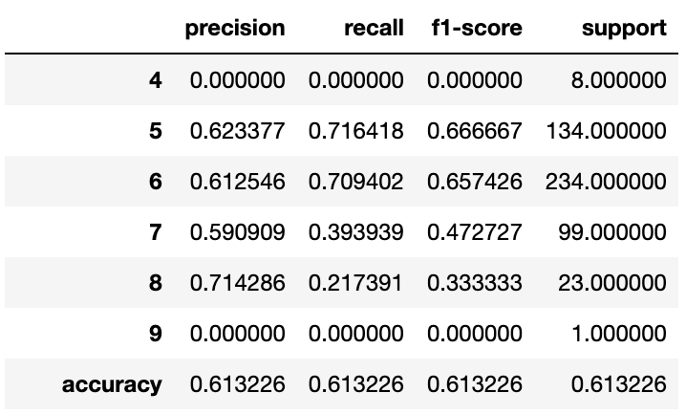
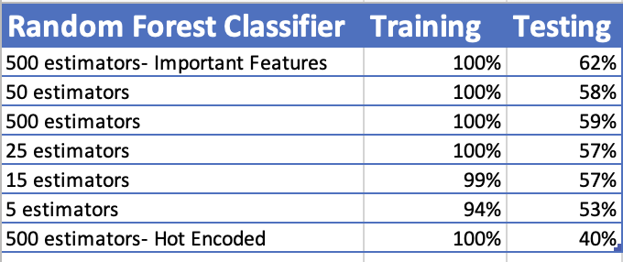
QUESTIONS
MACHINE LEARNING MODEL
Can we use machine learning to predict the quality of a wine based upon an analysis of it’s various chemical properties?
Notes:
Ryan (2-3 min)
The questions that we pose are the following:
(read the questions)
So why are these questions important?
Well if there is a correlation between chemical variables and quality, then we can utilize that knowledge for future variations
For example, if pH is high and quality is high, then we can create a heavier focus on high pH wines
And if we can use machine learning to predict the quality based on different chemical properties, we can utilize that data to create a better wine and therefore a superior product within the market
Answer:
no

Slide 7
FUTURE RECOMMENDATIONS
More data points within the dataset
Region
Wine Color
Machine Learning:
Spend more time – try more variations on a neural network – more exploration
Try single variable predictions
More time to try to correct for heavily imbalanced data with most, almost all the data values falling under 3 classes
Notes:
Anna (2-3 min)

Slide 8
TECHNOLOGIES – LANGUAGES – TOOLS - ALGORITHMS
Decision Tree Classifier | Microsoft Powerpoint | SKLearn
Entity Relationship Diagram | Numby | Matplotlib
Github Pages | Pandas | Tableau
Jupyter Notebook | PostgreSQL | Visual Studio Code
Linear Regression | Random Forest Classifier | Keras
TensorFlow | ExtraTrees Classifier | Support Vector Model
Notes:
Anna
Here is the comprehensive list of all the tools we utilized during this project

Slide 9
TABLEAU DASHBOARD
(Four Wine-Os Dashboard
Notes:
Melissa / Jacob (4-5 min)
Open dashboard and run through all the properties – explain why certain charts are created and how is this helpful

Slide 10
QUESTIONS?
Notes:
(aim for 15 min total)

Slide 11
Additional Information Slides
Notes:
Anna

Slide 12
Extracted data from a SQL database
Pre-processing to remove outliers and error causing fields
Additional processing to fit it to Machine Learning Models

Slide 13
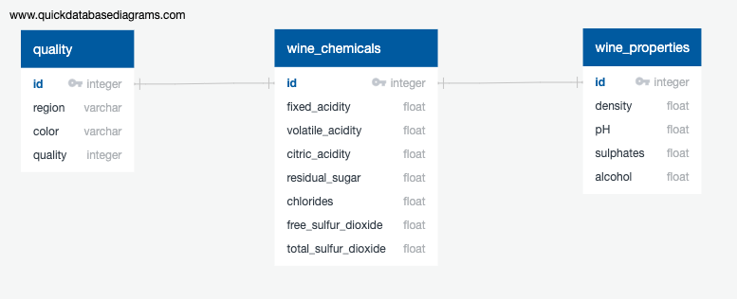
DATABASE ERD
Notes:
*Note: I don’t think we need to show off the ERD, I think that’s unneccessary

Slide 14
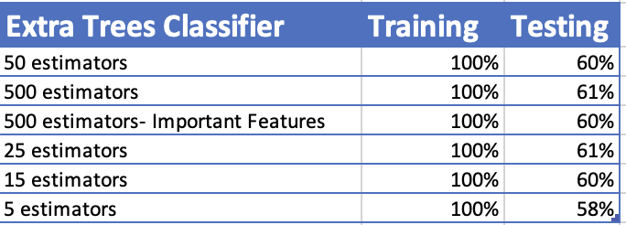
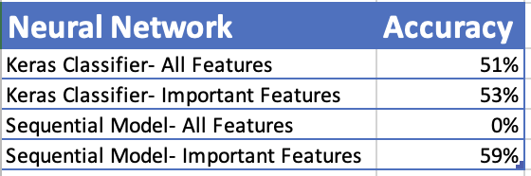
Notes:
Future recs

Slide 15
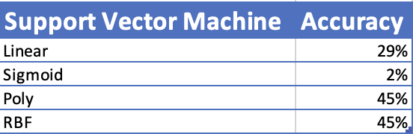
Notes:
Future recs

Slide 16
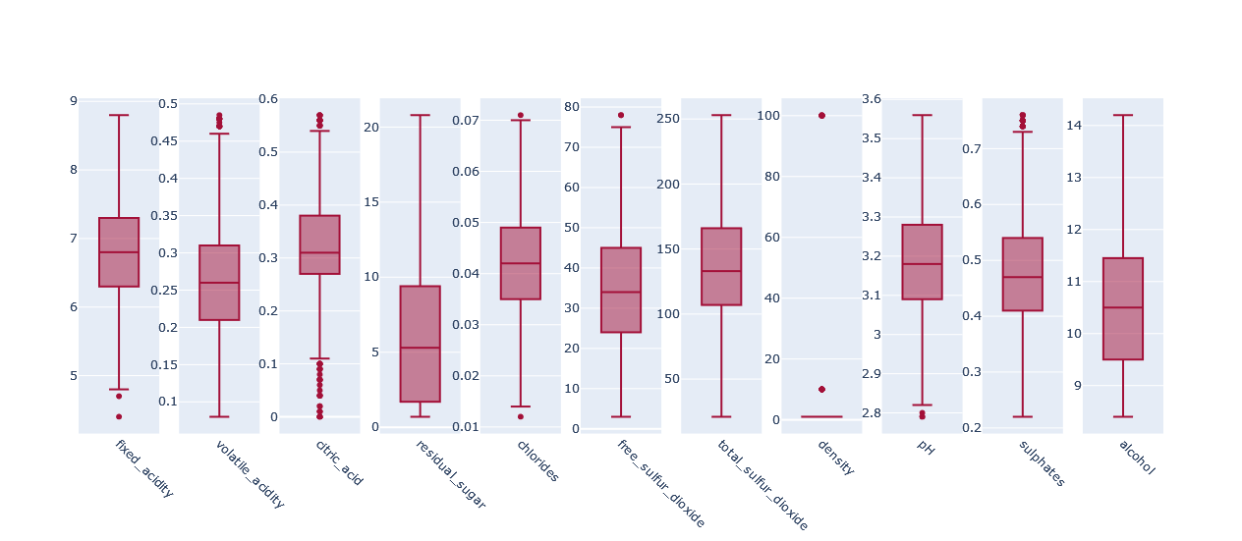

Slide 17
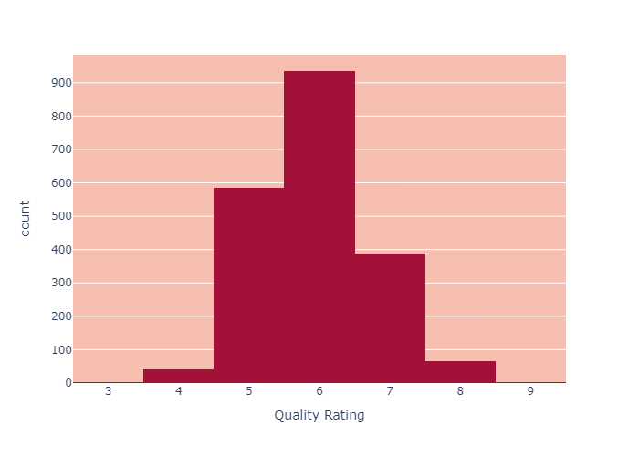
Notes:
I don’t think having this chart in the presentation is necessary – better to have it in the dashboard

Slide 18
Additional Dataset Information
https://www.kaggle.com/datasets/mpwolke/cusersmarildownloadswinecsv?resource=download
Dummy data was created for ‘Wine Region’ and ‘Wine Color’
Notes:
List attribute information

