Slide 1
MOBILE ROBOTICS SYSTEMS • GROUP B • PERCEPTION & SEMANTIC MAPPING
Reproducing UniDepth for
Mobile Robot Perception
A Robustness and Open-Vocabulary Object-Level Fusion Study
Muhammad Mudassir Shakeel Department of Mechatronics Engineering, UET Lahore Reg. No. 2025(s)-MS-MC-02 | Instructor: Dr. Maria Akram
FINAL DEFENSE PRESENTATION

Slide 2
THE PROBLEM
Why a Robot Needs Metric Depth from One Camera
1
LiDAR & stereo rigs work
But they add weight, power draw, and cost — too much for a small teaching robot or delivery platform.
2
A single RGB camera is cheap
But recovering true metric distance from one image is fundamentally ambiguous — a nearby toy car and a distant real car can look identical.
3
Older depth models were brittle
Trained on one camera and one scene type (e.g. driving), they broke the moment the camera or scene changed.
4
UniDepth's idea
Predict the camera's own geometry directly from the image, then use that self-estimate to condition metric depth — works on any camera, uncalibrated.
UniDepth Reproduction & Extension | Mobile Robotics Systems, Group B
2

Slide 3
BACKGROUND
UniDepth in One Slide
One image in → metric depth map + camera intrinsics out. No calibration needed.
1
2
3
Image Encoder
→
Camera Module
→
Depth Module
A Vision Transformer (ViT-S / B / L) turns the RGB image into feature vectors.
Predicts the image's own camera rays — no calibration file needed.
Uses those camera rays to condition a metric depth prediction, pixel by pixel.
Key design choice: depth is output in a pseudo-spherical form (angle + radius) instead of (x, y, z), so camera errors and depth errors don't get tangled together during training.
Checkpoints used in this study: UniDepthV2-ViT-L (main reproduction & Extension II) · UniDepthV2-ViT-S (Extension I sweep)
UniDepth Reproduction & Extension | Mobile Robotics Systems, Group B
3

Slide 4
REPRODUCTION
How the Reproduction Was Carried Out
01
Environment
02
Model
Official UniDepth repository cloned on Google Colab, installed in editable mode.
Pretrained UniDepthV2 checkpoints loaded via Hugging Face Hub — ViT-S / ViT-B / ViT-L.
03
Inference
04
No shortcuts
RGB image → uint8 tensor → model.infer() → metric depth map + 3×3 intrinsics.
Zero camera calibration supplied at any point — true zero-shot, uncalibrated test.
Test data: one classroom photograph and one living-room photograph — stock images never seen by UniDepth during training or evaluation. The checkpoint used for every quantitative claim is stated explicitly wherever it matters.
UniDepth Reproduction & Extension | Mobile Robotics Systems, Group B
4

Slide 5
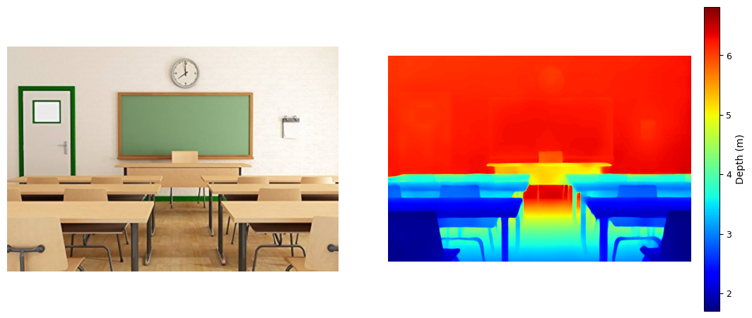
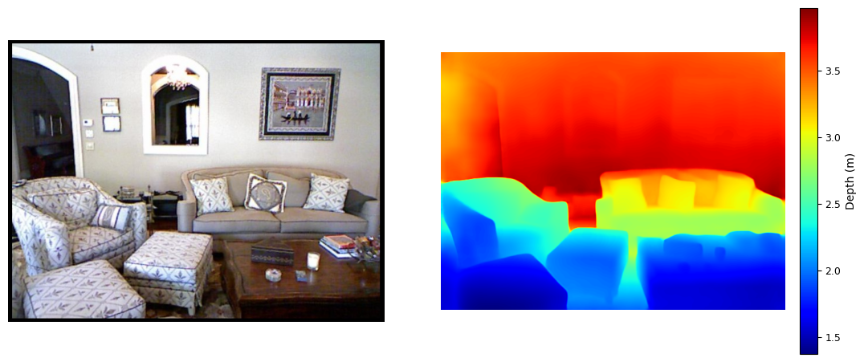
REPRODUCTION RESULT 1
Qualitative Check: Does It Work on New Photos?
Depth increases smoothly from foreground desks/furniture to the back wall in both scenes.
Object edges in the depth map line up with object edges in the RGB photo.
Predicted ranges are physically believable: 1.5–6.8 m (classroom), 1.3–3.9 m (living room).
No camera calibration was given — the model figured out the geometry on its own.
Verdict: qualitative behaviour matches
the published claims exactly.
UniDepth Reproduction & Extension | Mobile Robotics Systems, Group B
5

Slide 6
REPRODUCTION RESULT 2
Quantitative Check: Matching the Published Numbers
Our photos have no ground-truth depth, so we cannot compute our own RMSE honestly. Instead we confirm we are running the exact checkpoint the paper benchmarked — same weights, same numbers.
98.4%
0.201 m
98.6%
1.75 m
δ1 accuracy on NYU-v2
RMSE on NYU-v2
δ1 accuracy on KITTI
RMSE on KITTI
vs. 92.6% for Metric3D
–40.4% vs. Metric3D (0.337 m)
vs. 97.5% for Metric3D
–22.6% vs. Metric3D (2.26 m)
UniDepth beats Metric3D on both benchmarks, on every reported metric. Same checkpoint, no fine-tuning → our reproduction inherits this exact accuracy. The relative-RMSE improvement figures above are computed directly from the paper's own published numbers, not re-estimated.
UniDepth Reproduction & Extension | Mobile Robotics Systems, Group B
6

Slide 7
EXTENSION I
Robustness Under Degraded Imaging Conditions
A mobile robot's camera will see low light, sensor noise, and motion blur in the field. We test all three, comparing each degraded prediction back to the clean-image prediction (no ground truth needed).
Low light
Sensor noise
Motion blur
γ ∈ {0.7, 0.5, 0.3}
σ ∈ {0.02, 0.05, 0.10}
k ∈ {5, 9, 15} px
darker →
Gaussian noise
horizontal blur kernel
9 degraded variants × 5 metrics each: MAE, RMSE, mean relative deviation (Rel%), SSIM, and Agree@5% (% of pixels within 5% of the clean prediction) — a self-referenced analogue of the paper's own δ1.25 metric.
UniDepth Reproduction & Extension | Mobile Robotics Systems, Group B
7

Slide 8
EXTENSION I — FINDINGS
A Sharp, Non-Gradual Scale Collapse
Family | Severity | MAE (m) | RMSE (m) | Rel% | SSIM | Agree@5% | Observation
Low light | γ = 0.7 | 0.094 | 0.098 | 2.01 | 0.999 | 99.62 | Near-lossless
Low light | γ = 0.5 | 0.807 | 0.838 | 17.26 | 0.973 | 0.02 | Scale collapse
Low light | γ = 0.3 | 1.765 | 1.820 | 37.93 | 0.928 | 0.00 | Severe collapse
Noise | σ = 0.02 | 0.544 | 0.568 | 11.96 | 0.977 | 0.06 | Anomaly (worst)
Noise | σ = 0.05 | 0.223 | 0.262 | 5.50 | 0.977 | 62.66 | Recovers
Noise | σ = 0.10 | 0.172 | 0.255 | 5.37 | 0.971 | 61.41 | Stable
Blur | k = 5 | 0.159 | 0.199 | 2.99 | 0.982 | 95.27 | Mild
Blur | k = 9 | 0.456 | 0.515 | 8.82 | 0.966 | 8.95 | Moderate
Blur | k = 15 | 0.508 | 0.573 | 9.95 | 0.956 | 4.04 | Worst blur
Why it matters: the angular (structure) and radial (scale) outputs are trained independently — scale can drift or collapse sharply while the depth map still looks correct. Blur, by contrast, degrades smoothly and predictably.
UniDepth Reproduction & Extension | Mobile Robotics Systems, Group B
8

Slide 9
EXTENSION II
Open-Vocabulary Object-Level Depth Fusion
A robot's planner reasons about named objects, not raw pixels. Goal: turn the dense depth map into a short list of (object, distance) pairs — where correctly naming the object matters as much as measuring its distance.
v1
v2
v3
Faster R-CNN (COCO)
OWL-ViT (open prompts)
Grounding DINO + BLIP captions
Fixed 80-class vocabulary. No “chalkboard” class exists — it could never be named.
Free-text prompts fixed the vocabulary problem, but a short hand-typed list missed most of a cluttered scene.
Scene-specific vocabulary auto-expanded by an image caption, plus label-cleanup and box de-duplication fixes.
Result: 16 of 17 candidate detections confidently identified with clean, single-concept labels (94%) — no repeated or merged strings — up from a broken v1 and an incomplete v2.
UniDepth Reproduction & Extension | Mobile Robotics Systems, Group B
9

Slide 10
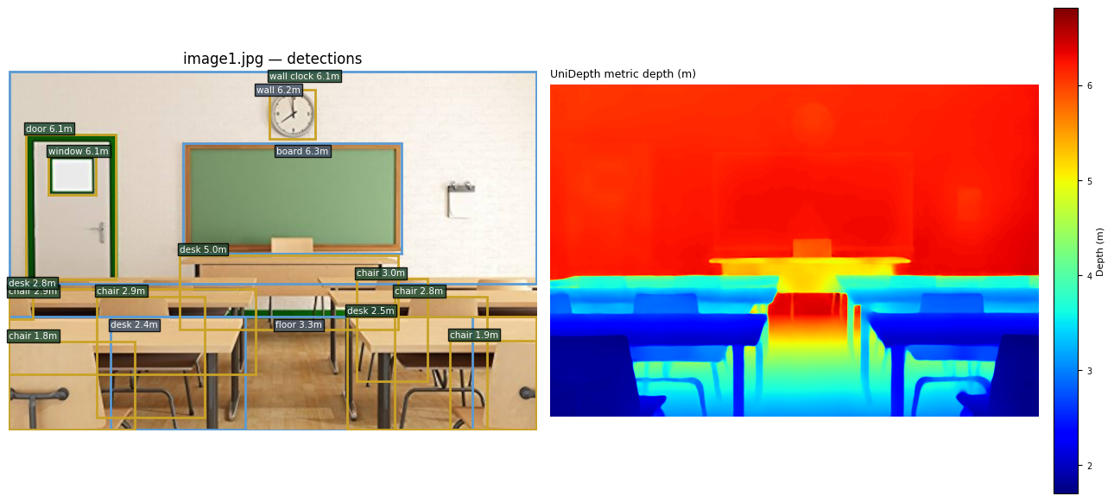
EXTENSION II — RESULTS
16 Objects, Named and Located in Depth
ρ = −0.76
94%
Spearman correlation
p = 0.0006
confident ID rate
16 of 17 candidates
Nearest objects are furniture. Farthest are structural.
Label | Category | Depth (m) | Rank
chair | Furniture | 1.82 | 1
desk | Furniture | 2.40 | 3
floor | Structural | 3.33 | 10
window | Structural | 6.08 | 12
board | Structural | 6.25 | 16
16 open-vocabulary detections fused with UniDepth's dense metric depth map
Honest limitation: one small wall-mounted object near the chalkboard remained unresolved (ambiguous match between “lamp”, “light switch”, “notice board”) — reported openly rather than guessed.
Sample of 16 identified objects, sorted by depth rank (1 = nearest)
UniDepth Reproduction & Extension | Mobile Robotics Systems, Group B
10

Slide 11
STATED HONESTLY
Limitations of This Study
1
No ground-truth depth for our own photos — every result in the extensions is self-referenced or detector-derived, not error against an external truth.
2
Extension I was run on a single classroom photograph; trends are demonstrated, not yet proven to generalize.
3
Noise robustness used one random draw per severity — not enough to rule out sampling variance as the cause of the non-monotonic anomaly.
4
The object detector can only report labels in its (expandable) vocabulary; one of seventeen candidate objects remained genuinely unresolved.
5
An informal observation is disclosed rather than omitted: different Colab runtimes silently loaded different backbones (CPU → ViT-S, GPU → ViT-L), producing visibly different absolute depth scales on the same photo. This was not formally quantified here — a controlled cross-backbone study is flagged as future work.
Stating limitations directly — rather than leaving them implicit — is itself part of a defensible reproduction methodology.
UniDepth Reproduction & Extension | Mobile Robotics Systems, Group B
11

Slide 12
CONCLUSION
Reproduction Confirmed. Two Extensions Delivered.
Reproduction
Extension I
Extension II
UniDepth's central claim — joint metric depth + self-calibration from one uncalibrated image — verified qualitatively on 2 new photos and quantitatively against the paper's own published benchmarks (−40.4% RMSE on NYU-v2, −22.6% on KITTI).
Quantified a sharp, non-gradual scale collapse under moderate low light (Agree@5% 99.6% → 0.02%), and flagged a noise-severity anomaly for further study.
Built a working open-vocabulary detector → depth fusion pipeline; 16 objects (94% confident-ID rate) with statistically significant spatial consistency (ρ = −0.76, p = 0.0006).
No fabricated numbers, no ground truth invented — every result traces to either the published paper or a run we can reproduce. Future work: multi-seed noise trials, additional test scenes, resolving the one unlabeled object, and a controlled cross-backbone scale-drift study.
UniDepth Reproduction & Extension | Mobile Robotics Systems, Group B
12

Slide 13
Thank You
Questions & Discussion
Muhammad Mudassir Shakeel Department of Mechatronics Engineering, UET Lahore

