Slide 1


My company/my work
Marius Müller
January 29, 2012

Slide 2
Table of Contents
General information about UBS
Product
My work

Slide 3
Section 1
General information about UBS

Slide 4
General information about UBS
1998: Union Bank of Switzerland merge with Swiss Bank Corporation
Result: Biggest Bank in Switzerland
65'000 Employees
4 divisions: Global Wealth Management & Swiss Banking, Investment Bank, Global Asset Management and Corporate Center

Slide 5
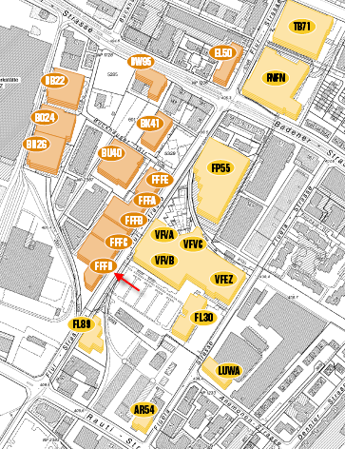
General information

Slide 6
Section 2
Product

Slide 7
Product
Project: "Opportunity Management"
Key tasks:
  Generating mass opportunities by import
  Display opportunities
  Remind client advisor for open tasks
  Provide an opportunity report
  Export data for analysis
  3th level support

Slide 8
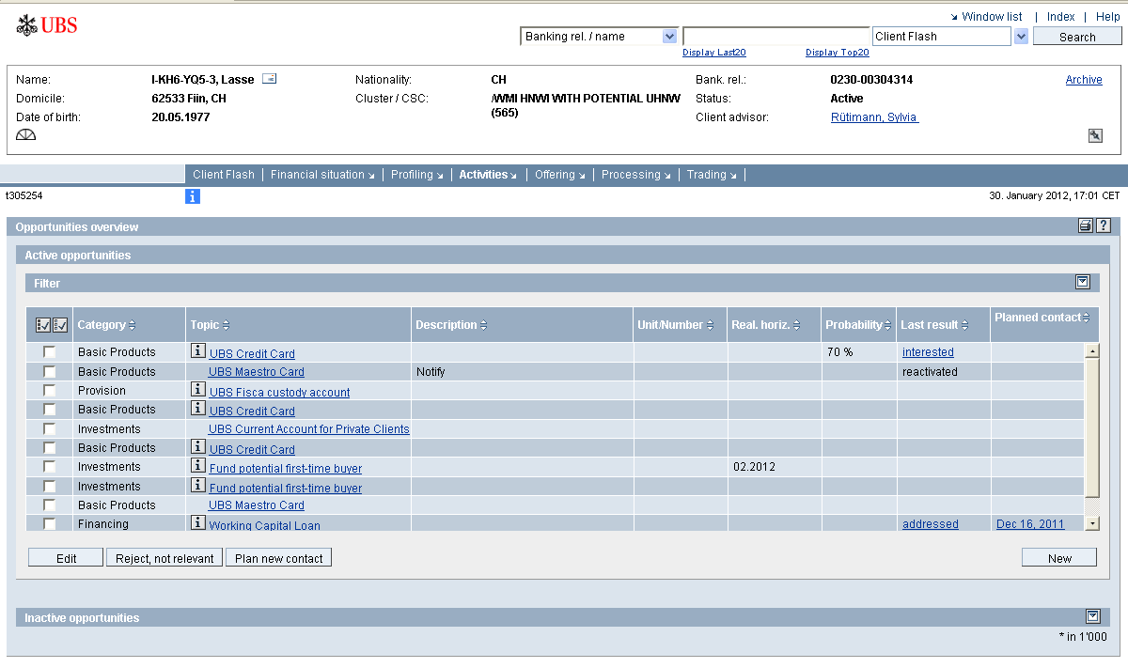
Product

Slide 9
Section 3
My work

Slide 10
My work
Chief developer
Developing Java
Developing on Oracle
Responsible for the installation
Know how transfer

