Slide 1
Smart Copy Book – Project Status Update
Current Progress, Next Steps, and Demo Screenshots

Slide 2
Problem Statement
Students struggle to organize handwritten and digital notes efficiently.
Traditional notebooks lack smart search and filtering features.
Switching between subjects can be inefficient.
No integrated AI support for summarization or handwriting recognition.
Target Users / Stakeholders:
University & secondary school students
Teachers and instructors
Self-learners
Educational institutions

Slide 3
Proposed Features
Subject-based note organization
Note creation and editing
Local storage persistence
Dark mode support
Subject filtering system
Empty-state UI handling
Basic navigation system

Slide 4
Feature Enhancements & Modifications
New Features Planned:
Handwriting recognition
Voice-to-text transcription
AI-powered summarization
Modifications to Original Plan:
Prioritized UI stability before AI integration
Implemented local persistence before cloud sync
Improved dark mode compatibility

Slide 5
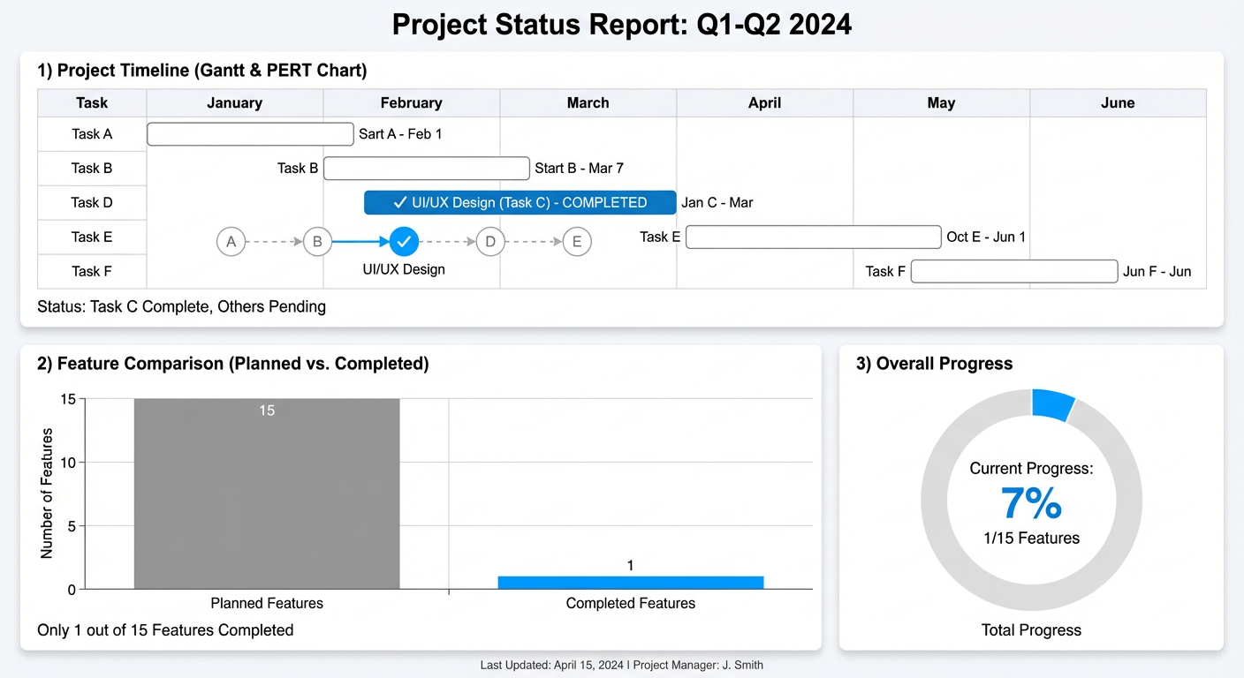
Progress Tracking

Slide 6
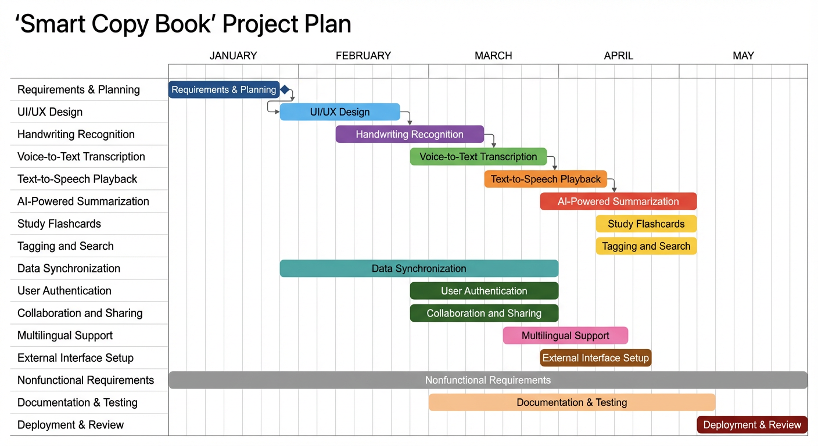
Updated Gantt Chart

Slide 7
Challenges & Solutions
Challenge: Structuring scalable UI architecture on macos
Solution: prototyping of the app in website mode
Challenge: AI feature integration complexity
Solution: Using a live implementation by using railway

Slide 8
Current Project Status
- UI layout implemented
- Notes creation and subject filtering working
- Local storage persistence added
- Empty state UI completed
- Basic app navigation functional

Slide 9
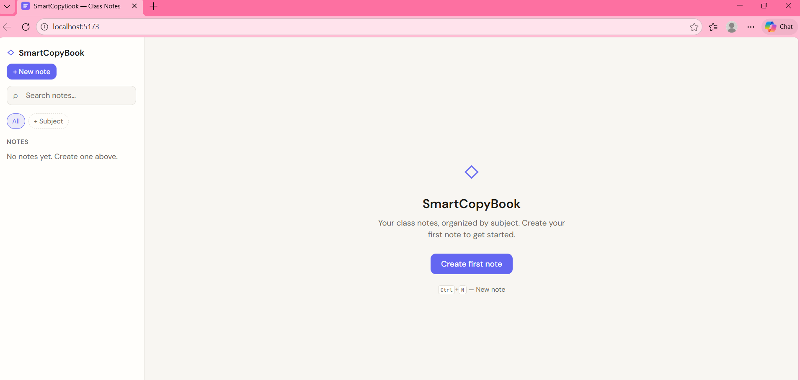
App – Home Screen

