Slide 1
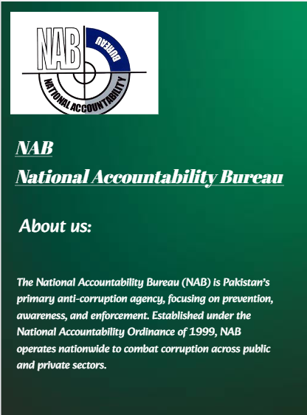
Website Design: User Journey
This presentation outlines the user flow for our investigation platform.

Slide 2
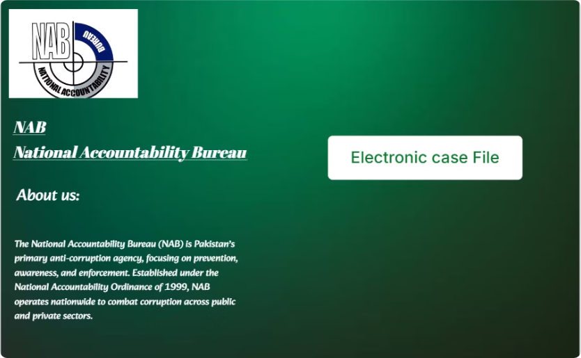
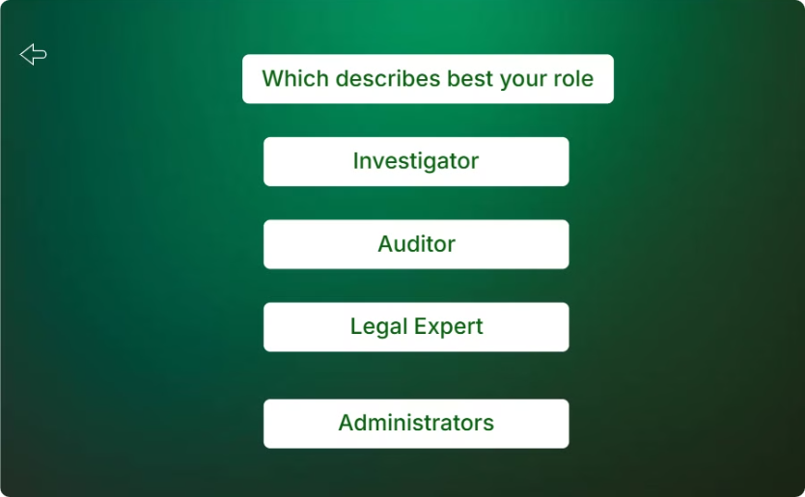
Homepage: Welcome and Access
Vision and Logo
Case File Access
Prominent display on the homepage.
Button leads to the case file directory.

Slide 3
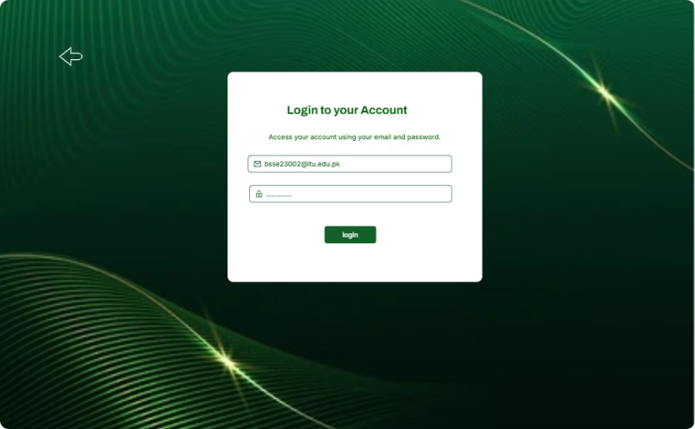
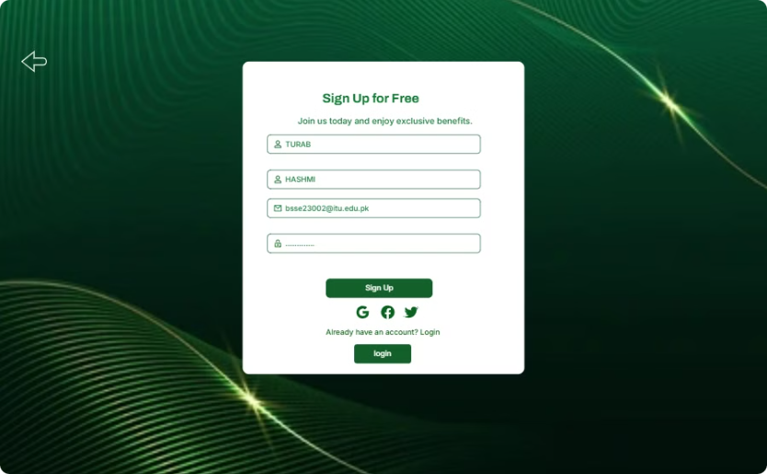
Role Selection
Role Choice
Back Button
Select investigator or auditor role.
Return to homepage for role change.

Slide 4

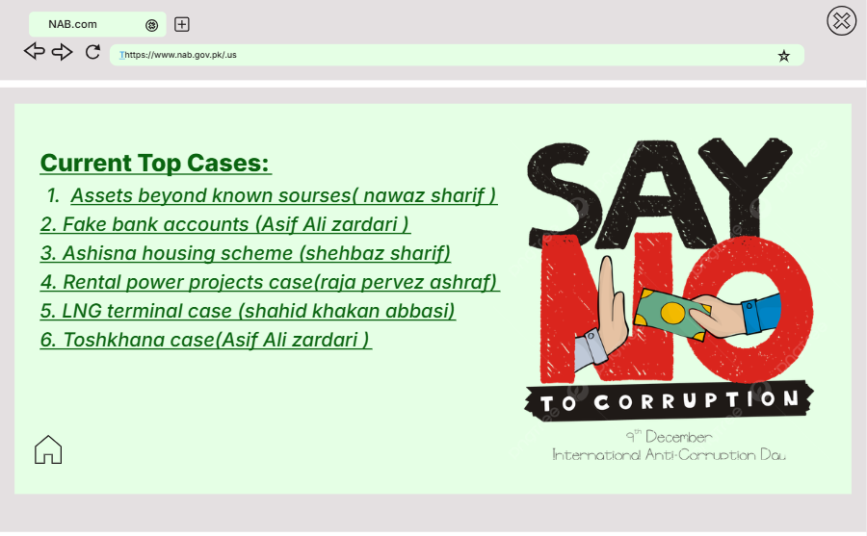


Login or Sign Up
Account Check
Existing accounts are recognized.
Login
User credentials are entered.
Sign Up
New users create an account.

Slide 5
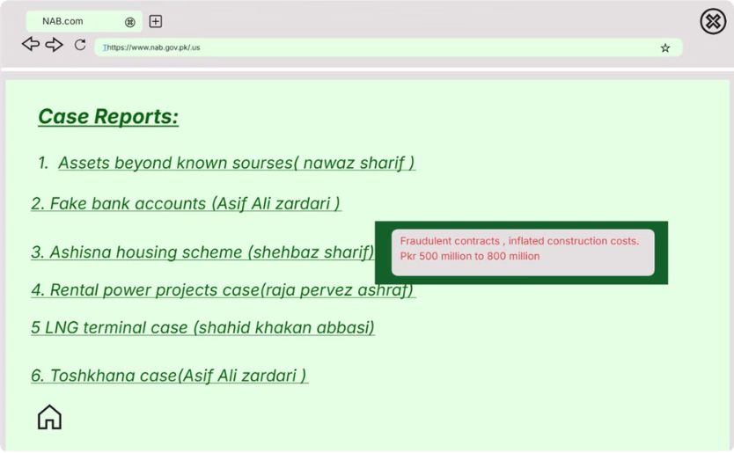
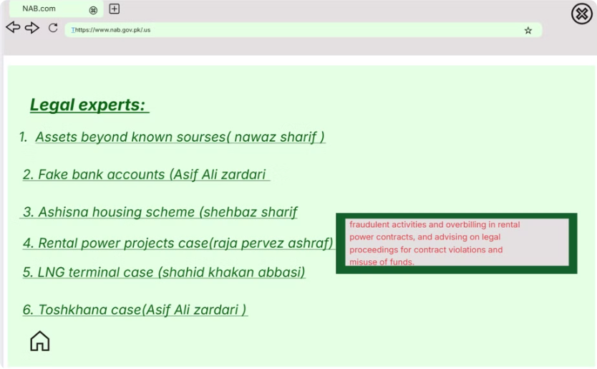
Investigator Dashboard
Case Listing
Report Access
Investigator access to case files.
Auditors view case reports.

Slide 6
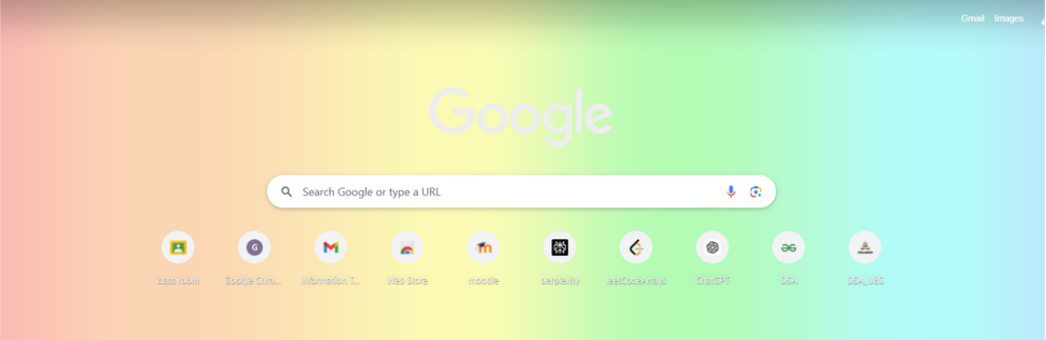
Legal Expert Access
Legal experts review cases for compliance.

Slide 7



Session End
Close Button
Google Account
User exits current session.
User returns to their main account.

