Slide 1

Data Analysis Essentials
Cornerstone Project
Analysis of Anemia among Indian Women
Presented by
M.N.B.Sasirekha (25B11CS528)
P.N.Maheswari (25B11CS691)
M.Yaswanth (25B11CS527)
M.Pavan (25B11CS535)
Guide: Mr. K. Ashok Teja, Assistant Professor,M.Tech, CSE Dept.
Department of Computer Science and Engineering

Slide 2




CONTENTS
Problem Understanding
Introduction
Current Approach & Limitations
Proposed Approach
Dataset Description
Requirements
Methodology
Data Analysis
Data Visualization
Machine Learning Model
Interactive Dashboard
Key Insights & Analysis
Implementation Workflow
Conclusion

Slide 3
PROBLEM UNDERSTANDING
Anemia is an important health concern among women in India.
Large health datasets contain valuable information about anemia prevalence.
Raw datasets can be difficult to understand without proper processing and analysis.
This project analyzes anemia prevalence among women aged 15–49 years.
The project uses NFHS data to identify patterns across States/UTs and districts.
Data analysis and visualization are used to present the findings clearly.

Slide 4
INTRODUCTION
Anemia affects the health and well-being of women.
Understanding anemia prevalence can help identify areas with higher levels of anemia.
The National Family Health Survey (NFHS) provides important health-related data.
Python is used for data processing, analysis, and visualization.
Pandas and NumPy are used for data manipulation and statistical analysis.
Matplotlib and Seaborn are used to create visualizations.

Slide 5
CURRENT / MANUAL APPROACH
Health data is often available in large CSV or Excel files.
Manually examining large datasets is time-consuming.
Comparing anemia prevalence across many districts and States/UTs is difficult.
Patterns and relationships may not be easily visible in raw tables.
Manual calculations can lead to errors.
Raw numerical data is difficult to communicate without visualizations.

Slide 6
LIMITATIONS OF MANUAL ANALYSIS
• Time-consuming for large datasets.
Difficult to compare many States/UTs and districts.
Difficult to identify correlations manually.
Missing or inconsistent data can affect analysis.
Trends are difficult to identify from raw tables.
Manual calculations increase the possibility of errors.
Results are harder to present without charts.

Slide 7
PROPOSED APPROACH
Our proposed data-analysis approach:
Load NFHS dataset using Pandas.
Acquire and filter relevant data.
Extract required variables.
Validate and clean the data.
Aggregate data for analysis.
Perform descriptive and statistical analysis.
Create meaningful visualizations.
Interpret the results and summarize findings.

Slide 8
DATASET DESCRIPTION
Field | Description
State/UT | Name of the State or Union Territory
District Names | Name of the district
All women age 15-49 years who are anaemic22 (%) | Percentage of women aged 15–49 years who are anaemic
Risk Score | Calculated score representing selected anemia-related risk indicators
Risk Category | Category assigned based on the Risk Score
Dataset Snapshot
NFHS-5 health data | District/Sate-level analysis | Women aged 15–49 years
Data Quality Checks
Data validation performed • Missing/invalid data checked • Relevant variables selected • Data aggregated for analysis
Tools & Libraries
Python • Pandas • NumPy • Matplotlib • Seaborn

Slide 9
REQUIREMENTS
Hardware Requirements
• Processor: Intel i3 or above
• RAM: Minimum 4 GB
• Storage: 20 GB
Software Requirements
• Windows / any supported operating system
• Python
• Google Colab
• Pandas
• NumPy
• Matplotlib / Seaborn

Slide 10
METHODOLOGY
Data Loading & Reading: Load NFHS-5 datasets using Pandas.
Data Acquisition & Filtering: Select relevant data and columns.
Data Extraction: Extract anemia, health, education, and nutrition indicators.
Data Validation & Cleaning: Handle missing values, duplicates, and inconsistencies.
Data Aggregation & Representation: Summarize data and calculate Risk Scores, if applicable.
Data Analysis: Analyze and compare anemia prevalence across States/UTs and districts.
Data Visualization: Create charts, graphs, and correlation heatmaps.
Machine Learning Model: Train a Linear Regression model and evaluate its predictions.
Interactive Dashboard: Display key indicators, visualizations, and comparisons.
Results & Interpretation: Summarize findings, insights, and limitations.

Slide 11
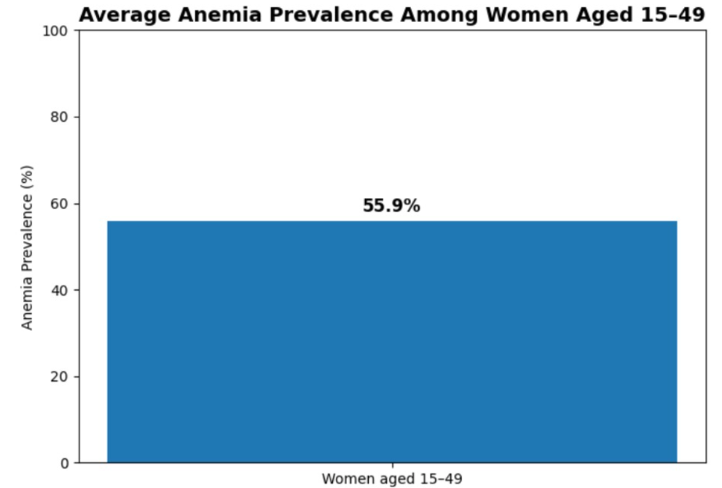
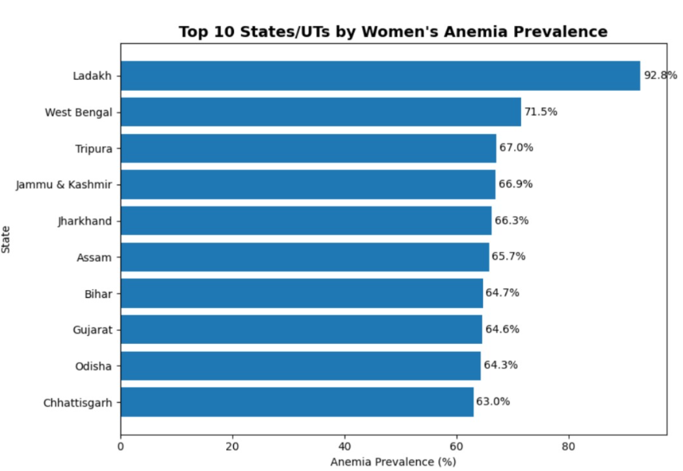
DATA VISUALIZATION

Slide 12
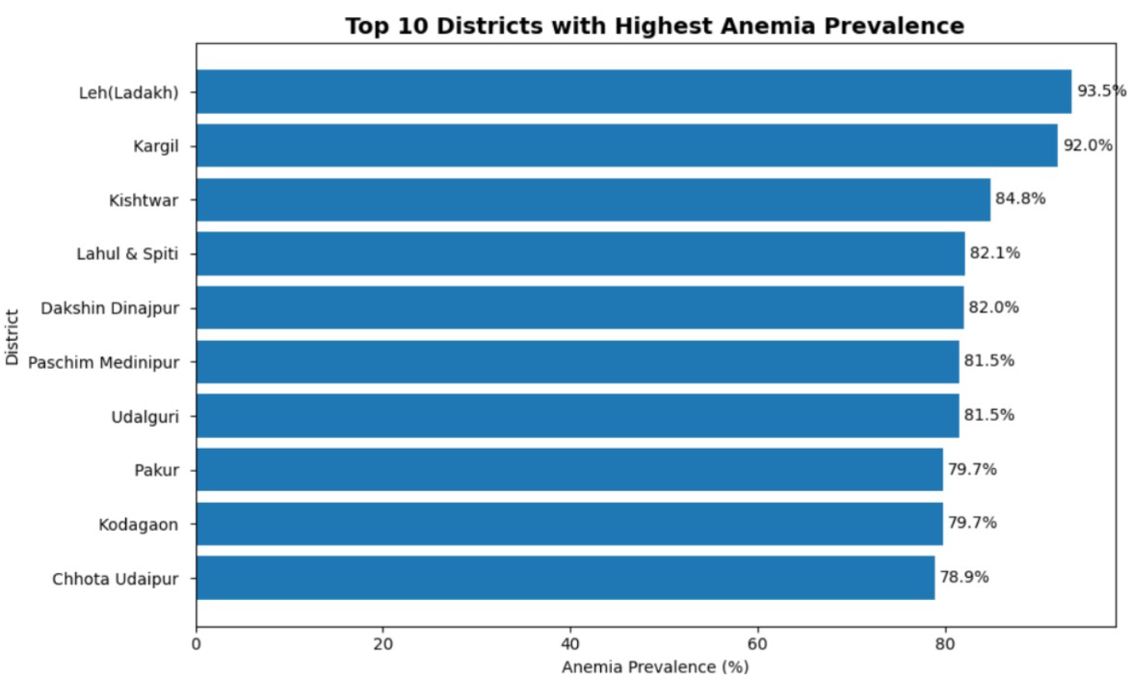
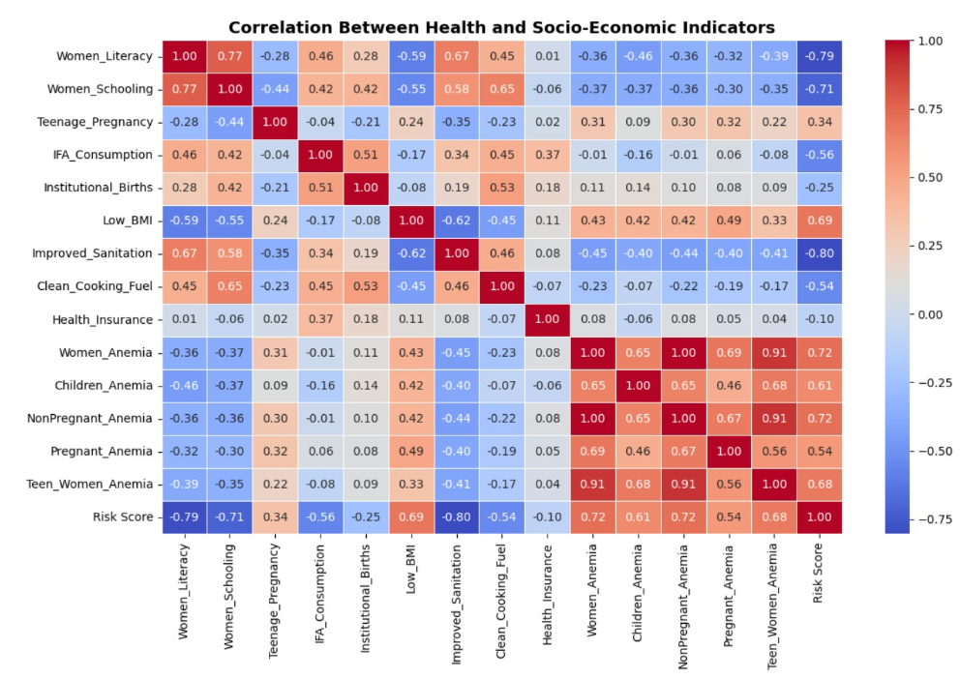

Slide 13
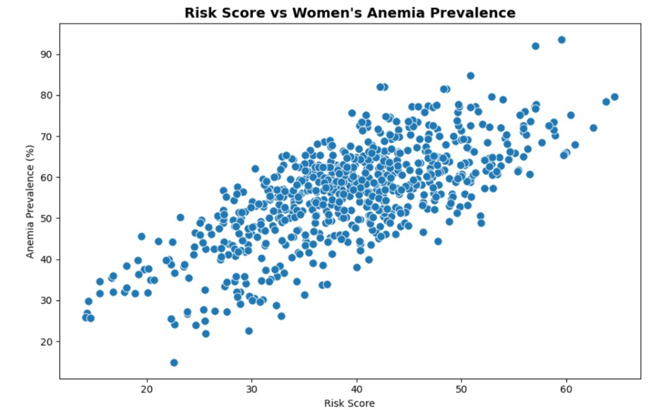
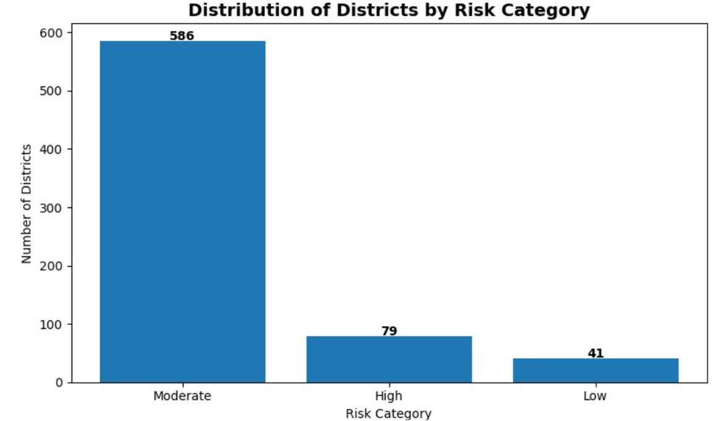

Slide 14
KEY INSIGHTS & ANALYSIS
The overall average anemia prevalence was 55.9%.
The state-wise analysis shows differences in anemia prevalence across States/UTs.
The top 10 States/UTs with higher anemia prevalence were identified.
The district-wise analysis identified the districts with the highest anemia prevalence.
The correlation heatmap shows relationships between anemia prevalence and other numerical indicators.
The Risk Score analysis was used to examine its relationship with women's anemia prevalence.
Risk Categories helped summarize districts according to their calculated risk levels.

Slide 15
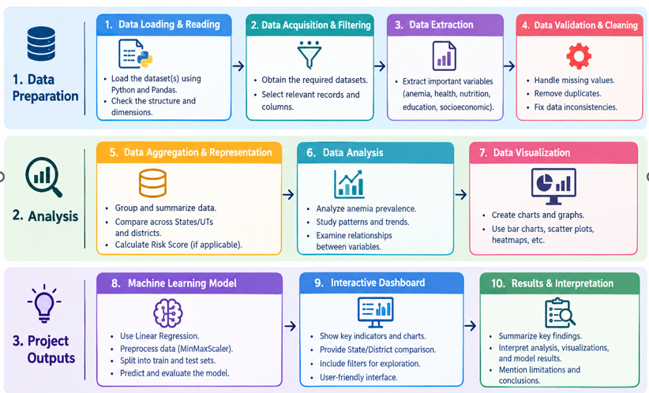
IMPLEMENTATION WORKFLOW

Slide 16
CONCLUSION
The project analyzed anemia prevalence among women aged 15–49 years using NFHS data.
Data processing techniques helped transform raw health data into useful information.
State-wise and district-wise analysis revealed differences in anemia prevalence.
Correlation analysis helped examine relationships between anemia and other numerical indicators.
Risk Score analysis provided an additional way to examine anemia-related patterns.
Visualizations made the analysis easier to understand and communicate.
The findings provide useful descriptive insights into anemia patterns in the analyzed NFHS data.

Slide 17
THANK YOU

