Slide 1
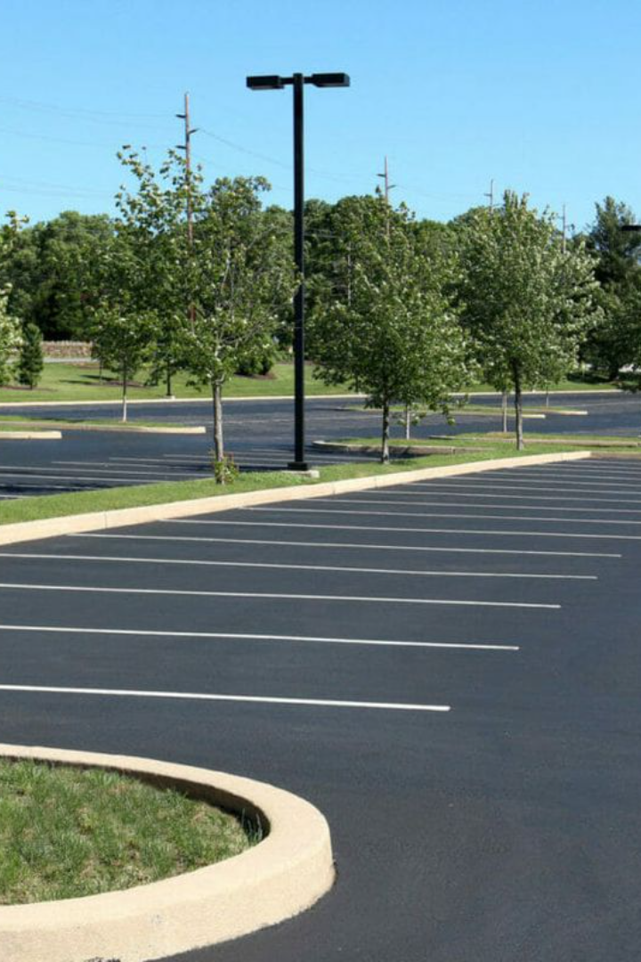

Automatic Parking Space Counter
Welcome to our presentation on the automatic parking space counter, designed to revolutionize parking management. See how it works and the benefits it offers.
By:-Manoj Nath Goswami
Roll no:-22 (2161228) Section :-C

Slide 2
Overview of the Problem
Urbanization
Inefficient Use of Space
Urbanization has caused an exponential increase in traffic and parking congestion.
Parking lots with reserved spots may be underutilized while others go unmonitored.
Wasted Time
Environmental Impact
Drivers often waste time combing the lot for an open spot.
Circling for a parking space leads to more emissions and unnecessary fuel consumption.

Slide 3
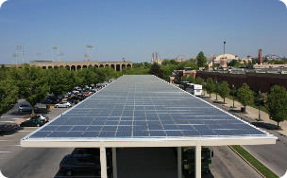

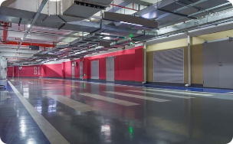
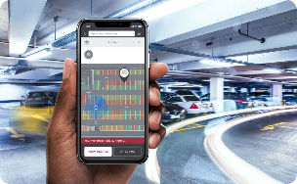
Benefits of Automatic Parking Space Counting
Efficient Use of Resources
Improved User Experience
Reduced Traffic Congestion
User-Friendly Integrations
The system ensures optimal utilization of space and resources, freeing up space for more green initiatives.
Drivers will no longer waste time searching for a spot, providing a more positive parking experience.
The system helps to reduce traffic congestion caused by unnecessary circling around parking lots, benefiting the environment and city infrastructure.
Parkers can be notified in advance of available spots through the automatic parking app or on-site digital displays.

Slide 4

How it Works: Real-Time Monitoring and Analysis
1
Counting Available Parking Spaces
The system uses various sensors and cameras to monitor parking spots' availability in real-time.
Data Collection & Analysis
2
The data is processed in real-time through an intelligent algorithm, analyzing parking patterns, spot usage, and historical trends.
3
Digital Display
Real-time data is displayed to the parkers providing useful information to find an open parking space efficiently.

Slide 5
Applications and Advantages
Smart Cities
Commercial Buildings
The system can integrate with other smart city technologies and be a game-changer in parking management.
Building management can use the data to streamline parking management and billing.
Airports
Hospitals
Can be used for remote parking with shuttle service to the airport entrance, making transport more efficient.
Real-time information about parking availability will offer more convenience and empathy for patients and visitors.

Slide 6
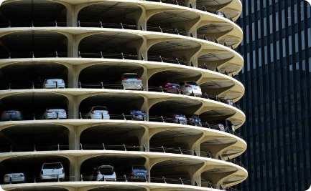

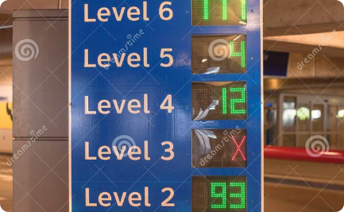
Efficient Parking Management
Optimal Allocation of Space
Data-Driven Decision Making
Streamlined Parking Experience
Maximizing the use of parking space, leaving no parking lot unused or unmonitored.
The system collects data and provides in-depth analysis, making it easier to make informed decisions about parking management.
Provides parkers with real-time availability of parking spaces, reducing traffic congestion and wasted time.

Slide 7

Enhanced User Experience
1
Friendly Integration
2
Parking Reservation
Applications that provide notifications of available parking spaces and timely access to appropriate parking areas.
Booking parking spots in advance can be a game-changer at concerts, major events, and shopping centers
3
Contact-Free Payment
Reduce staff workload and costs by allowing drivers to pay automatically through an app on their smartphone.

Slide 8
Conclusion
1
Maximizing Efficiency
The automatic parking space counter is a comprehensive and smart solution geared towards increasing parking efficiencies and improving users' experience.
Real-Time Environment Monitoring
2
The system not only optimizes parking spaces but also contributes to sustainable urban development through resource conservation and emission reduction.
3
Wider Adoption and Impact
The evolution of parking management offers ample opportunities for its adoption in commercial real estate, sporting arenas, airports, and beyond.

