Slide 1
FISCAL CONSOLIDATION : NEED OF HOUR IN INDIA
UJESH MAURYA
JOYDIP SARKAR

Slide 2
WHAT IS FISCAL CONSOLIDATION?
A set of measures designed to reduce government deficits and the accumulation of debts.

Slide 3
WHAT IS FISCAL STIMULUS?
An economic stimulus is the use of monetary or fiscal policy changes to kick-start growth during a recession. Governments can accomplish this by using tactics such as lowering interest rates, increasing government spending and quantitative easing.

Slide 4
UNDERSTANDING EXTERNAL STIMULUS

Slide 5

External stimulus / fiscal stimulus / stimulus packages have become common terms after the world suffered one of its worst meltdowns.
Let’s try and understand what they conceptually mean with the help of an interesting story…

Slide 6

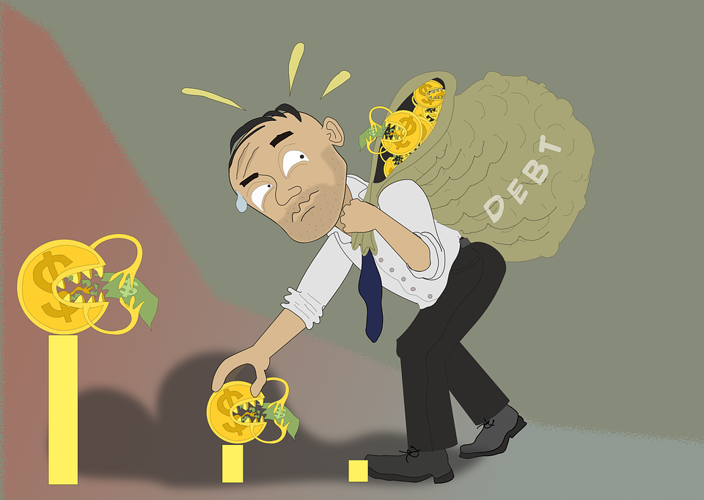

Understanding External Stimulus
In a small town in the US, the weather is horrendous and hence, despite being a holiday season, business is not picking up.
Earnings and profits being affected, everyone is in debt.
Luckily, a rich Russian tourist arrives in the foyer of the small local hotel.

Slide 7



He asks for a room and puts a $1000 note as advance on the reception counter and books a room for use after 7 days.
The hotel owner takes the banknote in a hurry and rushes to his meat supplier to whom he owes $1000.

Slide 8




Now…
The butcher takes the money and races to his wholesale supplier to pay his debt.
The wholesaler rushes to the farmer to pay $1000 for pigs he purchased some time ago.
The farmer triumphantly gives the $1000 note to a local cook who cooked food for him on credit.

Slide 9


The cook goes quickly to the hotel, as she owed the hotel for using their kitchen.
But here’s the twist in the tale: The Russian comes back after 7 days and informs the hotel owner that his plan of staying in the hotel is cancelled and takes his $1000 advance back and departs.

Slide 10


So while there was no profit or income, everyone got free of their debts and the small town people now look optimistically towards their future!

Slide 11

Thus the fiscal stimulus of the $1000 advance was the liquidity that got circulated within the economy and improved sentiments of the various stakeholders by making them get rid of their debt.
Once debt-free, people would happily resume their consumption, giving the various players in the economy a boost.

Slide 12
UNDERSTANDING FISCAL CONSOLIDATION

Slide 13
Understanding “Fiscal Consolidation”
Fiscal Consolidation is one word that often appears in columns of pink papers. So I thought we should bust this jargon

Slide 14

Let me tell you a story of 2 brothers Karan and Arjun both of whom were educated and did well in their jobs respectively.

Slide 15
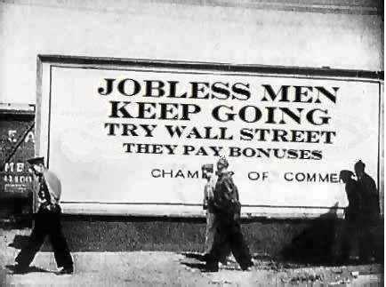
However, two years back Karan lost his job. All of a sudden his world changed. He had to start making compromises in his day to day life. He was also considering to discontinue the education of his children

Slide 16

But fortunately Arjun came to his rescue. He agreed to share his salary so that Karan’s life did not get disrupted. As a consequence Arjun had to postpone many of his plans such as purchasing a car for his family.

Slide 17

For the next 6 months Karan got financial support from Arjun and managed to keep his problems at bay.
However after 6 difficult months Karan finally got a job and his cash flow situation improved significantly.
Hence his need for assistance also reduced

Slide 18

Hence Arjun decided to discontinue the financial support to Karan.
Having discontinued this financial support Arjun was in a good position to fulfill his plans of purchasing the car for his family.

Slide 19
The financial support that Arjun provided Karan was like the fiscal stimulus that governments /central banks provided to industry during the financial crisis whereas his decision to discontinue the support once Karan’s position improved is nothing but the financial consolidation of Karan’s account.

Slide 20
So when we talk of financial consolidation what is meant is that because the Indian economy is back on track, a time has come to withdraw the fiscal support that was provided during the financial meltdown in 2008 so that the money could be put to better use for the economy

Slide 21
FISCAL POLICY
Fiscal policy is the means by which a government adjusts its spending levels and tax rates to monitor and influence a nation's economy. It is the sister strategy to monetary policy through which a central bank influences a nation's money supply.

Slide 22
NEED OF FISCAL CONSOLIDATION
Fiscal Stimulus over a long period of time weakens government treasury and increases Fiscal Deficit.
It is a burden on Indian economy.
It triggers the cycle of fiscal deficits.
It creates Inflation, which in turn increase fiscal deficit. (a recursive cycle, which may end only after fiscal consolidation)

Slide 23
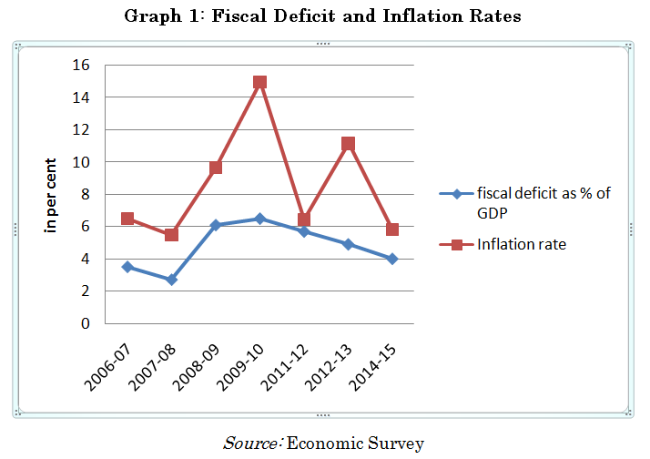
INFLATION v/s FISCAL DEFICIT

Slide 24
NEED OF FISCAL CONSOLIDATION
After the economic meltdown of 2008, some countries suffered fiscal deficits as much as $ 1 Trillion. (USA)
Similar case is with India: Fiscal Deficit rising surprisingly in 2007-08 and the graph has gone higher year by year.
Consider the following Graph. (Source: https://community.data.gov.in/deficit-of-the-indian-government-from-2000-01-to-2015-16) A digital India Initiative.

Slide 25
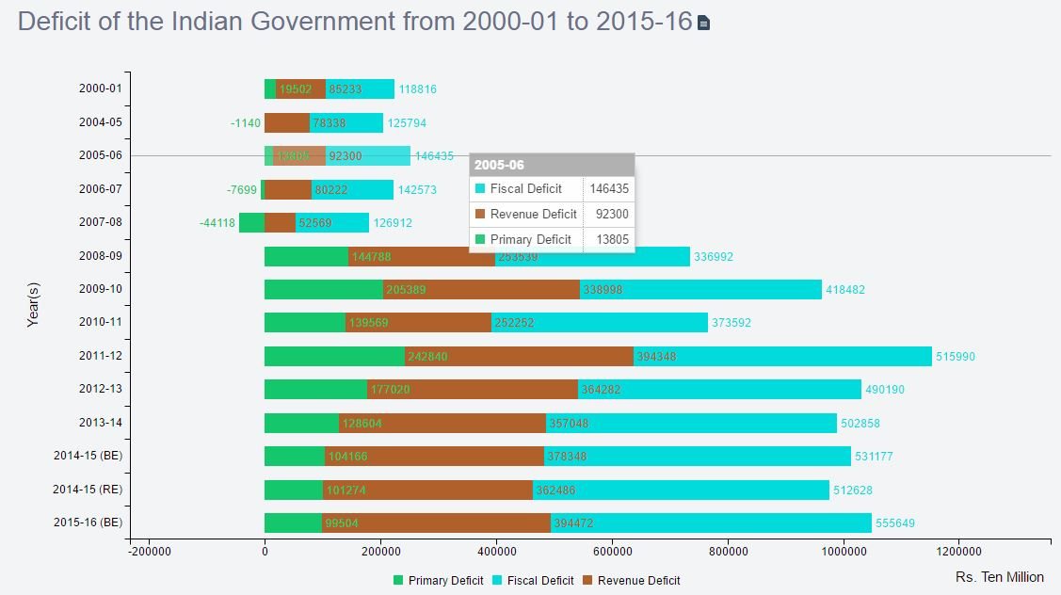

Slide 26
NEED OF FISCAL CONSOLIDATION
The graph and data says it loud and clear that, to help the economy to grow in all directions we need to cut down our expenses on Fiscal stimulus, which is being provided over several years.
Now that the Recession period is over and the dust has settled, it is the correct time to limit the resources spend as fiscal stimulus.

Slide 27

FISCAL CONSOLIDATION : NEED OF HOUR
The above facts and logic says themselves that if India is to continue without fiscal consolidation in future then in no time a situation may arise where Fiscal deficits can never be recovered in any way.
There are many examples like Argentina and Jamaica where Government debts are more than 50% of GDP itself. Thus in order to avoid such bankruptcy FISCAL CONSOLIDATION is need of hour in INDIA.

Slide 28
ACHIEVING FISCAL CONSOLIDATION
FRBM ACT. 2003 -> Institutionalize financial discipline, reduce India's fiscal deficit, improve macroeconomic management and the overall management of the public funds by moving towards a balanced budget and strengthen fiscal prudence.
It stands for Fiscal Responsibility and Budget Management.
AIM: 1. Eliminate Revenue Deficit.
2. Bring Fiscal Deficit to 3% of GDP.
3. Build Revenue Surplus by 2008.

Slide 29

POSTPONING FRBM
Due to International Financial Meltdown of 2008, FRBM was postponed.
This incident proved to be a crucial point and after this India’s Fiscal and Revenue Deficits increased in a way no one could imagine.

Slide 30
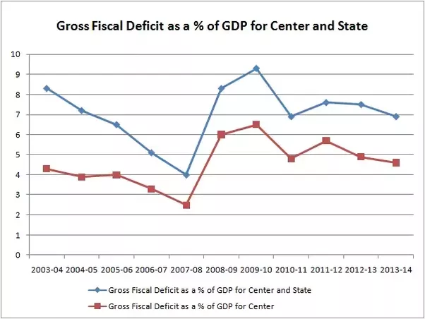
FISCAL DEFICIT OVER LAST 10 YEARS (2003-2014)

Slide 31
Targets and fiscal indicators
Subsequent to the enactment of the FRBMA, the following targets and fiscal indicators were agreed by the Central government:
Revenue deficit
Date of elimination – 31 March 2009 (postponed from 31 March 2008)
Minimum Annual reduction – 0.5% of GDP
Fiscal Deficit
Ceiling – 3% of the GDP by 31 Mar 2008
Minimum Annual reduction – 0.3% of GDP

Slide 32
Targets and fiscal indicators
Total Debt – 9% of the GDP (a target increased from the original 6% requirement in 2004–05)
Annual Reduction – 1% of GDP
RBI purchase of Government bonds – to cease from 1 April 2006
Four fiscal indicators to be projected in the medium term fiscal policy statement were proposed. These are, revenue deficit as a percentage of GDP, fiscal deficit as a percentage of GDP, tax revenue as percentage of GDP and total outstanding liabilities as percentage of GDP.^{[12]}

