Slide 1
ABOUT BSNL
Bharat Sanchar Nigam limited was formed on 1st October 2000 by corporatising Department of Telecom Services and Department of Telecom Operations. BSNL is fully owned by Government of India and operates throughout the country, except Delhi and Mumbai.
BSNL board comprises of Chairman and Managing Director, seven board of Directors, with two nominated from Ministry of Communications, and a Company Secretary.

Slide 2
Vision, mission and objectives.
Vision.
To become the largest Telecom Service provider in South East Asia.
Mission.
To provide world class state-of-the-art technology, Telecom Services on demand at affordable price.
To provide world class Telecom infrastructure to develop the country’s economy.

Slide 3
Objectives.
To be a lead telecom service provider.
Build customer confidence through quality and reliable service.
Provide band width on demand.
To meet all emerging communication needs of individual and small enterprise and corporate houses.
Contribute towards :
National plan target of 250 million subscriber base for the country by December 2007 in mobile sector.
Broad band customer base of 20 million in the country by 2010 as per broad band policy 2004.
Telephone in all villages.
Implementation of triple play as regular commercial proposition.

Slide 4
STATUS OF THE BSNL
BSNL is given MINIRATNA-I Status in spite of the fact that it is fully eligible to get NAVARATNA Status.

Slide 5
SOURCES OF DATA
Data presented in charts and graphs is obtained from DoT and BSNL annual reports.

Slide 6
PHYSICAL STRUCTURE OF BSNL
The BSNL physical structure comprises of various segments, each having definite tasks to be performed. A brief picture of the same is given here.
Telecom Circles/Metro Districts:
There are 24 Telecom Circles and two Metro Districts. They are responsible for installation, operation, maintenance and providing various telecom services coming under basic services, cellular services and data services within their jurisdiction.

Slide 7
PHYSICAL STRUCTURE OF BSNL
Transmission Maintenance Regions: There are 4 transmission maintenance regions, one each for Northern zone, Southern zone, Eastern zone and Western zone. They are to install, operate and maintain transmission systems connected through optical fiber cable, satellite stations, microwave systems. They maintain optical fiber cable used as media for interconnecting transmission systems. They also operate and maintain large Trunk Automatic Exchanges.

Slide 8
PHYSICAL STRUCTURE OF BSNL
Telecom Project Circles: There are 4 telecom project circles, one each for Northern, Southern, Eastern and Western zones. They are to install large transmission and switching systems, lay optical fiber cables and erect transmission towers.
North-East task force circle is exclusively meant for installation of transmission systems, erection of towers, laying of optical fiber cable, in the north eastern states and Assam.
I.T. Project Circle: IT Circle Pune takes care of all software related requirements like HR Package, Billing etc.

Slide 9
PHYSICAL STRUCTURE OF BSNL
Telecom Quality Assurance and Testing and Development Circles: Telecom quality assurance circle is having its operational units in all cities/towns where factories for manufacturing and supplying of telecom equipment and its accessories, meters, OFC cables,drop wire etc are situated. The TQA circle tests quality not only of the finished equipment but also of the components used for the same before giving its approval for use in the field.
T &D circle mainly conducts tests of all the installed equipments before making over to the field units for operations. They also test cables meant for local and long distance networks.

Slide 10
PHYSICAL STRUCTURE OF BSNL
DATA Network Circle: All DATA services right from packet switching public data network(PSPDN), Internet over dial up and lease line, multi-protocol label switching (MPLS-VPN) , broad band and other value added services, E-mail service, web hosting, co-location of web server, Maintaining Network Operation Center(NOC) of NIB2, Disaster recovery NOC at Pune, broad band project-I , MPLS narrow band project-3, Wi-Fi and Wi-Max services are maintained by DNW circle.

Slide 11
PHYSICAL STRUCTURE OF BSNL
Telecom Factories: There are 3 telecom factories which mainly manufacture certain accessories required for field units. The main items of manufacture are towers, cable jointing kits, coin box pay phone, telephone instruments, SIM cards etc.

Slide 12
PHYSICAL STRUCTURE OF BSNL
Training Centers: There are 3 main training centers, ALTTC Ghaziabad, BRBRAIT at Jabalpur and NATFM at Hyderabad. These training centers are to impart pre-appointment training for Group “A” and Gr. “B” level officers and, in addition, provide refresher/in service trainings to both group “A” and “B” officers. In addition, there are 11 Regional Telecom Training Centers(RTTCs) and one circle telecom training center in each telecom circle. They also provide pre-appointment training for group “B” officers and refresher/in-service training for all the staff. The data below indicates the total number of employees trained on year to year basis.
 | 2002-03 | 2003-04 | 2004-05 | 2005-06 | 2006-07
Employees trained | 85,665 | 91,083 | 1,09,564 | 1,12,429 | 1,07,749

Slide 13
SERVICES OFFERED BY BSNL
Basic Telephone Services
Internet Services
Data one
Leased Circuits
Wireless Services
Rural Telecom Services

Slide 14
Basic Telephone Services
Different kinds of services offered are :-
B-Fone: fixed line telephone connection with different rental /free call plans. Under “Sulabh” scheme a fixed monthly rental of Rs. 120 is charged without free calls. For rural customers, the rental varies from Rs.50/- to Rs.150/-, based on the exchange capacity. Number of free calls is 75.
One India Plan: A fixed monthly rental of Rs.180/- with 50 free calls. The call charges are Re.1/- per 60 seconds to any place in India beyond 50 kms and Re.1/- per 180 seconds to any place within 50 kms.
Integrated Services Digital Network(ISDN): The ISDN connections are given under two categories, namely, primary rate access (PRI) 30B+D and basic rate Access (BRI) 2B+D . Both these categories have different rental /free call plans.

Slide 15
Basic Telephone Services
Centrex: Customers having more than one connection in the same city /town can use this facility to have intercommunications . This facility is having different plan charges depending upon the number of telephones. The calls within Centrex numbers are free of charge.
Intelligent Network Services (IN Services): India Telephone Cards, Toll free phone services, Tele voting, universal access number service, premium rate services, revenue share graded basis service, account calling card, virtual private network of land line and Mobile are the recently launched services under IN platform.
Public Telephone(PT): PTs are provided to physically challenged people for earning their livelihood through commission paid by BSNL . PTs provide telephone facility for general public for making local/STD /ISD calls.

Slide 16
Internet Services
Internet under Dialup Access( Sanchar net): This facility has different plans, ranging from 25 to 1000 hours, with different validity periods. The Sanchar net service is prepaid. The service is offered through Sancharnet Card and customer can register on line.
ISDN Dialup Access: This facility also has different plans, ranging from 100 to 1000 hours, with 2 years validity. This is also a prepaid service.
Internet Leased Line Access: This service is having different plans wherein a customer has to pay fixed annual charges, depending on the Bandwidth and whether it is a non ISP(1:1), Non ISP (1:4) or ISP. Educational Institutions owned / recognized by Central/State Govts. get concession up to 25% on port charges.
Net One: It is an instant internet service . It is an account free internet dial up access, based on CLI. In this service, customer will have to pay 10 paise per minute for use of internet, in addition to telephone dial up charges. It is a post paid dial up Internet service.
Internet Dhabas: These are provided to facilitate general public to have access to internet services in rural areas.

Slide 17
DATA ONE
This is a Broad Band data network . It provides 2 types of plans. Home plan and business plan. Both home and business plans have different monthly/annual charges, depending upon bandwidth and amount of data usage. Depending upon the plan opted, customer gets min. 256 Kbps to from max 2Mbps speed. In each case, there is limit to download/upload of data and separate tariff for additional usage. In certain plans, modems are given free of cost by BSNL. Customers have an option to purchase the modem from outside or have it from BSNL on fixed monthly rental.

Slide 18
Wireless Services
Tarang-WLL-M: This is a mobile telephone with limited mobility within SDCA. The tariff plan is similar to that of b-fone telephone services. The pulse rate for local calls and tariff for STD calls within territorial circle and outside it are different compared to that of landline telephones. The WLL-M is also having ONE INDIA scheme and tariff is Re.1/- per minute to any place in the country. The customer is free to use his own CDMA handset as per specifications. However BSNL provides handset under different schemes.
CELL ONE and Excel: This is cellular mobile service having mobility across the country. The service is having both prepaid(Excel) and postpaid(Cell One) facility with different plans, on the basis of which the tariffs for local, STD and ISD calls vary. This service provides SMS facility of 160 characters. It is also having International roaming which is chargeable.

Slide 19
Leased Circuits
MLLN: Managed Leased Line Network is a leased circuit which is monitored 24 hours on all 365 days centrally at the district level and has different plans, with different annual rental depending on the distance between the two ends and the bandwidth.
MPLS-VPN/IP-VPN Services: The two services have different plans, whereas the charges are determined based on the bandwidth. If 5 or more ports are used then VPN ports get discount depending upon the total number of ports. This service is particularly meant for small enterprises and big corporate houses, having their offices / branches located across the country.

Slide 20
Rural Telecom Services
In addition to provision of telephone connections under b-Fone, WLL-M and cellular schemes, efforts are continued to be made for providing telecom facilities under different schemes for all rural places. BSNL of its own has provided 5.35 Lakhs village Panchayat telephones for the use of public living in rural places. In addition, BSNL, by various agreements with DOT under Universal Service Obligation Fund (USO fund), has provided telephone facilities, both with wire and wireless. As on 31.3.06 nearly 1.5 Crore telephone connections are working in rural areas of the country. Based on agreement with DOT under USO fund, BSNL, as on 31.3.2006, has developed rural telecom network as mentioned below.
Village Public Telephone(VPT): As per agreement signed in Nov. 2004, 66,822 villages having a population of more than 100 as per 1991 census have to be provided with village public telephones. This includes 14183 villages to be covered by digital satellite phone terminals since these are remote and far –flung and cannot be covered by any other means of communications. As on 31-3-2006, 24,687 villages out of 66822 villages are provided.

Slide 21
Rural Telecom Services
Rural Community Phones: As per agreement signed in Sep.2004 24,794 villages having a population of more than 2000 as per 1991 census having no public telephone are to be provided with rural community phones. As on 31-3-2006 , 16398 villages are provided out of 24794 villages.
Replacement of MARR Village Panchayat Telephones.: As per agreement signed in September 2003 1,41,233 MARR VPTs as on 1-7-2003 are to be replaced by a land line/WLL telephones. As on 31-3-2006, 104066 MARR VPTs have been replaced by land line/ WLL connection.
Rural Household DELs: As per the agreement signed on 15-3-2005 rural household DELs are to be provided in 1267 SDCAs. As on 31-3-2006, 3,43,235 rural DELs have been provided in these specified SDCAs.

Slide 22
Role of Executives in BSNL
BSNL, a telecom service provider throughout the country, has about 59,421 officers, as on 31-3-07, of which 25,830 are entry level executives, 31,666 middle level executives and 1925 top level executives, comprising of Deputy General Managers, General Managers and Chief General Managers. Total number of 57,496 executives have got permanently absorbed in BSNL. In top level executives, officers belonging to finance, civil, electrical etc. wing have got by and large absorbed, whereas an insignificant number of officers belonging to ITS got absorbed. Majority of ITS officers are yet to get absorbed. The total number of non-executive staff of BSNL as on 31-3-2007 is 2,60,676.

Slide 23
Role of Executives in BSNL
The executives belonging to the telecom engineering are responsible for complete development/expansion, installation, operation and maintenance of entire telecom network relating to all areas like Switching, Transmission, RF network, Ip network, Out-door network, OFC network, etc. in the country. They have been identified as the” BACKBONE” for the growth of telecom services and are the main “REVENUE EARNERS” of the BSNL. They work across entire length and breadth of the country, including not only metro/major cities/towns, but also in rural, under developed and highly inaccessible areas like North east, Andaman Nicobar islands, J&K, Jharkhand, Assam where insurgency is a challenge always to face.

Slide 24
Role of Executives in BSNL
The executives of the telecom engineering exhibit extraordinary courage and commitment in restoring and maintaining telecom services during natural calamities like earth quake at Gujarat, Srinagar valley and Sunami affected Andaman and Nicobar islands.

Slide 25
Role of Executives in BSNL
The telecom engineering executives perform round the clock duties in almost all telephone exchanges, co-axial, microwave, GSM, satellite earth stations and trunk automatic exchanges. They lay and maintain the entire underground local cable network and optical fiber cable which forms major trunk junction network. They work at factory premises for testing and ensuring the quality of the equipment and later, after installation, they do acceptance testing of all the equipments. They work in training centers to impart not only pre-appointment training but also in-service and refresher courses of training. They are also involved in planning and estimation.

Slide 26
Role of Executives in BSNL
The executives of architecture ensure that the building plans are drawn according to the modern needs relating to technical / administrative purposes. The executives of civil wing ensure that the materials used and the construction work is done as per the specifications agreed upon in the tender documents. The civil executives main job is to maintain the company owned buildings. The executives of electrical wing carryout electrical installations in all newly built company buildings and maintain existing electrical installations.

Slide 27
Role of Executives in BSNL
The executives of financial wing are mainly involved in budgeting and in assisting the auditing of company accounts, including that by CAG. Their main job is to ensure proper utilization of company funds. They are also responsible in drawing pay and allowances and settlement of monetary claims of all employees.
The administrative executives mainly work in corporate office . Their main responsibility is to ensure smooth functioning of corporate office in matters related to creation of posts, recruitments, promotions, transfers and postings, issue of clarifications on administrative and financial matters and holding of internal exams etc.

Slide 28
Role of Executives in BSNL
The executives working in telecom factories are responsible for production of certain telecom components needed for the maintenance of field units. They also manufacture coin collecting public telephones, tower materials, SIM cards and telephone instruments.

Slide 29
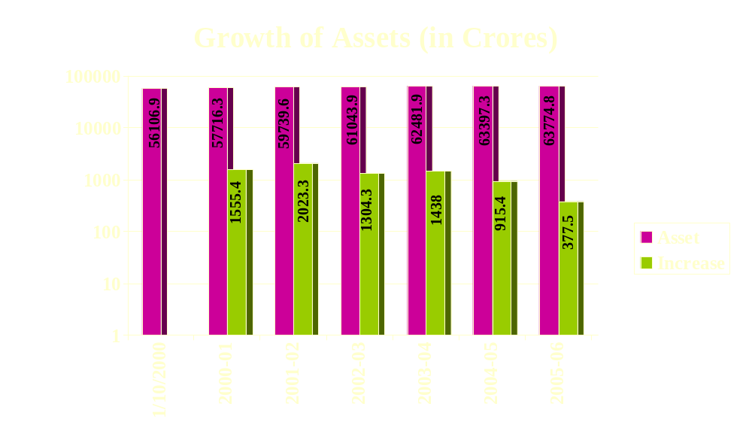
Please Note: Even with tough and stiff competition from other operators, BSNL Assets grew by 7614 crores, that is, by 13.6% by the year 2005-06.

Slide 30
Chart showing size of Network and Working connections in different area of services
 | 2001-02 | 2002-03 | 2003-04 | 2004-05 | 2005-06 | DEC 06
Tel. Xges | 34592 | 36136 | 36618 | 37040 | 37442 | 37636
Eqpd Cap | 41167467 | 45031557 | 53421282 | 59312511 | 70746550
Total.cons | 33419000 | 38189000 | 41649000 | 46935000 | 55159000
Basic | 33419000 | 35933000 | 36395000 | 37488000 | 37995000 | 33577097
Celluclar |  | 2256000 | 5254000 | 9447000 | 17164000 | 26610000
OFC(Kms) | 326271 | 402083 | 437475 | 461940 | 480196
PT lines | 903900 | 1195668 | 1519686 | 1871268 | 2106554 | 2092148
VPTs | 468016 | 504945 | 509682 | 518992 | 535134 | 545066
Internet dhaba | 3097 | 3484 | 3616 | 3794 | 3715
Internet conn | 242230 | 481996 | 934950 | 1798089 | 2201044 | 3050000
Dataone | (Commissioned w.e.f.14-01-05) |  |  | 33907 | 586374 | 841000
ISDN cons | 34022 | 49868 | 63879 | 77615 | 92283

Slide 31
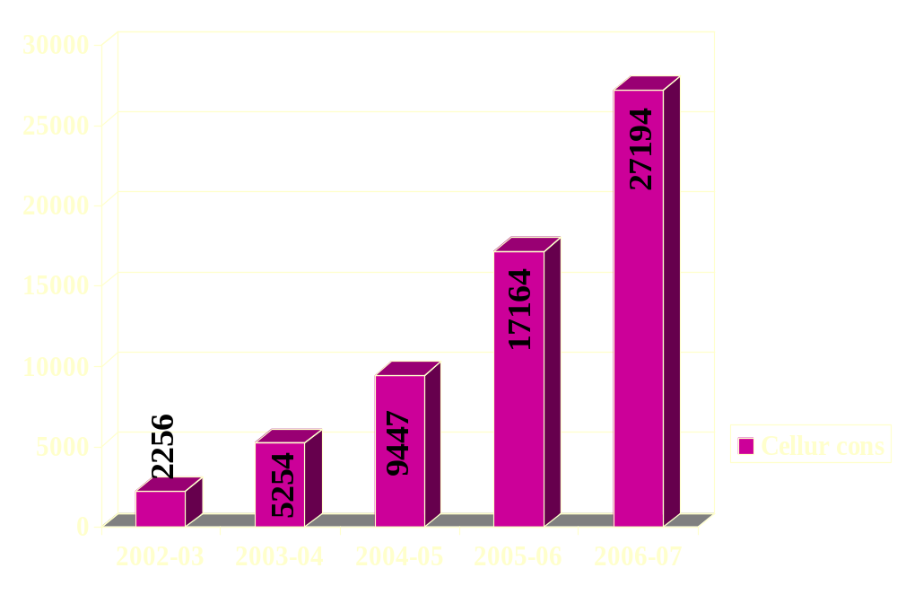
YEAR WISE CELLULAR WORKING CONNECTIONS (in Thousands) & REVENUE(in crores)

Slide 32
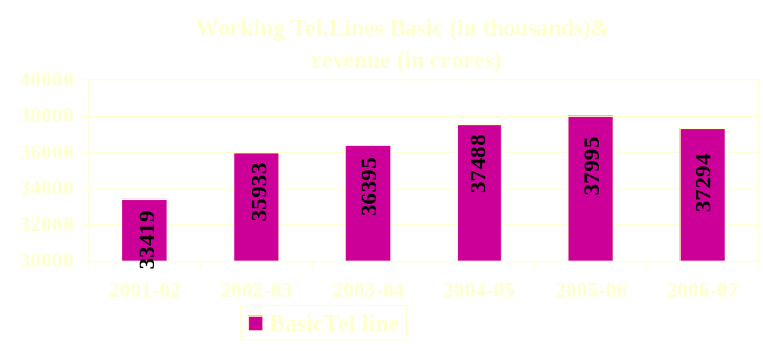
Please Note:
Cellular service was launched in Oct.2002.
A steady growth in telephone network resulted in a steady growth of working connections
After launching cellular services (CellOne) the number of Cellular connections is almost double year after year.
In spite of disconnections of Telephones in Basic Services, yet as a whole there is a growth of 8 Million connections as on 2005-06.
The Net effect of increase in Telephone Network and working connections is an increase in Income from services.

Slide 33
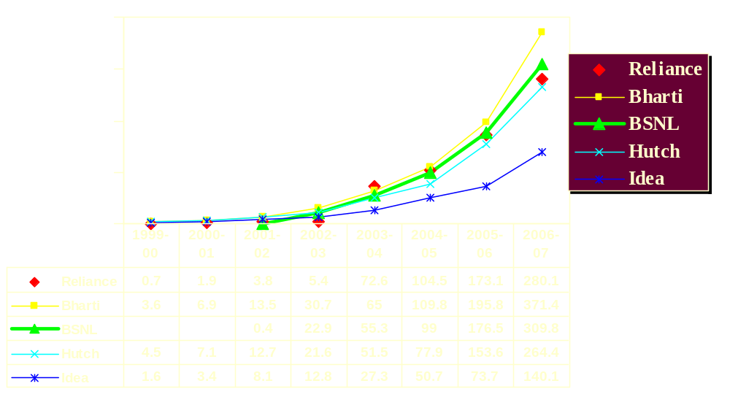
Mobile (Cellular & WLL-M) Services subscriber base ( in Lakhs)
Source: TRAI Report year ending Mar 07.

Slide 34
Tele density of BSNL per 100 population as on 31st Dec 2006
Urban Tele density : 17.71
Rural Tele density : 2.00
Overall Tele density : 6.04

Slide 35
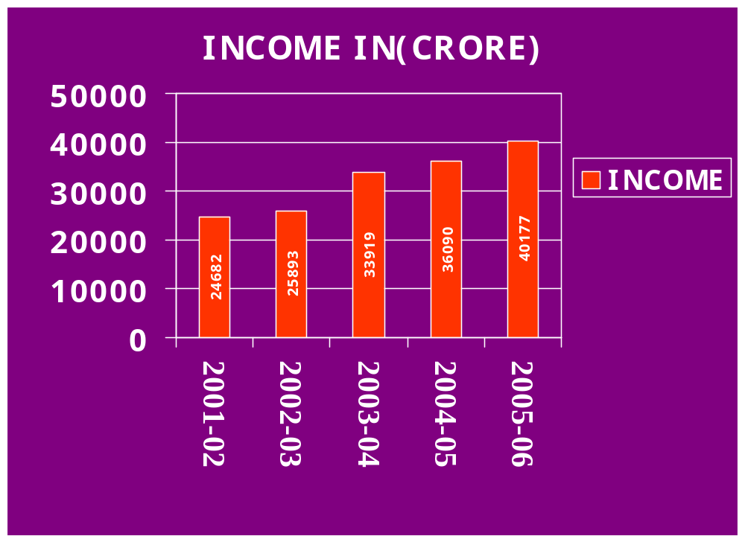

Slide 36
INCOME
Please note:
In spite of stiff competition from other operators, the income of BSNL grew, year after year, and by the year 2005-2006, the income grew by 63% over the income for the year 2001-2002, mainly because of:
Digitalization of both switching & transmission equipments.
Usage of optical fiber cable for trunk & local junctions.
Introduction of WLL, cellular, broadband and many other new services.
Large scale development and expansion of telecom networks.
Elimination of over head wires by under ground cables.
Large scale development of rural networks in the form of VPTs, rural community phones, replacement of MARR VPTs, use of WLL systems for wireless communication, revival of household DELs.
In-service / refresher trainings for executives for updating their technical knowledge and behavioral and attitudinal training for non-executives.
Staff adopting ‘customer friendly’ approach and attitude.

Slide 37
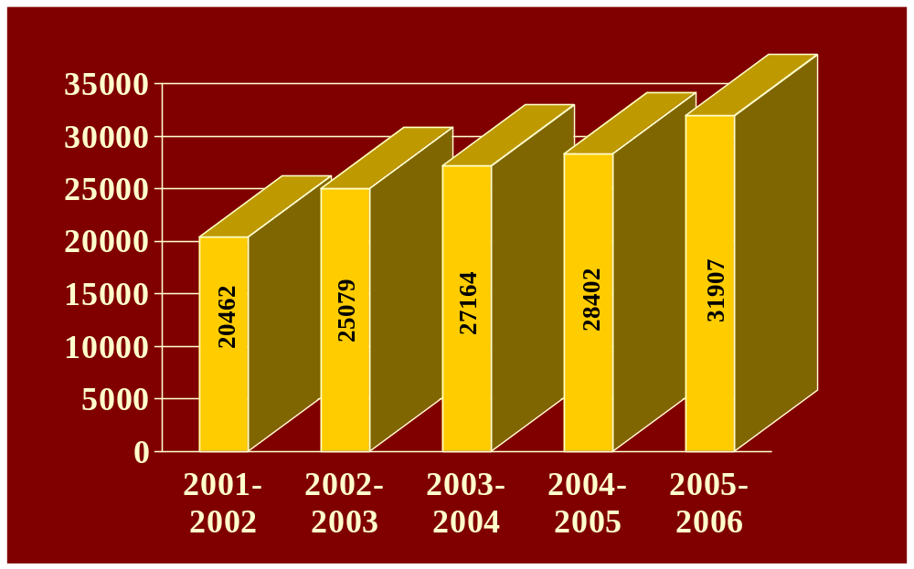
Expenditure (in Crores )

Slide 38
Expenditure
Please note:
The expenditure of the company grew year after year and reached 50% more for the year 2005-06 as compared to 2001-02 on account of
Steady growth in ‘operating expenditure’ on year to year basis which became 250 % greater in the year 2005-06 as compared to 2001-02.
Payment of pay and allowance in IDA scales with effect from 1st October 2000 consequent to permanent absorption of Group’B’, ‘C’, & ‘D’ staff.
Adhoc payment of Rs. 2750/- per month for all ITS group ‘A’ officers working on deputation with effect from 1.10.2000.
Payment of pay & allowance in IDA scales with effect from 1st October 2000 consequent to permanent absorption of Group’A’ officers of finance, civil, electrical , architechture wing and certain ITS officers.

Slide 39
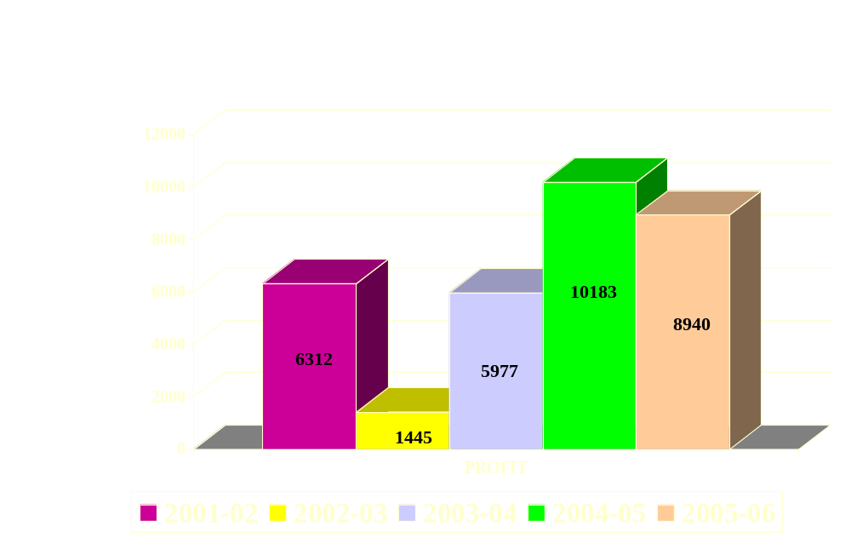
PROFIT (in Crores)

Slide 40
Profit
Please note:
The profit for the year 2002-03 has gone down by Rs. 5000/- crores as compared to 2001-02 on account of ,
Increase in staff remuneration by Rs. 2500/- crores on account of payment of IDA scales with effect from 1st October 2000 consequent to permanent absorption of group ‘C’, & ‘D’ staff and payment of adhoc amount of Rs. 2000/- per month with effect from 1st October 2000 for all group ‘B’ staff.
Increase in operating expenditure by Rs. 1500/- crores.
Increase in expenditure towards depreciation by Rs. 800/- crores.

Slide 41
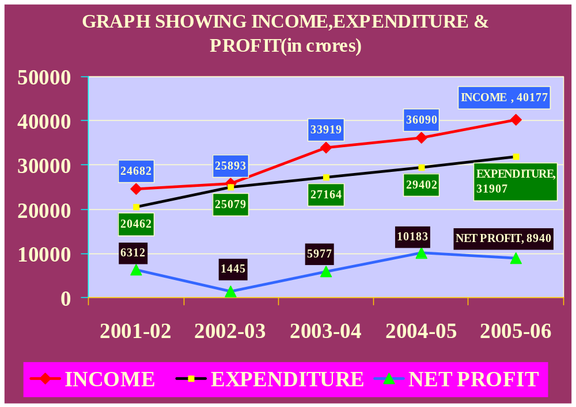

Slide 42
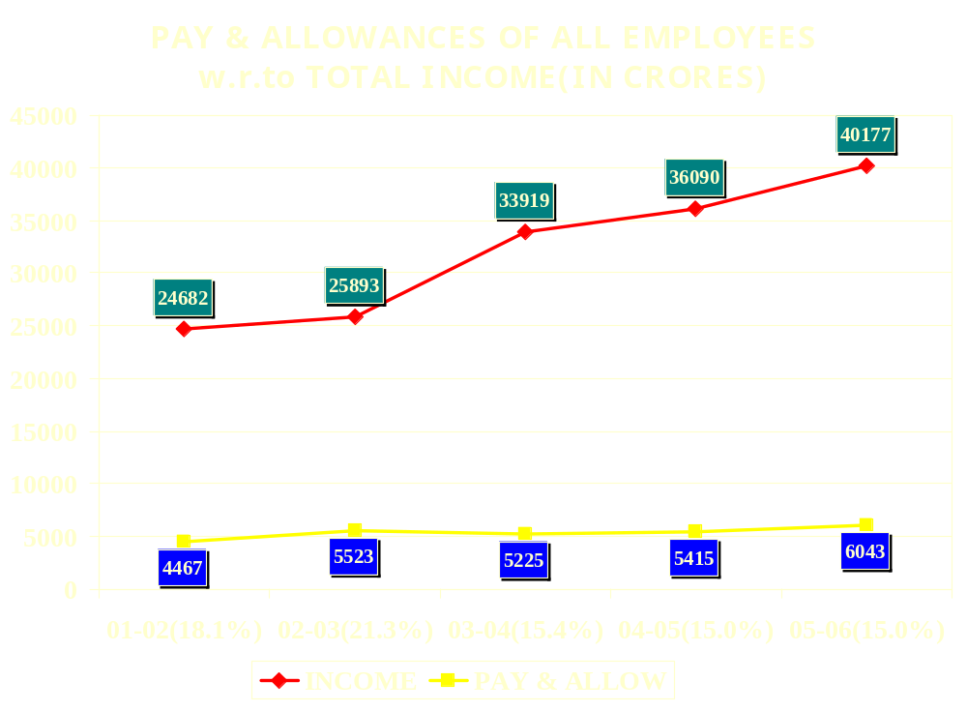

Slide 43
THANK YOU

