Slide 1
THE IMPACT OF NEW ECONOMIC REGIME IN INDIA
NEW ECONOMIC POLICY (1991)
By:
Rishabh Mittal (2015ucp1715)
Siddhartha Singh (2015ucp1773)

Slide 2
INDIA BEFORE ECONOMIC
REFORMS
India's post-independence development strategy showed all the signs of stagnation.
By 1985, India had started having grave economic crisis characterized by unprecedented adverse BOPs problem, Inflation, decline in the Foreign Exchange Reserve and the Gross Domestic Product (GDP) growth rate.

Slide 3
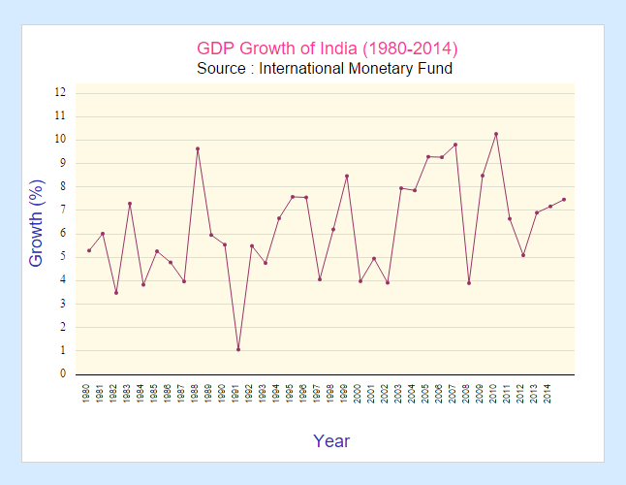
NEED OF ECONOMIC REFORMS
The crisis was caused by currency devaluation
Fall in Forex reserve.
Inflation.
Precipitated by the Gulf War , India’s oil import bill swelled.
Exports slumped and credit dried up.
Large fiscal deficits.

Slide 4
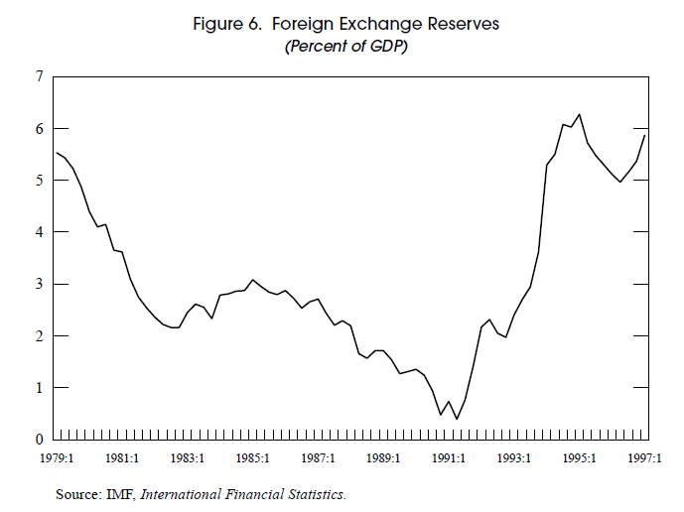
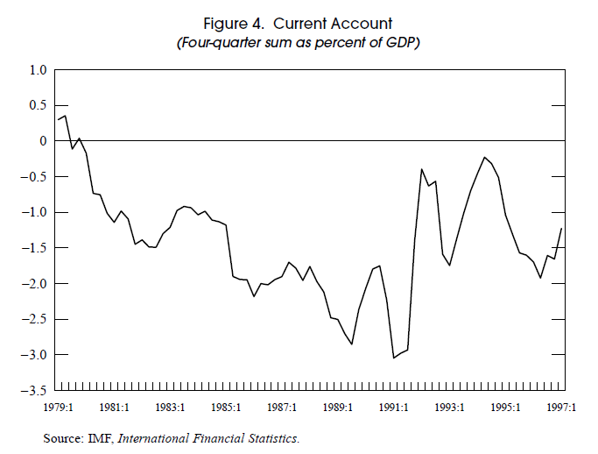
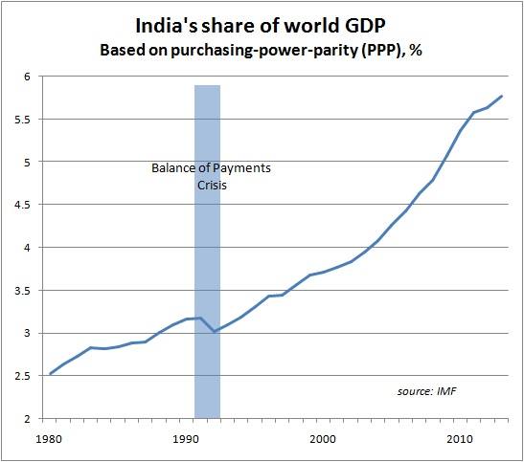

Slide 5
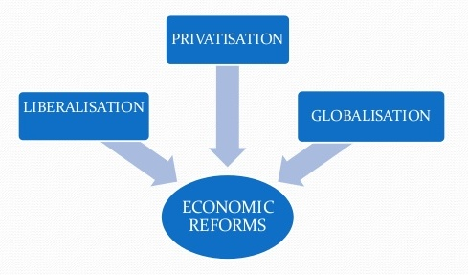
NEW ECONOMIC POLICY 1991
On July 24, 1991
To face the crisis situation, the government decided to bring about major economic reforms to revive Indian economy.
known as 'structural adjustments' or LPG

Slide 6
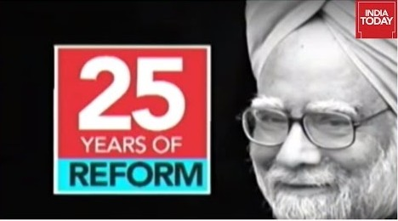
OBJECTIVES
The main objective was to make Indian economy , a part of world economy.
To achieve self-reliance.
Reduce the inflation rate.
Remove imbalance in payments.
Raising investments, Improvement in efficiency and productivity.
Ensuring rapid industrial development.

Slide 7
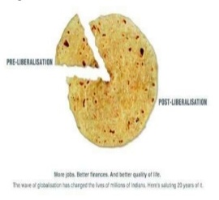
LIBERALIZATION
Liberalization means to free the Indian economy from the controls imposed by the Govt. Before 1991, Govt. had put many types of controls on Indian economy which were –
Industrial Licensing System
Foreign exchange control
Price control on goods
Import License.

Slide 8
MEASURES ADOPTED
Independent determination of interest rate.
Freedom to import capital goods.
Freedom for expansion and production to Industries.
Softening of MRTP Regulations.
Abolition of Industrial Licensing.
Freedom to import Technical know-how.
Increase in the investment limit of the Small Scale Industries.

Slide 9


IMPACTS OF LIBERALIZATION
POSITIVE
Increase in foreign investment.
Increase in production.
Technological advancement.
Safety check on fiscal deficit.
Increase in GDP growth
rates.
NEGATIVE
Ignored agricultural sector.
Increase in unemployment.
Decrease in Tax receipt.

Slide 10

PRIVATISATION
It is the process of transferring ownership of a business, enterprise, agency, public service, or public property from the public sector (a government) to the private sector.
The Govt.’s role is only reduced it does not disappear.
To cure problems related to the public sector
mounting losses,
low profitability, and
underutilization of capacity.
Lack of Competition.

Slide 11
MEASURES ADOPTED
Sale of shares
Disinvestment in PSU’s.
Minimization of Public Sector:
Number of industries reserved for public sector was reduced from 17 to 4.
Transport and railway
Mining of atomic minerals
Atomic energy
Defense equipment.

Slide 12


IMPACTS OF PRIVATIZATION
POSITIVE
Reduced the burden on govt.
Better results in revenues and efficiency and productivity
Increased competition.
More responsive to customer complaints.
Removal of political interference.
NEGATIVE
Concentration of wealth in few hands.
Unhealthy competition.
More focus on profit maximization and less on social objectives.
Lack of transparency in private sector.

Slide 13

GLOBALIZATION
Till 1991 Indian government was following strict policies for import and foreign investment such as licensing of imports, tariff, restrictions, which were eased by adopting the policy of GLOBALIZATION .
Globalization means integration
of economies and societies
through cross country
flows of information, ideas,
technologies, goods, services,
capital, finance and people.

Slide 14
MEASURES ADOPTED
FERA (1973) was scrapped and FEMA was passed in 1991 to facilitate entry of MNCs.
Import liberalization by reducing import duties.
Raising capital in foreign countries by the GDR route (Global Deposit Receipt).
Encourage NRIs, Foreign Institutional Investors (FIIs) and MNCs to invest in India.
Free mobility of managerial personnel and entrepreneurs.

Slide 15

IMPACTS OF GLOBALIZATION
POSITIVE
Expansion of market.
International co-operation.
Efficient technological innovations.
Deregulation and lowering of trade and tariff barriers.
Improved economic relations with other countries.
NEGATIVE
Low growth of agriculture sector.
Adverse impact on environment.
Free trade limits the ability of states to set policy and protect domestic companies.
Rise in Rural- Urban divide.

Slide 16
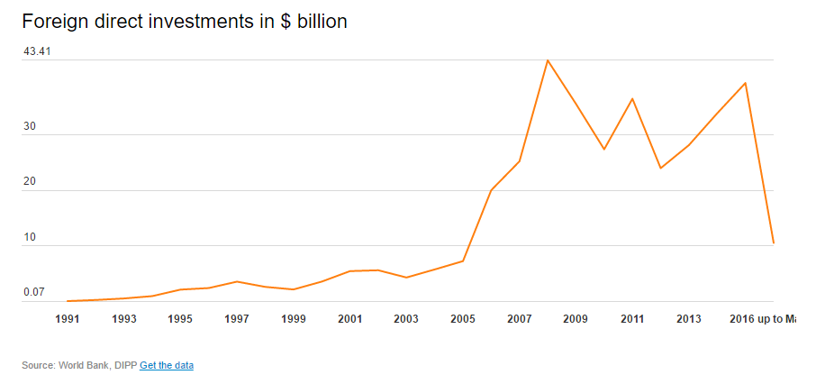
ECONOMIC SCENARIO-
POST 1991 REFORMS
India remained the second fastest growing economy in the world, behind China until 2015.
India was billed as the fastest growing major economy in the world, with a growth rate of 7.6% in 2015-16.
The first year of reform saw a total foreign investment of only $74 million.
In 2015, India received $63 billion (nearly Rs 4.19 lakh crore ) and replaced China as the top FDI destination, according to The Financial Times.

Slide 17
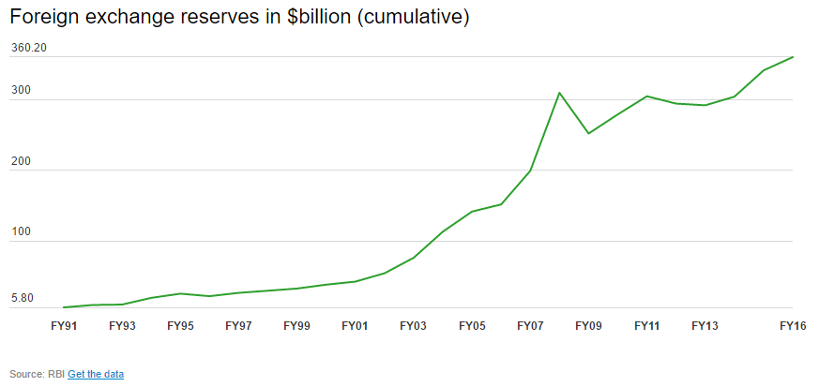
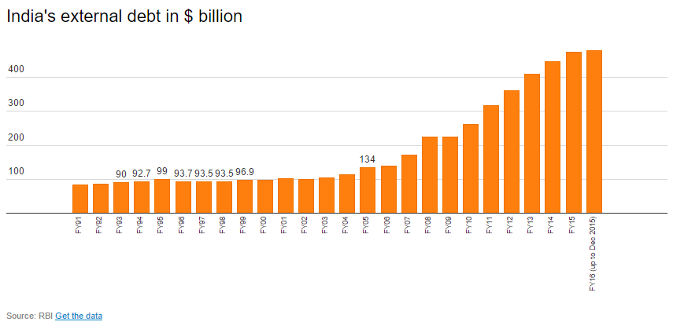
ECONOMIC SCENARIO-
POST 1991 REFORMS
In 1991, FOREX (Foreign Exchange Reserve) stood at just $5.8 billion.
As of 24 June 2016 , the country’s FOREX reserves are at $360.8 billion.
In 1991, the country’s external debt stood at $83.8 billion.
The rise has been steady with the figure in December 2015 hitting $480.2 billion.

Slide 18
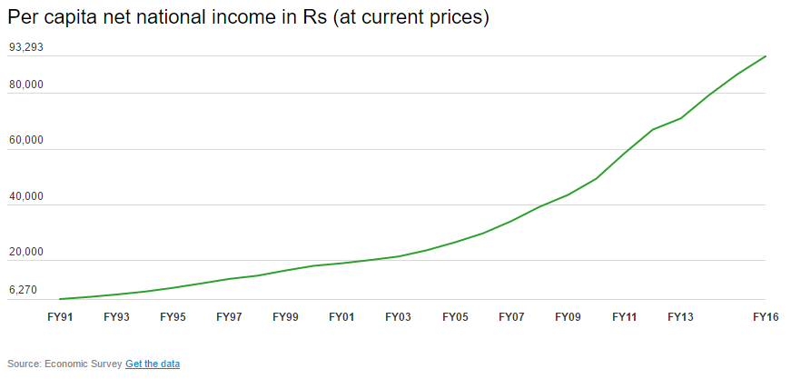
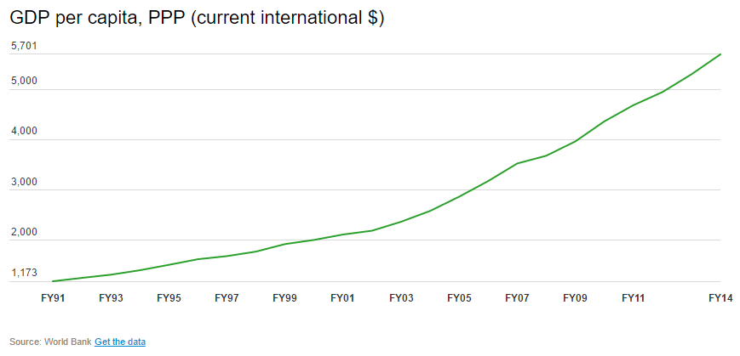
ECONOMIC SCENARIO-
POST 1991 REFORMS
Between 1991 and 2016, per capita income rose from Rs 6,270 to Rs 93,293.
This is a whopping 1388 percent jump.
Purchasing power parity (PPP) gives a comprehensive idea on the standard of living and the cost of living in a particular country.
In 1991, per capita PPP was $1,173. In 2014, it rose nearly five-fold to $5,701.

Slide 19
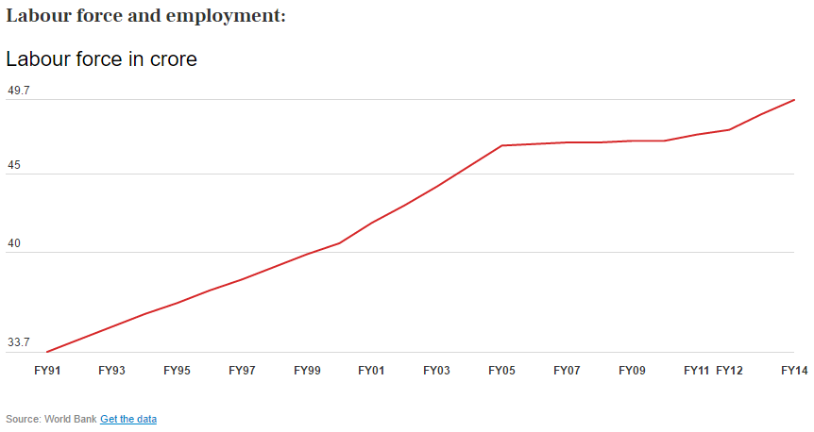
ECONOMIC SCENARIO-
POST 1991 REFORMS
The labour force in India currently stands at 49.7 crores. In 1991, it stood at 33.7 crores.
The most important fact is that the decline in unemployment rate over the last 25 years is only marginal – from 4.3% in 1991 to 3.6% in 2014.

Slide 20
CONCLUSIONS
The process of economic reforms is not fast enough to achieve the goals.
India had built diversified Industrial Structure and was also ready to face International Competition. But, the way it was implemented in India took a heavy toll on them.
Small Scale Industries faced direct competition from Large Scale Industries and Imports from Outsiders. This led to the increase in Indian Reserves along with suicide of 1000 Power loom Industrialists (Small ones) . Hence, Liberalization should have been implemented with better policy measures.

Slide 21
CONCLUSIONS
Globalization was not implemented perfectly either. While developed nations continued to have barriers on entry in their markets, they asked developing nations to remove barriers in their market. This further degraded Indian Industries and also the employment opportunities which were supposed to be created.
Coming to Privatization, this probably had hurt India the most. India sold many things to private sector after seeing a potential growth in them. All the scams are result of it. India often undervalued the assets of PSUs and sold it to private sector. This led to a substantial loss to govt. which it recovers by imposing on public. So basically it is a public loss.

Slide 22
CONCLUSIONS
Seeing, LPG's negative aspect is essentially seeing Indian Government's fallacy to implement it. Though we have better GDP and lower levels of unemployment and better diversification of opportunities, we still lag to satisfy the basic needs of Indian rural people.
So, overall, its a long way for India to become a developed nation. To solve a problem, a problem should first be identified and then the policies should be designed and implemented efficiently.

Slide 23
THANK YOU
FOLKS

