Slide 1

Professional Ethics:
Need of the hour

Slide 2


Slide 3
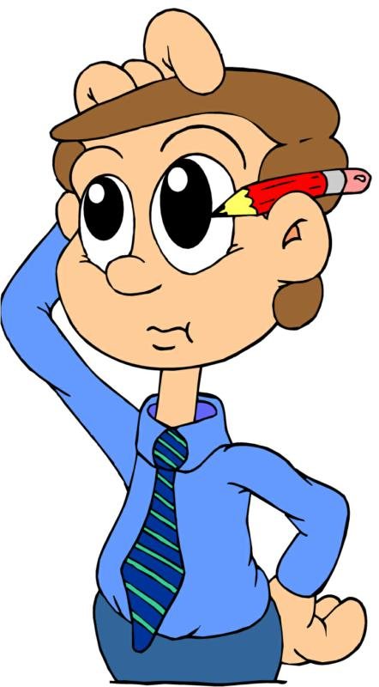
WHY??
Not Sincere
Not Honest
Not Regular and Punctual at work
Didn’t respect Time
Didn’t respect the Customers

Slide 4

ETHICS:
It tells us about our moral duties and obligations so
that our behavior at work and other places is right, truthful and just.

Slide 5
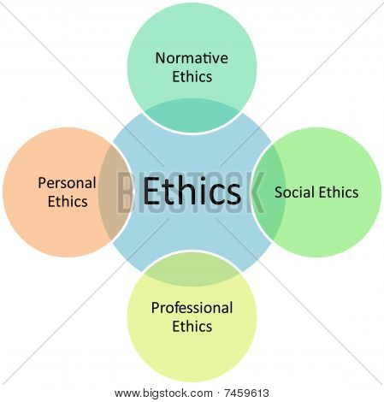

Slide 6

Professional Ethics
Professional ethics encompass the personal, organizational and corporal standards of behavior expected by professionals.

Slide 7
Components and their importances
●Honesty
●Loyalty
●Credibility
●Integrity
● Respect
●Accountability
●Obedience to the law
●Transparency

Slide 8
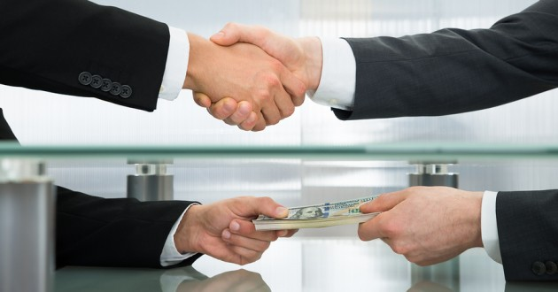
Honesty and loyalty
Extortion and greediness

Slide 9

RESPECT
Often
fades
away

Slide 10

ACCOUNTABILITY
Be accountable to your result…
Take ownership of your mistakes…

Slide 11

OBEDIENCE TO THE LAW AND TRANSPARENCY
●Obedience to the law
◊ Common law , equity and Trust
◊ Religious and
constitutional law
◊Security
●Transparency :
◊Accessibility
◊Usability
◊Auditability
To all members.

Slide 12

Alignment of personal and organizational ethics .
● The articulated values of all the members can provide a framework for the collective leadership of an organization to encourage common norms of behavior which will support the achievement of the organization’s goals and mission.
“ So , What happens if there is a conflict between what an individual believes in and the organization's values ?? “

Slide 13

Alignment of personal and organizational ethics , contd…
Three possibilities :-
● The individual stands up for his or her beliefs, and possibly loses his or her job.
● Doesn’t make a stand for their belief and goes with the flow.
● To influence the organization to change its values or behavior.

Slide 14

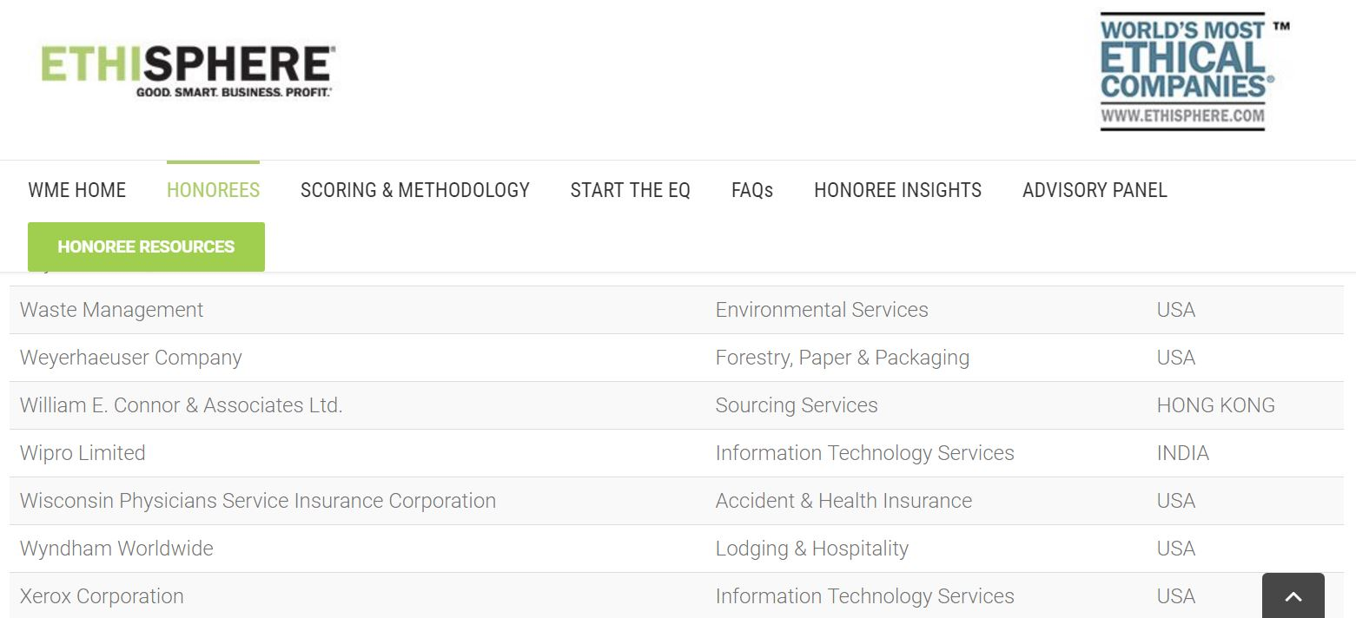
WIPRO
Applying Thoughts
◊ Wipro is one of only three companies in the global
Information Technology Services industry honored as ethical
company this year.
source :- http://worldsmostethicalcompanies.ethisphere.com/honorees/

Slide 15

WIPRO , contd…
● Wipro promises to server its customer with integrity , through innovative ideas.
●Value for money solutions by applying thoughts , day after day.
● Their human value says “we respect the unique needs of customers and employees.”
● With integrity they promise to deliver their commit.
●Stays committed to resolving internal conflicts which helps them in being ethical.

Slide 16
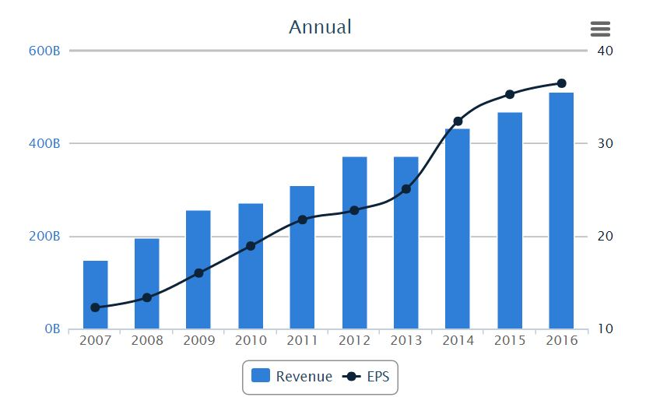
Revenue and Net Income, EPS Growth Rate :-

Slide 17

CADBURY SCHWEPPES
Socially responsible behavior
Efforts to improve the nutritional values of products
Responsibility towards environment
Proper waste water management
Gases discharged into atmosphere
Energy efficient practices
Developed programs to assist local communities and farmers
In a company statement titled, ”Our Business Principles”
Schweppes states,” a creative and well managed corporate and social responsibility programme is in the best interest of all our stakeholders -not just our consumers – but also our shareowners, employees, customers, suppliers and other business partners who work together with us”.
Cadbury Schweppes is the third largest soft drink manufacturer.

Slide 18

ADITYA BIRLA GROUP
One among the best energy efficient fertilizer plants.
The fourth-largest producer of insulators.
Focus on:: health-care, education, women empowerment projects, infrastructure and espousing social reform etc.
Company logo:
”A Brand New journey: A new mark for new milestones”
represents a transformative journey into future.
Mission: To deliver superior value to customers, shareholders, employees and society at large.
Values:
Seamlessness
Commitment
Integrity
Speed
Passion

Slide 19

3m
2016 World’s Most Ethical Company
Values which are followed:
Show uncompromising honesty and integrity in all of 3M activities and relationships.
Avoid all conflicts of interest between work and personal life.
Respect the dignity and worth of all individuals.
Encourage individual initiative and innovation in an atmosphere of flexibility, cooperation and trust.
Promote a culture where promise keeping, fairness, respect and personal accountability are valued, encouraged and recognized.
Create a safe workplace.
Protect the environment.

Slide 20

Most common unethical behavior at workplace:
Misusing company time
Showing up late
Personal Business
Abusive behavior
Misusing Position and Powers

Slide 21
Employee theft
Every one of 40 employees caught stealing from their employers
On an average they steal 5.5 times more than a shoplifter($715 vs $129)
Lying to employees
Violating company internet policies
Cyber slackers and cyber loafers
About 64% employees visit websites during working hours

Slide 22

STEP TAKEN BY GOVERNMENT
Social Work Educators’ forum(SWEF) at TISS,Mumbai: declared a code of ethics for professional social workers in India.
The Bar council of India is progressively reviewing the ethical standards with the demands of our time, in order to strike the best balance.

Slide 23

SUGGESTIONS
Understand the importance of ethics.
Transparency should be between company and consumers.
Government should keep an eye on company’s product.
Consumer should not attract to the brand which are strongly connected to some stars but should know about benefits and loses to environment.
Companies should be loyal.

Slide 24
CONCLUSION
There’s great deal between of difference between thinking reflectively about moral issues and achieving high standards of ethical behavior. -Derek Bok a country should be defended not by arms but by ethical behavior. -Vinoba Bhave

Slide 25


