Slide 1
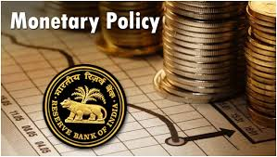
MONETARY POLICY OF INDIA:
A TUG OF WAR BETWEEN INFALTION CONTROL AND GROWTH
MAULIK JADEJA
LAVKUSH KUMAR

Slide 2

What is monetary policy ????
The process by which the monetary authority of a country controls the supply of money.
Central monetary authority : Reserve Bank of India (RBI).
Announcement:
1. slack season policy | April-September
2. Busy season policy | October-March

Slide 3
Importance of Monetary Policy
Gross National Product (GNP) = C + I + G + X
Where: C = Private Consumption expenditure
I = Private Investment Expenditure
G = Government Expenditure
X = Net Exports

Slide 4
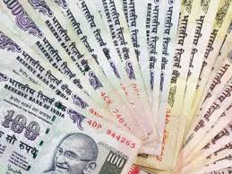
TYPES OF MONETARY POLICY
EXPANSIONARY MONETARY POLICY
CONTRACTIONARY MONETARY POLICY

Slide 5

EXPANSIONARY MONETARY POLICY
tends to encourage growth by expanding the money supply
Appropriate when economy is in recession.
Money
Supply
rise
Interest rate decline
Investment level rise
Aggregate demand rise
Real GDP rise
Unemploy-ment decline
Price rise
Inflation rise
Notes:
Expansionay- appropriate when economy is in recession and unemployment is a problem . To reduce unemployment ;increase in money supply by lowering interest rates and reserve ration

Slide 6

CONTRACTIONARY MONETARY POLICY
tends to curb inflation by contracting/reducing the money supply
Appropriate when economy is in expansion.
Money supply decline
Interest rate rise
Investment level decline
Aggregate demand decline
Real GDP
decline
Unemploy-
ment rise
Price decline
Inflation decline

Slide 7


Slide 8

Economic growth
Price stability
High employment
Neutrality of money
Stability in foreign exchange market
Interest rate stability

Slide 9

INSTRUMENTS/TOOLS OF MONETARY POLICY
QUALITATIVE OR SELECTIVE CREDIT CONTROL TECHNIQUES
QUANTITATIVE OR GENERAL CREDIT CONTROL TECHNIQUES

Slide 10
QUANTITATIVE OR GENERAL CREDIT CONTROL TECHNIQUES
To increase or decrease the supply of credit in the economy as a whole.
QUANTITATIVE TECHNIQUES:
OPEN MARKET OPERATIONS.
BANK RATE.
CASH RESERVE RATIO(CRR).
STATUTARY LIQUIDITY RATIO(SLR).
Indicator | Current rate
Inflation | 7.50%
Bank rate | 6.50%
CRR | 4.00%
SLR | 20.50%
Repo rate | 6.25%
Reverse repo rate | 6.00%
source: Reserve Bank of India

Slide 11
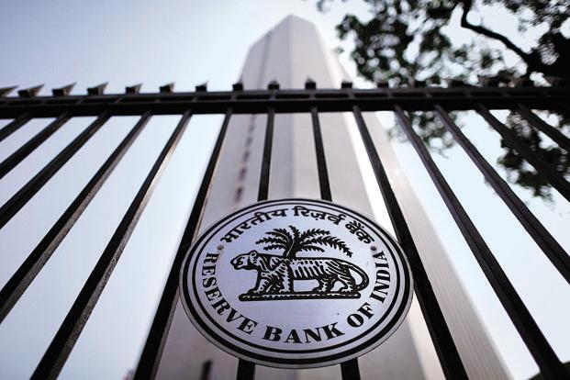
BANK RATE (DISCOUNT RATE)
Bank rate is the rate of interest charged by the RBI for providing funds or loans to the banking system.
Impacts during inflation and deflation.
Notes:
Lending rates were kept high during 70’s ,80’s and 90’s ➔discouraged private investment➔worked against economic growth price stability➔appropriate for long run economic growth but for short run there is a trade off between inflation and economic growth

Slide 12

Cash reserve RATIO(crr)
Every commercial bank has to keep a certain percentage of its total deposits in the form of cash with the RBI.
Higher CRR => commercial banks have lesser amount of money
STATUTORY LIQUIDITY RATIO(slr)
SLR = Liquid assets (gold, securities) x 100 demand + time liabilities
IF RBI WISHES TO CONTROL CREDIT AND DISCOURAGE CREDIT IT WOULD INCREASE “CRR” AND “SLR”

Slide 13
Qualitative or selective credit control
techniques
Regulates flow of credit from non-productive uses to essential uses.
QUALITATIVE TECHNIQUES:
Marginal requirements
Rationing of credit
Moral persuasion
Direct action

Slide 14
MARGINAL REQUIREMENTS:
Margin is the difference between the market value of a security and its maximum loan value.
Inflation arrested
To discourage the flow of credit to speculative activities
Reduction in money supply
To increase the Margin requirement
By reducing margin requirements
Greater flow of credit & more investment
Income rises
Demand expand
Deflation controlled

Slide 15
MORAL SUASION
It`s a psychological instrument of monetary policy.
It is a means of strengthening mutual confidence and understanding between monetary authority and the banks .

Slide 16
DIRECT ACTION
When moral suasion is ineffective ,RBI takes penal action against defaulting banks
ACTIONS
Cancelling license
levying penal interests
Lending restrictions
Not allowing participation in money market

Slide 17

TRENDS IN MONETARY POLICY OF INDIA
1. Pre‐reform Period (1972‐91)‐ Tight Monetary Policy .
2. Post Reform Period (1991-96)- Easy Monetary Policy.

Slide 18
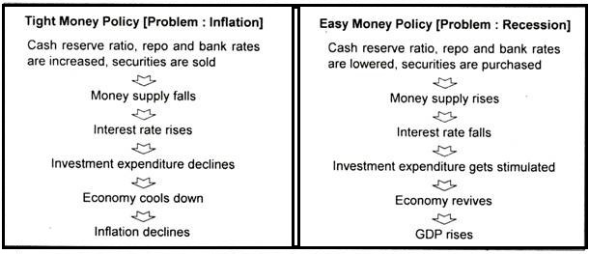

Slide 19

Effect of Monetary Policy on Indian economy:
Evidence of growth
Assurance of financial stability
Balance between inflation and deflation

Slide 20
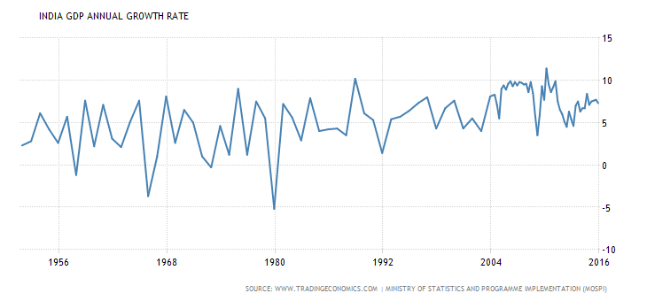

Slide 21
Assurance of financial stability
Poverty Headcount ratio at national poverty lines ( % of population )
% of Population | Year
21.9% | 2011
29.8% | 2009
37.2% | 2004
45.3% | 1993
It ensures that not only rich gain from such policies but benefits are reached to poor

Slide 22
Effect of Monetary Policy on Indian economy:
Evidence of growth
Assurance of financial stability
Balance between inflation and deflation

Slide 23
Year | Annual inflation (CPI)
2015 | 6.32%
2014 | 5.86%
2013 | 9.13%
2012 | 11.17%
2011 | 6.49%
2009 | 9.47%
2008 | 14.97%
Annual Inflation – Year wise (CPI)
Year | Annual inflation (CPI)
2007 | 5.51%
2006 | 6.53%
2005 | 5.57%
2004 | 3.78
2003 | 3.72%
2002 | 3.20%
2001 | 5.16%
Year of great depression
Source – www.inflation.eu | Ministry of Labour & Employment , Govt. of India

Slide 24

Tug of War

Slide 25

“Too less sugar means a bitter coffee, and too much sugar has health consequences “
Notes:
Reserve Bank of India (RBI) likes its coffee bitter. Central government likes it too sweet. The twist is that there is a recipe sufficient only for one cup!

Slide 26

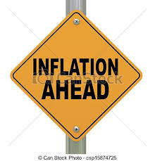
Govt. wants to keep economic growth
HIGH
RBI likes to keep inflation under control
Notes:
RBI Governor seems still wary of interest rate cuts as he fears inflation the most, which as per his perception may go out of hand due to uneven and less than average monsoon .

Slide 27
- Source : world bank

Slide 28

LIMITATIONS / CHALLENGES

Slide 29
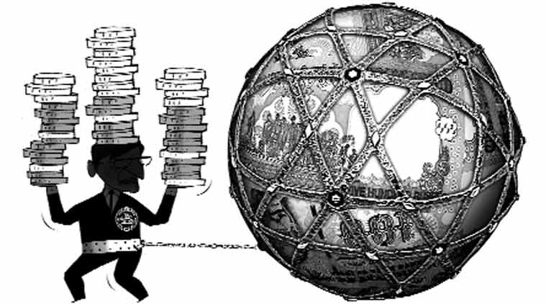
LIMITATIONS OF MONETARY POLICY :
Large non–monetized sector.
Under-developed money market.
Existence of black money.
Influence of non-monetary factors.
Conflicting objectives.
Not proper implementation of monetary policy

Slide 30


Slide 31

THANK YOU

Slide 32

QUERIES ?

