Slide 1
Group 1

Slide 2
Process
1. Brainstorm
We talk about how we will create the system
2. Team separation
First we started the UML, then we started programming it.
Two Teams: Programmers , UML Designer
We used Agile Software Development.
Cross Team collaboration as the project progress.

Slide 3
We didn’t grasp the whole system from the start.
Yes, we have brainstorm what we will do . We have acquired what system design we need but we need to figure out how we will do it along the way. (Agile)
Programmers depends on the first design of the UML designers, but when the programmers have seen some problems, programmers will change it then UML designers will change their design.

Slide 4
Work Allocation
UML Designer
John Paul Limos - Sequence
Ana Katrina De Leon – Use Case
Paulin Joyce Racelis - Class
Programmers
Aljun Dequilla
Mark Anthony Andes
Leader
Allocates task to members
See the whole picture of the system
Consultant (Programming/UML)
Help members.

Slide 5
UML
Ideal Design of the System

Slide 6
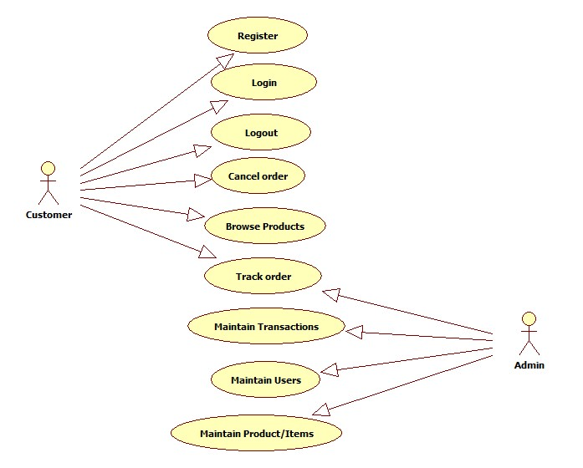

Slide 7
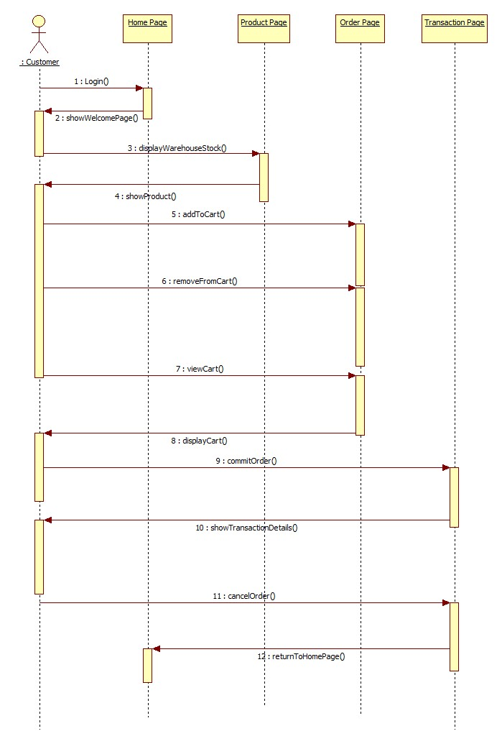

Slide 8
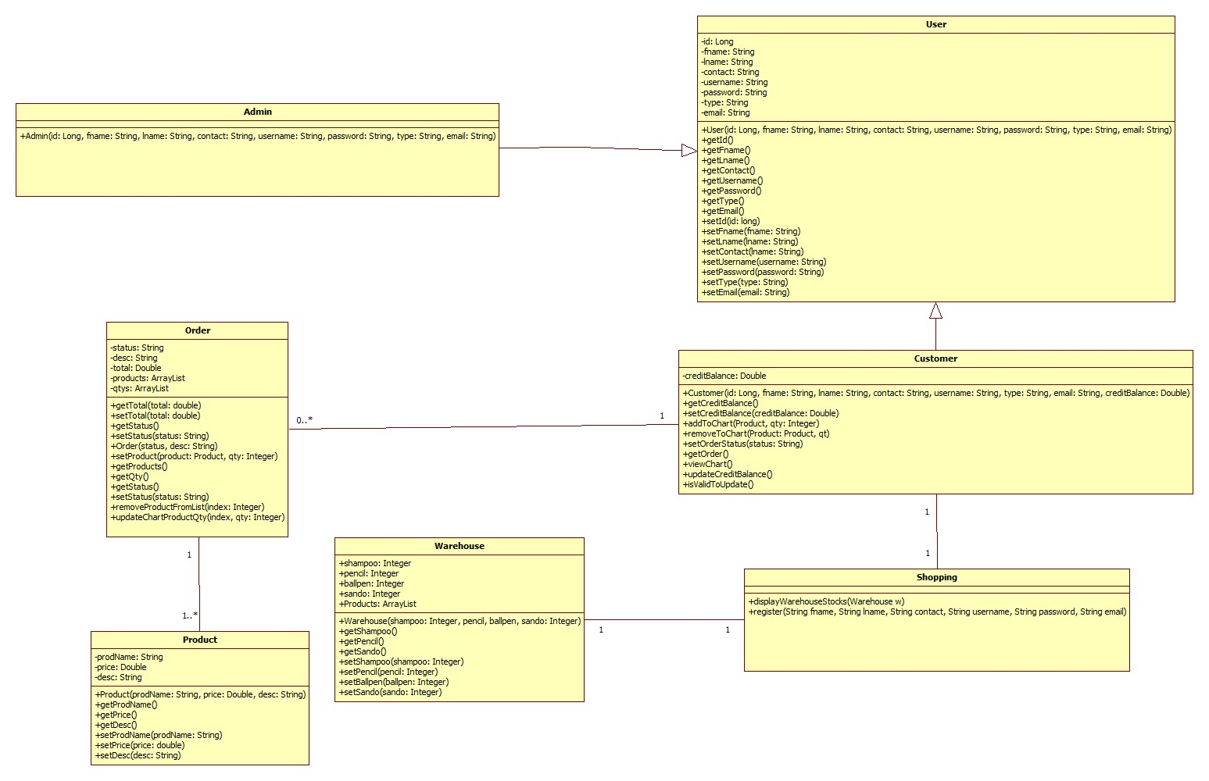

Slide 9
Java
System

Slide 10
Implemented Concept in the System
OOP(General)
Encapsulation
Reflection
Junit Test Case

