Slide 1
Kanen Online
Shopping
Alexis Cuntapay
Christian Joel Kanen
Jerica Flores
John Benedict Vergara
Melvin Robert Yu
Sebastian Briones

Slide 2
Kanen Online Shopping
We sell gadgets such as laptops and phones
Users can:
Admin can:
Register on the shopping site
Login with their username and password
Update their own information
View the products
Search products
Add products to cart
Give comments to a product
Can add products to their wish list
Can become a member with discount
View the history of their orders
Maintain products
Update the users’ membership types
User maintenance
View product comments
Order maintenance
Check count and view “logged in” users

Slide 3
Distribution of tasks
Alexis:
Kanen:
Blacklisted users Interceptor
UI Designer
Product details
User profile maintenance
User membership requests
Admin membership approval UI
Product maintenance form
Order maintenance form
Product - DAOImpl, Service, and Controller
Melvin:
Jerica:
Majority of Admin side backend
JMS for consuming membership requests
All users maintenance UI
View online users form and backend
Product comments – DAO, Service and Controller
Save user cart on logout / load on login
remove cart
Membership Type, User and Product Controller
JB:
Save cart/ order Controller, Service and DAO
Customer wishlist – form, controller and DAO
Most of the entities
Login and register forms
Sebastian:
Product display
Add to cart
Product search
Class diagram
Assign tasks

Slide 4
Common tasks:
JUnit Test case for own functions
ExtJS Window
Update DB and ERD
Controller, DAOImpl

Slide 5
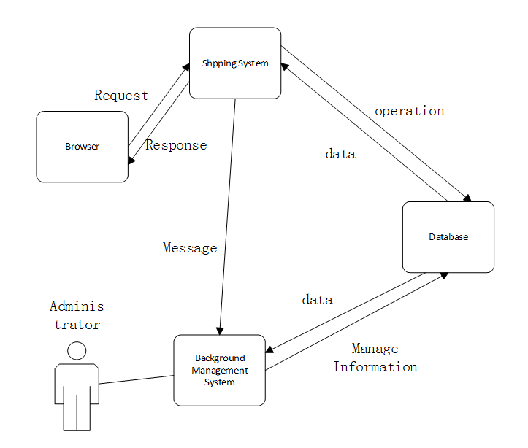
Architecture:

Slide 6
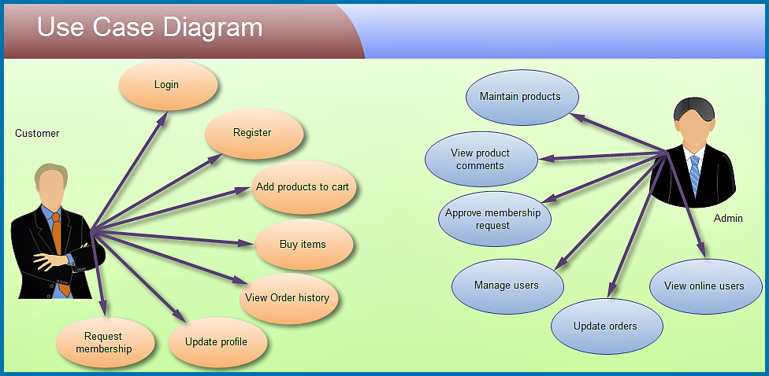

Slide 7
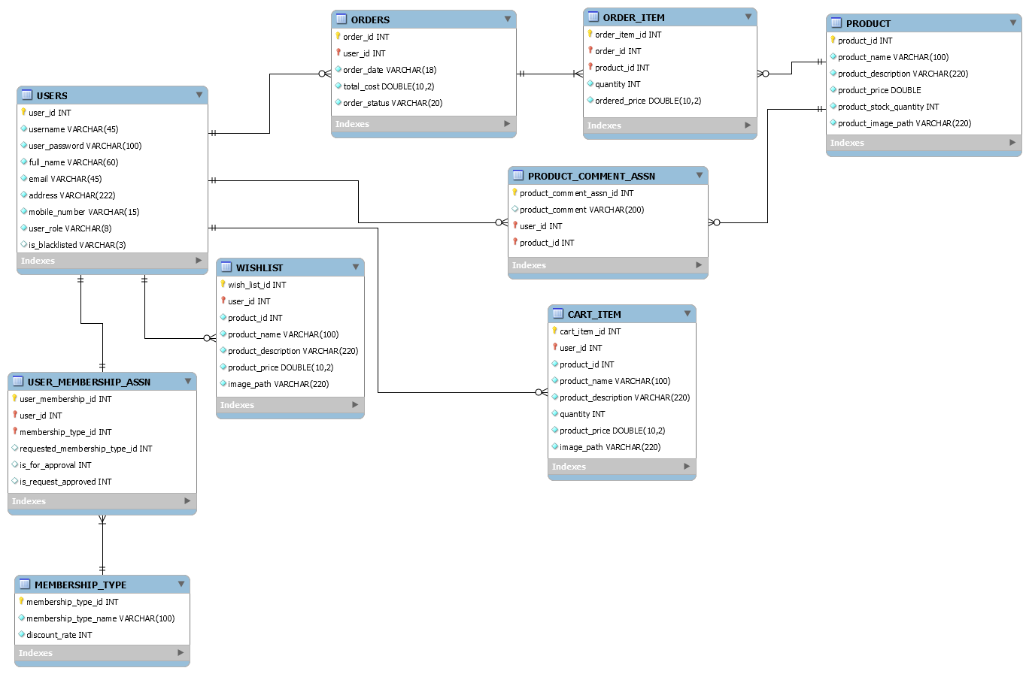
Entity Relationship Diagram

Slide 8
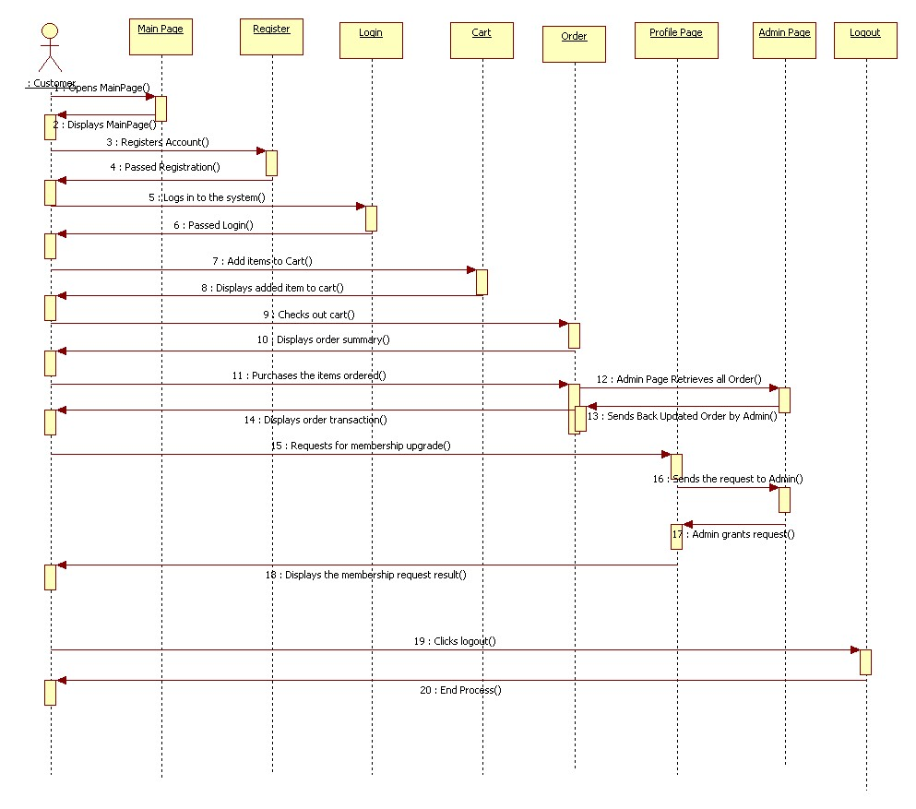
Sequence Diagram

Slide 9
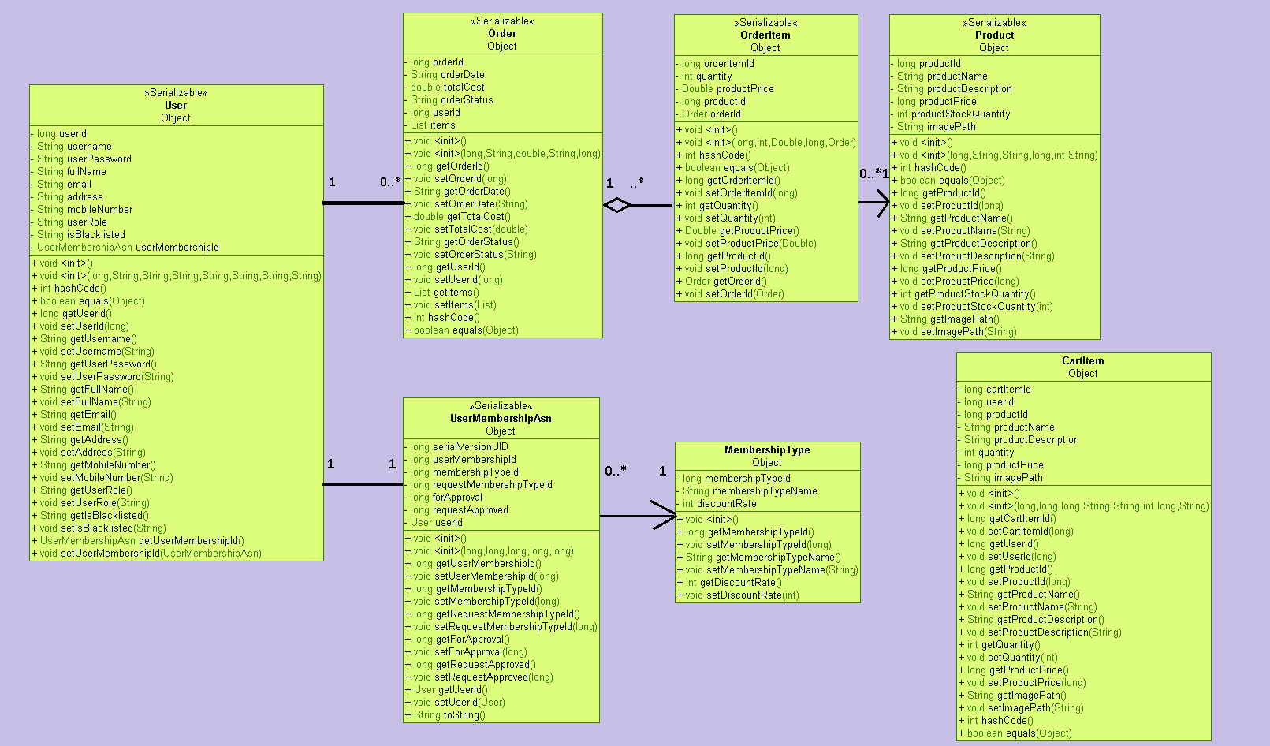
Class Diagram - Entities

Slide 10
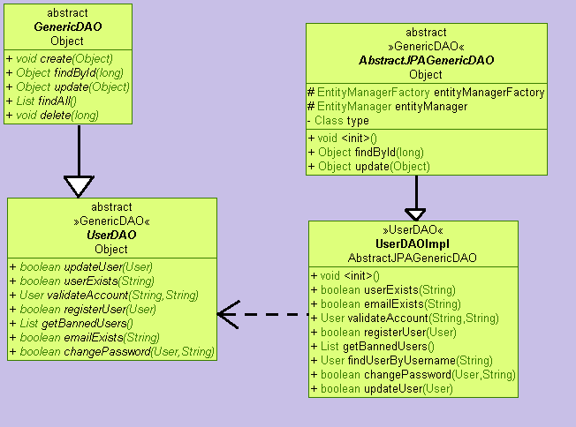
Class Diagram - DAOs

Slide 11
Learnings applied:
ExtJS 4 and Spring Framework
Ajax and JSON
Java Persistence API
Salted password hashing
Spring Interceptor/ Filter
Transaction
Log4J
Oracle DB
JMS Producer and Consumer
JUnit
Webservice

Slide 12
Project Demonstration

Slide 13
Q & A

