Slide 1
KaCHAT
Briones|Cuntapay|Flores|Kanen|VERGARA|yu

Slide 2
CONTRIBUTION
Baste– Project Supervisor, Login Ui, Account Model
Alexis- Main Ui, Registration Ui, FileWriter, Chat Model, Transaction Methods
Aica- ChatWindow Ui, Chat Client, DBConn, DAO, DAOIMPL, Transaction Methods
CJ- PPT, Registration Ui, FileWriter, Chat Model, Transaction Methods, Junit
JB- Chatwindow Ui, Chat Client, Transaction Methods, Server client – Integration to Chat UI
Melvin- UML, PPT, Javadocs, Chat Server, Database(tables), Transaction Class, Assist Coding

Slide 3
USE CASE DIAGRAM

Slide 4
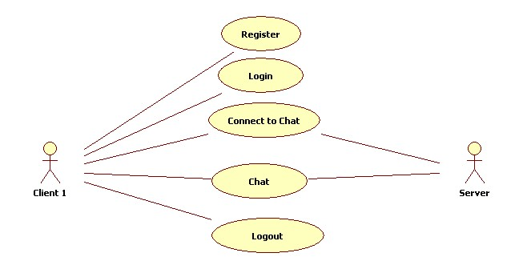

Slide 5
SEQUENCE DIAGRAM

Slide 6
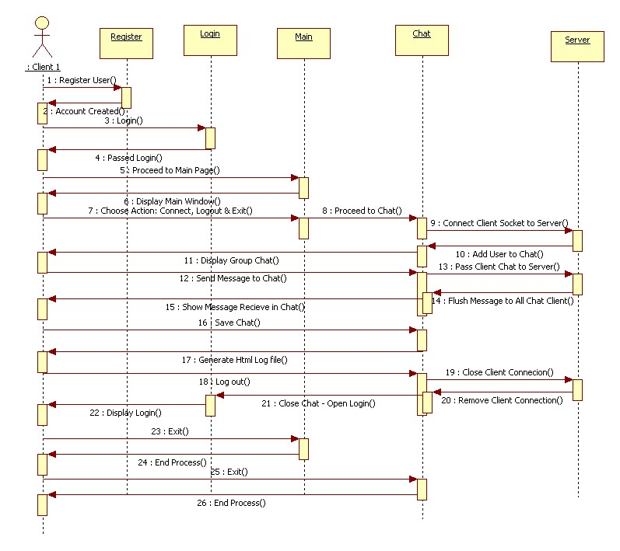

Slide 7
CLASS DIAGRAM

Slide 8
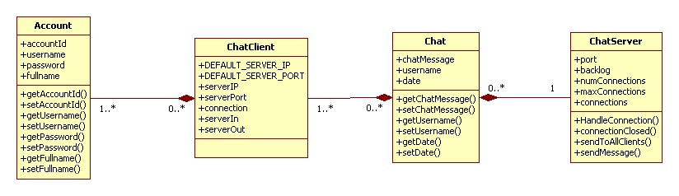

Slide 9
APPLIED CONCEPTS
Java Concurrency
InnerClasses
Junit
Javadocs
Networking Java
JDBC
Debugging & Tracking
Java Collection – Vector, ArrayList
HTML & CSS
File & FileWriter
Property Config
Paired Programming
Extra: Java Swing

