Slide 1
Informed search algorithms
Artificial Intelligence

Slide 2
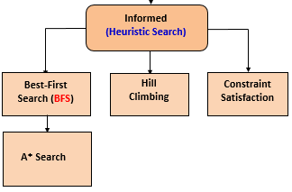
Informed Search
A search strategy which searches the most promising branches of the state-space first can:
Find a solution more quickly,
Find solutions even when there is limited time available,
Often find a better solution, since more profitable parts of the state-space can be examined, while ignoring the unprofitable parts.
A search strategy which is better than another at identifying the most promising branches of a search-space is said to be more informed.
2
Notes:
2

Slide 3
Informed Methods Add Domain-Specific Information
Add domain-specific information to select what is the best path to continue searching along
Define a heuristic function, h(n), that estimates the "goodness" of a node n with respect to reaching a goal.
Specifically, h(n) = estimated cost (or distance) of minimal cost path from n to a goal state.
h(n) is about cost of the future search, g(n) past search
h(n) is an estimate (rule of thumb), based on domain-specific information that is computable from the current state description. Heuristics do not guarantee feasible solutions and are often without theoretical basis.
Notes:
3

Slide 4
Review: Tree search
An abstract problem is modeled as a (finite or infinite) decision tree.
Weak methods do not use any knowledge of the problem
General applicable
Usually die from combinatorial explosion when exposed to “real life”

Slide 5
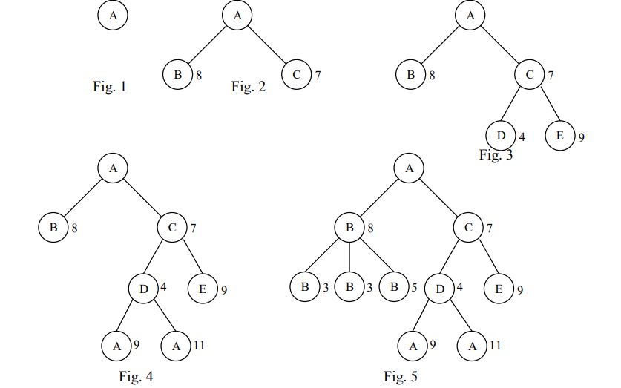

Slide 6
Best-first search
Idea: use an evaluation function f(n) for each node
estimate of "desirability"
Expand most desirable unexpanded node
Implementation:
Order the nodes in fringe in decreasing order of desirability
Special cases:
greedy best-first search
A* search

Slide 7
Best-First Search Scheme
Step1:Consturct a heap by using the evaluation function. First, form a 1-element heap consisting of the root node.
Step2:Test to see if the root element in the heap is a goal node. If it is, stop; otherwise, go to Step 3.
Step3:Remove the root element from the heap and expand the element. Add the descendants of the element into the heap.
Step4:If the heap is empty, then signal failure. Otherwise, go to Step 2.
7

Slide 8
A* (A Star)
We cannot guarantee to obtain the optimal solution using the “best-first search”. This is because the true cost from the initial node to the current node is ignored.
The A* algorithm can solve this problem (A=admissible).
In the A* algorithm, the cost of a node is evaluated using both the estimated cost and the true cost as follows:
f(n) = g(n) + h(n)
It has been proved the A* algorithm can obtain the best solution provided that the estimated cost H(x) is always smaller (conservative) than the best possible value H*(x).
8

Slide 9
A* (A Star)
A* uses a heuristic function which combines g(n) and h(n): f(n) = g(n) + h(n)
g(n) is the exact cost to reach node n from the initial state.
h(n) is an estimation of the remaining cost to reach the goal.
9

Slide 10
A* (A Star)
g(n)
f(n) = g(n)+h(n)
n
h(n)
10

Slide 11
A* Search
Start
State | Heuristic: h(n)
A | 366
B | 374
C | 329
D | 244
E | 253
F | 178
G | 193
H | 98
I | 0
A
75
118
140
B
C
111
E
D
80
99
G
F
97
H
211
101
I
f(n) = g(n) + h (n)
g(n): is the exact cost to reach node n from the initial state.
Goal
11

Slide 12
A* Search: Tree Search
A
Start
12

Slide 13
A* Search: Tree Search
A
Start
118
75
140
E
[393]
B
[449]
[447]
C
13

Slide 14
A* Search: Tree Search
A
Start
118
75
140
E
[393]
B
[449]
[447]
C
80
99
[413]
G
F
[417]
14

Slide 15
A* Search: Tree Search
A
Start
118
75
140
E
[393]
B
[449]
[447]
C
80
99
[413]
G
F
[417]
97
[415]
H
15

Slide 16
A* Search: Tree Search
A
Start
118
75
140
E
[393]
B
[449]
[447]
C
80
99
[413]
G
F
[417]
97
[415]
H
101
I
[418]
Goal
16

Slide 17
A* Search: Tree Search
A
Start
118
75
140
E
[393]
B
[449]
[447]
C
80
99
[413]
G
F
[417]
97
[415]
H
I
[450]
101
I
[418]
Goal
17

Slide 18
A* Search: Tree Search
A
Start
118
75
140
E
[393]
B
[449]
[447]
C
80
99
[413]
G
F
[417]
97
[415]
H
I
[450]
101
I
[418]
Goal
18

Slide 19
A* Search: Tree Search
A
Start
118
75
140
E
[393]
B
[449]
[447]
C
80
99
[413]
G
F
[417]
97
[415]
H
I
[450]
101
I
[418]
Goal
19

Slide 20
A* Algorithm
1. Search queue Q is empty.
2. Place the start state s in Q with f value h(s).
3. If Q is empty, return failure.
4. Take node n from Q with lowest f value.
(Keep Q sorted by f values and pick the first element).
5. If n is a goal node, stop and return solution.
6. Generate successors of node n.
7. For each successor n’ of n do:
a) Compute f(n’) = g(n) + cost(n,n’) + h(n’).
b) If n’ is new (never generated before), add n’ to Q.
c) If node n’ is already in Q with a higher f value, replace it with current f(n’) and place it in sorted order in Q.
End for
8. Go back to step 3.
20

Slide 21
A* Search: Analysis
A* is complete except if there is an infinity of nodes with f < f(G).
A* is optimal if heuristic h is admissible.
Time complexity depends on the quality of heuristic but is still exponential.
For space complexity, A* keeps all nodes in memory. A* has worst case O(b^{d}) space complexity, but an iterative deepening version is possible (IDA*).
Start
A
75
118
140
B
C
111
E
D
80
99
G
F
97
H
211
101
I
Goal
21

Slide 22
Properties of A*
Complete? Yes (unless there are infinitely many nodes with f ≤ f(G) )
Time? Exponential
Space? Keeps all nodes in memory
Optimal? Yes

Slide 23
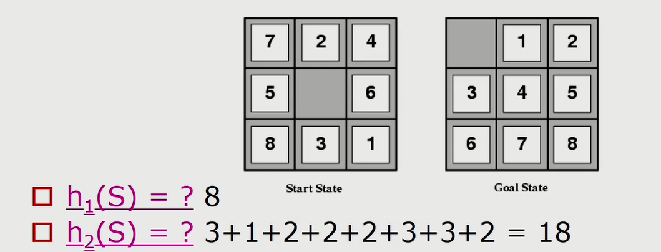
Admissible heuristics
E.g., for the 8-puzzle:
h₁(n) = number of misplaced tiles
h₂(n) = total Manhattan distance
(i.e., no. of squares from desired location of each tile)
Notes:
23

Slide 24
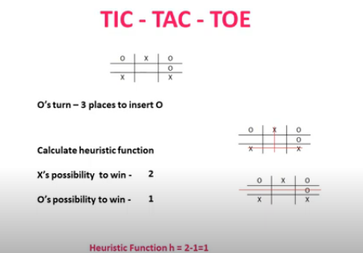

Slide 25
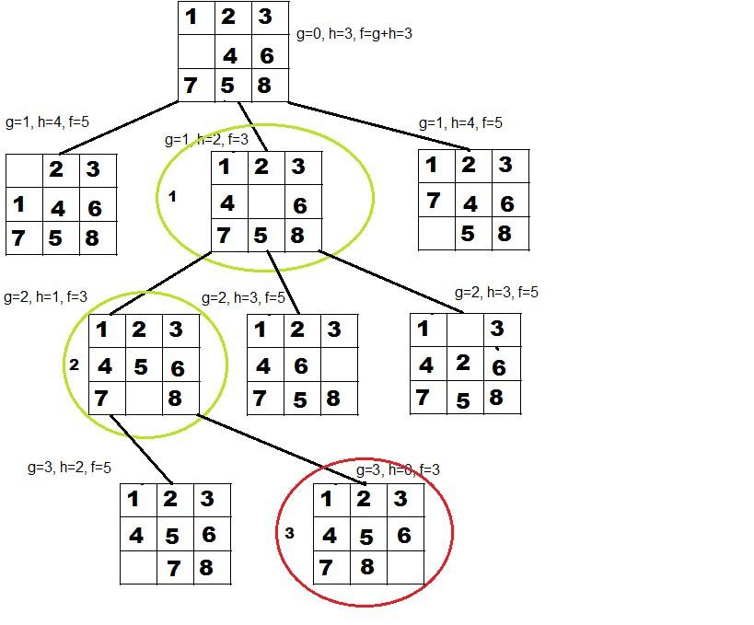
A* Search: 8 PUZZLE PROBLEM

Slide 26
Adversarial Search

Slide 27
What is Adversarial Search ?
In computer science, a search algorithm is an algorithm for finding an item with specified properties among a collection of items. The items may be stored individually as records in a database; or may be elements of a search space defined by a mathematical formula or procedure.
Adversarial search in Game playing :
“ In which we examine the problems that arise when we try to plan ahead in a world where other agents are planning against us”

Slide 28
Assumptions & aims
2 agents whose actions alternate.
Utility values for each agent are the opposite of the other which creates adversarial situations.
Fully observable environments.

Slide 29
Applications in games
Firstly, it should be a 2-player game.
Players alternate the moves.
Both should have perfect information.
Using dice is not involved.
Clear rules for legal moves.
Well defined outcomes.

Slide 30
Different types of games
Tic tac toe
Checkers
Chess
Go
Nim
othello

Slide 31
How to strategize in each game?
Consider all the legal moves you can make.
Each move leads to a new board configuration.
Evaluate each resulting position & determine which is best.
Make that move.
Wait for your opponent to move & repeat.

Slide 32
Game search problem
Initial state– Board position and player
Successor function– Returns a list of (action, state) pairs, indicating a legal move and
Resulting state
Terminal test– Determines when the game is over
Utility function– Numeric value for a terminal state representing its utility for a given player.
In tic tac toe, the outcome is win, loss or draw with values +1, -1 or 0

Slide 33
MIN-MAX Algorithm
Mini-max algorithm is a recursive or backtracking algorithm which is used in decision-making and game theory. It provides an optimal move for the player assuming that opponent is also playing optimally.
Mini-Max algorithm uses recursion to search through the game-tree.
Min-Max algorithm is mostly used for game playing in AI. Such as Chess, Checkers, tic-tac-toe, go, and various tow-players game. This Algorithm computes the minimax decision for the current state.
In this algorithm two players play the game, one is called MAX and other is called MIN.
Both the players fight it as the opponent player gets the minimum benefit while they get the maximum benefit.
Both Players of the game are opponent of each other, where MAX will select the maximized value and MIN will select the minimized value.
The minimax algorithm performs a depth-first search algorithm for the exploration of the complete game tree.
The minimax algorithm proceeds all the way down to the terminal node of the tree, then backtrack the tree as the recursion.

Slide 34
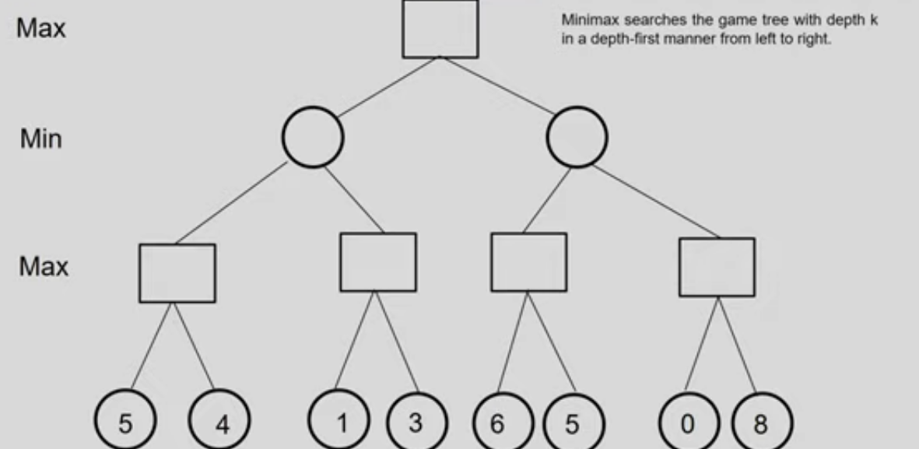

Slide 35
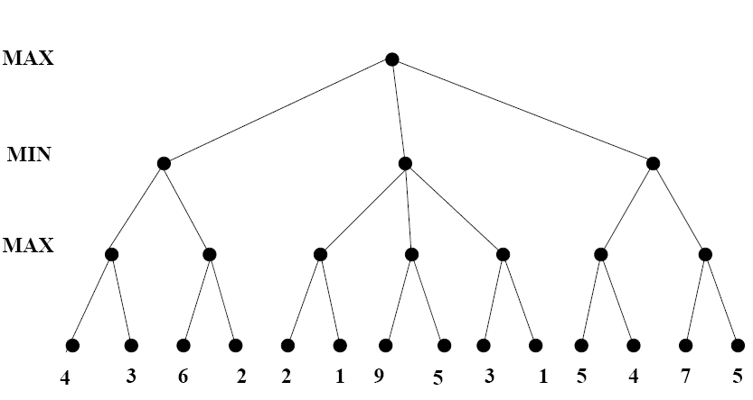
Example

Slide 36
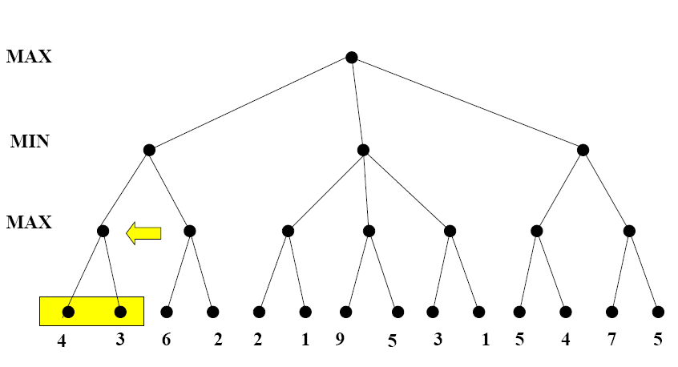

Slide 37
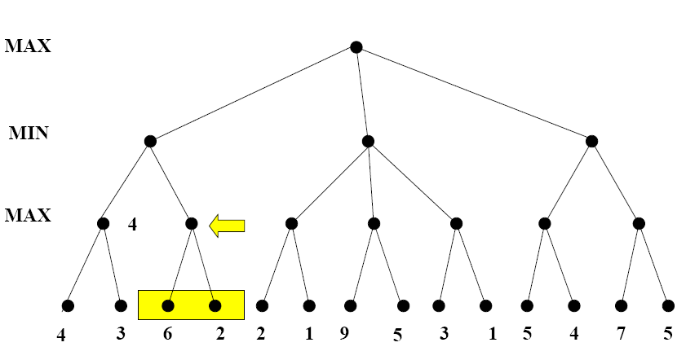

Slide 38
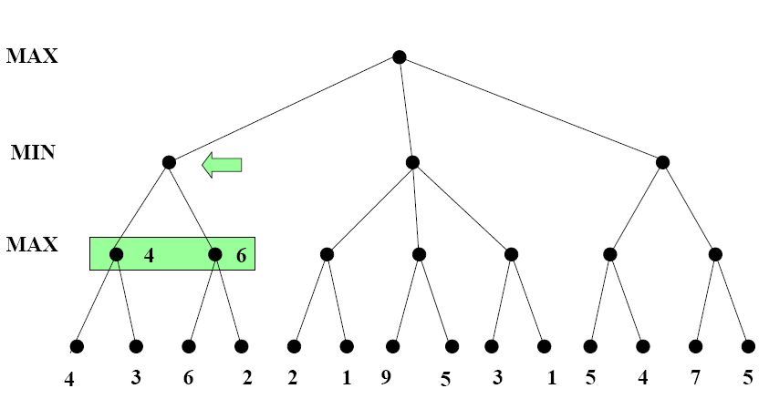

Slide 39
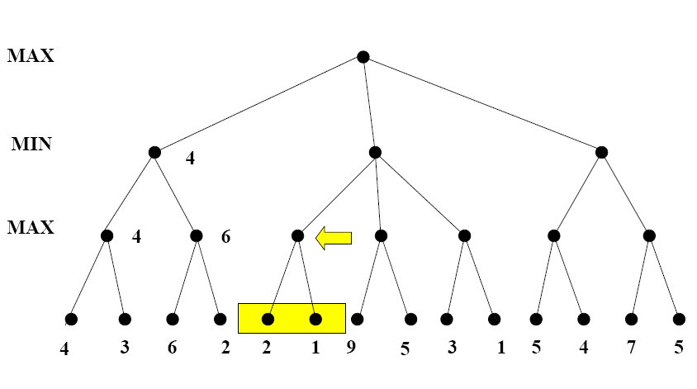

Slide 40
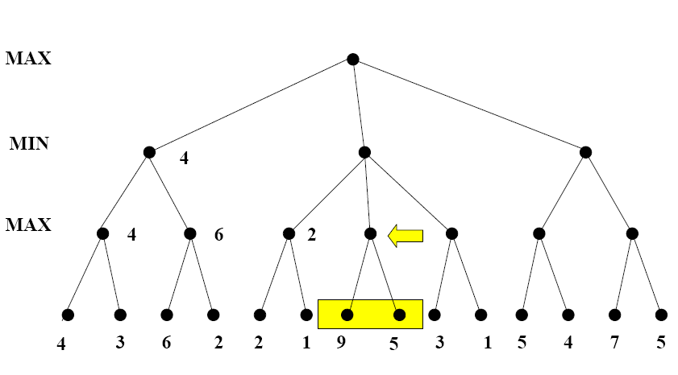

Slide 41
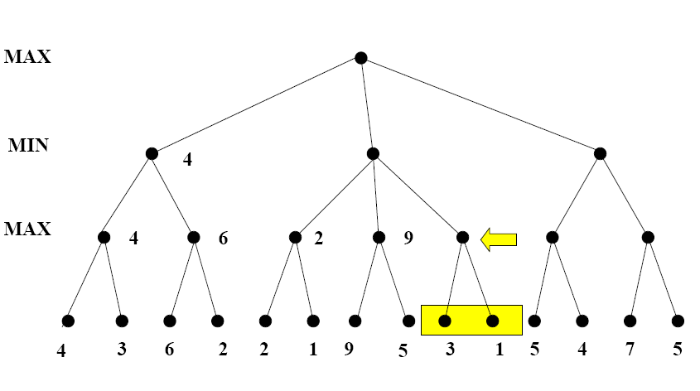

Slide 42
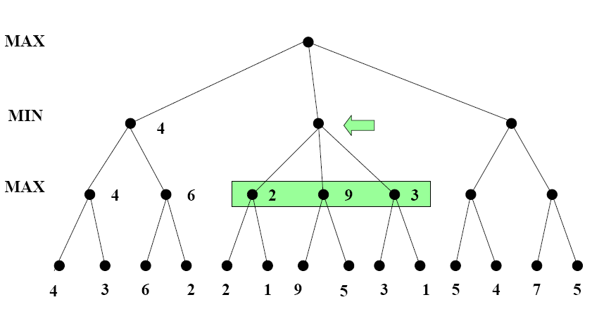

Slide 43
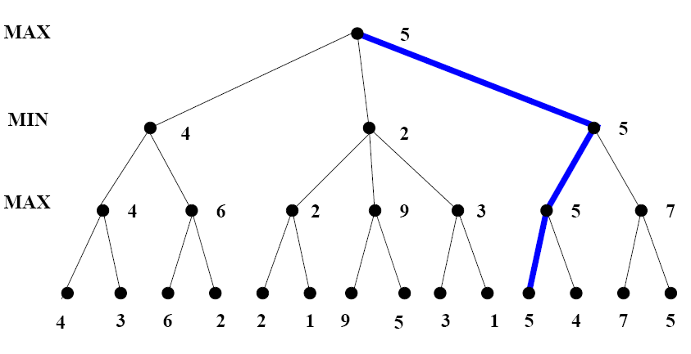

Slide 44

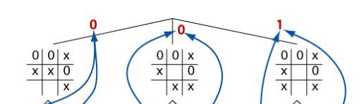
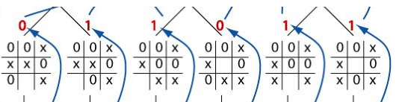
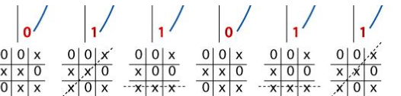

Slide 45
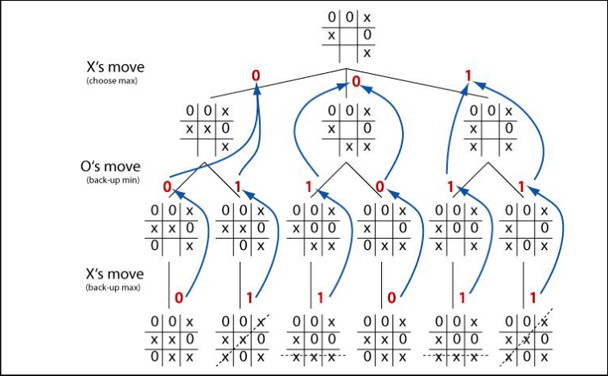

Slide 46
Why Minimax algorithm is bad ?
The problem with minimax is that it is inefficient
Search to depth d in the game tree
Suppose each node has at most b children
Calculate the exact score at every node
In worst case we search b^{d} nodes – exponential
However, many nodes are useless
There are some nodes where we don’t need to know exact score because we will never
take path in the future

Slide 47
Is there a good Min-Max ?
Yes ! We just need to prune branches that are not required in searching
Idea:
Start propagating scores as soon as leaf nodes are generated
Do not explore nodes which cannot affect the choice of move
The method for pruning the search tree generated by minimax is called
Alpha-Beta

Slide 48
α-β values
Alpha-beta pruning is a modified version of the minimax algorithm. It is an optimization technique for the minimax algorithm.
As we have seen in the minimax search algorithm that the number of game states it has to examine are exponential in depth of the tree. Since we cannot eliminate the exponent, but we can cut it to half. Hence there is a technique by which without checking each node of the game tree we can compute the correct minimax decision, and this technique is called pruning. This involves two threshold parameter Alpha and beta for future expansion, so it is called alpha-beta pruning. It is also called as Alpha-Beta Algorithm.
Alpha-beta pruning can be applied at any depth of a tree, and sometimes it not only prune the tree leaves but also entire sub-tree.
The two-parameter can be defined as:
Alpha: The best (highest-value) choice we have found so far at any point along the path of Maximizer. The initial value of alpha is -∞.
Beta: The best (lowest-value) choice we have found so far at any point along the path of Minimizer. The initial value of beta is +∞.
The Alpha-beta pruning to a standard minimax algorithm returns the same move as the standard algorithm does, but it removes all the nodes which are not really affecting the final decision but making algorithm slow. Hence by pruning these nodes, it makes the algorithm fast

Slide 49
The α-β pruning
The main condition which required for alpha-beta pruning is:
α>=β
Key points about alpha-beta pruning:
The Max player will only update the value of alpha.
The Min player will only update the value of beta.
While backtracking the tree, the node values will be passed to upper nodes instead of values of alpha and beta.
We will only pass the alpha, beta values to the child nodes.

Slide 50
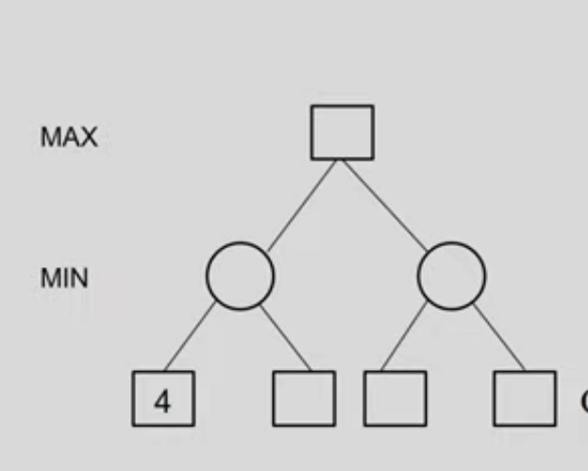

Slide 51
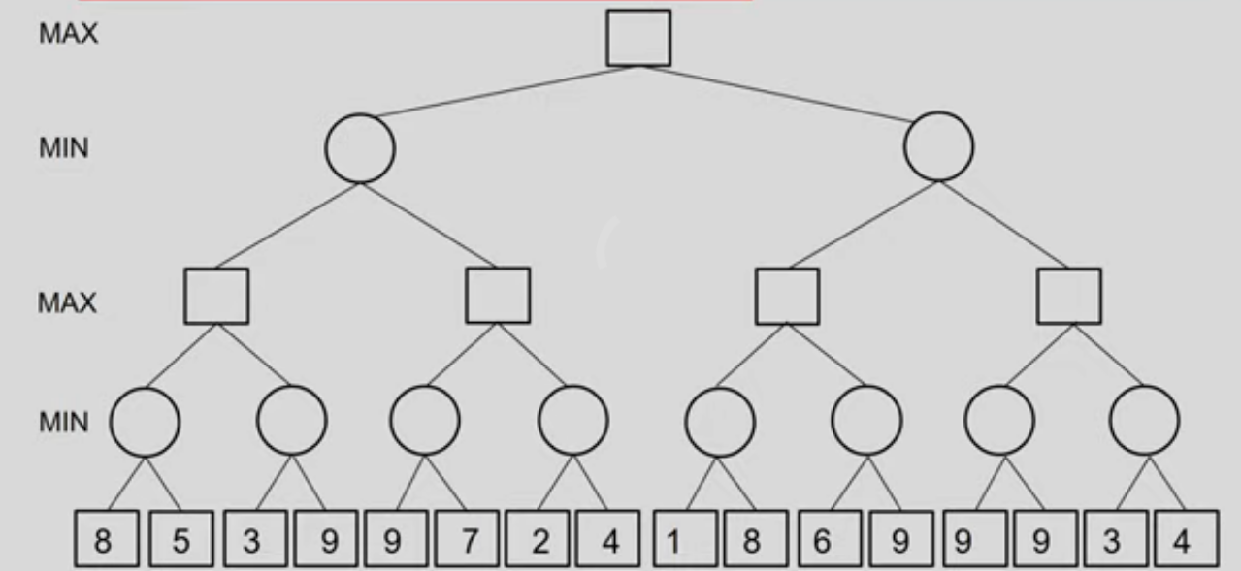

Slide 52
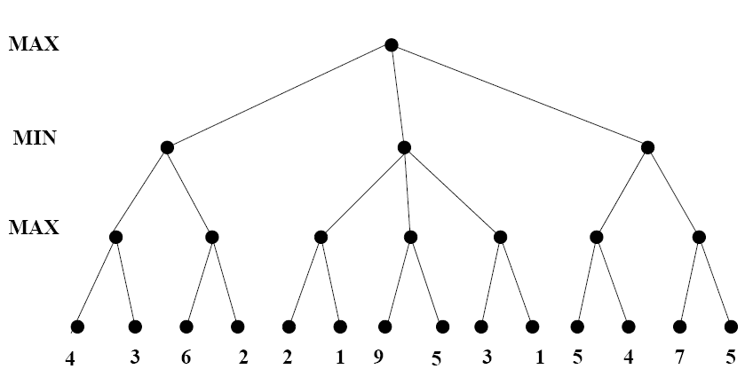
Example

Slide 53
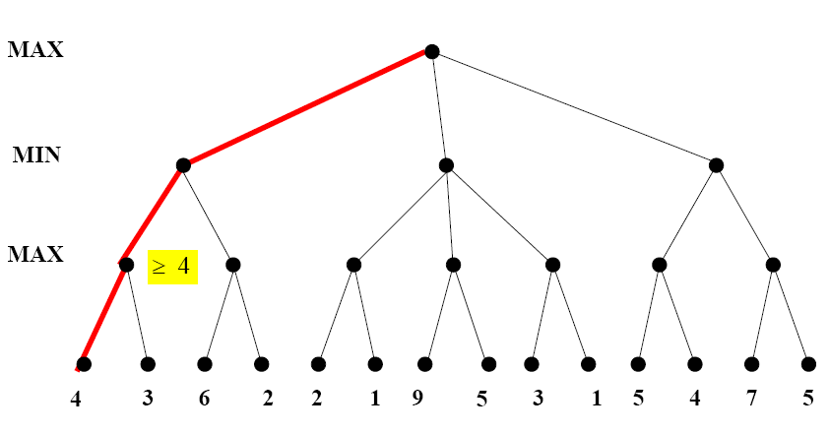

Slide 54
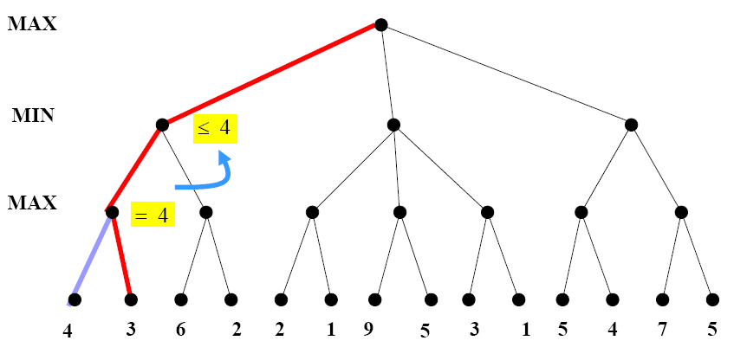

Slide 55
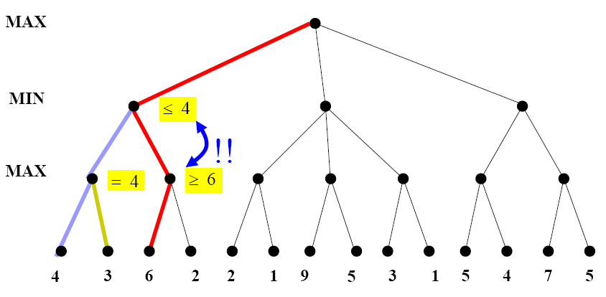

Slide 56
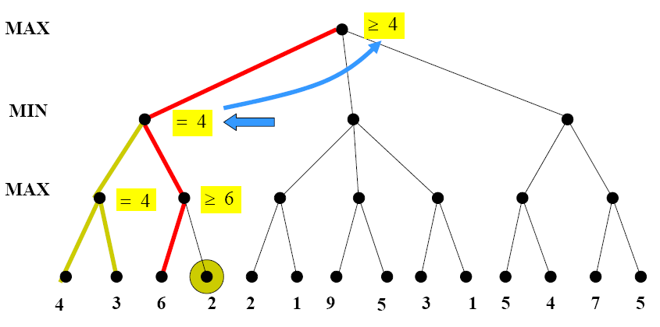

Slide 57
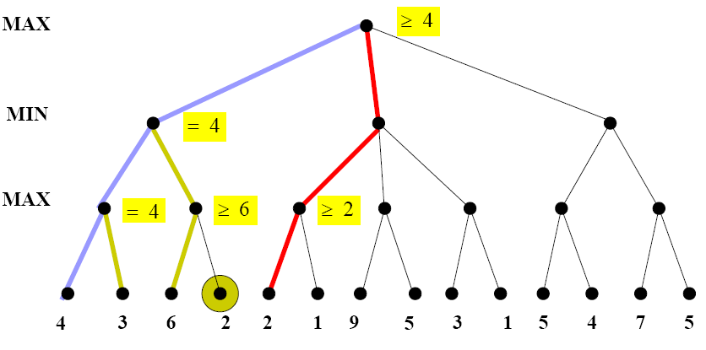

Slide 58
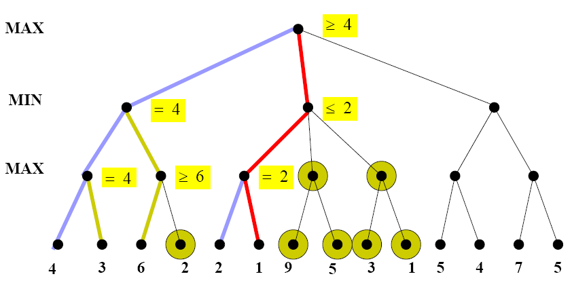

Slide 59
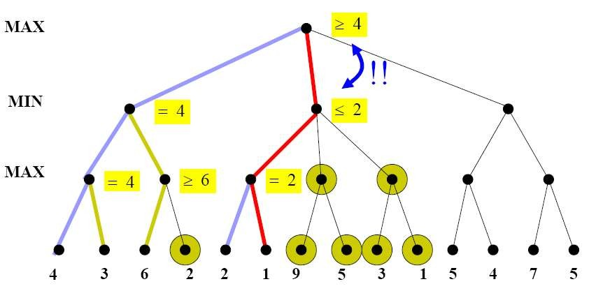

Slide 60
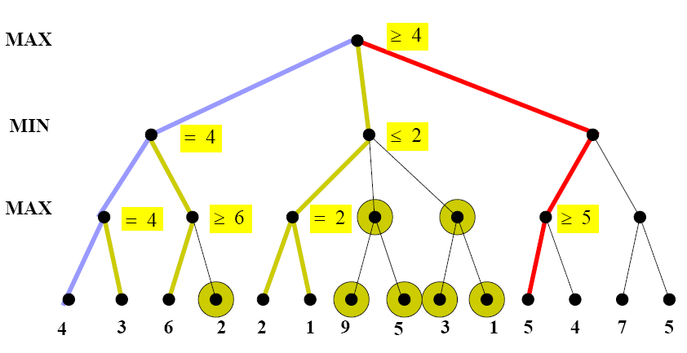

Slide 61
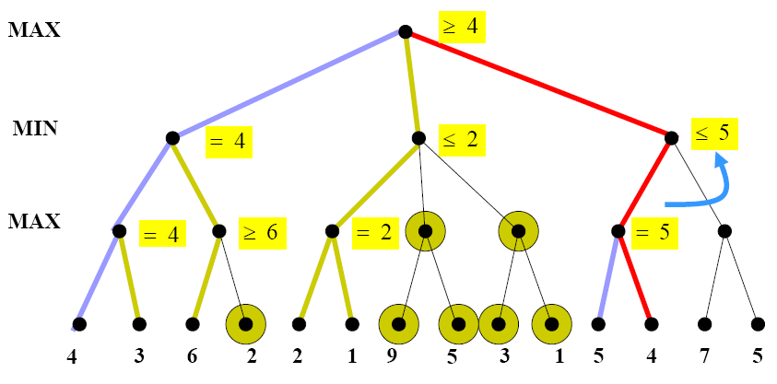

Slide 62
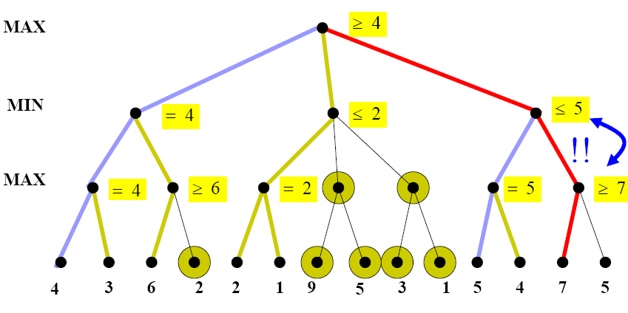

Slide 63
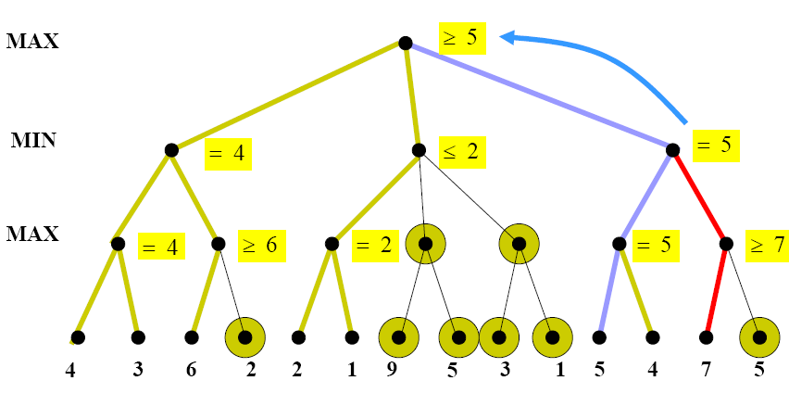

Slide 64

The α-β pruning

Slide 65
