Slide 1
Sports Championship Simulator
Mikołaj Nowak

Slide 2
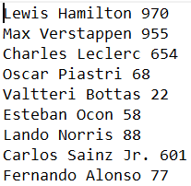
Functionality
Simulates Leagues, Sports in which champion is crowned based on their total tally of points and Cup formatted tournaments.
Reads data from given input files containing names of athletes/teams and an integer which represents their estimated strength:

Slide 3
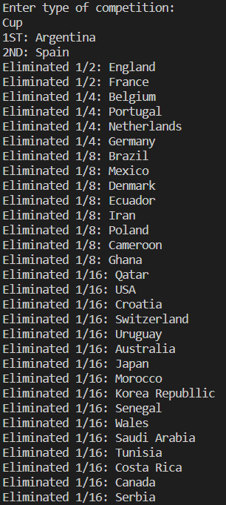
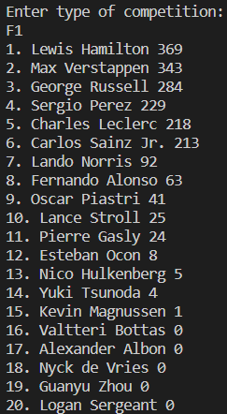
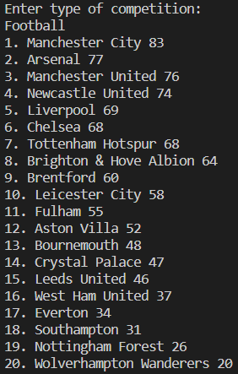
Functionality

Slide 4
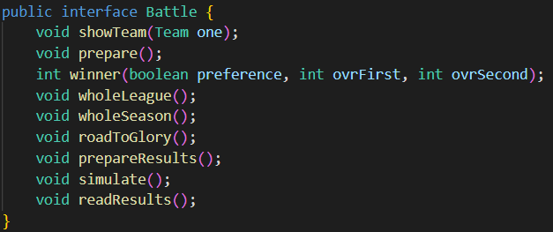
How it works

Slide 5

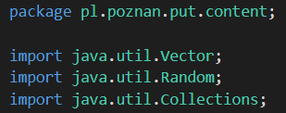
What i learned

Slide 6
Average Time of getting a correct anwser to my question
Source: | Time (s) | Corectness (%)
Java Documentation | 278 | 100
Stack Overflow | 54 | 76
Manual web scraping | 89 | 54
ChatGPC | 27 | 100

Slide 7
Problems i had
You have to use equals() method while comparing strings instead of (str1 == str2)

Slide 8
What Could be improved
Add more interfaces
Add group stages to the World Cup
Use less imports and more packages
My abilities and attitude towards foreign conventions (when I’m forced to follow these my coding power decreases by about 65%).

