Slide 1
Minecraft Setup on Azure
A first attempt

Slide 2
Before we start
There are currently two versions of Minecraft
Minecraft Java Edition
The one you generally play on your computer
Minecraft Bedrock Edition
This used to be called Minecraft Pocket Edition (MCPE)
This is played on Android, iOS, FireOS, Windows 10.
What is that important?
There are different server builds for each version. There is a Minecraft Java edition server and a Minecraft Bedrock server edition.

Slide 3
Azure requirements and setup
You’ll need an Azure subscription to create a server
Review the one that is the best fit for you.
Create a storage account
Cloud Shell
Cloud Shell is browser based shell you can launch PowerShell or Bash
I really started to like it
[demo of cloudshell and navigation]
Notes:
Demo directories and navigation in Cloud Shell

Slide 4
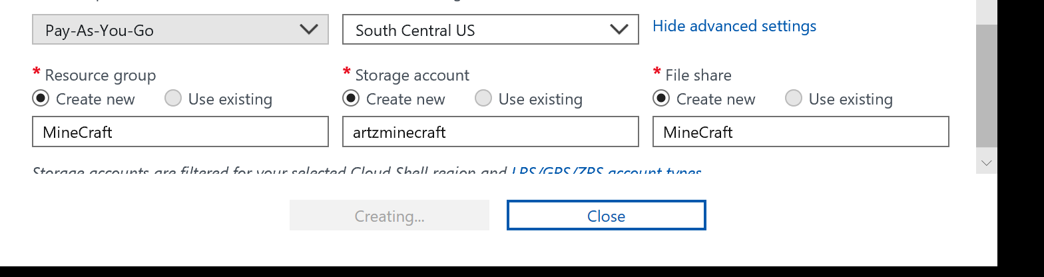
Quick setup
Launch Cloud shell, select PowerShell, select your subscription and show advanced options
Notes:
Quick setup
Launch Cloud Shell
Select PowerShell
Select your subscription, Show advanced options
Fill in the requested information
Note the settings must be lowercase and numbers and must be unique

Slide 5
Setup with Cloud Shell
List available locations
az account list-locations
Create resource group
az group create --name MinecraftBedrock --location northcentralus
List images available for deployment
az vm image list --output table
Create the VM
az vm create --resource-group Minecraft --name mcbedrockserver --image UbuntuLTS --admin-username joeartz --generate-ssh-keys

Slide 6
Setup cont’d
Connect to the server
In the VM overview, select connect to the VM use ssh and copy the connection string.
Determine your version of Ubuntu
lsb_release -a
This is new install, let's do due diligence and update all installed apps
Sudo apt-get update
Install powershell preview
Version 16.04 is our version

Slide 7
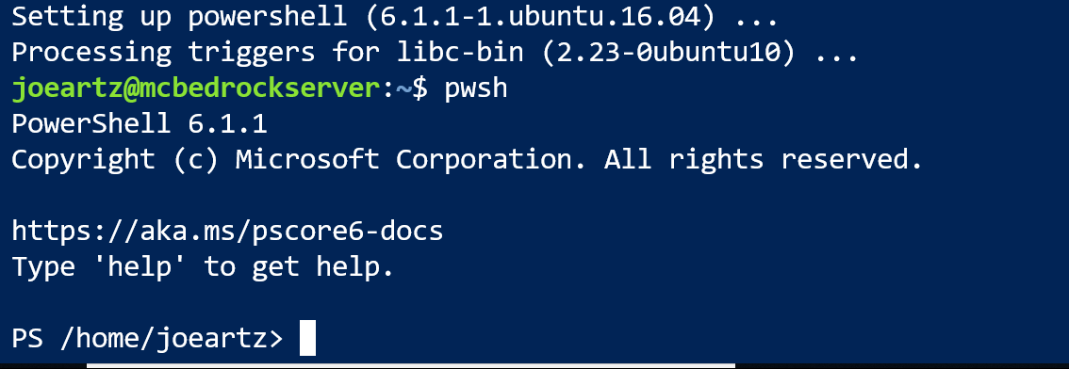
Setup cont’d
Microsoft instructions for install
https://docs.microsoft.com/en-us/powershell/scripting/install/installing-powershell-core-on-linux?view=powershell-6#ubuntu-1604
Launch PowerShell with pwsh command
Notes:
Since I'm a Windows guy by trade, I created a downloads folder moved the downloaded .deb file from Microsoft there and downloaded the Minecraft Bedrock server zip file to it
Create an empty folder to extract the zipped files to
Install unzip utility to extract the files to bedrock_server directory
Sudo apt-get install unzip
Use unzip to extract the files
unzip file.zip -d destination_folder
Start the server with the following steps
Exit powershell
Run the following command in terminal
LD_LIBRARY_PATH=. ./bedrock_server

Slide 8
Application doesn’t run!
Cannot launch the application
Easy fix
sudo apt-get install libcurl3
Failed again on relaunch with ssl library issue
NOTE: Bedrock server is an Alpha release and comes with no support and next to no documentation.
Fast forward a few hours

Slide 9
On to Windows!
Destroy what we setup and create a Windows VM
Nice quickstart guide with PowerShell, https://docs.microsoft.com/en-us/azure/cloud-shell/quickstart-powershell
Setup remoting
https://docs.microsoft.com/en-us/azure/cloud-shell/quickstart-powershell
Enter the remote session
Enter-AzVM -Name BedrockServerW -ResourceGroupName minecraft -Credential joeartz

Slide 10
Windows Setup – Cont’d
Download the bedrock edition for Windows
Invoke-webrequest -uri https://minecraft.azureedge.net/bin-win/bedrock-server-1.8.0.24.zip -outfile C:\users\joeartz\downloads\bedrock-server-1.8.0.24.zip
Create an empty directory to extract the app
New-item -type directory -path "C:\Program Files\BedrockServer“
Extract the application
$sourceFile = 'C:\users\joeartz\Downloads\bedrock-server-1.8.0.24.zip'
$targetFolder = 'C:\Program Files\BedrockServer'
[System.Reflection.Assembly]::LoadWithPartialName('System.IO.Compression.FileSystem')
[System.IO.Compression.ZipFile]::ExtractToDirectory($sourceFile, $targetFolder)

Slide 11
Launch the app
Failed!
Remember not documentation
Searching the missing DLLs
The application requires VS 2015 C++ runtime update 3
Install missing application with chocolately
Install chocolatey
Set-ExecutionPolicy Bypass -Scope Process -Force; iex ((New-Object System.Net.WebClient).DownloadString('https://chocolatey.org/install.ps1’))
Install C++ redist 2015 update 3
choco install vcredist2015 -y

Slide 12
Launch the app, take two
Wait for it….

Slide 13
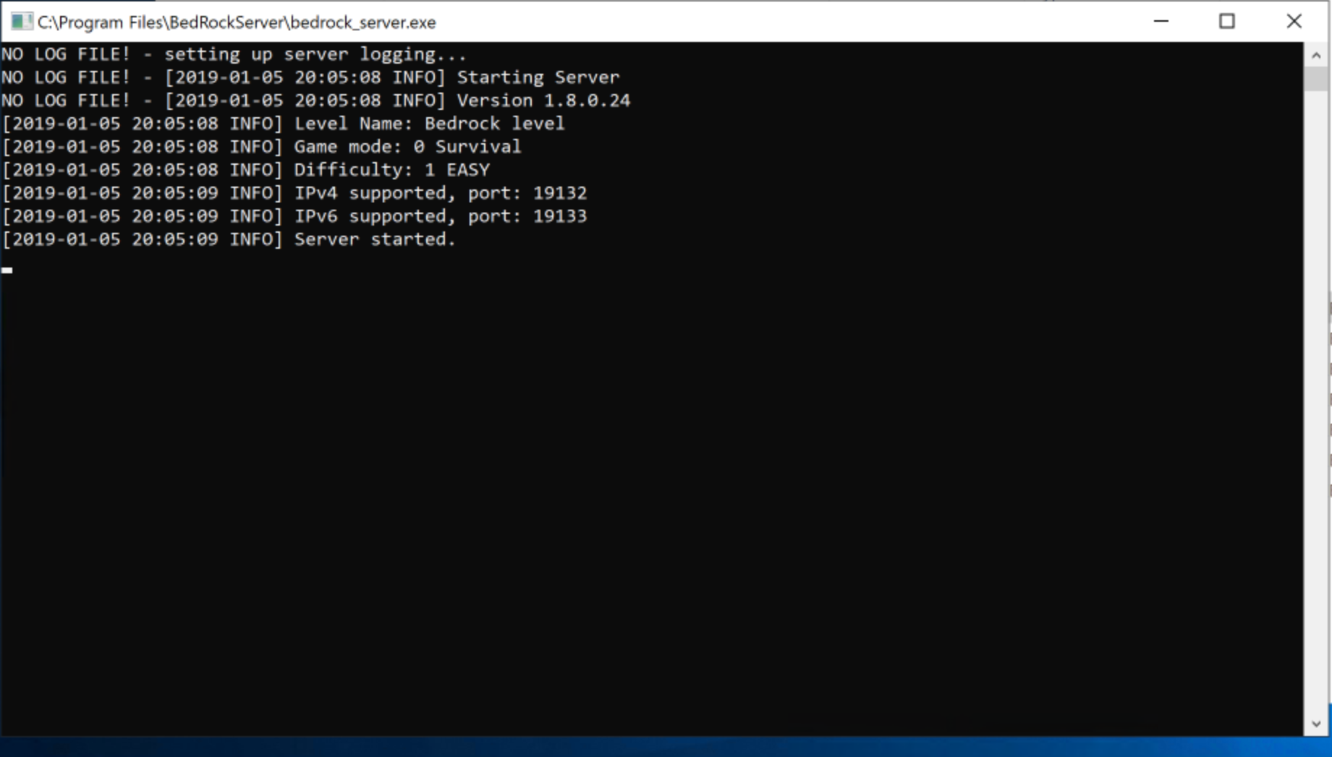
Success!

Slide 14
Application permissions
Access is handle via the Whitelist.json file
This requires an xbox live gamer tag to be setup to be accessed remotely
I have an xbox account
Setup kid 1 as a chile account on xbox.com
Block everything.
See what breaks
Go to: Xbox One/Windows 10 Online Safety
Select allow to join multiplayer games

Slide 15
Complete setup
Network Security group needs to be updated to allow remote access to the server over the required ports
I experienced a lot of pain here.
Let’s go through my pain.
[demo and overview of NSG setup and management]

