Slide 1
Think,Type,Get-Secure
Practical PowerShell in Security… And some pranks just for fun

Slide 2

Who Am I?
System Administrator at Tradition Capital Bank
Vice President of MN PowerShell User Group 3 yrs
Proud owner of mnpowershell.ninja – future blog domain…coming soon(?)
Total PowerShell Geek

Slide 3

Overview
Practical Uses of PowerShell in Security
GitHub Projects
Bash Bunny – So much power in the palm of your hand.

Slide 4
Practical PowerShell in Security
What does that even mean?

Slide 5
My Experience and Use Cases
Red Team
Blue Team
Internal Pentesting
Compliance Verification
Proof of Concept Projects
Audits!
Audits!
Incident Response

Slide 6
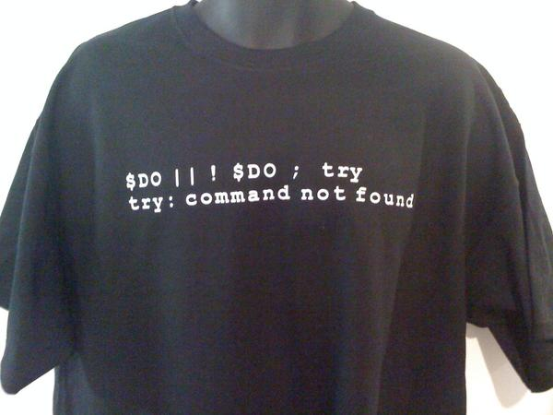
Switch to code!

Slide 7

GitHub Projects
Some of my personal favorites to share so you don’t re-create the wheel

Slide 8

PoshSec
Contributors:
NJJacob
mwjcomputing
rjcassara
rjcassara
Ben0xA
jwgoerlich
Jrotenberger
phatMoey
github.com/PoshSec
Also contains PoshSecFramework
http://www.powershellmagazine.com/2014/07/11/introduction-to-the-poshsec-framework/
Provides a graphical interface for helping introduce people not as experienced with CLI’s

Slide 9

PowerForensics
Contributors:
jaredatkinson
LeeHolmes
athegist
leechristensen
juneb
gitter-badger
waffle-iron
Github.com/Invoke-IR/PowerForensics
Framework for hard drive forensic analysis
Is in the PowerShell gallery: powershellgallery.com/packages/PowerForensics
Detailed instructions for installing and configuring at:
http://www.invoke-ir.com/2016/02/installing-powerforensics.html
Excellent blog post showing it in use and addition install nuances at:
http://www.redblue.team/2016/11/ransomware-ir-with-powerforensics-and.html

Slide 10
PowerSploit
Contributors:
There’s 24!
Github.com/PowerShellMafia/PowerSploit
PowerSploit is a collection of PowerShell modules intended to aid penetration testers in all phases of an assessment.
The first offensive security framework written for PowerShell
http://www.powershellmagazine.com/2014/07/08/powersploit/

Slide 11

BloodHound
Developers:
@_wald0 – Andrew Robbins
@CptJesus – Rohan Vazarkar
@harmj0y –Will Shroeder
Github.com/BloodHoundAD
Uses graph theory to reveal the hidden and
often unintended relationships within an Active
Directory environment.
Useful for both blue and red teams
Can be run from PowerShell script or executable
Uses a PowerShell ingestor to Javascript web app using Neo4j database

Slide 12

Bash Bunny
Even Mr. Robot’s showing off this little guy

Slide 13
Bash Bunny Resources
You can get your own Bash Bunny at:
https://hakshop.com/products/bash-bunny
Official Wiki Page:
https://wiki.bashbunny.com/#!index.md
Payload Repo on GitHub:
https://github.com/hak5/bashbunny-payloads
Hak5 Episode: How to Write Bash Bunny Payloads & Contribute on GitHub https://www.youtube.com/watch?v=H6z9BXevsZg

Slide 14
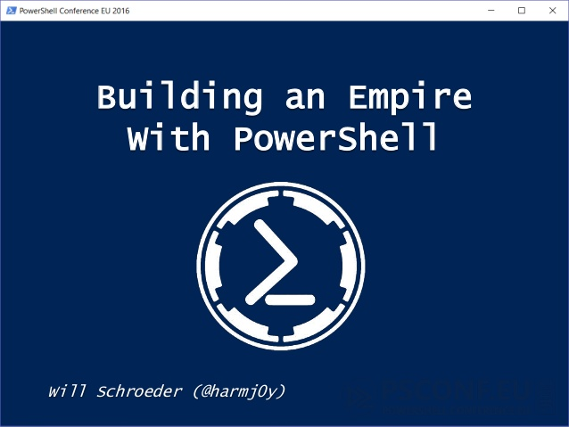
Fin…

