Slide 1
Biomedical Signals
Lab session 5
Matched filtering

Slide 2
Introduction
Matched filter → a filter applied in the time domain, based on the time-domain characteristics of the signal and NOT on the spectrum of it
Obtained by correlating a template with an unknown signal to detect the presence of the template in it = convolve the unknown signal with a time-reversed version of the template
Spike-and-wave complex (SWC) → a well-defined event in an EEG signal composed by a sharp spike followed by a wave

Slide 3
Introduction
To detect the SWC in a EEG signal we can follow two procedures:
TEMPLATE MACTHING:
Computing the cross-correlation function (CCF) between the template of the SWC extracted form the EEG and the EEG
DESING OF A MATCHED FILTER:
Applied when a signal is expected to contain repetitions of an event with similar characteristics. The output provides peaks at the time instants of the occurrence of the event.
We replaced the CCF with a matched filer that has an impulse response associated with the template

Slide 4
Introduction
Objectives:
Detection of SWC in EEG signals using template matching (CCF)
Design and implementation of a matched filter to detect SWC in EEG signals
Compare both results
Materials
Script ‘eeg2.m’ to upload the signal
File eeg2.dat
  Fs = 100 Hz
  10 channels

Slide 5
Procedure – Template matching
Upload the eeg2 signals
Extract the template of an SWC (ex: channel C3 from 0.6 to 0.82 s)
Compute the normalized cross-correlation function → IMPORTANT! Computing the root square of the product of E of the template and the E of the segment of the EEG signal being cross-correlated at that lag
Apply a peak-detection algorithm (based on a threshold of the coefficients of the normalized cross-correlation) + mark the locations
Plot the EEG + CCF + marks indentifing the SWC
Apply the template and procedure to two other EEG channels (ex: C4 and P4)

Slide 6
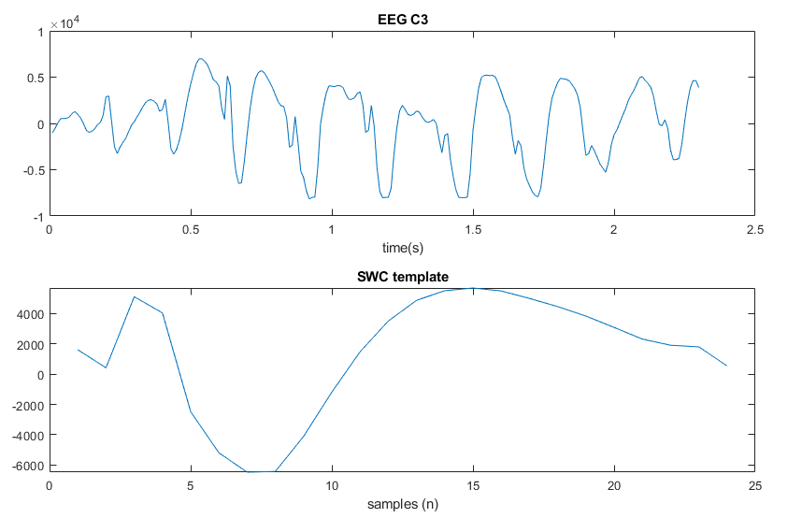
Procedure – Template matching

Slide 7
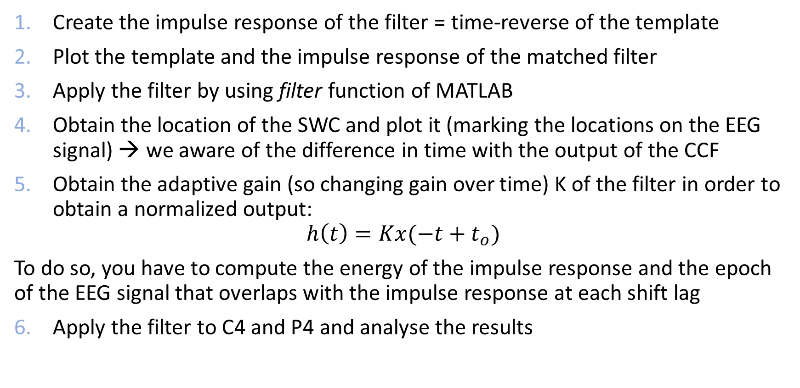
Procedure – Matched filtering
Create the impulse response of the filter = time-reverse of the template
Plot the template and the impulse response of the matched filter
Apply the filter by using filter function of MATLAB
Obtain the location of the SWC and plot it (marking the locations on the EEG signal) → we aware of the difference in time with the output of the CCF
Obtain the adaptive gain (so changing gain over time) K of the filter in order to obtain a normalized output:
$$h\left(t\right)=Kx(−t+t_{o})$$
To do so, you have to compute the energy of the impulse response and the epoch of the EEG signal that overlaps with the impulse response at each shift lag
Apply the filter to C4 and P4 and analyse the results

Slide 8
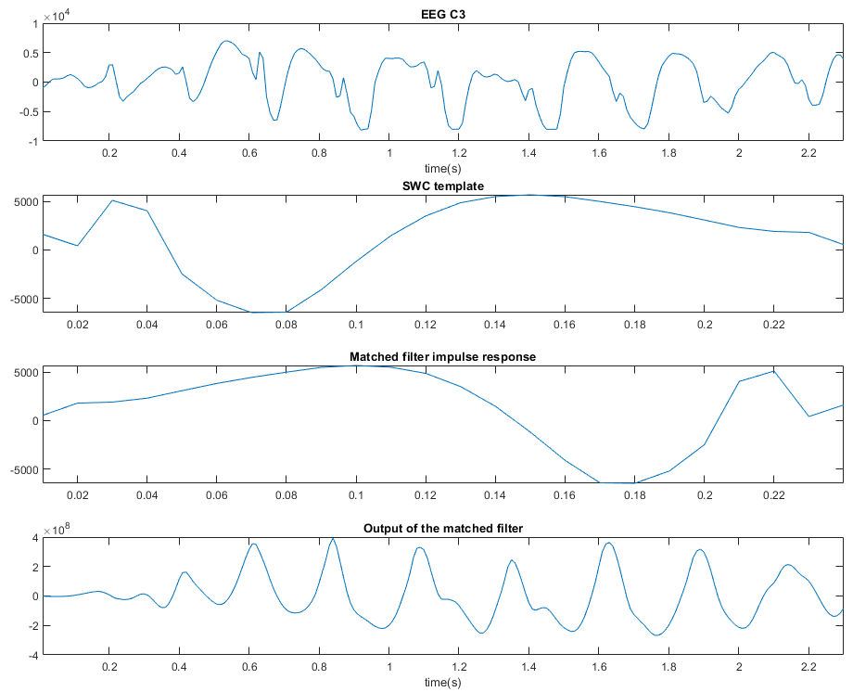
Procedure – Matched filtering

Slide 9
Procedure
Discuss the similarities and differences between template matching and matched filtering
Test the matched filter under noisy circumstances: adding white gaussian noise to the EEG C3 signal. Noise can be added with computing:
  signal_with_noise = awgn(signal_wo_noise, SNR, ‘measured’).
  Check SNR = [20, 15, 10, 5, 0, -5] dB
Discuss the robustness of the matched filter from these results

