Slide 1
Overview of the High-Leverage Practices Learning Module
A Foundation for Effective Instruction, Collaboration, and Student Success
Ruby L. Owiny, Ph.D.
Minnesota State University, Mankato

Slide 2

Reminder
Complete the Pre-Assessment on Google Forms before starting this video.

Slide 3
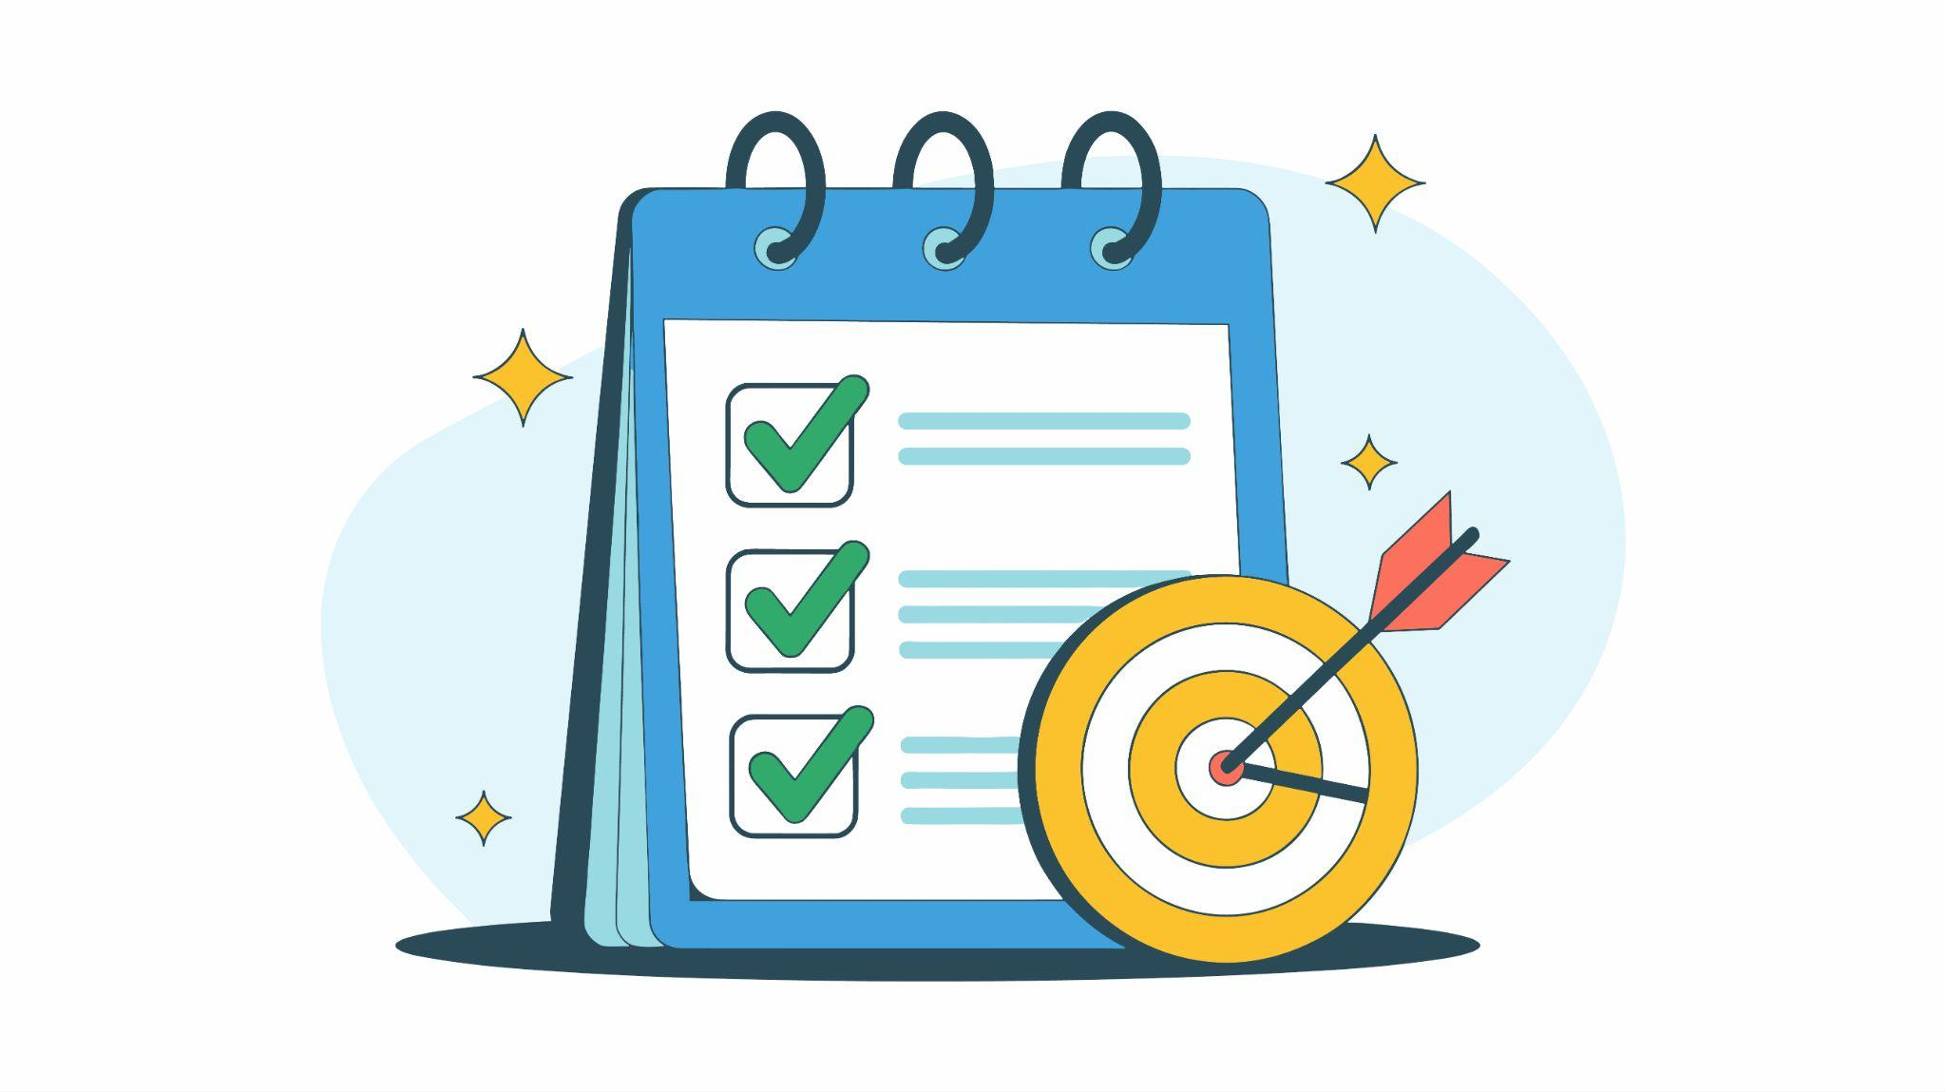
Module Objectives
As a result of this module, participants will be able to:
Define the High-Leverage Practices (HLPs).
Describe the purpose and structure of the HLP framework.
Explain how the HLPs work together to improve student outcomes.
Recognize the role of HLPs in supporting students with disabilities and all learners.

Slide 4

Introduction to the High-Leverage Practices

Slide 5
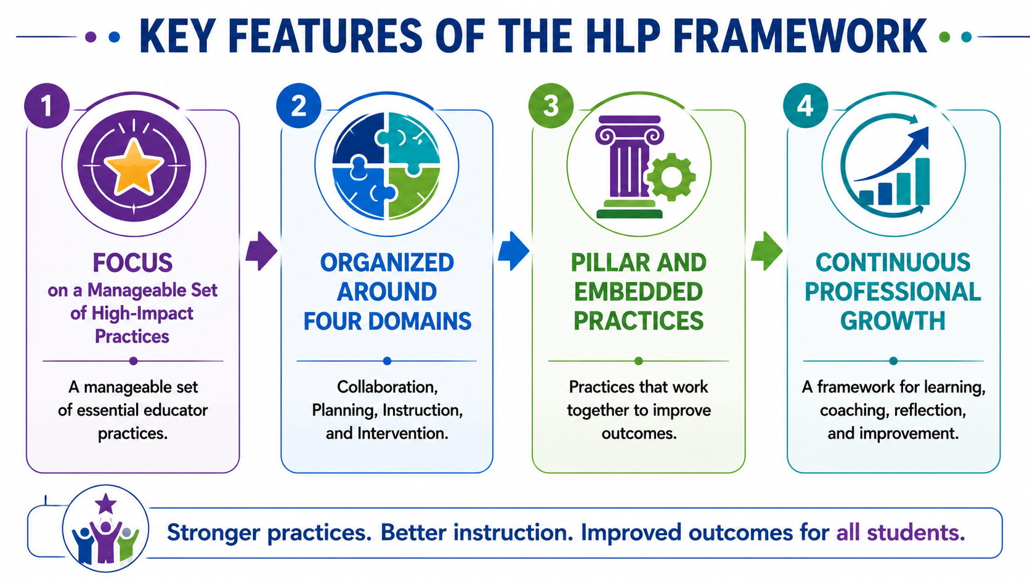
Notes:
What are the HLPs?

Slide 6
Key Terms
Term | Definition
High-Leverage Practice (HLP) | An essential practice used frequently by effective educators.
Pillar Practice | A foundational HLP that serves as a cornerstone for effective implementation.
Embedded Practice | A supporting HLP that strengthens implementation of pillar practices.
Culturally Inclusive Practices & Pedagogies (CIPP) | Approaches that recognize, value, and respond to students' diverse cultural, linguistic, and lived experiences while promoting equitable learning opportunities.

Slide 7
Why the HLPs Matter

Slide 8
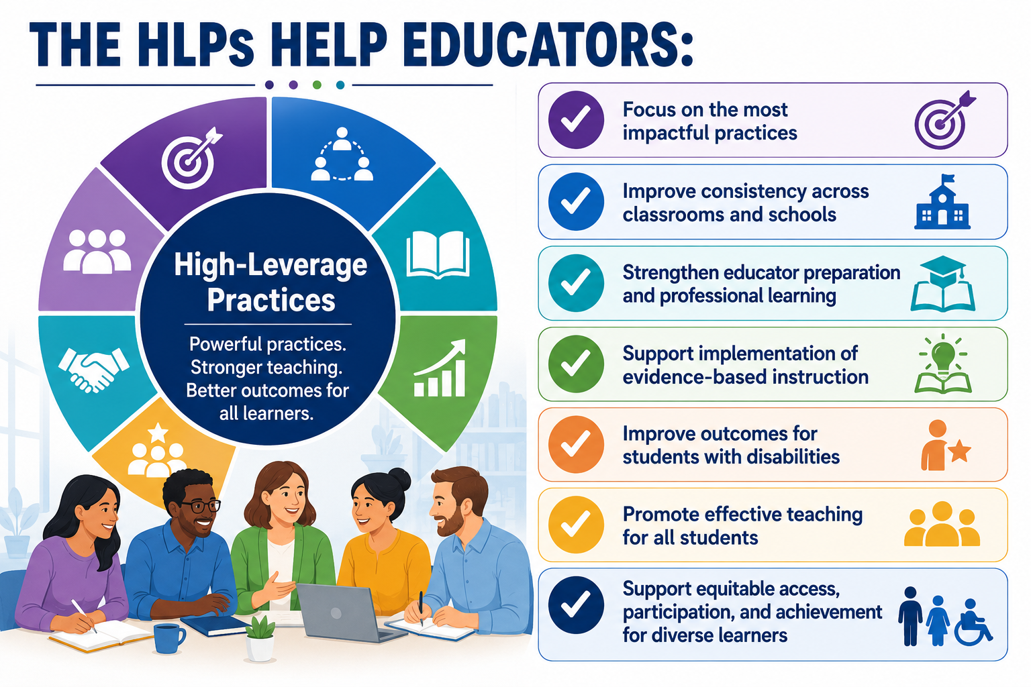

Slide 9
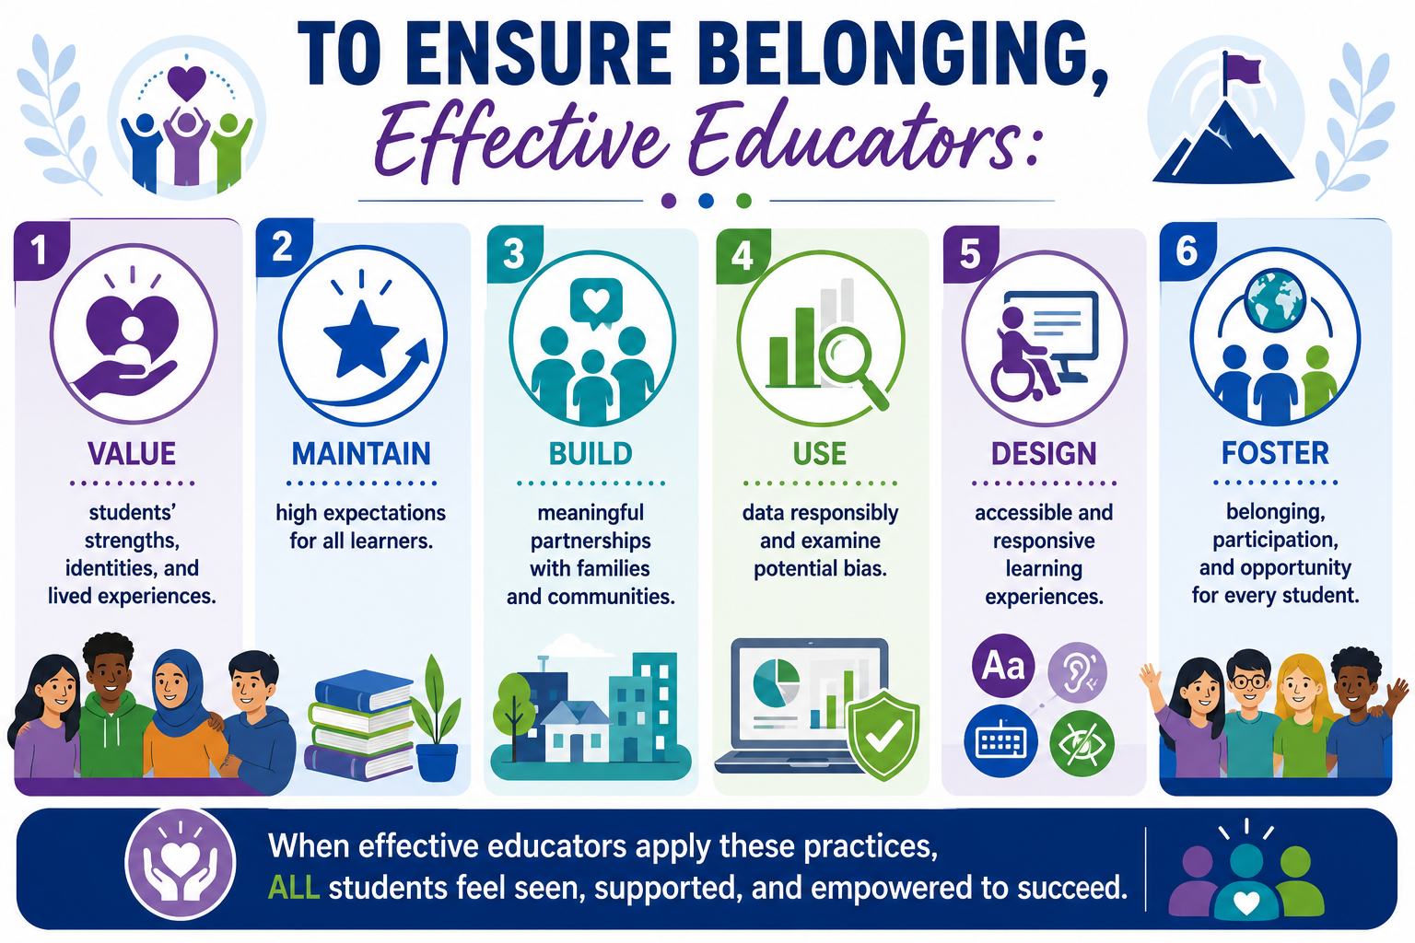

Slide 10
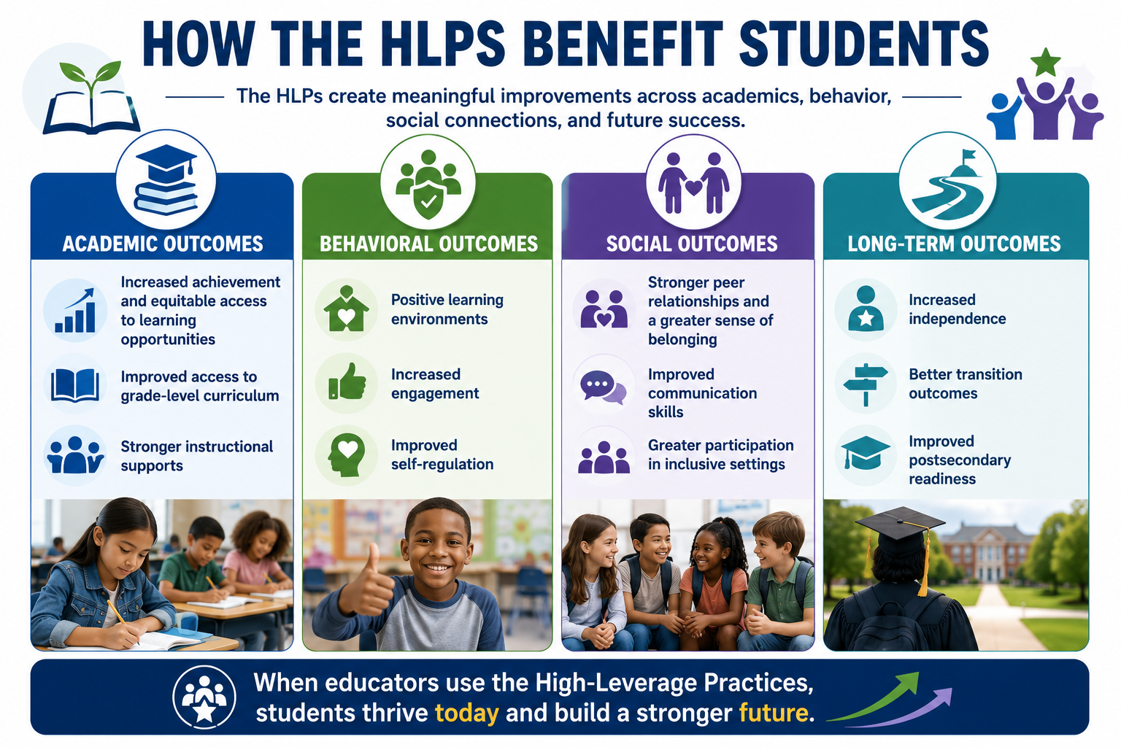

Slide 11
The Organizational Structure

Slide 12
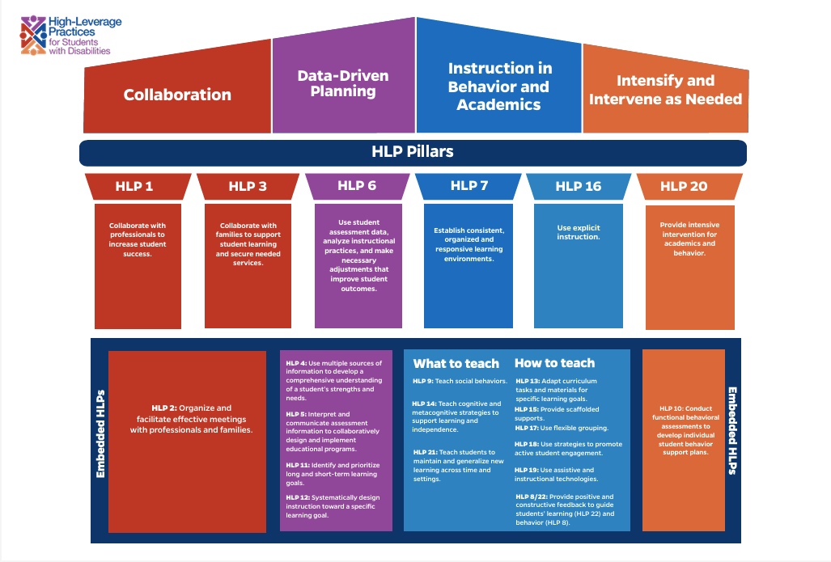

Slide 13
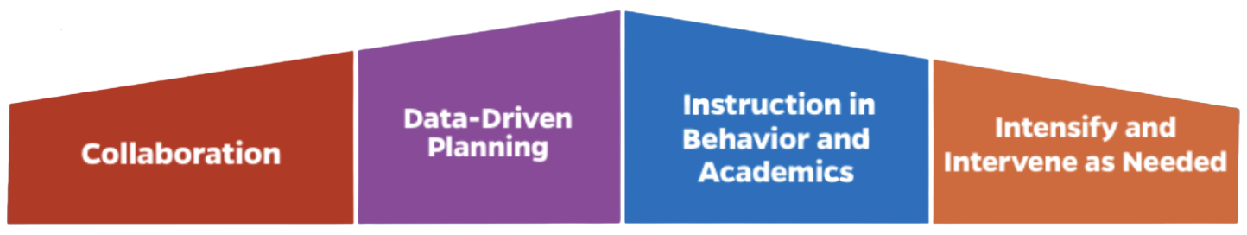
The Four HLP Domains
The four domains represent the essential work that educators do to support student success.
These domains provide a framework for effective teaching, collaboration, planning, and intervention.

Slide 14
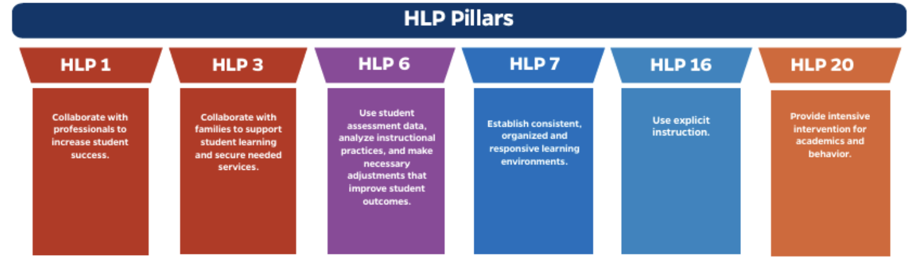
Pillar Practices
Pillar Practices are the most essential HLPs for educators to learn, master, and implement. They represent the foundational practices that have the greatest impact on student success.

Slide 15
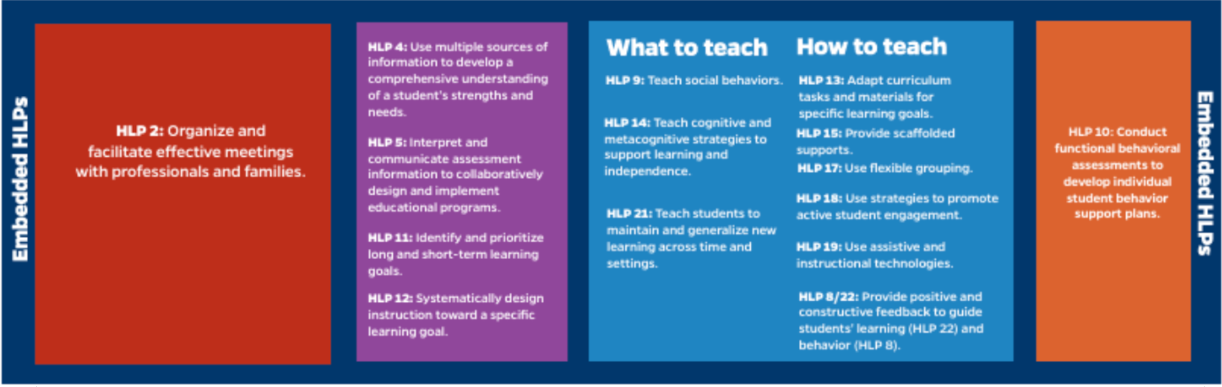
Embedded HLPs
Embedded Practices support and strengthen implementation of the Pillar Practices. They provide the additional knowledge and skills needed to effectively plan, teach, assess, collaborate, and intervene.

Slide 16
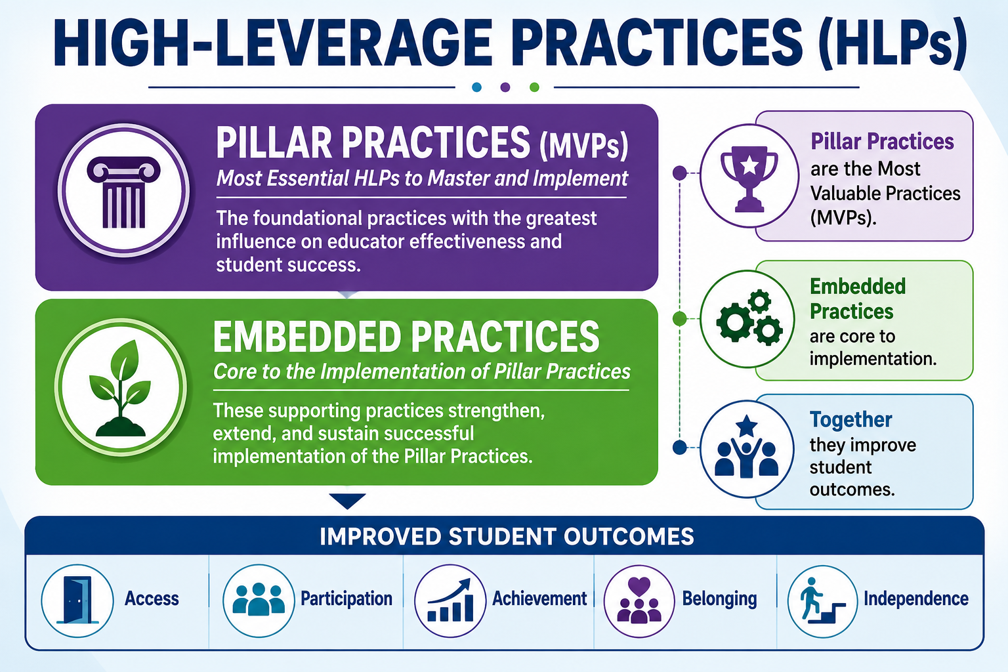
Relationship between Pillars & Embedded Practices

Slide 17
The HLPs Working Together

Slide 18

How the HLPs Work Together
Key Point: The HLPs are not intended to be implemented one at a time.
Effective educators blend multiple HLPs together as they collaborate, plan, teach, assess, and support students.
HLPs are interconnected and most effective when implemented together.

Slide 19
The HLPs in Action
Student Need or Classroom Goal | HLPs Commonly Used Together
A student with reading difficulties needs to improve reading comprehension. | 4, 6, 11, 12, 16, 20, 22
A student struggles to stay engaged during whole-group instruction. | 7, 15, 17, 18, 22
A student demonstrates challenging classroom behaviors that interfere with the learning of both themselves and others. | 7, 8, 9, 10
A student with a disability needs support accessing grade-level content. | 12, 13, 15, 16, 19
A student is not making adequate progress toward an IEP goal. | 4, 5, 6, 11, 20, 22

Slide 20
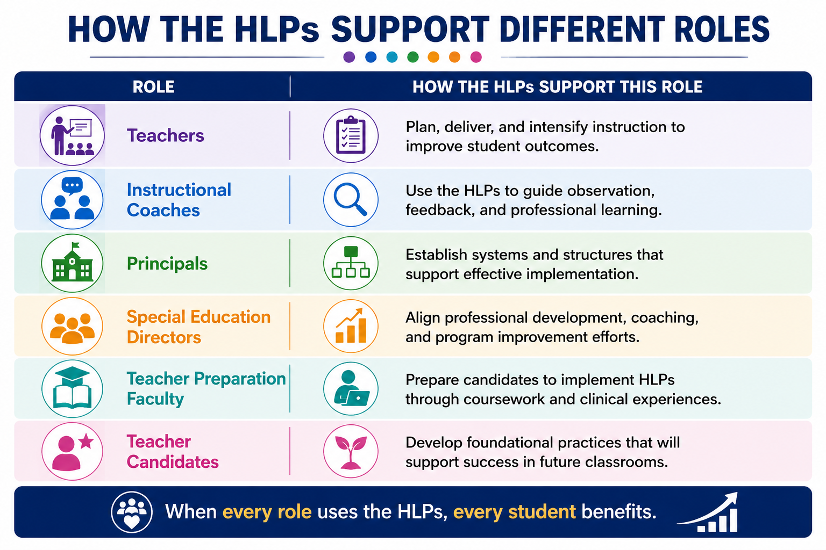

Slide 21
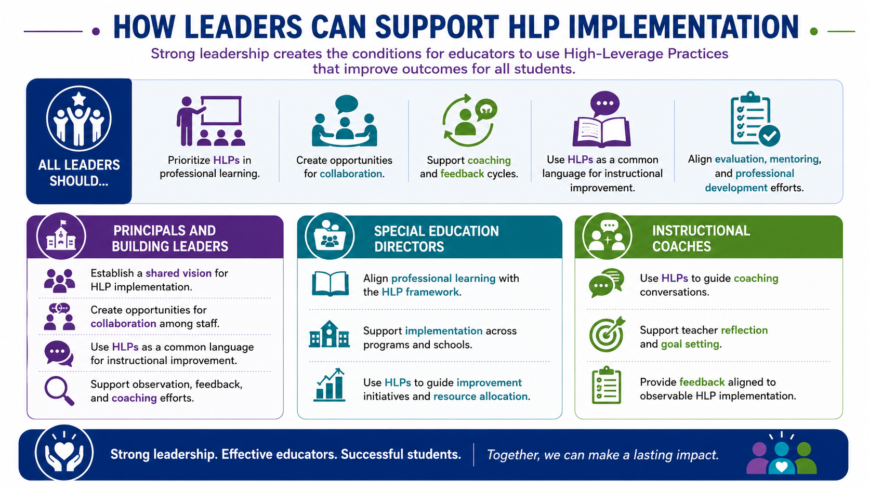
Notes:
Make 2 slides for this, if needed

Slide 22
Next Steps

Slide 23
HLP Self-Reflection
Rate your familiarity with each domain.
Domain | Emerging | Developing | Proficient
Collaboration | □ | □ | □
Data-Driven Planning | □ | □ | □
Instruction in Behavior & Academics | □ | □ | □
Intensify & Intervene as Needed | □ | □ | □

Slide 24

Reflect on Your Learning
Which HLP domain is your greatest strength? Which offers your greatest opportunity for growth?
Which HLPs do you already implement in your current role?
How can the HLPs improve equitable outcomes for all learners?
How do your practices honor students' strengths, identities, and experiences?
What is one action you will take after completing this module?
Notes:
This section should be highly practical.

Slide 25
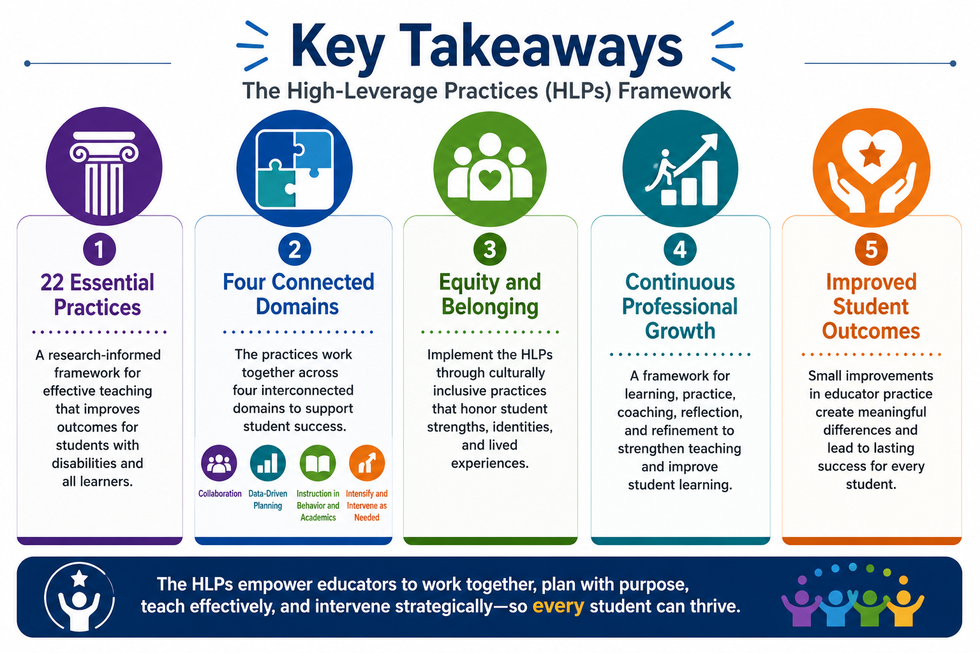

Slide 26
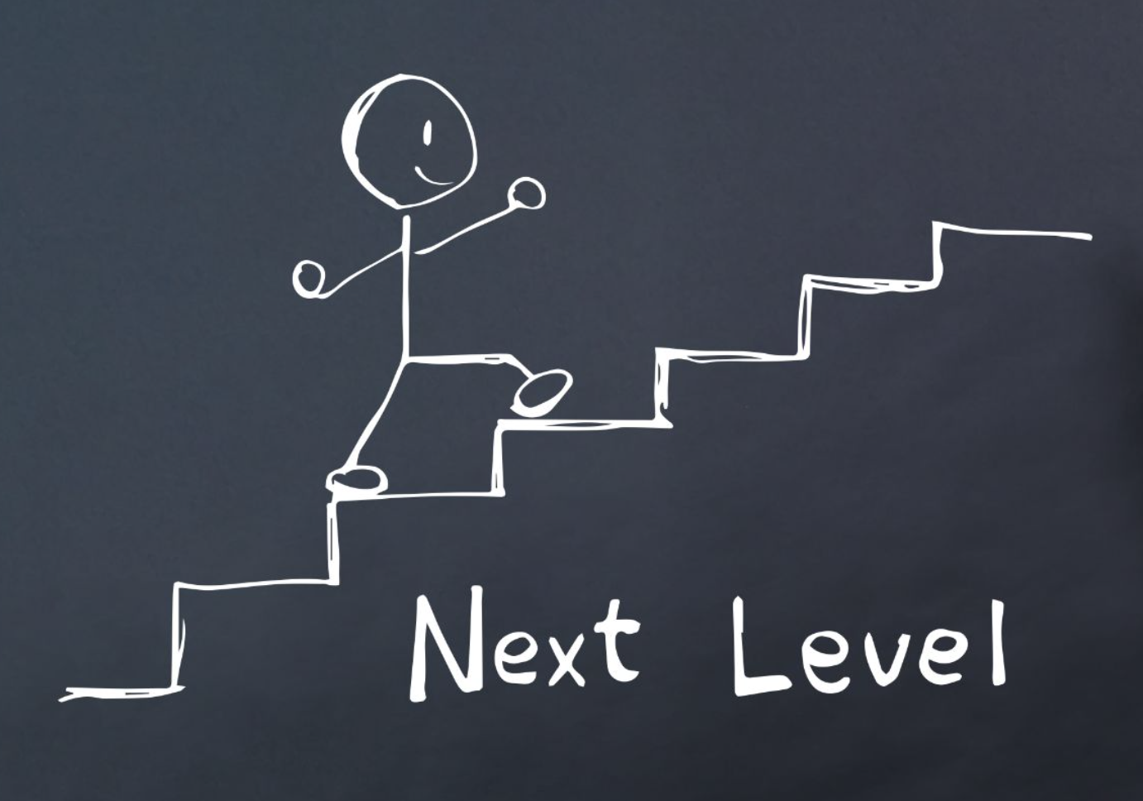
Next Step: Application Activity
Choose one HLP or domain to explore.
Visit the Resources section in MyHLPTracker.
Identify one strategy you will implement in your practice.
See complete directions in the module.

Slide 27
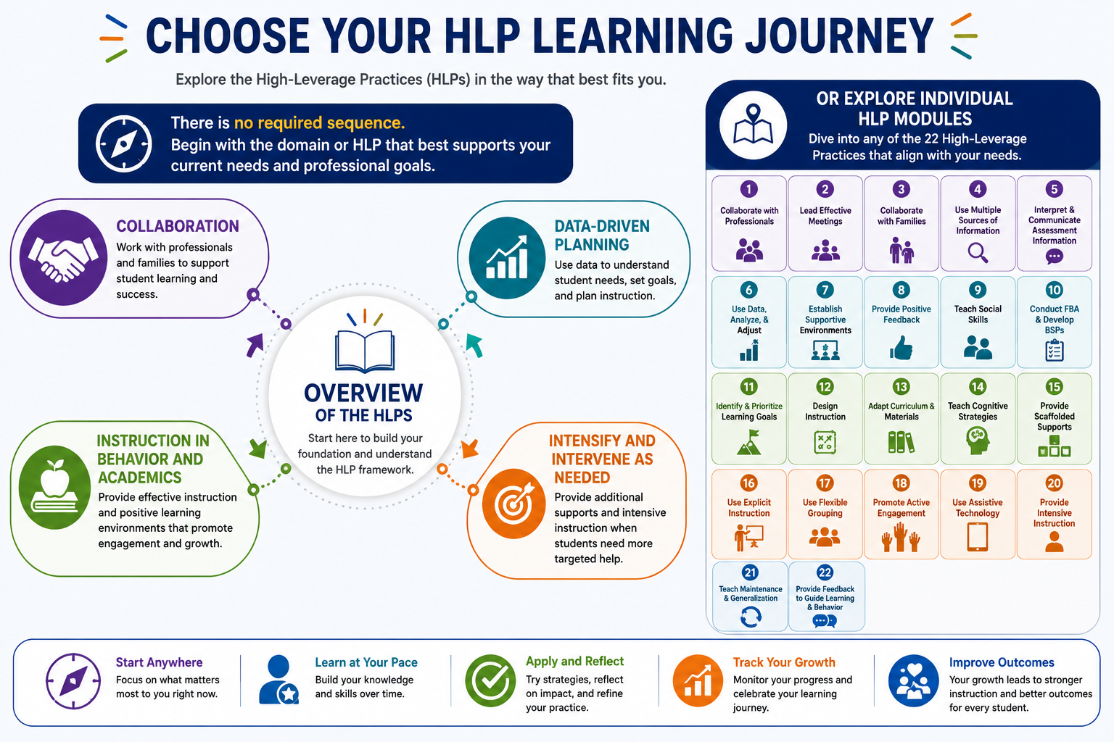
Notes:
Throughout the remaining MyHLPTracker modules, you'll explore each High-Leverage Practice in greater depth, learning how these practices work together to improve instruction and student outcomes.

Slide 28


Slide 29
References
Aceves, T. C., & Kennedy, M. J. (Eds.) (2024, February). High-leverage practices
for students with disabilities. 2nd edition. Council for Exceptional Children.
High-Leverage Practices for Students with Disabilities (2026).
https://highleveragepractices.org. Council for Exceptional Children.
McLeskey, J., et al. (2017). High-leverage practices in special education.
Routledge.
McLeskey, J., Maheady, L., Billingsley, B., Brownell, M. T., & Lewis, T. J. (Eds.).
(2022). High leverage practices for inclusive classrooms. Council for
Exceptional Children and Routledge.
Owiny, R. L., & Cornelius, K. E. (2023). The practical guide to high-leverage
practices in special education: The Purposeful ‘how’ to increase classroom
rigor. Routledge.

