Slide 1
CLOSEDESK · QUICK SETUP
Your inbox, sorted into one short page each morning.
About 10 minutes to set up. Runs on your laptop.
No Outlook add-in, no IT ticket, no cloud. A local AI model is optional.
Install Python · Download · Double-click · Drag mail in · (Optional) LM Studio

Slide 2
BEFORE YOU START
What you need, and what you don't.
You need
You don't need
A Windows or Mac laptop.
Python 3.11 or newer (free, from python.org).
The CloseDesk folder from GitHub.
Outlook: classic, new, web, or Mac. Any of them works.
Optional: LM Studio and a small model, for written summaries and chat answers.
An Outlook add-in or admin rights to Outlook.
IT approval, Azure, or a Microsoft 365 app registration.
A powerful laptop. No model? Everything still works: sorting, summaries, tasks, fraud warnings, search, chat lookups, and the daily digest.
To send your mail anywhere. It stays on this computer.
CloseDesk · quick setup
2 / 12

Slide 3
STEP 1
1
Install Python.
Go to python.org/downloads and click the big yellow Download Python button.
Run the installer.
Windows: tick “Add python.exe to PATH” at the bottom of the first screen, then click Install Now. This one box is the most common setup problem.
Mac: open the downloaded .pkg and click through.
You only do this once.
Windows installer
☐ Use admin privileges when installing py.exe
☑ Add python.exe to PATH
Tick this one.
CloseDesk · quick setup
3 / 12

Slide 4
STEP 2
2
Get CloseDesk from GitHub.
Open the CloseDesk page on GitHub.
Click the green Code button, then Download ZIP.
Unzip it somewhere permanent, for example Documents. (Windows: right-click the ZIP → Extract All.)
The folder is called outlook-email-main. Rename it CloseDesk if you like.
Don't run it from inside the ZIP; unzip first.
Your mail and settings live in this folder, in inbox and data. Keep the folder when you update.
Inside the folder
CloseDesk.bat
double-click (Windows)
CloseDesk.command
double-click (Mac)
inbox\incoming
drop mail here
data
appears after the first run
README.md
the short guide
CloseDesk · quick setup
4 / 12

Slide 5
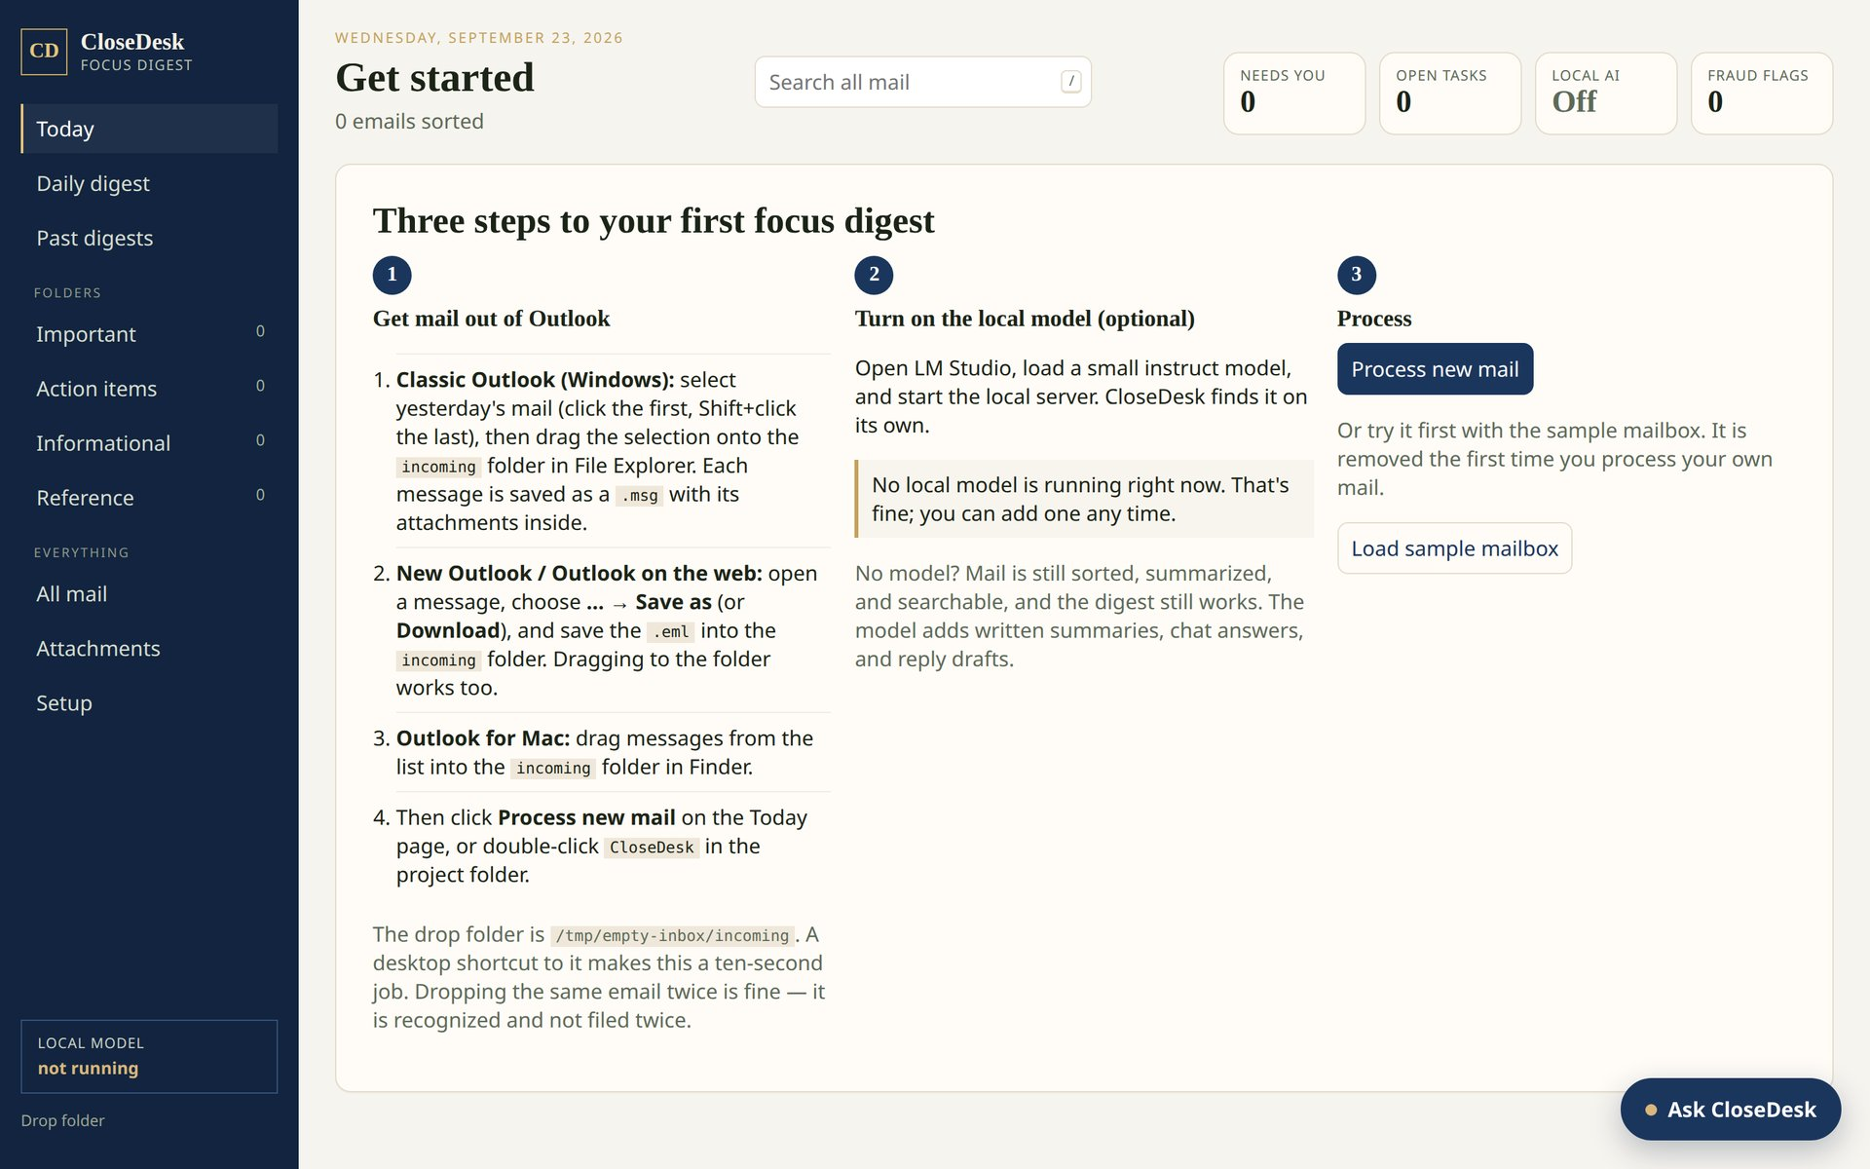
STEP 3
3
Double-click CloseDesk.
Windows: CloseDesk.bat.
Mac: CloseDesk.command.
The first run sets itself up (a minute or two), then opens the dashboard in your browser.
Leave the black window open while you use it.
Windows “protected your PC”? Click More info → Run anyway.
Mac “can't be opened”? Right-click → Open → Open once.
Click Load sample mailbox to look around first.
The first page. The sample is removed as soon as your own mail comes in.
CloseDesk · quick setup
5 / 12

Slide 6
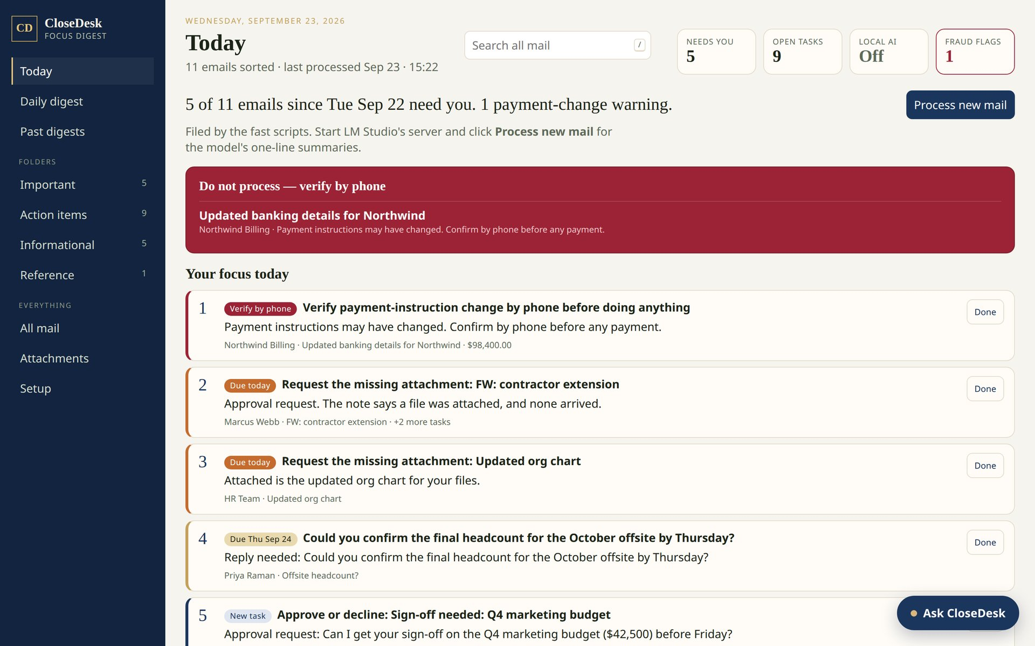
STEP 4
4
Drag your mail in, then Process new mail.
Classic Outlook (Windows): select yesterday's mail (click the first, Shift+click the last) and drag it onto the inbox\incoming folder.
New Outlook / web: open a message → … → Save as → save the .eml into inbox/incoming.
Mac: drag messages into inbox/incoming in Finder.
Click Process new mail.
Tip: pin inbox\incoming to Quick Access.
Today: payment-change warnings first, then your ranked focus list.
CloseDesk · quick setup
6 / 12

Slide 7
STEP 5 (OPTIONAL)
5
Add a local AI model, if the laptop can run one.
Install LM Studio (lmstudio.ai).
Download a small instruct model: 3B–8B is plenty.
Load it, open the Developer tab, click Start server.
Click Process new mail. CloseDesk finds the model on its own: Local AI: Off disappears and the bottom-left shows the model's name.
No model
With a model
Sorting into Needs you / Worth knowing / Reference
Yes (rules)
Yes, with guard rails
One-line summaries
The email's key sentence
Written by the model
Tasks, due dates, fraud warnings, digest
Yes
Yes
Ask CloseDesk
Finds the emails
Writes an answer with links
Draft a reply
Starter template
Written draft
CloseDesk · quick setup
7 / 12

Slide 8
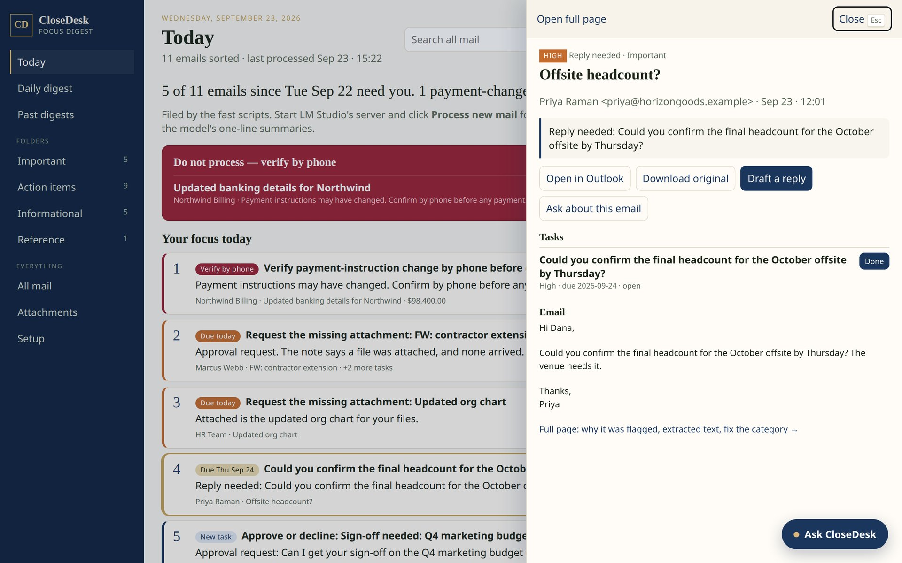
GETTING AROUND
Click an email and it opens right there.
Click any email, task, search result, or chat link: it opens in a panel on the right. Esc closes it.
Open in Outlook opens the original message.
Draft a reply writes a reply to copy or open in your mail app. Payment-change emails get “verify by phone” advice instead.
Press / to search everything, including attachments.
CloseDesk · quick setup
8 / 12

Slide 9
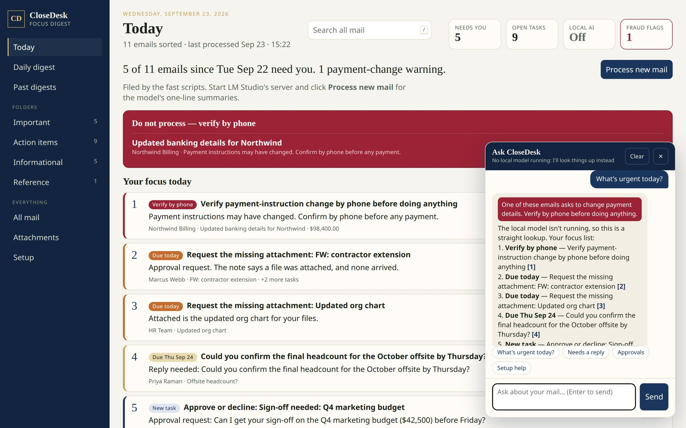
GETTING AROUND
Ask CloseDesk, like a support chat.
The button at the bottom-right of every page.
Try: what's urgent today? · what needs a reply? · anything from Maya? · invoice 10482
Click a [number] to open that email.
No model: it looks things up and lists the matching emails. With a model: it writes the answer.
Nothing leaves the laptop.
With no model running, answers are a lookup with links to each email.
CloseDesk · quick setup
9 / 12

Slide 10
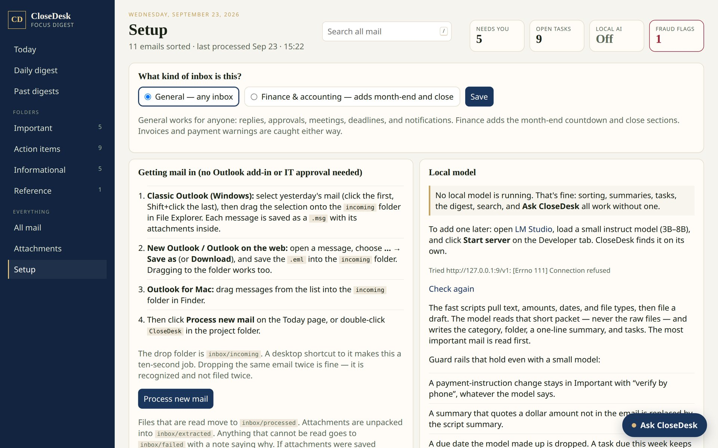
MAKE IT YOURS
Pick the kind of inbox on Setup.
General (default) suits anyone: replies, approvals, meetings, deadlines, notifications.
Finance & accounting adds the month-end countdown and close sections.
Invoices and payment-change warnings are caught either way.
The Setup page also shows whether a local model is running.
CloseDesk · quick setup
10 / 12

Slide 11
EVERY MORNING
Three steps, about five minutes.
1
2
3
Drag
Double-click
Work the list
Yesterday's mail from Outlook into inbox/incoming.
CloseDesk. It reads the mail and opens today's page.
Top to bottom. Click Done as you go; past digests are kept.
A red “Do not process — verify by phone” box
means someone asked to change bank or payment details. Call a number you already have before doing anything. Don't pay or reply from that email.
CloseDesk · quick setup
11 / 12

Slide 12
CHECK IT WORKS
You're ready when…
✓
Double-clicking CloseDesk opens the dashboard.
If something is off
“Python 3.11 or newer is needed”
✓
An email dragged into inbox/incoming shows up after Process new mail.
Reinstall Python and tick Add python.exe to PATH.
The page doesn't open
✓
The header says Local AI: Off (fine), or the bottom-left shows your model.
Keep the black window open; go to http://127.0.0.1:8765.
Local AI: Off
Full guide: docs/SETUP.md in the CloseDesk folder.
Fine. Start LM Studio's server for written answers.
A file went to inbox/failed
Read the .why.txt beside it; re-save from Outlook.
A category is wrong
Open it → Wrong category? → one sentence why.
CloseDesk · quick setup
12 / 12

