Slide 1
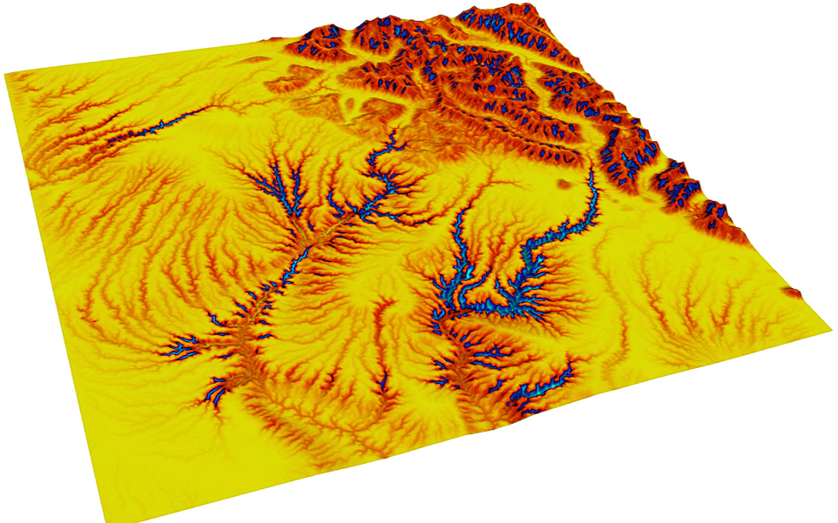
A landscape evolution journey through data-model comparison
BadLands Model

Slide 2
A landscape evolution journey through data-model comparison
What are we trying to solve?
What are the fundamental governing equations?
What data do we have on which to base our comparison?
Which metrics will we use for the comparison?
How will we find appropriate parameters?

Slide 3
A landscape evolution journey through data-model comparison
What are we trying to solve?
  What does the system look like?
  What do we know about it?

Slide 4
A landscape evolution journey through data-model comparison
What are we trying to solve?
  What does the system look like?
  What do we know about it?
  For us, today:
    We want to know the erodibility of the rock in a mountain range.

Slide 5
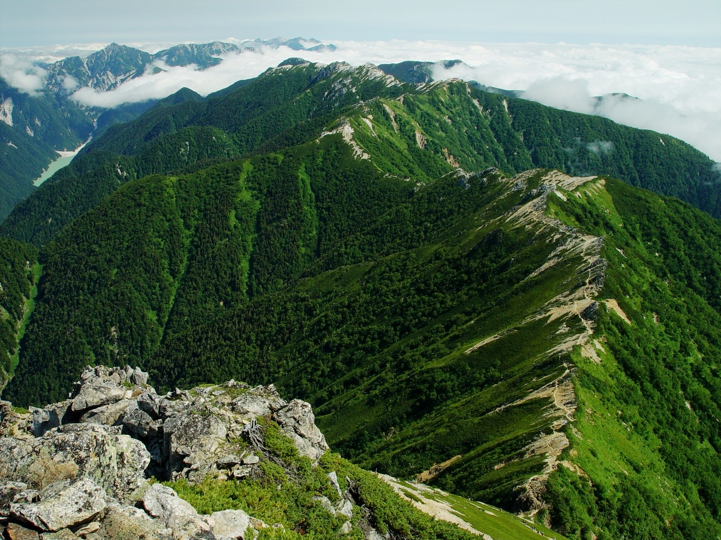

Slide 6
What do we observe?

Slide 7
What do we observe?
  Possible elevation (clouds)
  Vegetated
    These two together mean likely near the tropics
    (Independently, we confirm that this photo is from Mount Otensho, Japan)
  Very steep sides and sharp ridge tops

Slide 8
A landscape evolution journey through data-model comparison
What are the fundamental governing equations?
  Standard equation of landscape evolution modeling:
Coefficient:
Erodibility, precip., ???
Drainage area
(~ Discharge)
Slope
Erosion rate
Fluvial erosion
Hillslope diffusion

Slide 9
A landscape evolution journey through data-model comparison
What are the fundamental governing equations?
  Standard equation of landscape evolution modeling
  Can we make any assumptions that might help to simplify the equation?
    Let's take a look back at the image of our field site

Slide 10
What do we observe?
  Possible elevation (clouds)
  Vegetated
    These two together mean likely near the tropics
    (Independently, we confirm that this photo is from Mount Otensho, Japan)
  Very steep sides and sharp ridge tops
Tectonically active: uplift and erosion likely in balance
Hillslope diffusion overwhelmed by fluvial incision

Slide 11
A landscape evolution journey through data-model comparison
What are the fundamental governing equations?
  Standard equation of landscape evolution modeling
  Can we make any assumptions that might help to simplify the equation?
    Let's take a look back at the image of our field site
      Rapidly uplifting
        Not going into outer space
        Not eroding below sea-level
        So steady-state likely

Slide 12
What are the fundamental governing equations?
  Standard equation of landscape evolution modeling
  Can we make any assumptions that might help to simplify the equation?
    Let's take a look back at the image of our field site
      Rapidly uplifting
        Not going into outer space
        Not eroding below sea-level
        So steady-state likely
      Hillslope diffusive processes (would create rounded topography) are not evident on the landscape; likely are much less important than fluvial ersion
0
Erosion rate
Fluvial erosion
Hillslope diffusion

Slide 13
What are the fundamental governing equations?
  Standard equation of landscape evolution modeling
  Can we make any assumptions that might help to simplify the equation?
    Let's take a look back at the image of our field site
      Rapidly uplifting
        Not going into outer space
        Not eroding below sea-level
        So steady-state likely
      Hillslope diffusive processes (would create rounded topography) are not evident on the landscape; likely are much less important than fluvial ersion
Simplified:

Slide 14
A landscape evolution journey through data-model comparison
What data do we have on which to base our comparison?
  From the general literature?
  About the specific site?

Slide 15
A landscape evolution journey through data-model comparison
What data do we have on which to base our comparison?
  From the general literature?
    m ~ 0.5
    n ~ 1
    m/n is consistently ~0.5, regardless of their specific values (river convavity)
  About the specific site?
    DEM
    Thermochron data (Apatite U-Th-He)

Slide 16
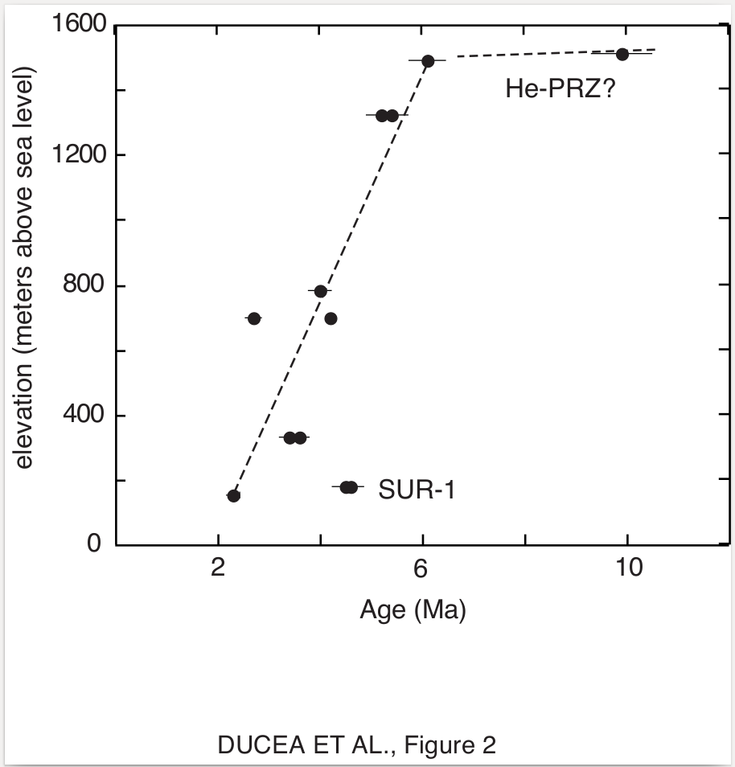
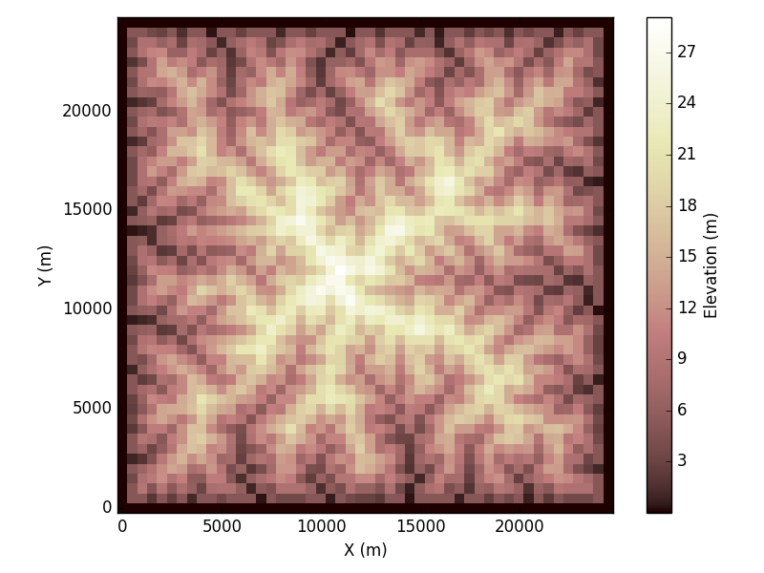
What data do we have on which to base our comparison?
  About the specific site?
    DEM
    Thermochron data (Apatite U-Th-He)

Slide 17
A landscape evolution journey through data-model comparison
What data do we have on which to base our comparison?
  From the general literature?
    m ~ 0.5
    n ~ 1
    m/n is consistently ~0.5, regardless of their specific values (river convavity)
  About the specific site?
    DEM
      Can analyze landscape features
    Thermochron data (Apatite U-Th-He)
      Uplift rate = 1 mm/year

Slide 18
A landscape evolution journey through data-model comparison
Which metrics will we use for the comparison?

Slide 19
A landscape evolution journey through data-model comparison
Which metrics will we use for the comparison?
  Elevation?
  Slope?
  Drainage area?
  Something in this equation?

Slide 20
A landscape evolution journey through data-model comparison
Which metrics will we use for the comparison?
  Elevation?
    Is there scale dependence?
  Slope?
    Does this work by itself?
  Drainage area?
    Does this work by itself?
  Something in this equation?

Slide 21
A landscape evolution journey through data-model comparison
Which metrics will we use for the comparison?
  Elevation?
  Slope?
  Area?
  Something in this equation?
Coefficient:
Erodibility, precip., ???

Slide 22
A landscape evolution journey through data-model comparison
Which metrics will we use for the comparison?
  Elevation?
  Slope?
  Area?
  Something in this equation?
    Let's solve for rock erodibility *in this specific environment*
Coefficient:
Erodibility, precip., ???

Slide 23
A landscape evolution journey through data-model comparison
Which metrics will we use for the comparison?
  Elevation?
  Slope?
  Area?
  Something in this equation?
    Let's solve for rock erodibility *in this specific environment*
    We already have the DEM. We know U, m, and n. So, do we really need to run a numerical model?
      No! But we're going to do it anyway because this is one case for which we do have an analytical solution to check our answers!

Slide 24
A landscape evolution journey through data-model comparison
Which metrics will we use for the comparison?
  Elevation?
  Slope?
  Area?
  Something in this equation?
    Let's solve for rock erodibility *in this specific environment*
    We already have the DEM. We know U, m, and n. So, do we really need to run a numerical model?
      No! But we're going to do it anyway because this is one case for which we do have an analytical solution to check our answers!
Plus, we can use this
set of slope and area
for data-model comparison

Slide 25
A landscape evolution journey through data-model comparison
Which metrics will we use for the comparison?
  Maximum elevation (still scale-dependent)
  Slope-area product, raised to the exponents:
Plus, we can use this
set of slope and area
for data-model comparison

Slide 26

A landscape evolution journey through data-model comparison
How will we find appropriate parameters?
  Analytical solution for K_{sp}
  Numerical solutions: repeat forward modeling
    Grid search: evenly-spaced parameter values
    Monte Carlo: randomly-located parameter values
    So we will test many values for K_{sp},
    and see which ones create a
    landscape that is similar
    to that in our data set, based on
    some metric that we choose.

Slide 27
Update your class GitHub repositories
Go to the InClassProjects/Landlab_Parameter_Estimation subfolder.
Run Test_synthetic_data_vs_theory.py. Look at the outputs and how the code is structured.
Now run Solution_FluvialOnly.py. Note how the code shows the misfits from the synthetic "data" of our landscape.
Now it's your turn with a grid search: change the range of k_{sp} that you input for Attempt_FluvialOnly.py. Also consider changing the scale of the grid.
  Which metric works better? Maximum elevation or A^{0.5}S¹?
  Can you create iterations by hand in which you successively "zoom in" on the right solution?
When you feel ready to move on, Attempt_FluvialOnly_MonteCarlo.py is your next stop.
After this, include the hillslopes and look at 2-D plots of misfits vs. data.
  Create_synthetic_topography.py
  Solution.py
  Attempt.py
Take notes on your ability to recover the actual answer, and on any parts you find easy, hard, or confusing. Please ask questions in class on these!

