Slide 1
Conditionals, loops, and flow control; mathematical operators
if
elif
else
for
while
+
-
*
/
**
%
break
continue

Slide 2
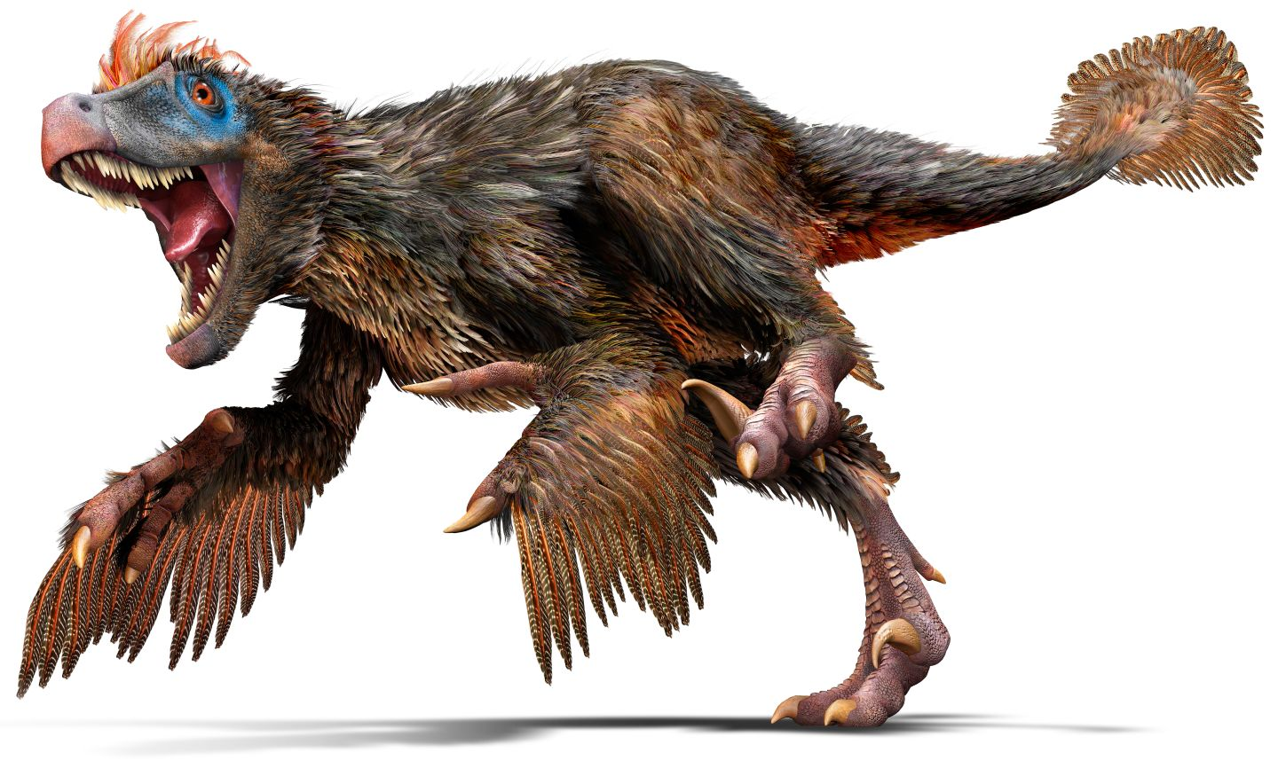
a.k.a. the Velociraptor Lecture

Slide 3
Exercise 1.0: subtraction
n_humans = 25
n_velociraptors = 2
# each velociraptor carries off one human
n_humans = n_humans - n_velociraptors

Slide 4
Exercise 1.0: subtraction
n_humans = 25
n_velociraptors = 2
# each velociraptor carries off one human
n_humans -= n_velociraptors

Slide 5
Exercise 1.1: if
n_humans = 25
n_velociraptors = 2
# Assuming enough time
if n_velociraptors > 0:
n_humans = 0

Slide 6
Exercise 1.1: if
n_humans = 25
n_velociraptors = 2
# Assuming enough time
if n_velociraptors > 0:
n_humans = 0
NOTE THE INDENT!

Slide 7
Exercise 1.1: if, else
n_humans = 25
n_velociraptors = 2
# Velociraptors kill humans if present.
# Otherwise, humans reproduce.
if n_velociraptors == 0:
n_humans *= 2
else:
n_humans = 0

Slide 8
Exercise 1.2: if, elif, else
n_helpless_humans = 20
n_human_hunters = 5
n_velociraptors = 2
# If there are more velociraptors than humans, they outflank
# them and devour them.
# Humans who are not busy holding velociraptors at bay reproduce to create more helpless humans
if n_velociraptors > n_human_hunters:
n_helpless_humans = 0
n_human_hunters = 0
elif n_velociraptors == 0:
n_helpless_humans += n_helpless_humans + n_human_hunters
# Otherwise, (n_velociraptors > 0) and (n_velociraptors <= n_human_hunters):
else:
n_helpless_humans += n_helpless_humans + n_human_hunters - n_velociraptors

Slide 9
Exercise 1.2: if, elif, else
n_helpless_humans = 20
n_human_hunters = 5
n_velociraptors = 2
# If there are more velociraptors than humans, they outflank
# them and devour them.
# Humans who are not busy holding velociraptors at bay reproduce to create more helpless humans
if n_velociraptors > n_human_hunters:
n_helpless_humans = 0
n_human_hunters = 0
elif n_velociraptors == 0:
n_helpless_humans += n_helpless_humans + n_human_hunters
# Otherwise, (n_velociraptors > 0) and (n_velociraptors <= n_human_hunters):
else:
n_helpless_humans += n_helpless_humans + n_human_hunters - n_velociraptors
WHAT IS BAD ABOUT THIS CODE?

Slide 11
Exercise 1.3: for, while
TOO MUCH CODE FOR THIS SCREEN -- TO THE BOARD!
Using for, while, and range() -- lists to be introduced later

Slide 12
Finishing your in-class activities
A few of you have discovered “modules” (I also call them “libraries”)
  Syntax: import <library-name>
  We will introduce these later on today
Today’s agenda:
  First, finish up in-class code and present what you did
  Then, move on to new and familiar topics
    Plain English logical operators
    More flow control
    Data types that combine multiple values
    Modules (I often call these “libraries”, but this is a loose term)
    Functions (if we get that far)
    GitHub: how to connect with the notes (and do assignments)

Slide 13
Plain English operators
and Are both of these cases true?
or Is one of these cases true?
is
  Same object? (== checks if the value is the same)
  a=5; b=5
  (a == b) evaluates to True
  but (b is a) evaluates to False
is not Are these not the same object?
in Is this inside [a list, etc]: for i in range(7)

Slide 14
“break”, “continue”, and “pass”
break: exit loop immediately
continue: skip ahead to the next iteration of the loop
pass: do nothing

Slide 15
break
# Expand on the last example to also skip
# numbers 5-10
i = 0
while True:
print i
if i >= 50:
break

Slide 16
break
# Expand on the last example to also skip
# numbers 5-10
i = 0
while True:
print i
if i >= 50:
break
Why does “while True” work?

Slide 17
continue
# Expand on the last example to also skip
# numbers 5-10
i = 0
while True:
if (i >= 5) and (a <= 10):
continue
print i
if i >= 50:
break

Slide 18
continue
# Expand on the last example to also skip
# numbers 5-10
i = 0
while True:
if (i >= 5) and (a <= 10):
continue
print i
if i >= 50:
break
Note parentheses: these are critical for
order of operations with logical operators

Slide 19
continue
# Expand on the last example to also skip
# numbers 5-10
i = 0
while True:
if (i >= 5) and (a <= 10):
continue
print i
if i >= 50:
break
How would you rewrite this with if/else?

Slide 20
pass
# Simplest infinite loop
while True:
pass
Type this into your terminal window / run this program.
Then use CTRL+c to exit the program. These this is the “big red abort button” of computers

Slide 21
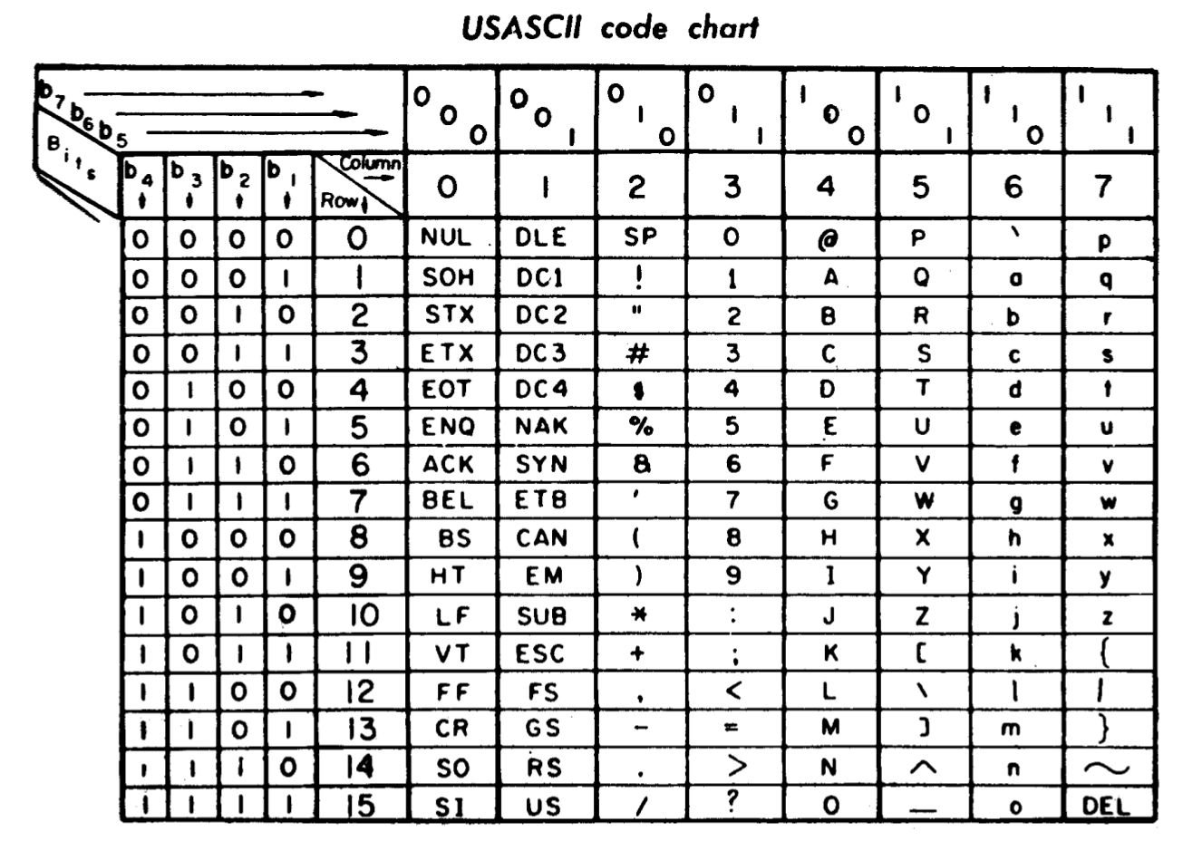
CTRL+c historical note

Slide 22
Handling errors: “try” and “except”
How many of you have had an error appear before?
There is a way to handle those, if you expect them to appear.
try:
print asdf
except:
print “fail!”
try:
print “asdf”
except:
print “fail!”

Slide 23
Handling errors: “try” and “except”
How many of you have had an error appear before?
There is a way to handle those, if you expect them to appear.
try:
print asdf
except:
print “fail!”
try:
print “asdf”
except:
print “fail!”
What is the difference, left and right?

Slide 24
Data types that contain multiple values
Lists
  You have created them by using range(a, [b])
  They are denoted by square brackets []
  They are an ordered set of items of any type:
    [‘cat’, 3, 9.7, [‘bird’, ‘dog’]] is a list
  You can use a number of tools to change lists
Tuples
  Also a list of items, denoted with parentheses
  But meant to be static (unchanging)
Dictionaries: keyword - value pairs.
b is optional, range() is a function!

Slide 25
Data types that contain multiple values
For lists and tuples, use [i] to select item i by its index (placement)
For dictionaries, select by the key
l0 = [1, 2, 3]
print l0[0]

Slide 26
Data types that contain multiple values
For lists and tuples, use [i] to select item i by its index (placement)
For dictionaries, select by the key
t0 = (1, 2, 3)
print t0[0]

Slide 27
Data types that contain multiple values
For lists and tuples, use [i] to select item i by its index (placement)
For dictionaries, select by the key
d0 = {}
d[‘animal’] = ‘cow’
d[‘number’] = 2
d[‘emotional state’] = ‘happy
print d.keys()
print d.values()

Slide 28
Appending to lists
For lists and tuples, use [i] to select item i by its index (placement)
For dictionaries, select by the key
# Dynamically expand the size of a
# list of items - can be useful!
l0 = []
for i in range(10):
l0.append(i)

Slide 29
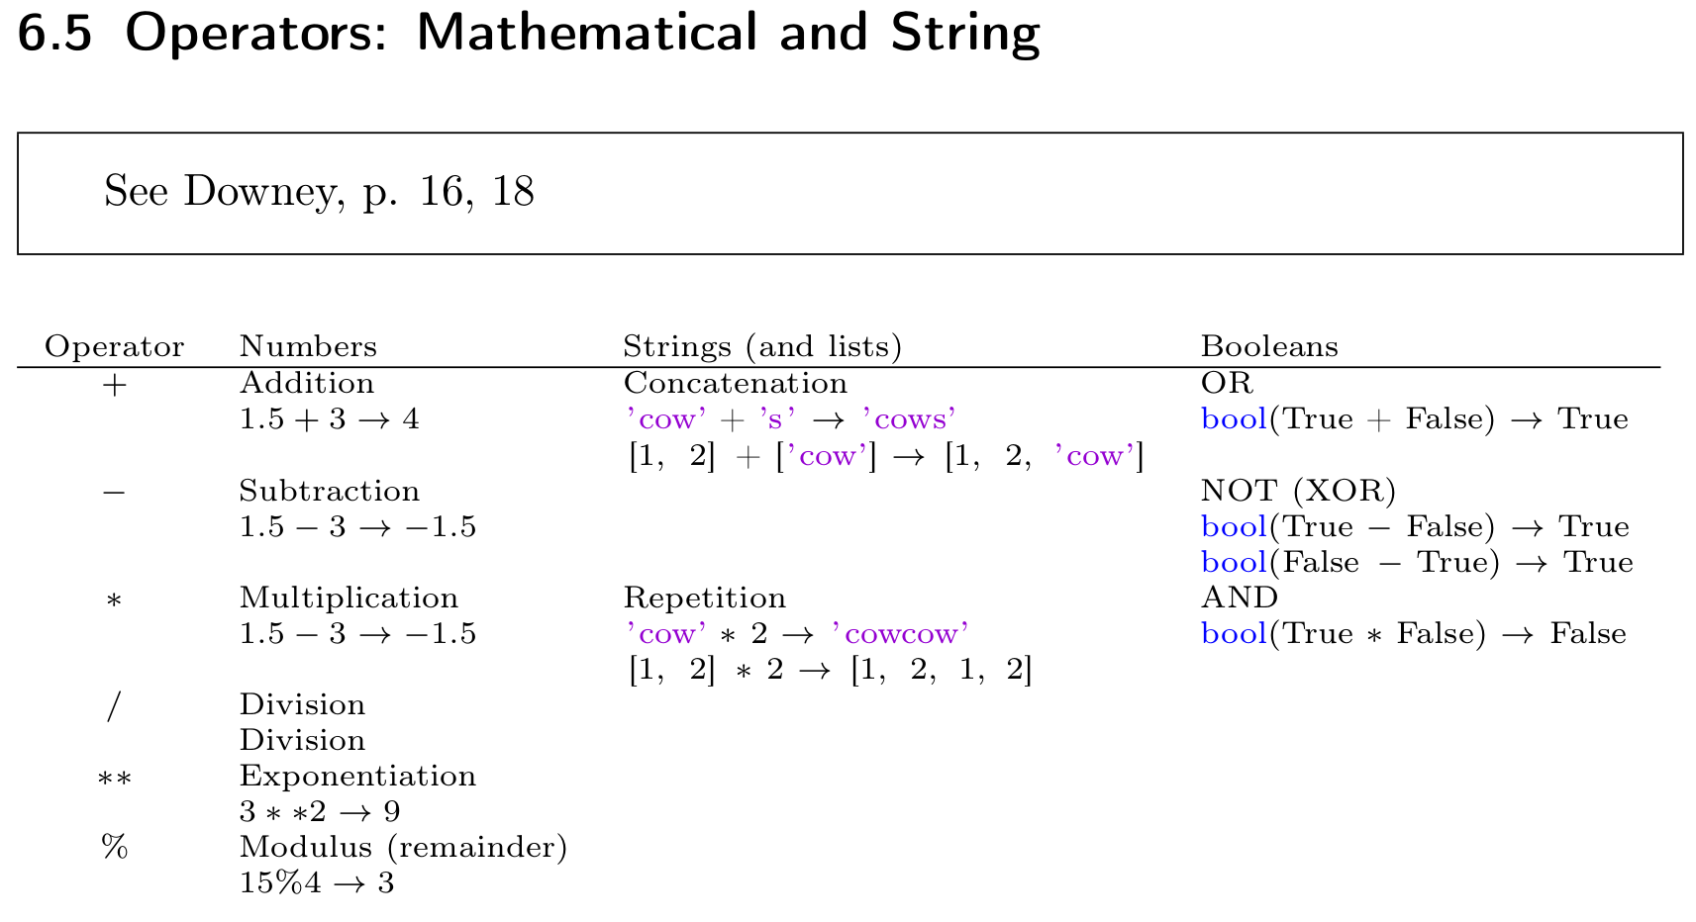
Operators on different data types

Slide 30
Practice with lists and tuples
Go to pp. 16-17 in the notes

Slide 31
Modules, functions, programs, etc.
Continue on main course notes
Afterwards, students reform groups from first project, and rewrite their code as a function that is called

Slide 32
Functions
Package some code that you’ve written into a handly little container.
Give it something, and it returns something

Slide 33
Functions
def

